Slide 1
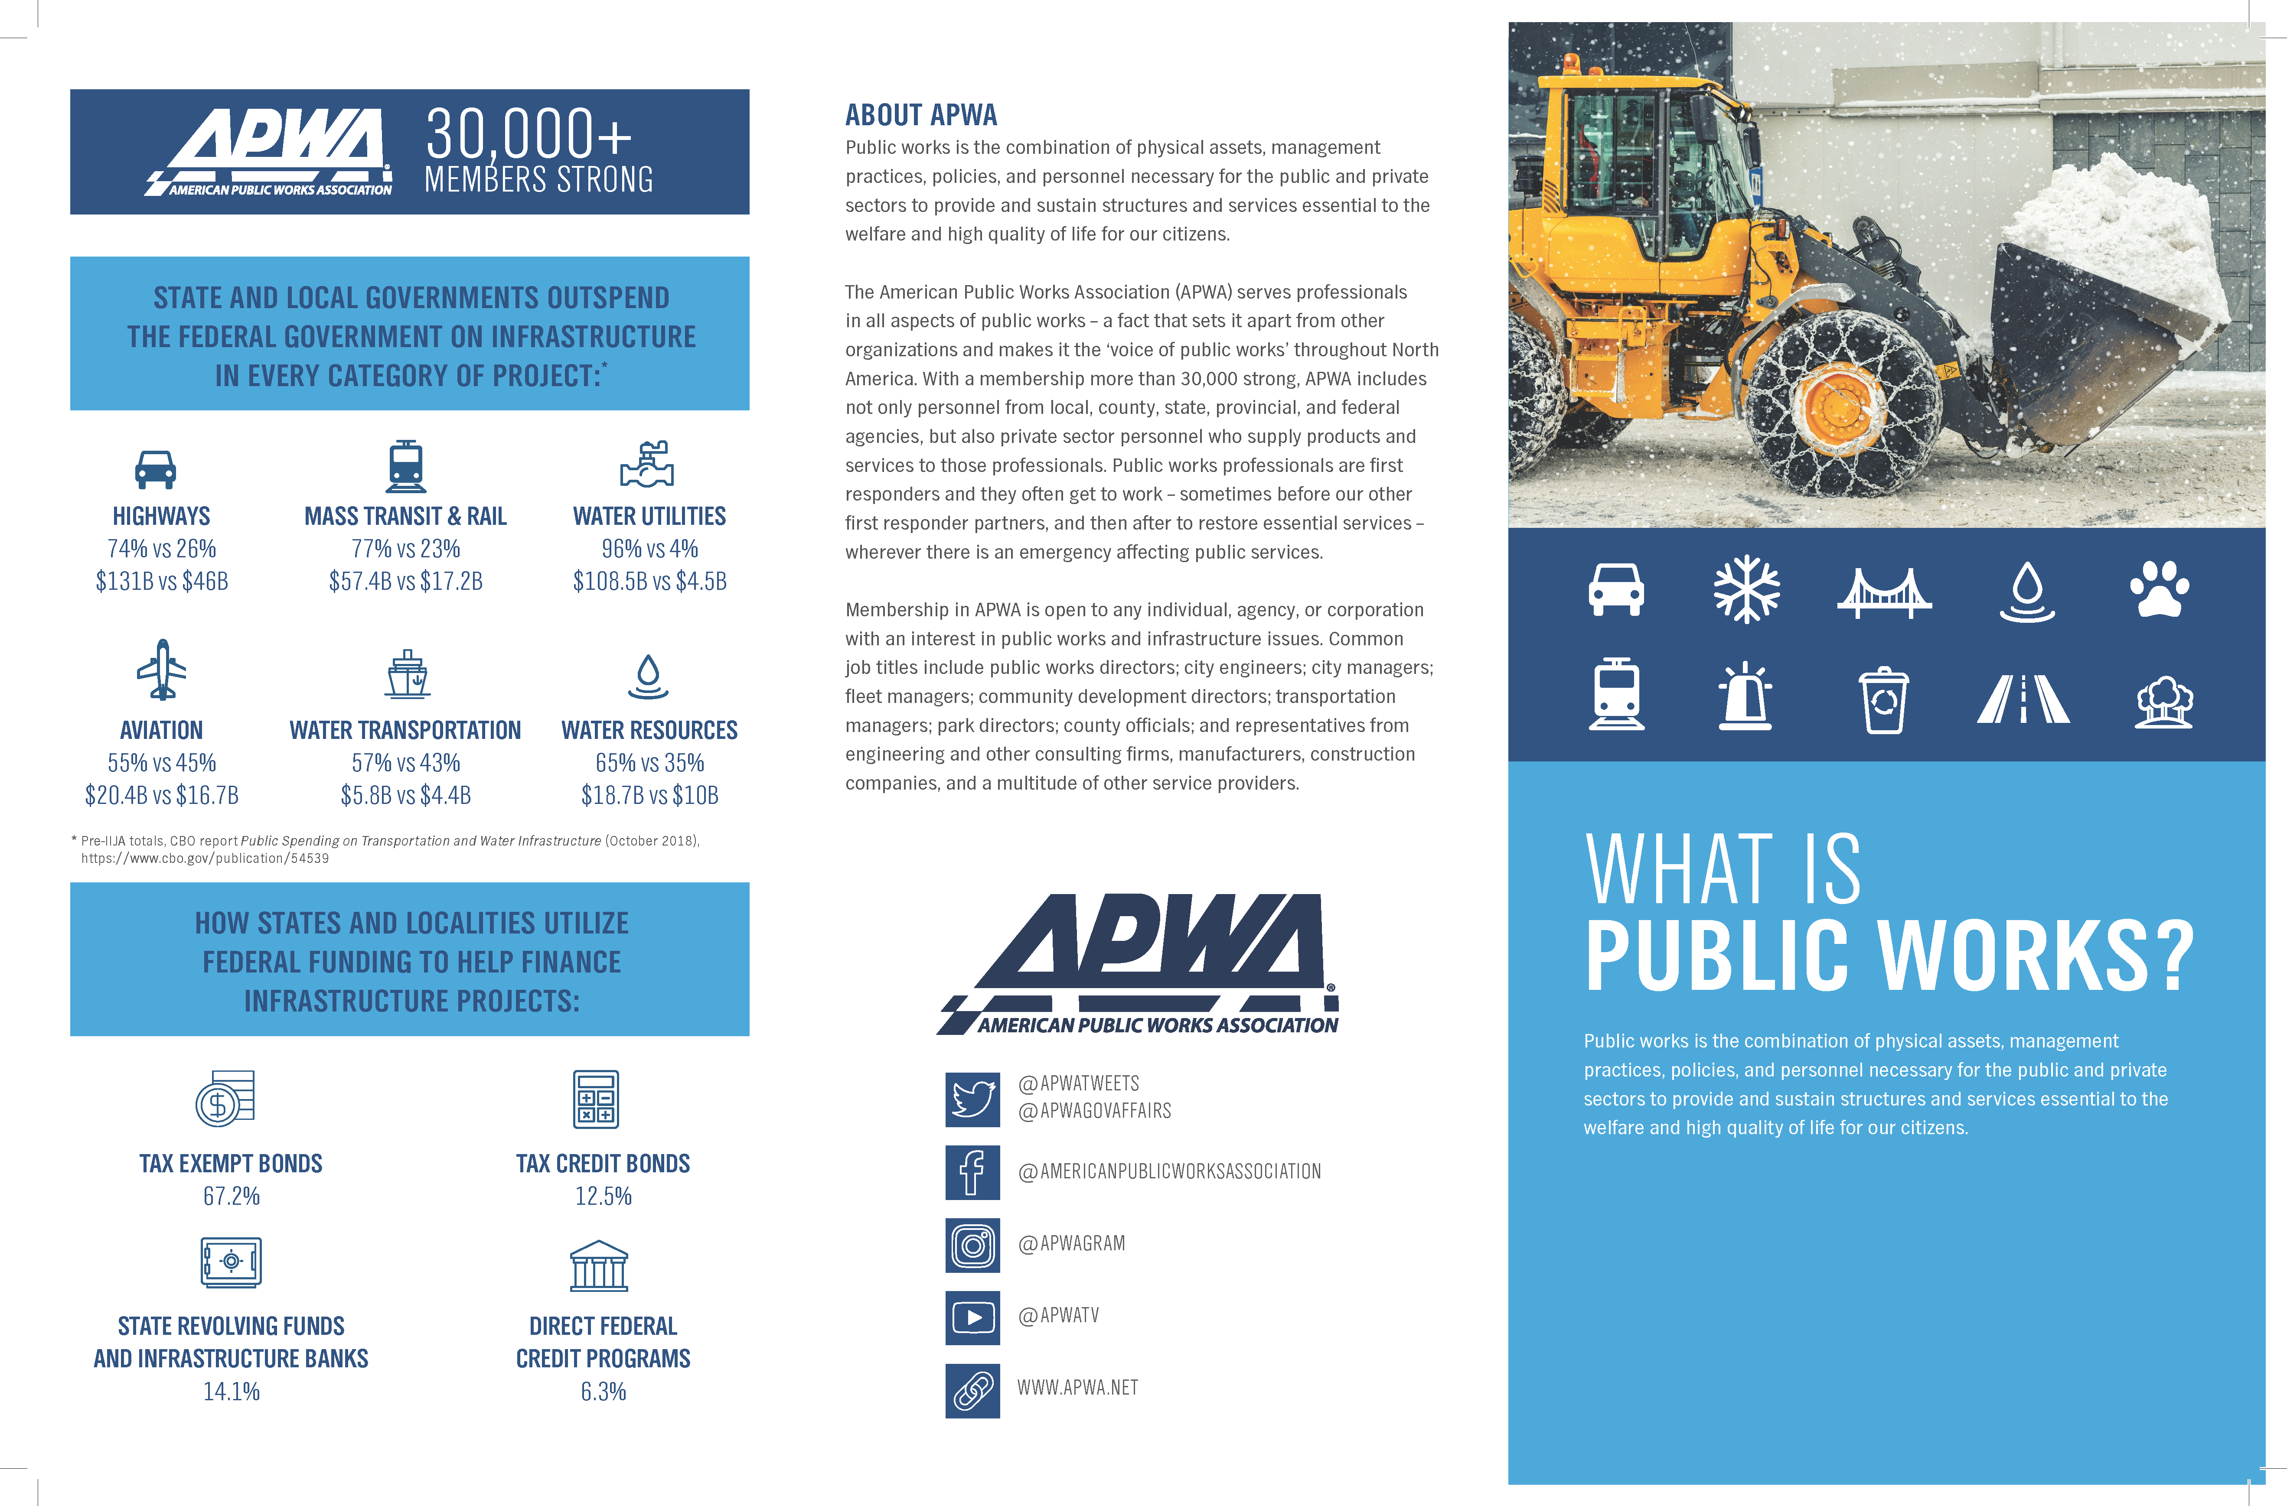
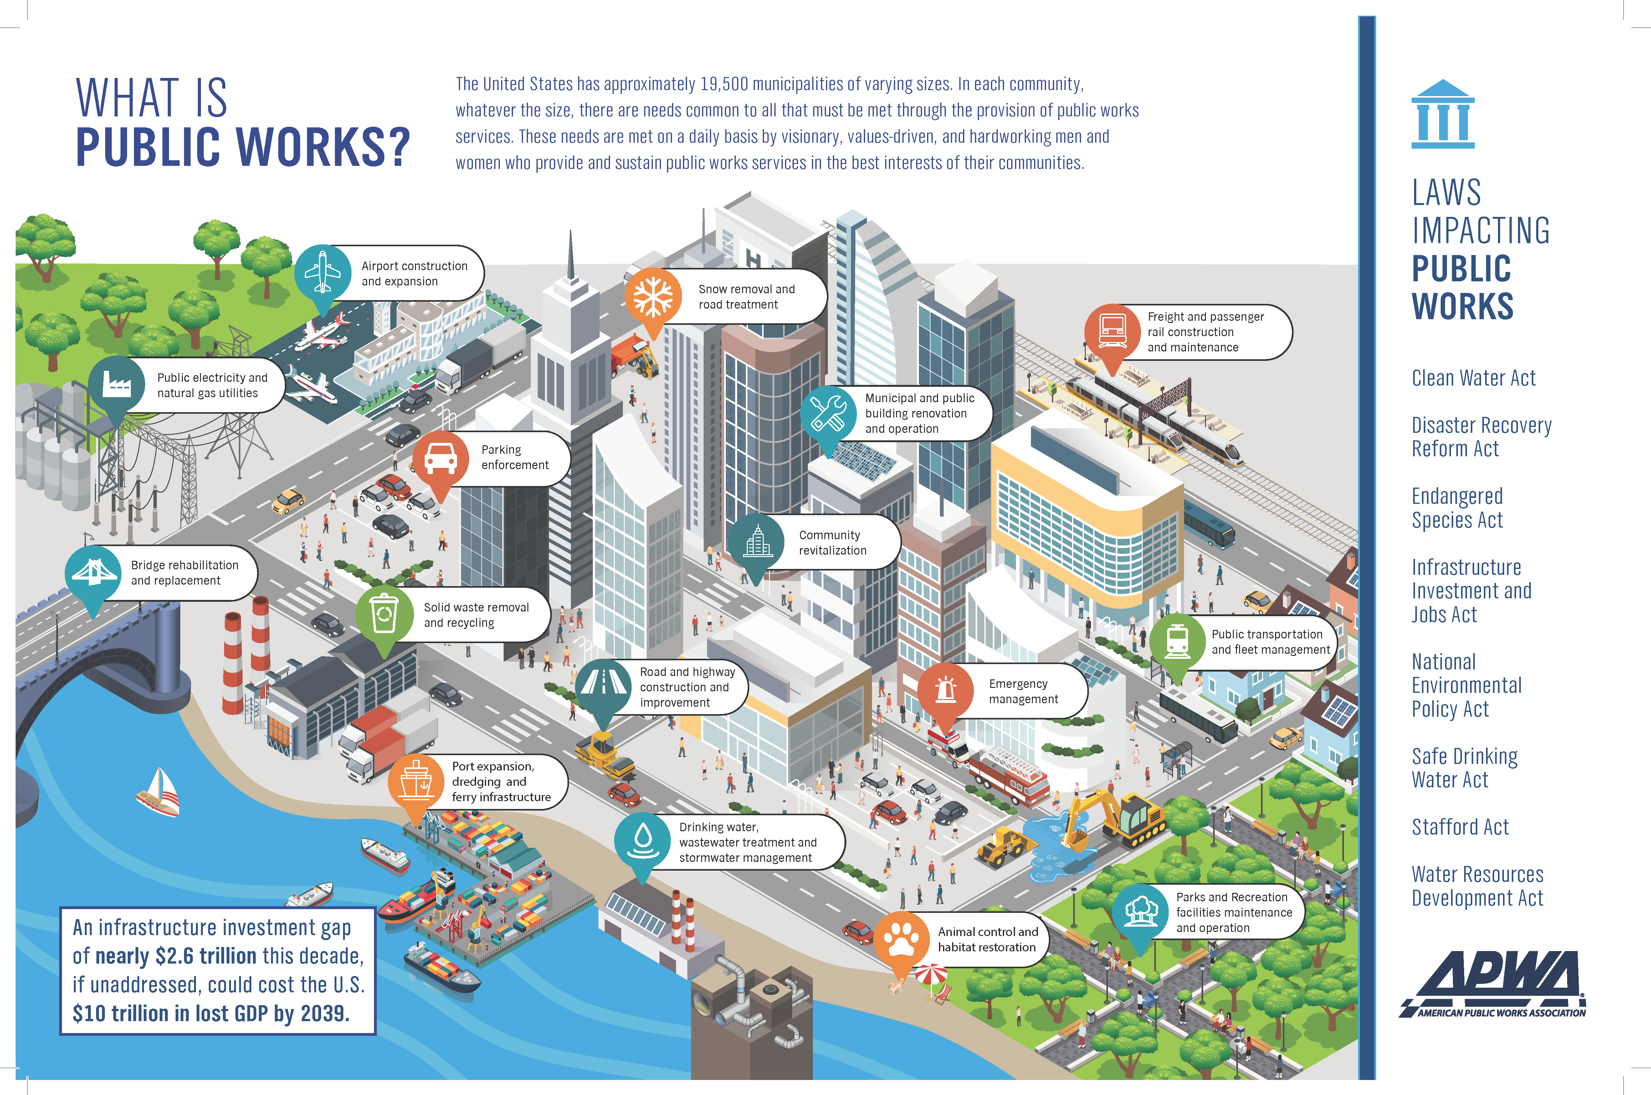

Slide 2
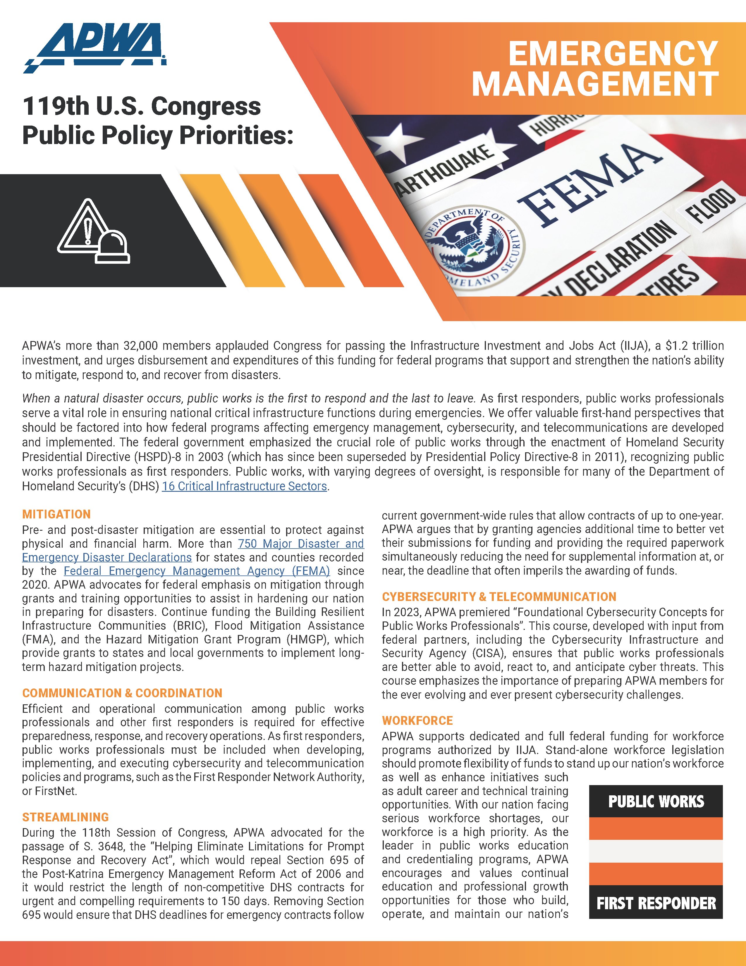
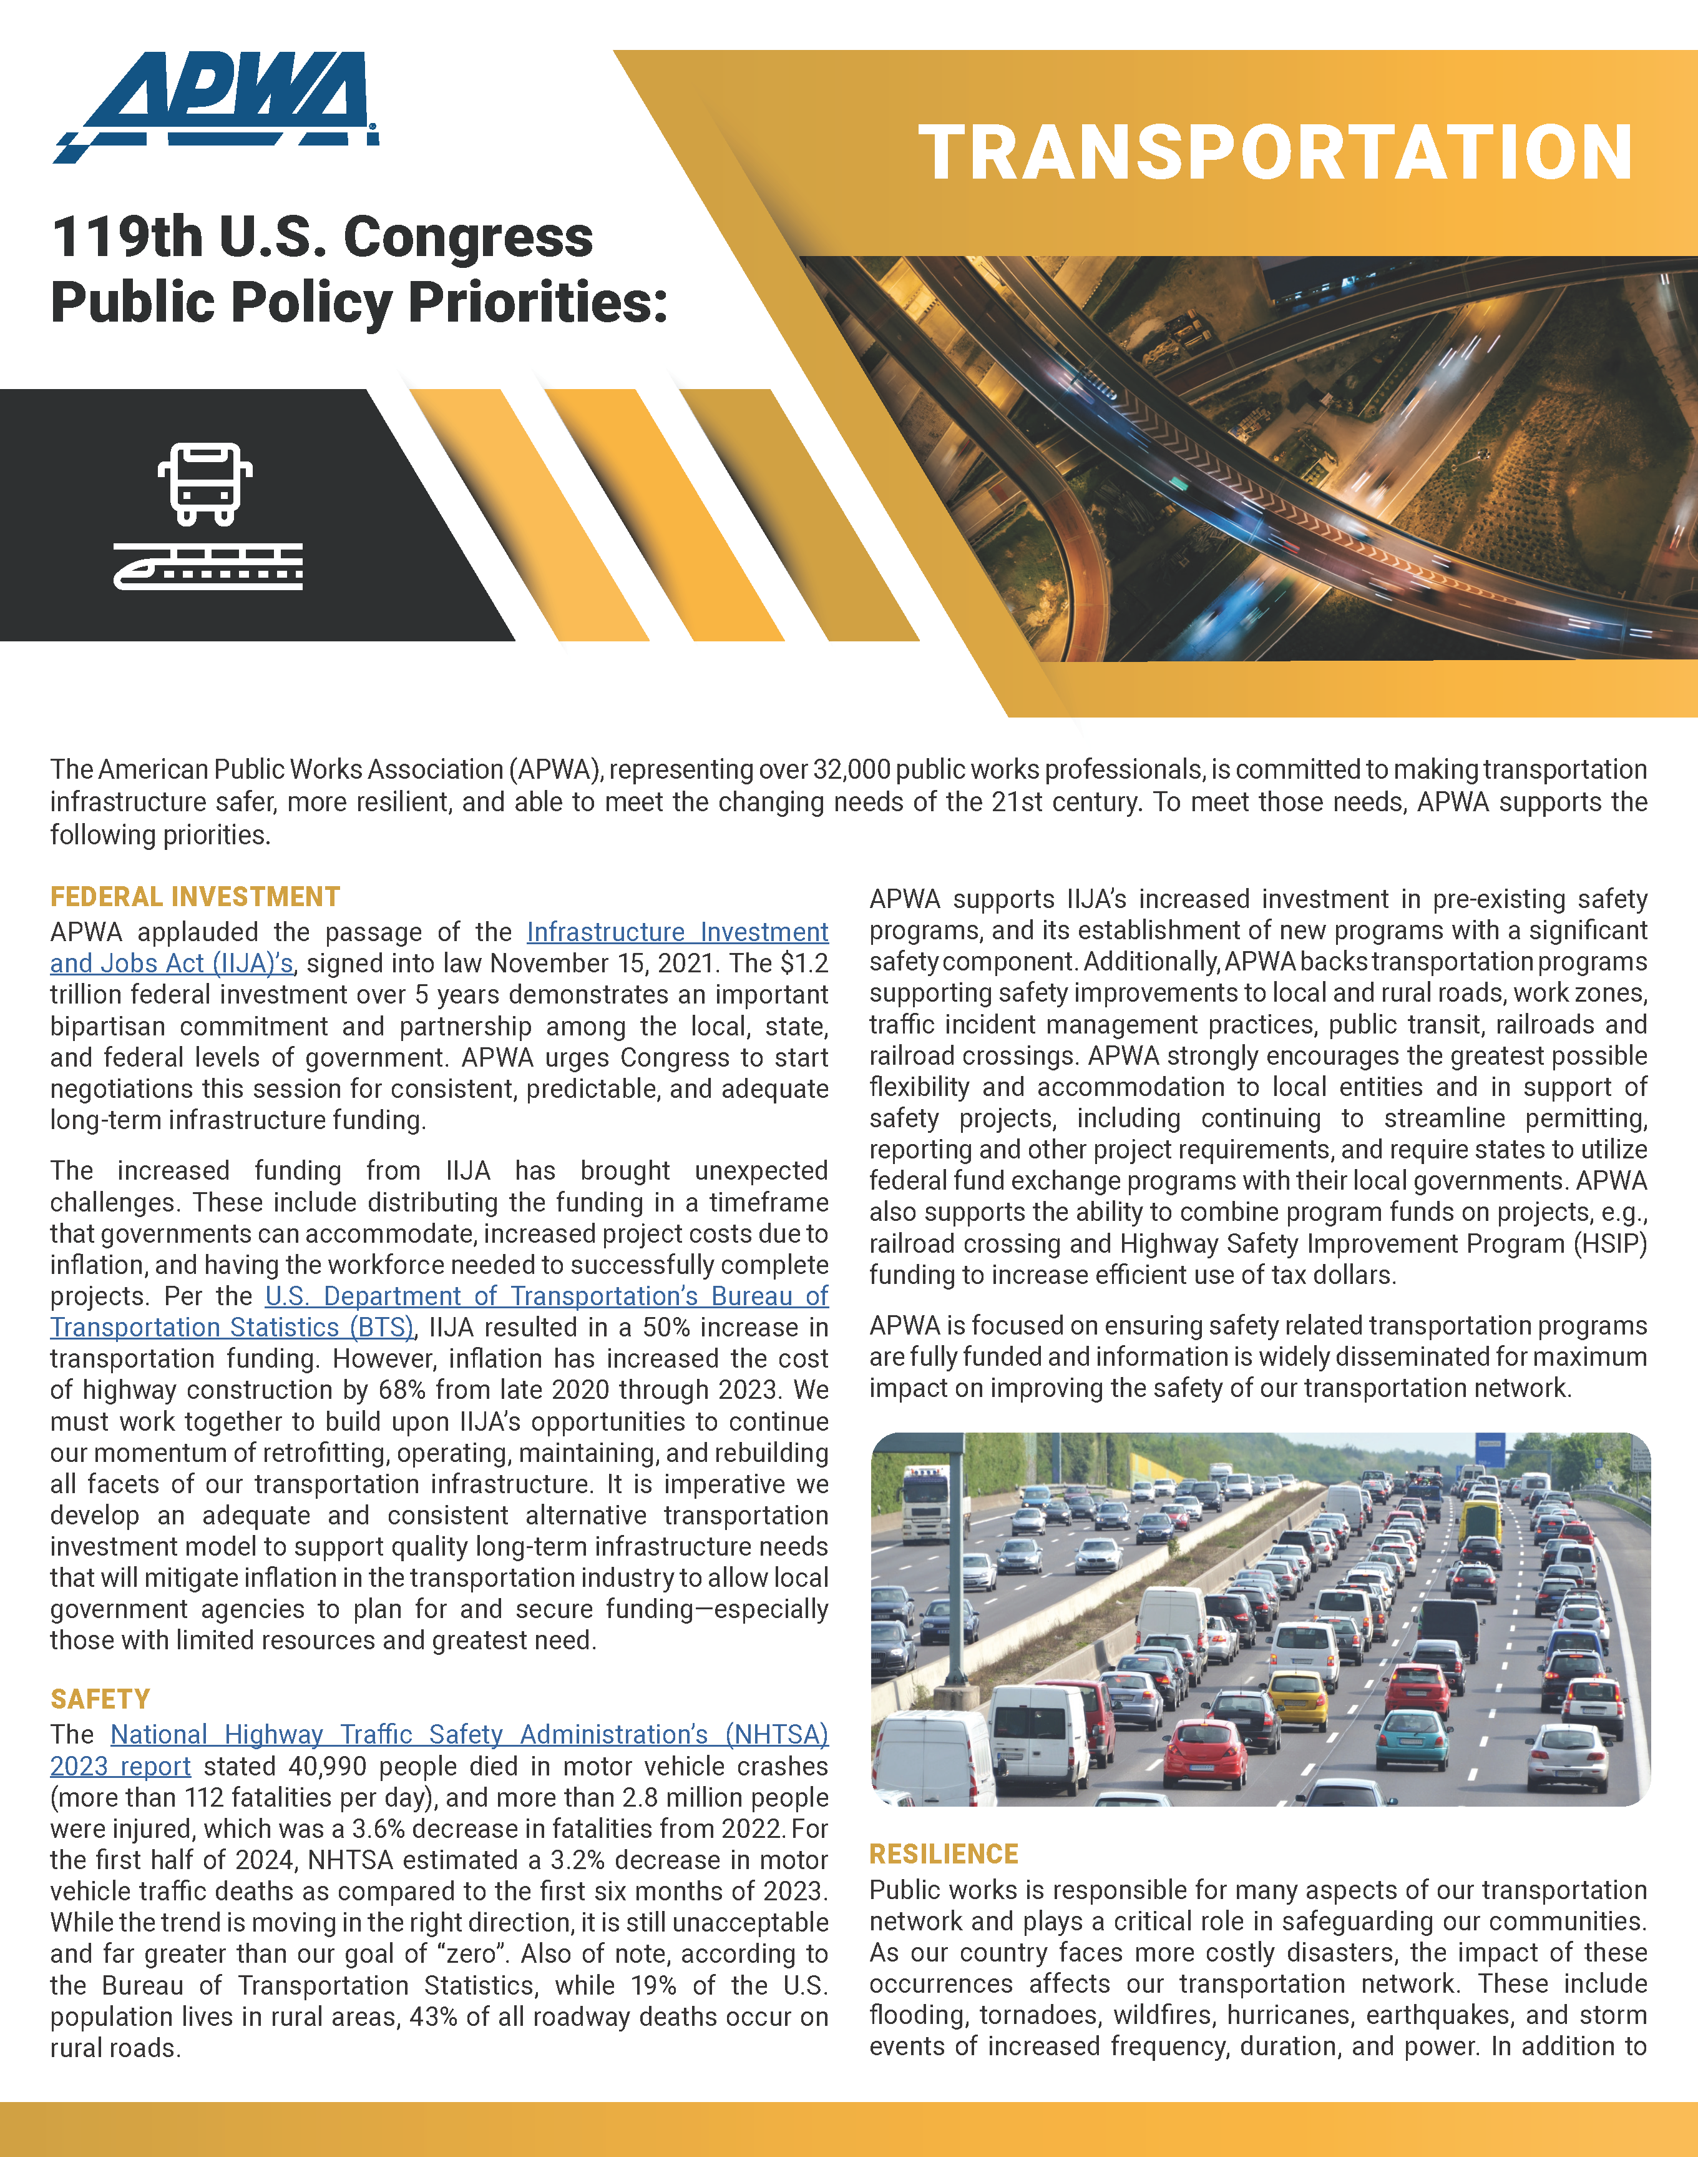
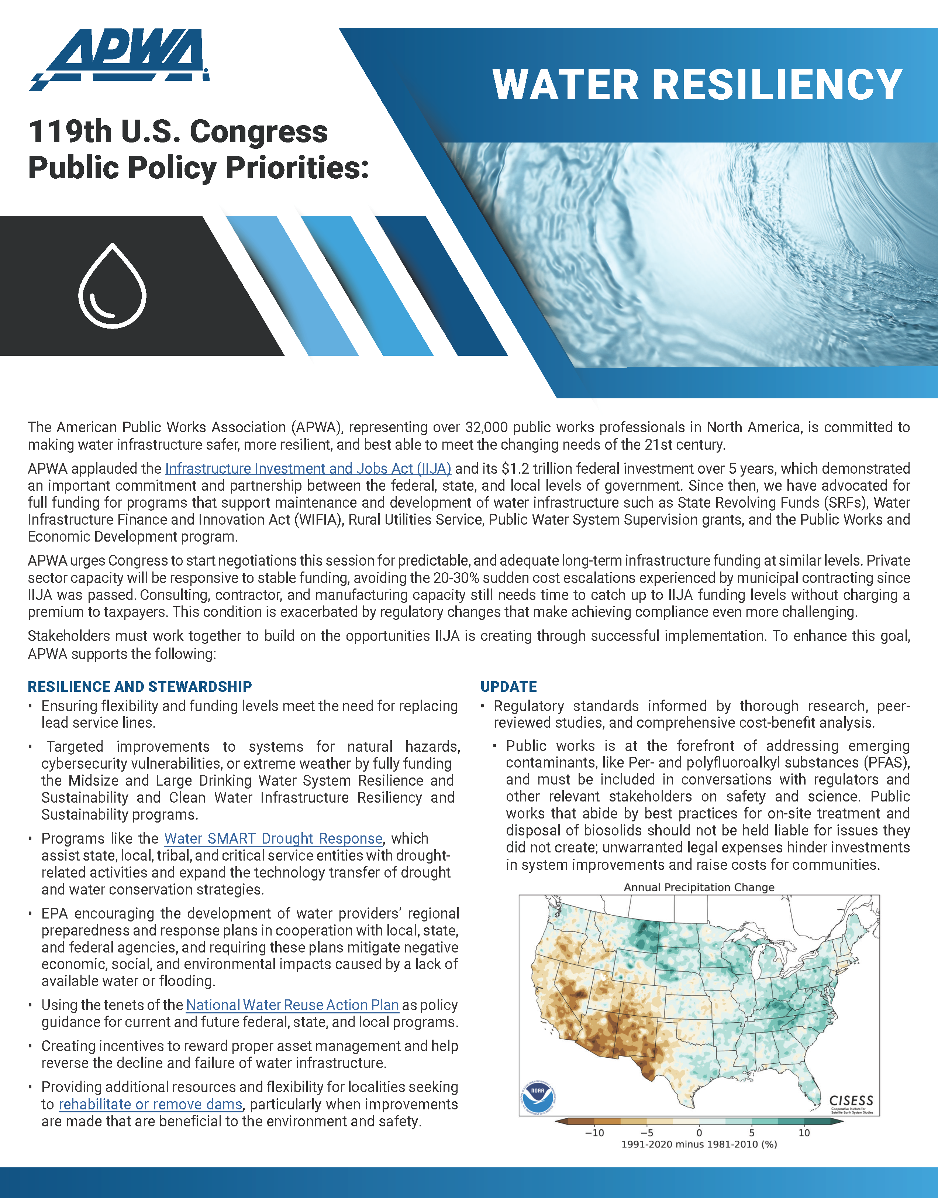
Notes:
The new Congress, sworn into office January 3 and these are APWA’s new public policy priorities for the 119th session of Congress. The APWA Board approved the policies on December 6 and the policies serve as APWA’s policy roadmap for the next two years. The APWA Government Affairs Committee, Government Affairs staff in the DC office, and volunteers from additional APWA technical committees review and draft the policy priorities every 2 years to align with the Congressional election cycle. Any questions on APWA’s US Government Affairs activities contact Director of Government and Public Affairs Andrea Eales at aeales@apwa.org

Slide 3
