Slide 1

Presentation for the
National Association of Regional Councils
February 10, 2025

Slide 2
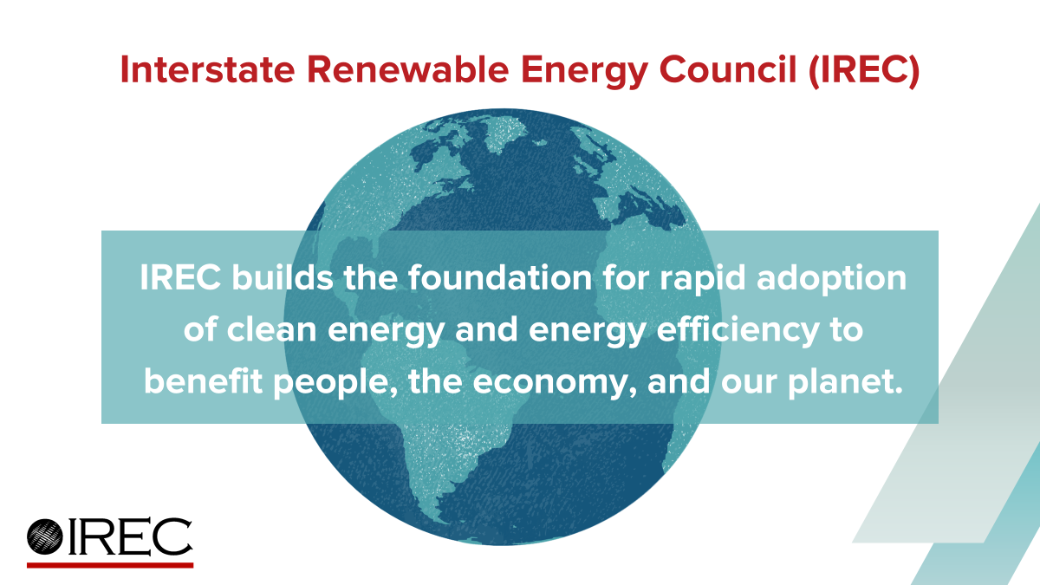

Slide 3
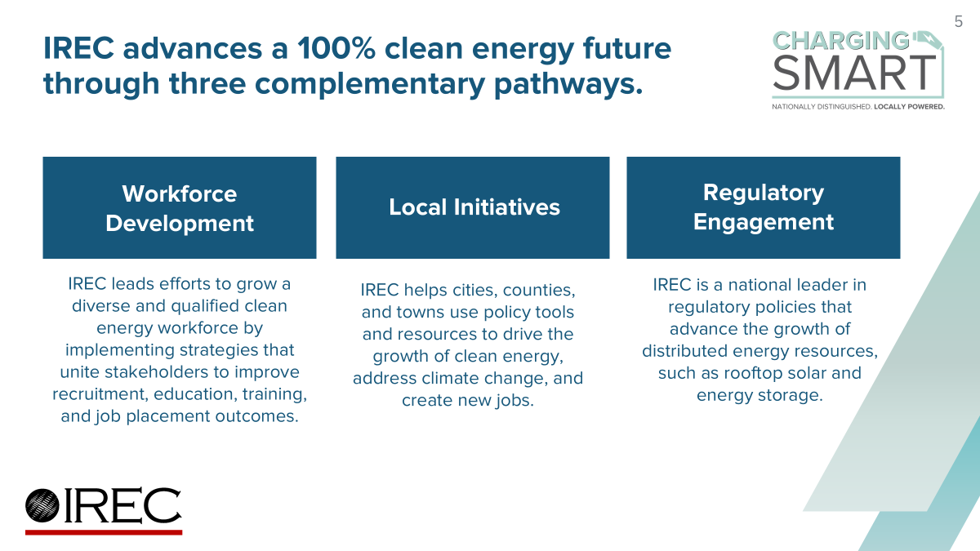

Slide 4


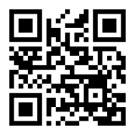
Energy Ready: Free Technical Assistance
Free technical assistance & recognition to local governments
Strategically manage the expansion of energy technologies
Energy-Ready.org
Notes:
In this slide, give a brief overview of the Energy Ready program. Discuss how Charging Smart is related to SolSmart and Distributed Wind Smart, and how viewers can learn more about the program at Energy-Ready.org.

Slide 5


What is Charging Smart?
Charging Smart provides free technical assistance and national recognition to local governments to facilitate the adoption of electric vehicles (EVs) and EV charging for their community.

Slide 6

Modeled off Success of SolSmart
500+ designated communities
44 states and counting
Over 1 in 3 U.S. residents live in a SolSmart designated community

Slide 7
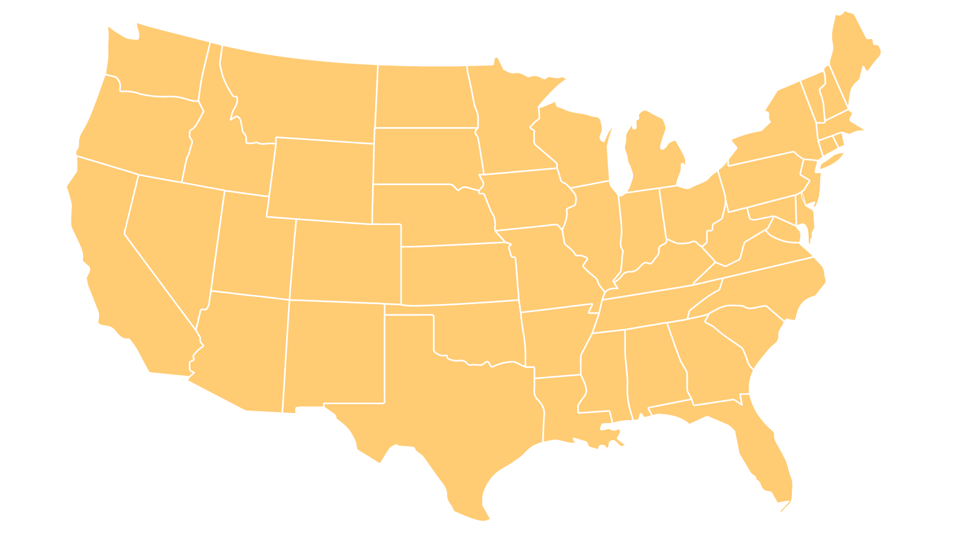
SolSmart Regional Organizations
a. Atlanta Regional Commission
b. Capital Area RPC
c. Centre Region COG
d. Delaware Valley RPC
e. Metropolitan Council
f. Michiana Area COG
g. Mid-Ohio RPC
h. Naugatuck Valley COG
i. New River Valley Regional Commission
j. N. Central Texas COG
k. N. Virginia Regional Commission
l. Ohio Kentucky Indiana COG
m. Region Nine Development Commission
n. Richmond Regional Planning District Commission
o. South Bay Cities COG
p. S. Central Regional COG
e
p
m
h
b
c
d
f
g
l
k
i
n
o
a
j

Slide 8
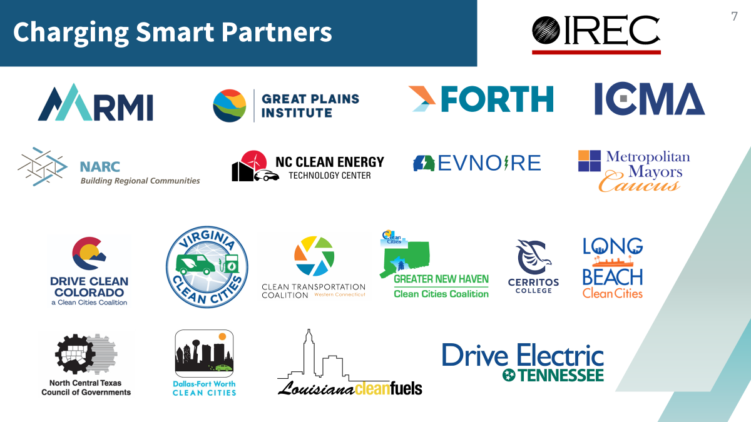

Slide 9






Industry Advisory Partners
Notes:
We should get there logos

Slide 10
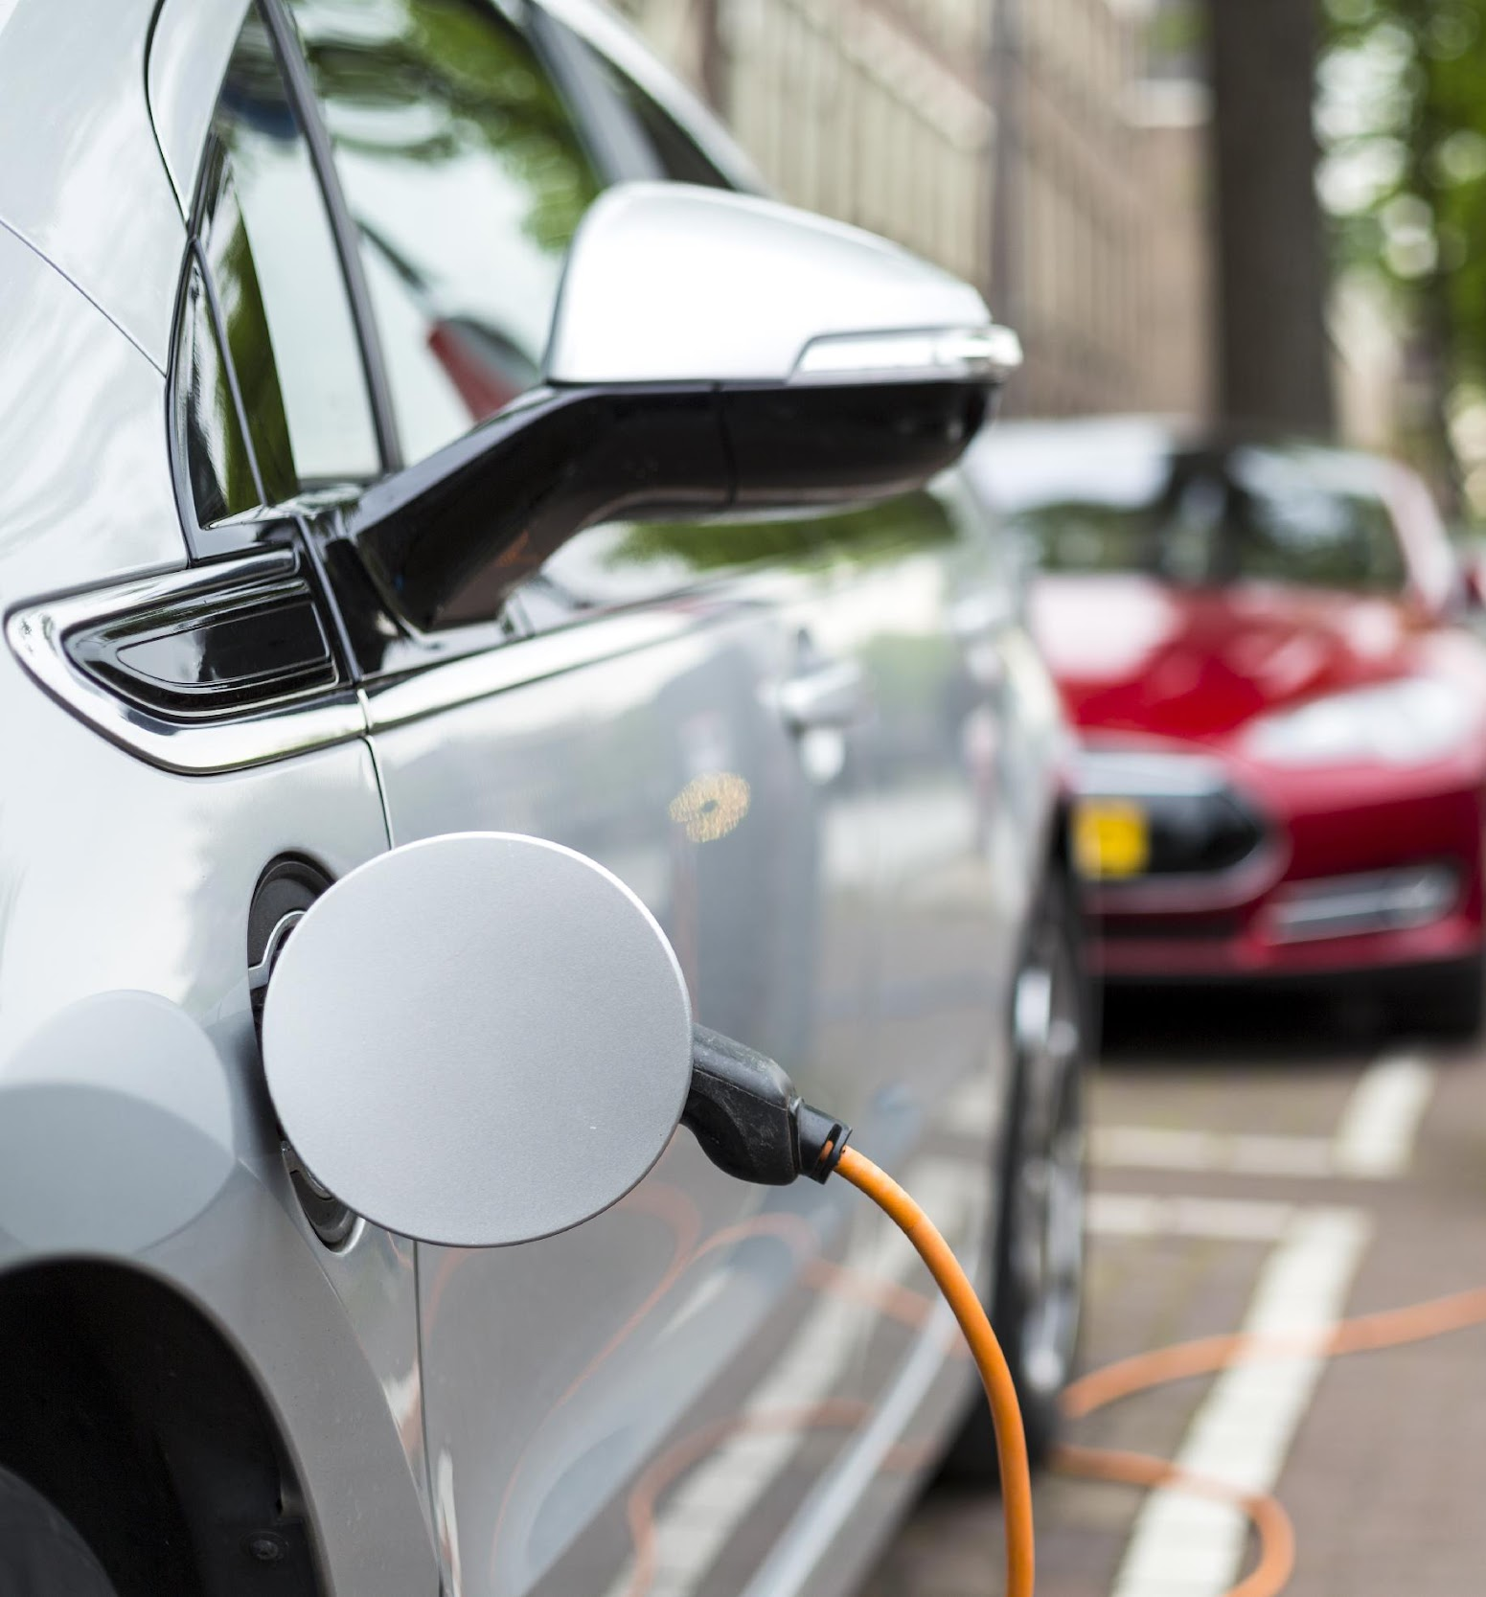
Charging Smart Action Categories
Planning
Government Operations
Regulation
Education and Incentives
Utility Engagement
Shared Mobility

Slide 11



Designation Structure

Slide 12
Designation Requirements: Bronze
Total Points: 80 EVs for All Points: 15
Specific Required Criteria
ID | Points | Criteria
R1.6 | 15 | Review zoning requirements and identify barriers to EV charging
R3.1 | 10 | Adopt a standard EV charging infrastructure permit application processes
R3.4 | 5 | Develop charging infrastructure permitting checklists
U1.1 | 5 | ​Meet with utilities to discuss EV collaboration opportunities
Required Points from Specific Categories
Planning: 10 Points
Education and Incentives: 15 Points
Points from Any Action(s): 20

Slide 13
Designation Requirements: Silver
Total Points: 150 EVs for All Points: 30
All Specific Bronze Requirements Plus:
Specific Required Criteria
ID | Points | Criteria
R1.1 | 10 | Permit chargers as an accessory use by right
R2.8 | 10 | Allow EV charging stalls to count towards minimum parking requirements
G2.2 | 10 | Complete an initial municipal fleet analysis
Required Points from Specific Categories
Utility Engagement: 20 Points
Points from Any Action(s): 40

Slide 14
Designation Requirements: Gold
Total Points: 300 EVs for All Points: 60
All Specific Bronze and Silver Requirements Plus:
Specific Required Criteria
ID | Points | Criteria
P3.1-P4.4 | 5 - 10 | Address EVs and charging infrastructure in functional area plan (sustainability plan, transportation plan) or comprehensive plan
R1.4 | 10 | Establish standard approval timelines and provide all comments at one time
R2.1 | 20 | Adopt an EV readiness ordinance or plan for new construction*
G1.4-6 | 20 | Install a public charger
G2.3 | 10 | Complete a comprehensive municipal fleet analysis
G2.5/7 | 10 - 15 | Purchase an EV for the municipal fleet
Points from Any Action(s): 105 - 120
*Alternative action available: R1.2 Define EV charging as its own primary use

Slide 15
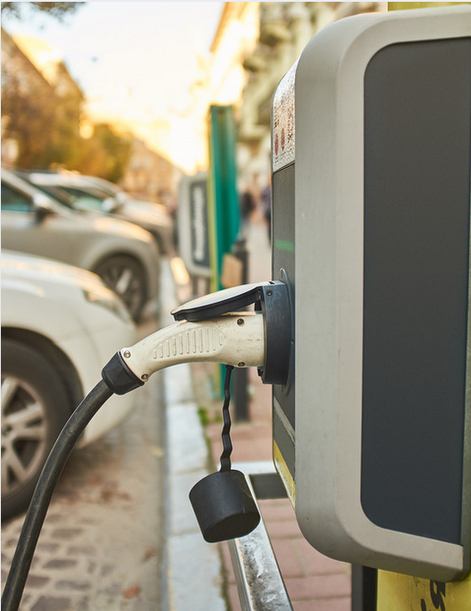

Expert Technical Assistance
Clear Pathway to Achieve Designation
Vetted Best Practices and Implementation Strategies
Guidebooks, Templates, and Model Language
Tailored Support to Communities at All Levels
Meet Your Community’s Adopted Goals and Implement Plans
Effectively Address Critical Concerns including:
  Land Use and Zoning Regulations
  Permitting

Slide 16
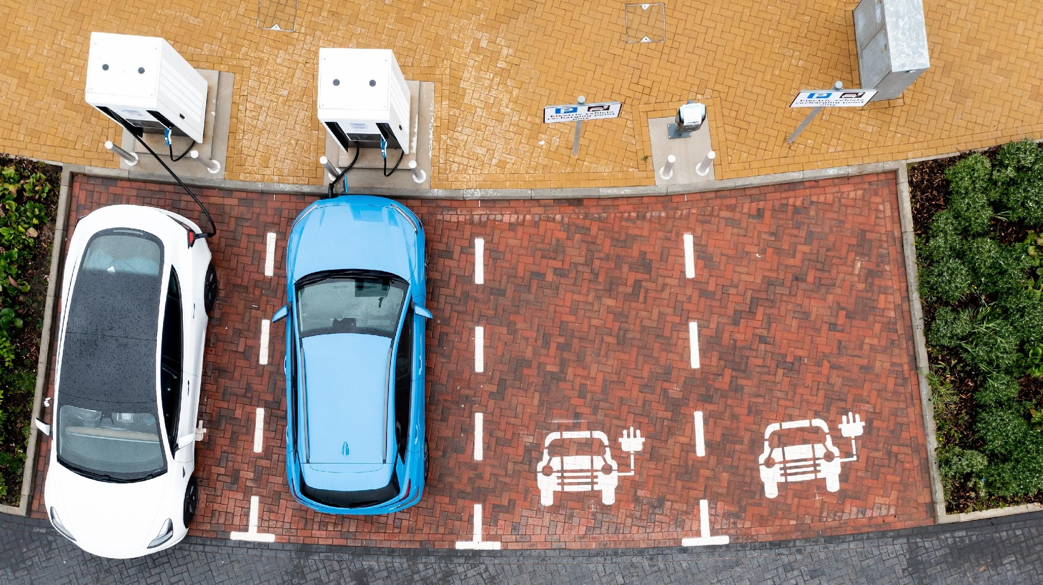
Benefits of Charging Smart
Supplement and Leverage Staff Capacity and Funding
Amplify Impacts of State and Federal Funding
Remove Unnecessary Barriers
Decreased Soft Costs
EV Market Growth
Notes:
Increases efficiency, cutting costs and staff time
Showcases your achievements via the Charging Smart website, media opportunities, and public events and announcements
Facilitates development of EV charging on public properties, increasing clean transportation options
Encourages even distribution of charging portals, including in underserved communities
Supports EV project development

Slide 17

Charging Smart Designation
Celebrate your community’s accomplishments
Be recognized as a national leader
Send a signal that your community is “open for EV charging”
          Attract new business
          Create new jobs
          Spur economic growth

Slide 18
Roles for Regional Organizations
Roles
Recruitment
Recruitment & TA
Approaches
Cohort
Individual
Training on program implementation

Slide 19
RFP Seeking Charging Smart Regional Engagement Partners
OPEN NOW until March 21, 2025
Up to 5 awards for Regional Engagement Partners for 8-10 months
Budget range: $40,000 - $50,000 per award
Facilitate communities in your region to become Charging Smart designated
Includes program training and ongoing support
Other priorities:
  geographic considerations
  cohorts

Slide 20
Designation for Regional Organizations
Designation Pathway for Regional Organizations is now under construction
  For multi-jurisdictional organizations such as regional councils, councils of government or metropolitan planning organizations
IREC and NARC will be convening a focus group to consult with on appropriate designation criteria
Once built out, ROs participating in Charging Smart can receive retroactive designation points

Slide 21

Contact Information
Ed Gilliland | Senior Director
edg@irecusa.org
Interstate Renewable Energy Council

Slide 22


Contact Information
Interested in another Energy Ready designation program?
SolSmart
Brandy O’Quinn
Program Director | IREC
brandy@irecusa.org
Distributed Wind Smart
Sarah Yeager
Senior Program Manager | ICMA
syeager@icma.org

Slide 23
Appendix

Slide 24
Bronze Designation
Designed to be achievable for many communities
Menu-based approach to select criteria based on community priorities or recently completed actions
Bronze Designation Requirements:
  4 specific required actions
  1 – 2 planning actions
  1 – 3 education and incentive actions
  1 – 4 actions in any category

Slide 25
Bronze Designation
Designation Requirement: 10 Planning Points
Complete 1 – 2 actions to achieve 10 points
Example actions include:
P1.1 | 10 Points | Create a community-wide EV vision ☞ Template provided
P1.3 | 10 Points | Develop SMART goals for EV actions ☞ Template provided
P3.4 | 10 Points | Include SMART goals for EVs in a functional plan

Slide 26
Bronze Designation
Designation Requirement: 15 Education and Incentives Points
1 – 3 actions to achieve 15 points
Example actions include:
E1.3 | 10 Points | Include material on EVs in newsletters
E1.4 | 5 Points | Table at events with educational materials
E2.1 | 5 Points | Create a webpage that addresses EVs (plus additional points for content on website)

Slide 27
Planning
Focus: Establish a policy environment and community-wide vision supportive of electric vehicle adoption
Best Practices:
Establish a community EV vision and goals
Address EVs and EVSE in planning documents (comprehensive plans, sustainability plans, transportation plans, small area plans)

Slide 28
Regulation
Focus: Update planning and zoning documents, and building codes and streamlining related application and approval processes legal frameworks that shape the built environment to enable seamless integration of electric vehicle charging infrastructure.
Best Practices:
Enable EV charging infrastructure in land use regulations
Incorporate charging infrastructure in building or zoning codes
Incorporate EV and EVSE charging infrastructure in permitting

Slide 29
Utility Engagement
Focus: Build collaborative relationships between local governments and electric utilities to unlock programs, rates, and investments that accelerate EV adoption.
Best Practices:
Work with utility on collaborative education and communication initiatives
Work with utility on service load connection process
Work with utility to address managed EV charging initiatives
Work with utility to address EV programs and rates
Work with utility to address renewable energy EV programs and incentives

Slide 30
Education and Incentives
Focus: Public education, outreach programs, and financial incentives that communities can provide to stimulate consumer awareness, understanding, and excitement for electric vehicles and charging equipment.
Best Practices:
Host public education events and campaigns
Create an EV landing page on the City website
Provide EV and EV charger education to commercial property owners
Offer financial incentives for charging infrastructure installation
Offer financial incentives for purchasing EVs

Slide 31
Government Operations
Focus: Municipally-controlled assets and resources to lead by example in embracing transportation electrification.
Best Practices:
Provide publicly available EV chargers in the community
Electrify the city fleet
Install staff-reserved EV chargers

Slide 32
Shared Mobility
Focus: Accelerate electrification across modes of transportation serving the public, such as public transit fleets, school buses, rideshare services, car-sharing programs, shuttles, and paratransit.
Best Practices:
Deploy electric transit, paratransit vehicles
Deploy electric school buses
Develop electric micromobility transportation
Develop EV car sharing program

