Slide 1
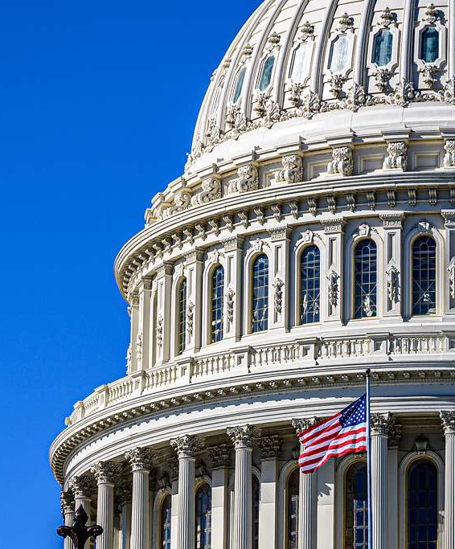
Federal Broadband Policy:
2025 Landscape
National Conference of Regions
February 10, 2025

Slide 2
Notes:
About NLC
19,000 cities, towns and villages
49 SMLs – Kentucky League of Cities is a great partner
Thank you Terri and Scott for inviting NLC to speak with you all today

Slide 3
2025 Federal Action Agenda
America’s prosperity depends on thriving local economies. By streamlining federal programs and empowering local governments, we can ensure a strong national economy. Local leaders are best positioned to understand the needs of their communities and should be key partners in shaping federal policies that prioritize fiscal responsibility and efficiency.
Streamline Federal Programs for All Communities
Increase the Nation’s Housing Supply
Promote Public Safety
Solidify Infrastructure Investment
Close the Digital Divide
Build Community Resilience
Reduce Legal and Financial Burdens on Local Governments
Notes:
Each bucket includes a set of federal actions that NLC will prioritize in service of the toplines
Agenda was crafted and revised several times in alignment with the following: 2025 NMP, messaging data and auditing of available policy proposals from the new Congress and Administration
Emphasis on bipartisanship traction and reflective of priorities that NLC members expressed throughout meetings at City Summit
Final agenda will go live after it is reviewed and approved by the Board Executive Committee, who will be meeting at the end of January
Federal actions will be reviewed and updated quarterly if necessary based on congressional and executive actions
Important to remember: If something is missing from this (but is reflected in the NMP) – it does not mean we WON’T advocate for it – priorities are developed for a reason, and these issue areas will help drive our work.
How does it affect portfolios across the organization? Think about initiatives, cohorts and reports you may be working on this year that could help inform these above priorities, how can you help tell the story of how cities are governing around these issues areas?

Slide 4
Federal
Broadband Programs
Notes:
BEAD, Digital Equity Act, USF, ACP

Slide 5
Untangling the Federal Funding Web
American Rescue Plan Act
SLFRF
Capital Projects Fund
Bipartisan Infrastructure Law
BEAD
Digital Equity Act
Affordable Connectivity Program
Permanent Programs
USDA ReConnect
FCC Universal Service Fund
Various community development grants
https://broadbandusa.ntia.doc.gov/funding-programs

Slide 6
Bipartisan Infrastructure Law
$42.45 billion for the Broadband Equity, Access and Deployment Program.
$14.2 billion for the Affordable Connectivity Program.
$2.75 billion for the Digital Equity Act.
$2 billion for rural broadband through USDA ReConnect.
$1 billion for Middle Mile Broadband Infrastructure.

Slide 7
New Administration & 119th Congress:
State of Play
Notes:
Appointees landscape, Executive Orders

Slide 8
Setting the Stage
The Trump/Vance Administration is moving swiftly to enact the President’s agenda through exercising Executive Branch authority and working with leaders in the Congressional majority. This approach is common.
Through various Presidential Actions, the Executive Branch authority will likely call into question the balancing of powers across all three of our federal government branches with some of them impacting commonly accepted Legislative Branch authority and some others already challenged in the courts.
The Office of Management and Budget (OMB) issued Memorandum M-25-13 ordering federal agencies to “temporarily pause… obligations or disbursement of all Federal financial assistance.” Although rescinded, local government’s ability to regularly access federal grant funding awarded to them remains uncertain. Recently, two temporary restraining orders have also been issued related to this Memorandum and the Administration's efforts to "temporarily pause... Federal financial assistance."
NLC is communicating with the White House, federal agencies, and Members of Congress and advocating for local governments. The following summaries could impact local governments in both positive and negative ways.

Slide 9
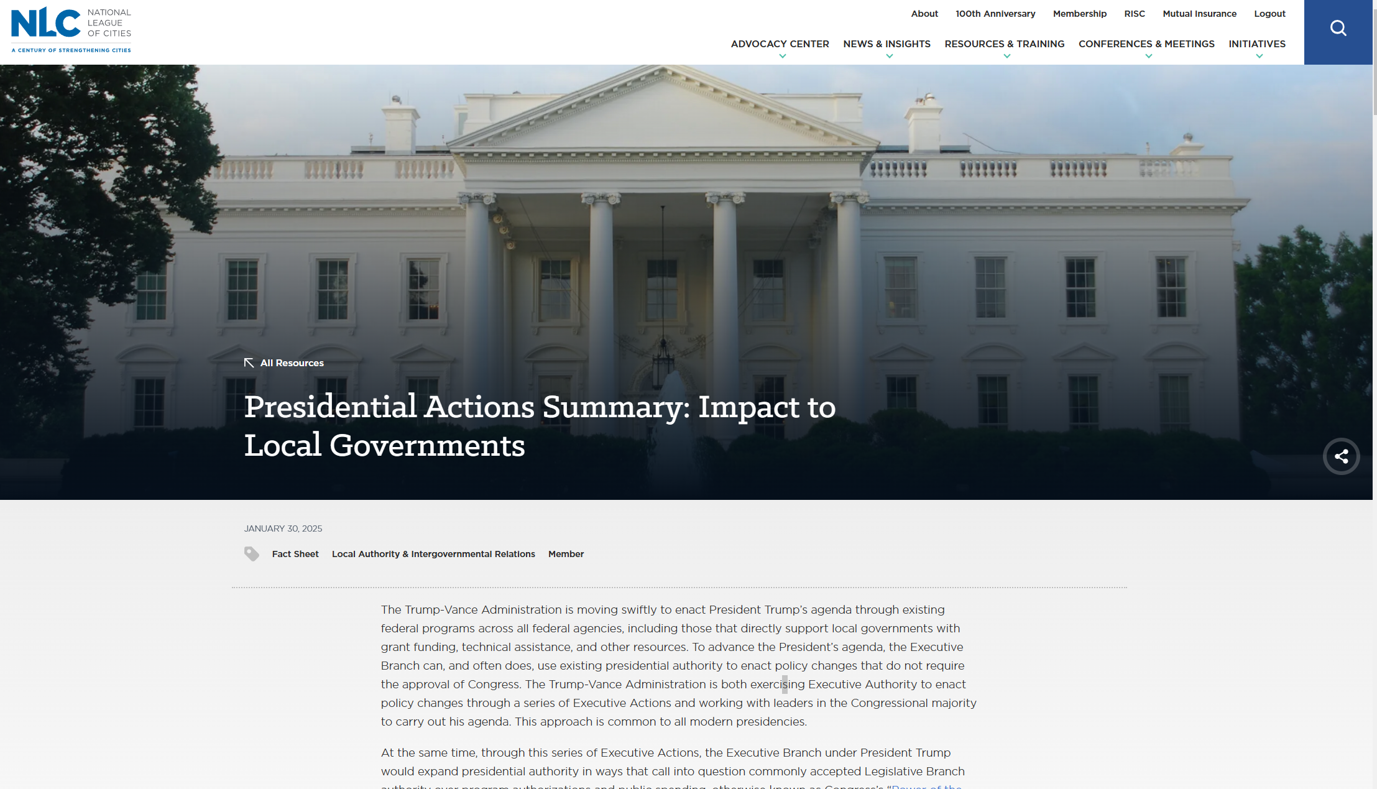

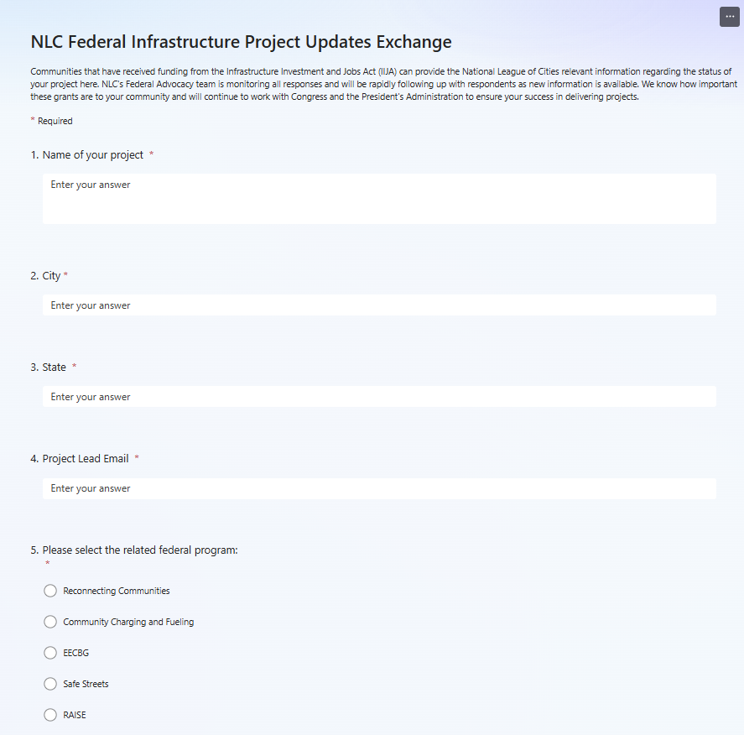
Resources And Actions For Local Governments
NLC has developed a resource page to update local governments on rapidly changing guidance and how to navigate them.
We’re also collecting project implementation information from cities, towns and villages and closely monitoring all responses to inform development of new resources and rapid-response channels as new information is made available.

Slide 10
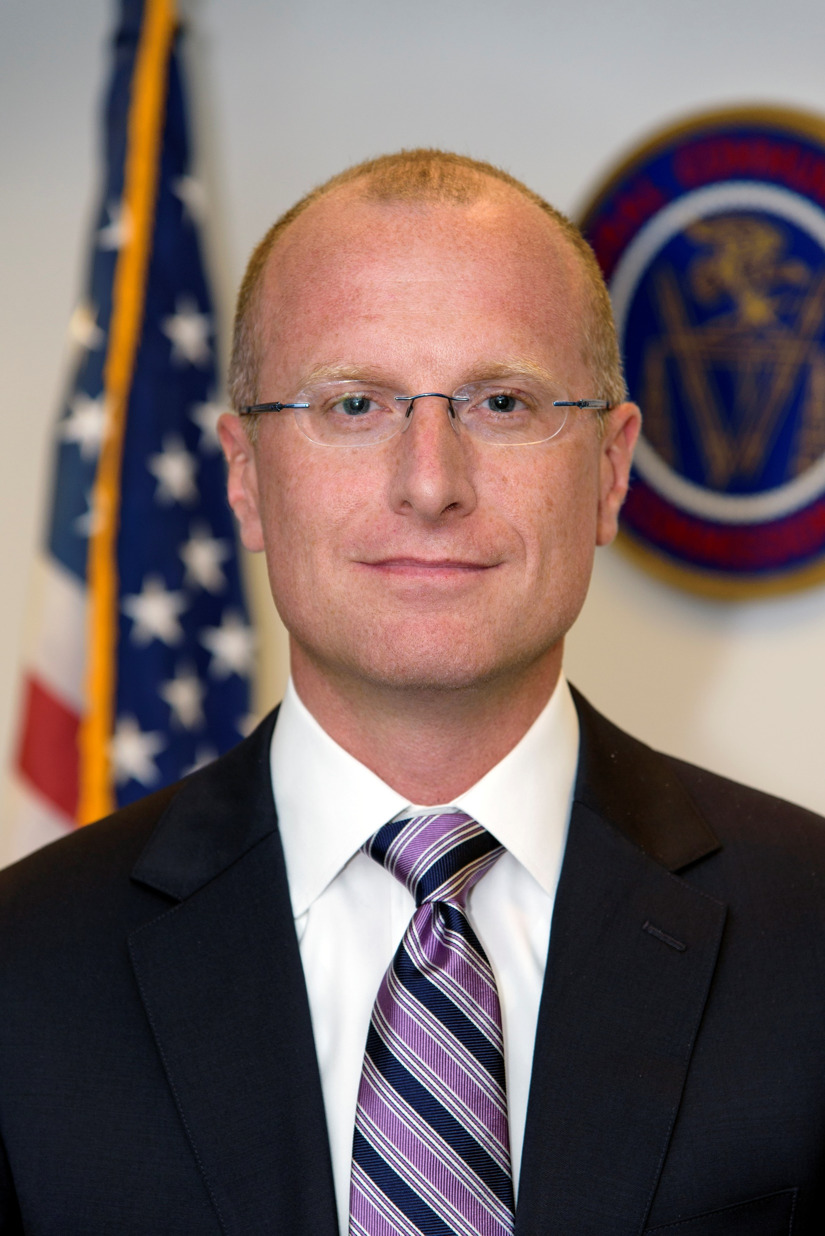

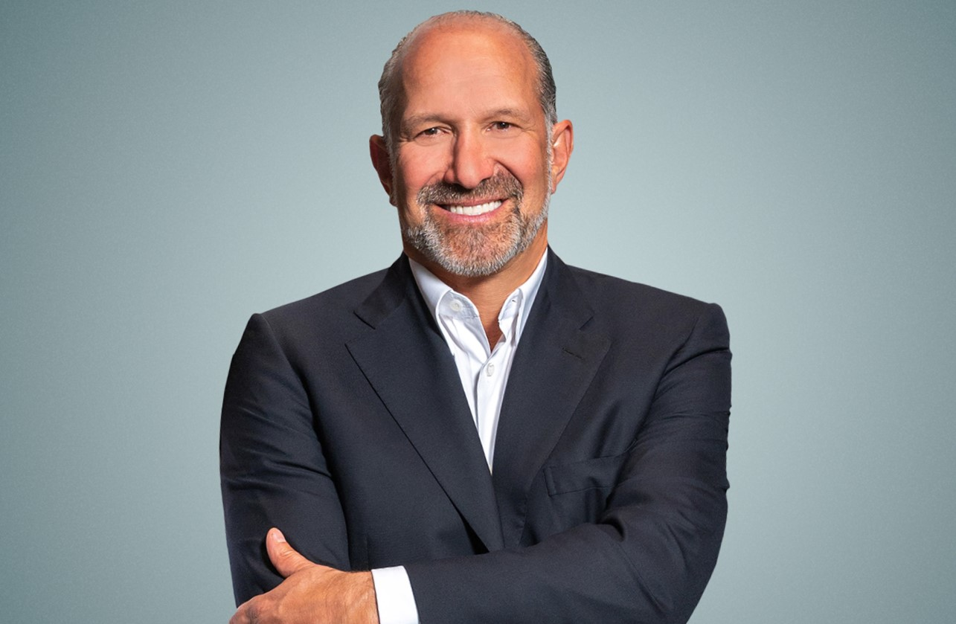

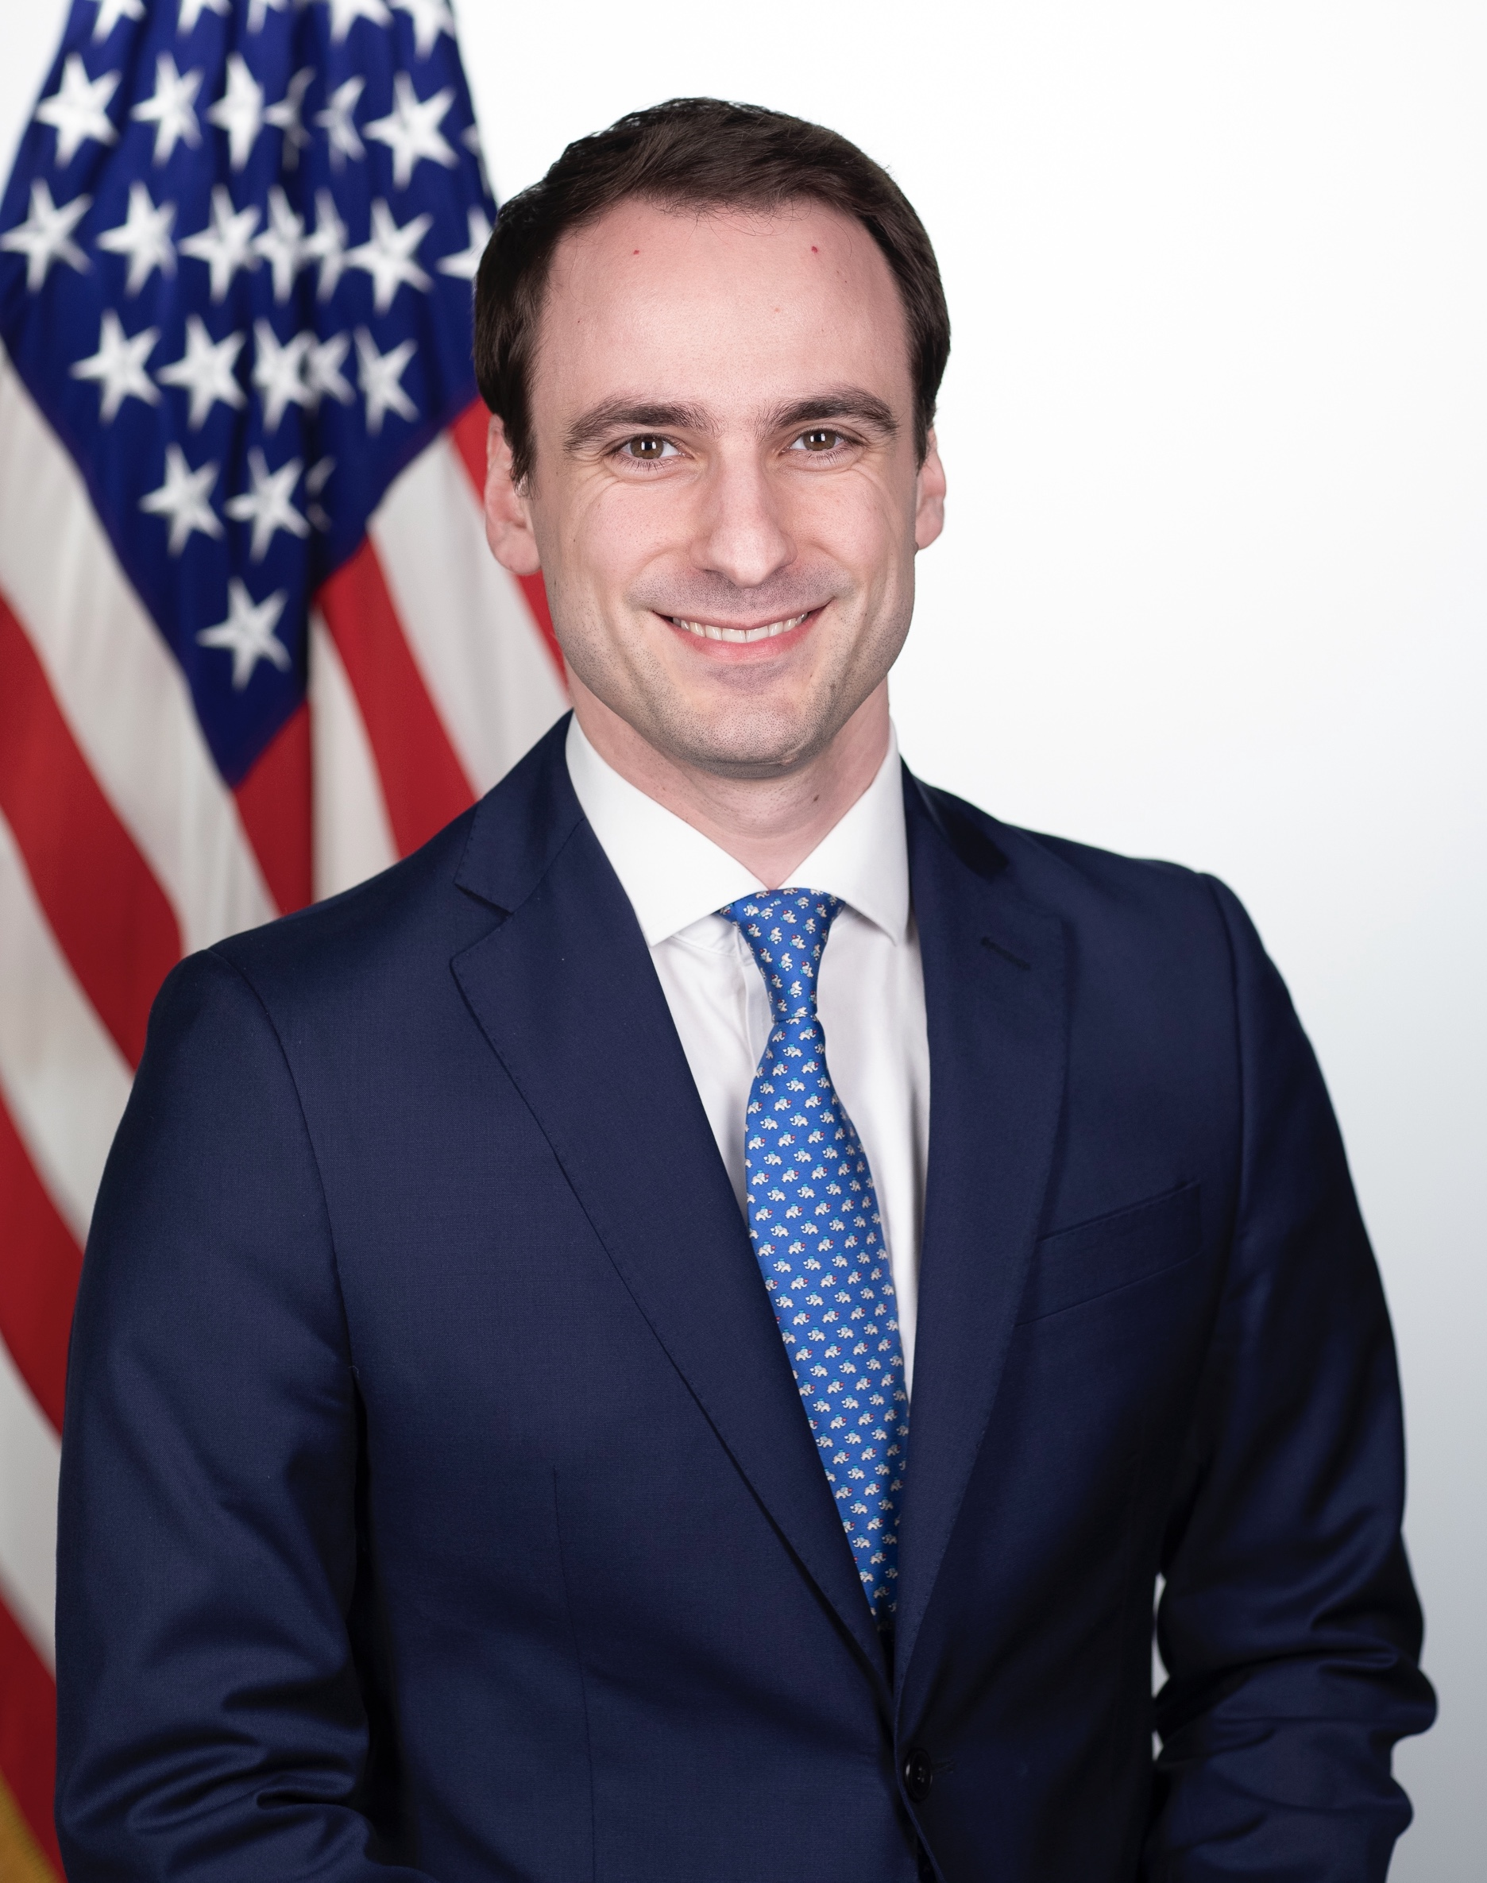
Key Appointees
Brendan Carr
FCC Chair
Olivia Trusty
FCC Commissioner
Howard Lutnick
Secretary of Commerce
Arielle Roth
NTIA Administrator
Michael Kratsios
White House OSTP Director

Slide 11
FCC Activity
Executive Order Action: “Chairman Carr Ends FCC’s Promotion of DEI” – 1/21
Withdrawal of Rules Under Consideration:
Chairman Carr Stops Costly Regulatory Overreach FCC Ends Consideration of Biden-Era ‘Bulk Billing’ Proposal - 1/24
Chairman Carr Ends Biden-Era Plan to Slow Down Infrastructure Builds – 1/28
February Open Meeting & Recent Priorities:
Broadcaster enforcement
Robocall enforcement
Spectrum management, call blocking, wireless emergency alerts
Intergovernmental Advisory Commitee Report – 1/15

Slide 12
Congressional Action
House Energy & Commerce, Communications & Technology Subcommittee – “Strengthening American Leadership in Wireless Technology” – 1/23
Preemption Watch: H.R. 278, ‘‘Barriers and Regulatory Obstacles Avoids Deployment of Broadband Access and Needs Deregulatory Leadership Act’’ or the ‘‘BROADBAND Leadership Act’’

Slide 13
Universal Service Fund & Broadband Affordability
Affordable Connectivity Program Wind-Down
Universal Service Fund Reform
FCC v. Consumers’ Research
NLC & Local Government Legal Center Amicus brief

Slide 14
Discussion

