Slide 1
FCC National Broadband Map and Deployment Programs
Eduard Bartholme
Acting Bureau Chief
Consumer & Governmental Affairs
Federal Communications Commission

Slide 2
Broadband Data Collection (BDC):
New Approach to Mapping Broadband Availability
The FCC historically collected broadband deployment data at the census-block level. Large geographic scale meant a generalized view of deployment.
Congress directed the FCC to develop processes and procedures to collect, verify, and publish more granular data in the Broadband Deployment Accuracy and Technological Availability (DATA) Act.
The first draft of the new Map was published in November, 2022.
Notes:
Fixed broadband service providers have reported coverage based on Census Blocks.
11,000,000+ census blocks in the U.S., which vary in size, especially between urban and rural areas.
No way to distinguish which locations within a census block are served.
Mobile broadband providers have reported by technology and based on minimum advertised speed or speeds consumers should reasonably expect to receive within the coverage area.
Lack of standardized reporting parameters prevents apples-to-apples comparisons of data among providers.
BDC=
Entirely new filing/data-collection system
Fixed broadband availability data down to the individual location
Mobile broadband availability data standardized across providers
Challenge process to identify and dispute data collected from providers
Incorporation of data from state, local, and Tribal governments
Crowdsource information to support verification efforts
Audits and enforcement

Slide 3
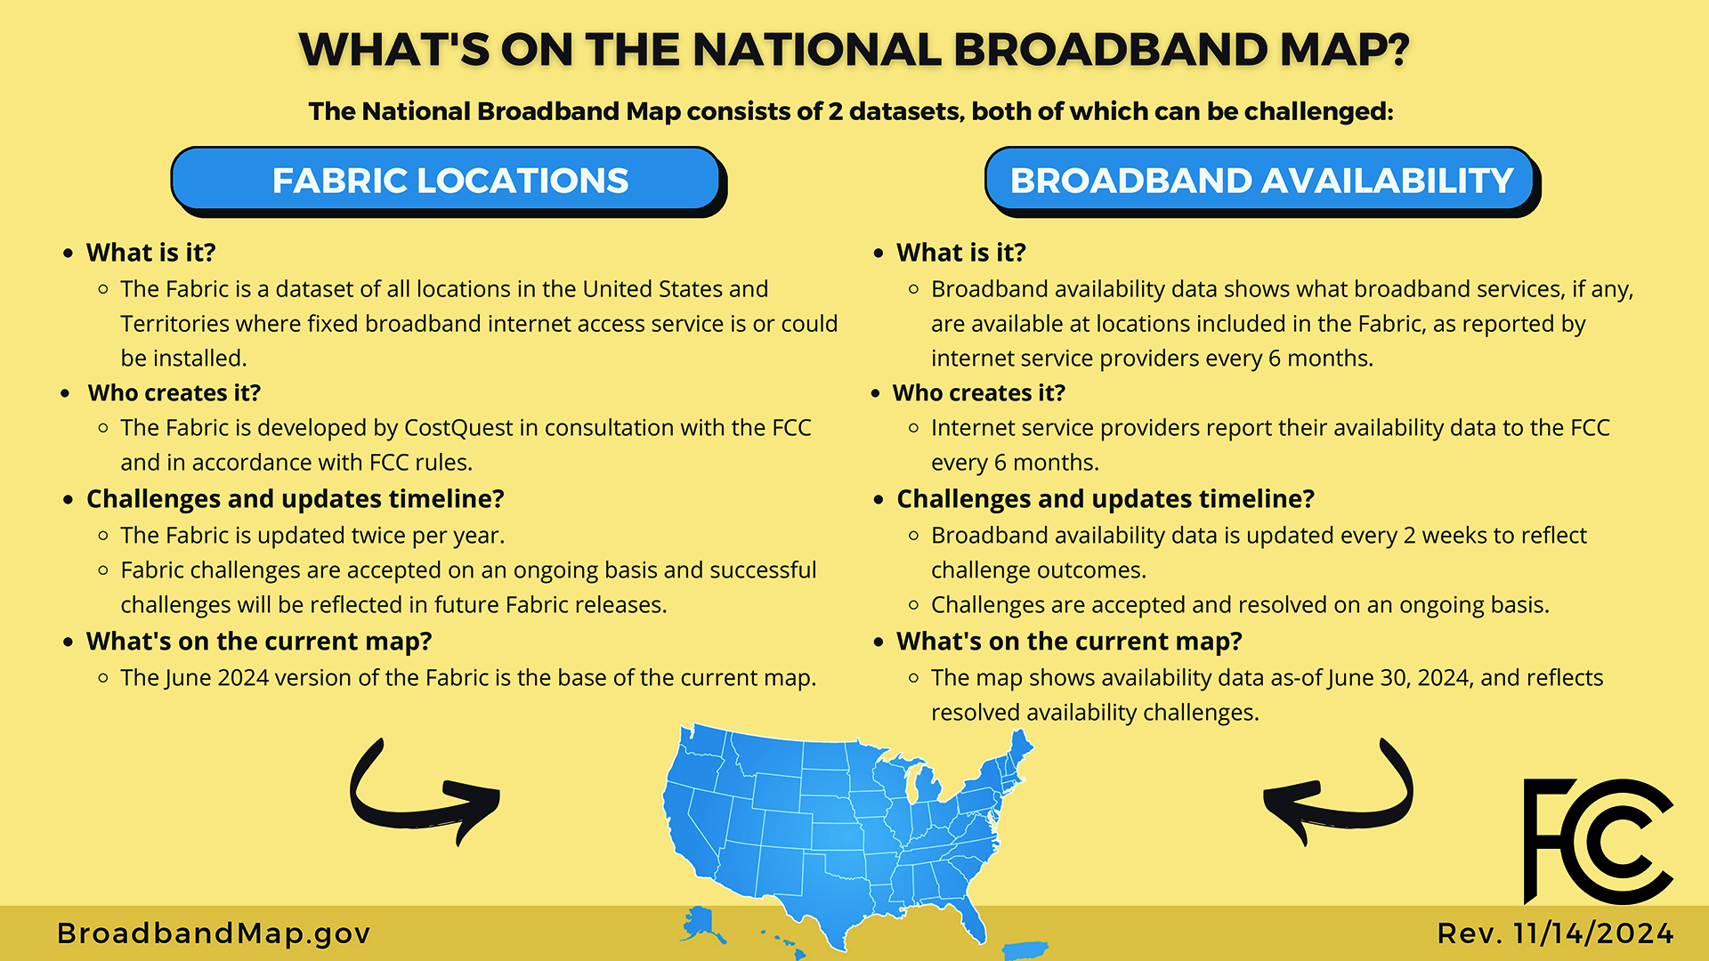

Slide 4
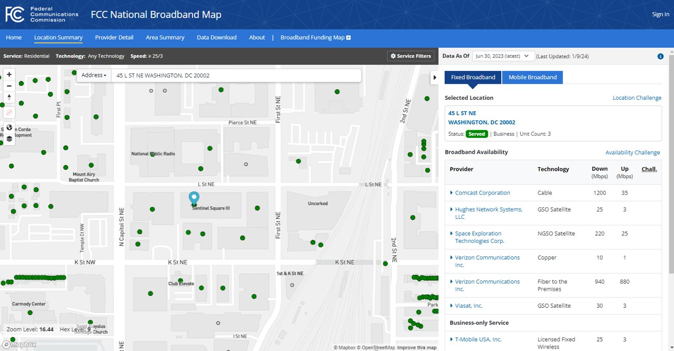
National Broadband Map:
Location Challenges
Location points are part of a dataset called the Broadband Serviceable Location Fabric.
What can be challenged?
Wrong address
Wrong unit count
Wrong placement on the map
Misidentified as non-Broadband-Serviceable
Missing location

Slide 5
National Broadband Map:
Availability Challenges
Fixed broadband service is “available” at a location if the:
provider has, or previously had, a connection in service to the location.
provider could initiate service through a routine installation within 10 business days of a request with no extraordinary charges or delays attributable to the extension of the provider’s network.

Slide 6
Validating Provider Reported Data
  Challenges
    Over 5 million sent to providers for response
    The map is updated on a rolling basis every two weeks as challenges are resolved
  Verifications and Audits
    FCC has conducted over 1,000 verifications
    Often results in corrections to reported availability
    Conducting Mobile Coverage Audits in multiple states
  Enforcement
    Referrals to enforcement proceedings where it appears that “materially inaccurate or incomplete” availability information is “willfully, and knowingly, or recklessly” submitted.

Slide 7
Primary Active FCC Deployment Programs
Connect America Fund II
  Awards made in 2018 and as of September 30, 2024, CAF-II auction carriers have reported serving 595,919 locations (87% of total currently authorized locations)
Rural Digital Opportunity Fund
  Auction held in 2020, authorizations made in 2021 and 2022
  More than 98% of locations will be offered broadband at Gigabit speeds or higher.
Enhanced ACAM
  Designed to increase speeds to locations with existing service with a goal of providing 100/20 minimum speeds.
  Our first round of deployment data is currently being collected, and we should know more about progress in March.
Notes:
Fixed broadband service providers have reported coverage based on Census Blocks.
11,000,000+ census blocks in the U.S., which vary in size, especially between urban and rural areas.
No way to distinguish which locations within a census block are served.
Mobile broadband providers have reported by technology and based on minimum advertised speed or speeds consumers should reasonably expect to receive within the coverage area.
Lack of standardized reporting parameters prevents apples-to-apples comparisons of data among providers.
BDC=
Entirely new filing/data-collection system
Fixed broadband availability data down to the individual location
Mobile broadband availability data standardized across providers
Challenge process to identify and dispute data collected from providers
Incorporation of data from state, local, and Tribal governments
Crowdsource information to support verification efforts
Audits and enforcement

Slide 8
Broadband Data Collection: Resources
For More Information:
www.fcc.gov/BroadbandData

