Slide 1

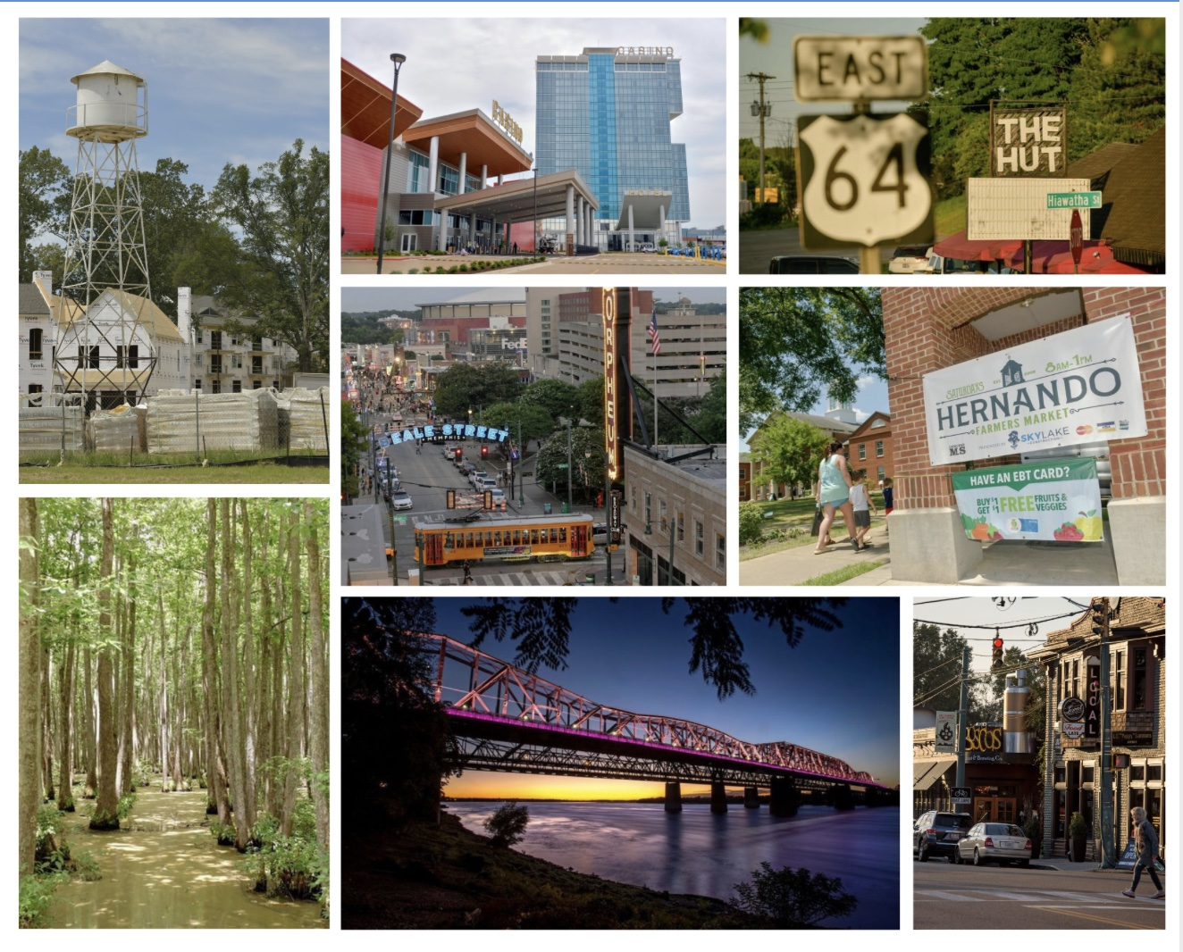
One Regional Team
National Association of Regional Councils
February 11, 2025

Slide 2
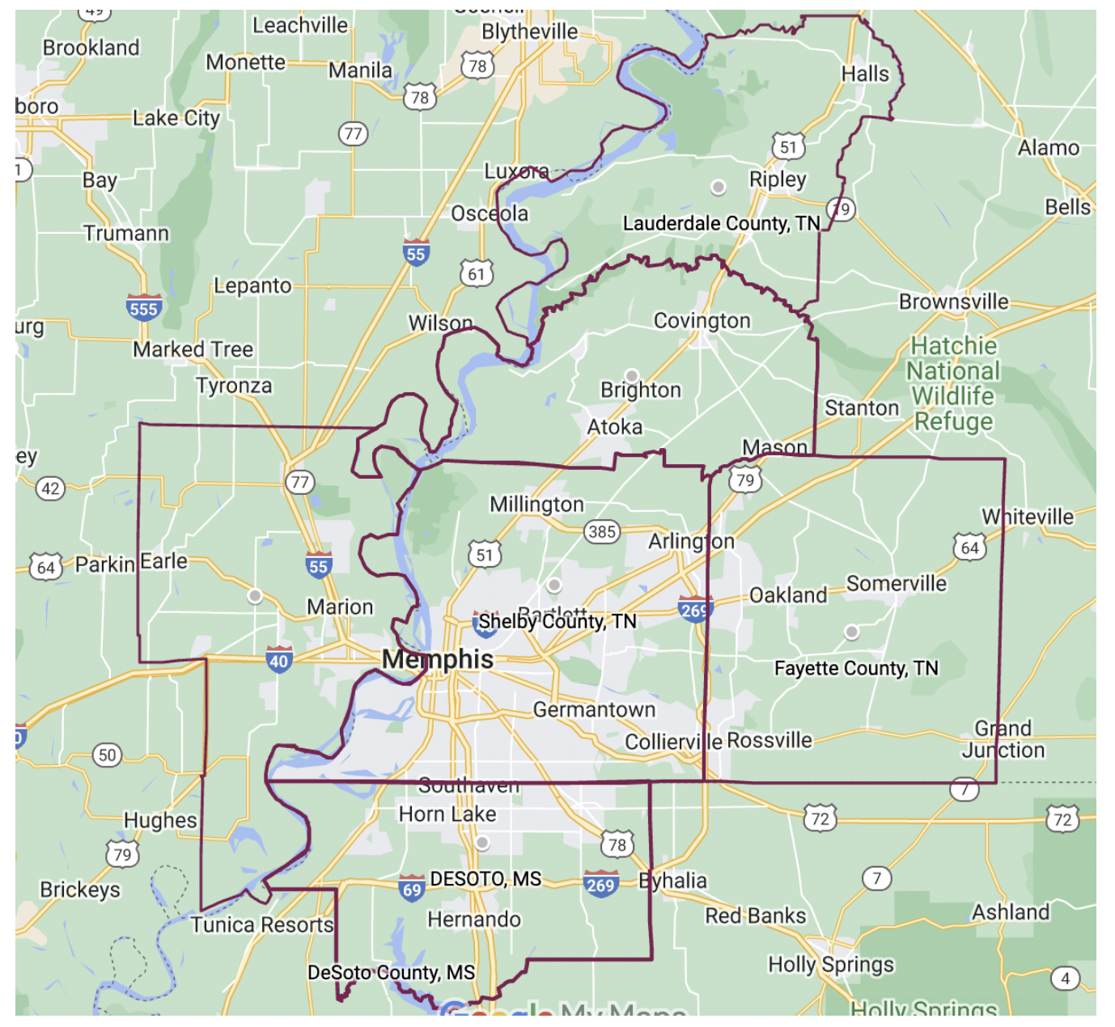

MidSouth Development District’s Tri-State Region

Slide 3

MidSouth Development District
Major organizational change since 2023
  Staff, budget, scope
Empowered by statute
  EDA Comprehensive Economic Development Strategies
  Regional Planning
  Rural Planning Organization
  Tourism: Destination Management Organization
  Solid Waste Technical Assistance
  TACIR Inventory
Merged other regional efforts
  Regional Summit
  Mid-South Mayors’ Council (founded in 2013)
Notes:
Services
Grant Writing & Administration
Research & Data
Marketing – Economic Development
Training
Transportation & Mobility
Regional Planning
MPO is not part of MDD, and is solely focused on transportation
Convenings
Board & Executive Committee (Regional Mayors)
Law Enforcement Roundtable (Police Chiefs)
Municipal Planners & Economic Development Staff
Federal Grant Writers
Tourism Advisory Board

Slide 4
Our Regional Opportunity
Unprecedented Engaged
Regional Mayors
CEDS: Regional Economic Development Plan:
Ford Blue Oval + Amplify Cellular Technologies + Steel + 2 Buc-ees
New Memphis Mayor with Regional Agenda
Move the Needle in the Memphis Region
Federal Infrastructure Dollars
Rebuilding the COG & the Development District

Slide 5
Focus Areas
  Housing
    Quality housing choices at all levels of the housing spectrum.
  Infrastructure
    Management of natural, human and manufactured resources for the social wellbeing of all community members – now and in future generations.
  Transportation
    Fluid and connected mobility options for multiple transportation modes
  Good Governance
    Elected and appointed officials have access to the training and tools they need to effectively do their jobs.

Slide 6
Housing Work
City of Memphis Housing Supply Accelerator Work
  Missing Middle, focused on increasing density
  Using HOME + LIHTC
  Addressing efficiencies in zoning and funding
Regional MDD overall approach
  Pending HUD Pro application, regulatory toolkit (planning and zoning guidelines) and pattern book
  Water and sewer infrastructure
Some specific approaches
  Workforce development related to construction industry
  Public-private models to rehab aging multifamily developments
  Home Repair Network

Slide 7


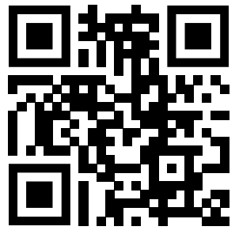
https://www.midsouthdd.org

Slide 8
MDD Federal Awards
MDD Federal Opportunities:
Awarded and Under Review
AWARDED
USDA NRCS - Regional Conservation Partnership Pilot | $ 21,250,000
DOT Safe Streets for All | $ 2,419,870
TOTAL AWARDED | $ 23,669,870
UNDER REVIEW
HUD PRO Housing | $ 2,449,299
EPA Brownfields Coalition Assessment | $ 997,592
EPA Brownfields Coalition RLF | $ 1,199,986
DOT RAISE/BUILD (Lakeland) | $ 25,000,000
DOT RAISE/BUILD (Hernando) | $ 612,000
TOTAL UNDER REVIEW | $ 30,258,877

Slide 9
Current Grants Awarded to Our Region: $32M
Organizational
MDD Contract Work (State & Federal)
MDD Operations
Community
Competitive Community
Regional
Pending Grants
$1.3 M
$ 855 K
$ 7 M
$24 M
$30 M

