Slide 1



50-State Transportation Funding Study
Amy Luft, COMPASS
Benjamin Perez, WSP
National Conference
of Regions
February 11, 2025
Washington, D.C.

Slide 2


Why
What
Results
Next Steps
How
Notes:
Amy

Slide 3
Why
Few local tools
Disproportionally low STBG funding for the Nampa Urban Area
No dedicated funding for public transportation
Fuel tax not keeping up
$193 MILLION ANNUAL SHORTFALL
Notes:
Amy Plant the seed of how we can build off of what we have done in the study to help this community to develop a greater understanding of regional transportation strategies and solutions.

Slide 4
Why
What
Results
Next Steps
How
Notes:
Amy

Slide 5
Our questions
What are other states doing?
What innovative ideas are out there?
What could generate the most revenue?
Are road usage charges a viable option?
Notes:
Amy

Slide 6





Local funding tools
Public transportation funding
STBG suballocation
Road usage charges
50 states
Notes:
Amy

Slide 7
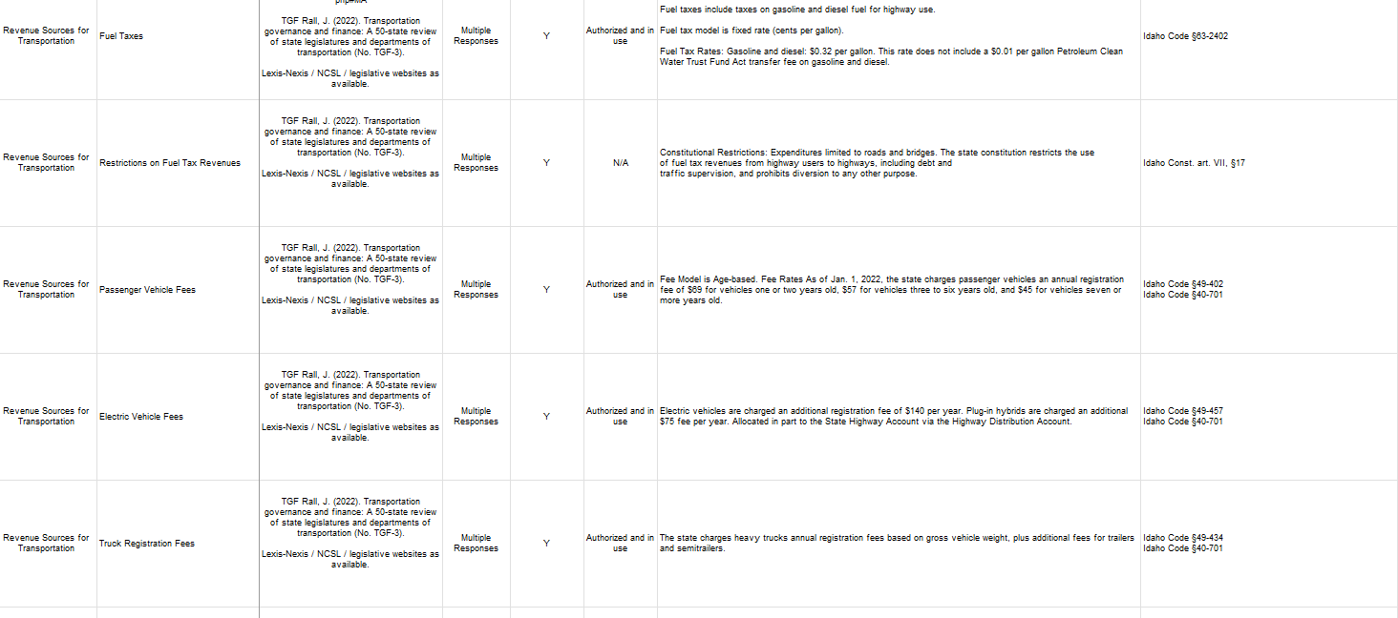
7 reports
>89,000 data points
Notes:
Amy

Slide 8
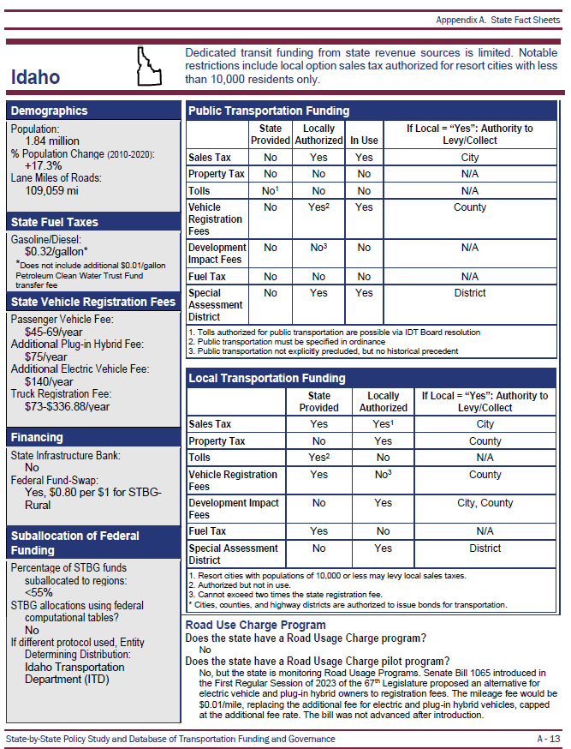
State Profiles

Slide 9
Why
What
Results
Next Steps
How
Notes:
Amy

Slide 10
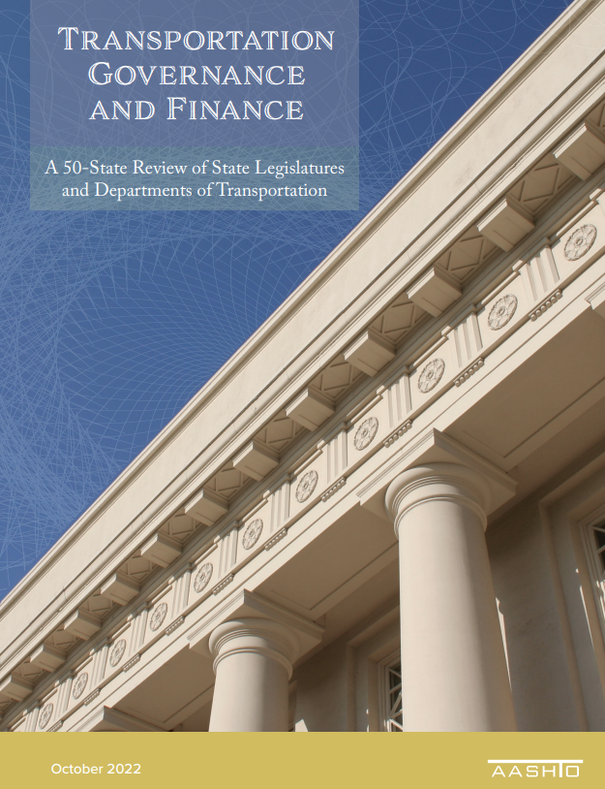
Methodology
Builds of off AASHTO’s Transportation Governance and Finance
Desktop research
LexisNexis legislative research
Incorporates industry knowledge from WSP’s national RUC practice
Notes:
Ben

Slide 11

Methodology
Documents:
Transportation Networks
Demographic Trends
State Revenue Sources /
Restrictions / Citations
Local Revenue Sources / Restrictions / Citations
Public Transit Revenue Sources/ Restrictions / Citations
Finance Mechanisms
Transportation Expenditures
Notes:
Ben

Slide 12
STBG Suballocation Methodology
Captured previously unavailable information through a pioneering survey of state DOTs
Obtained information on STBG suballocation practices from 47 states through direct outreach to DOT CEOs
Provides new insight on the collaborative approaches states are using to suballocate STBG funding
Achieved a 94% response rate
Notes:
Ben

Slide 13
Why
What
Results
Next Steps
How
Notes:
Amy

Slide 14
Local funding tools
Public transportation funding
STBG suballocation
Road usage charges
Notes:
Ben

Slide 15
Local funding tools
Local funding tools
Revenue source | Unit | National Average
Local Sales Tax | % of sales | 2.1%
Property Tax | % of property value | 1.06%
Real estate transfer tax | % of property sale price | 1.04%
Local registration fees | $ per vehicle / year | $25.00
Development impact fee | $ per unit | $4,200
Local Fuel tax | $ per gallon | $0.07
Local Vehicle Excise Tax | $ per vehicle / year | $36.00
Local Vehicle Sales Tax | % of vehicle sales price | 2.25%
Local Income Tax | % of gross annual income | 1.38%
Hotel tax | % of hotel revenue | 5.00%

Slide 16
Most common local funding tools
Taxes
Property tax – 42 states
Fees
Vehicle registration
Impact
Notes:
Ben
Maybe something else here, since this may be covered in the previous slide

Slide 17

Public transportation funding trends
More flexible state transportation funding
  Plan and fund more holistically
More state public transportation funding
Local public transportation funding often used to augment state funding; not “either/or”
Many nuances
Notes:
Ben
Maybe add more detail to the trends, nationwide

Slide 18
Public transportation
State funding; allows local | State funding; does not allow local | Allows local; no state funding | Little to no state funding; does not allow local
Most | Georgia Tennessee | Alabama Alaska Arizona Montana New Hampshire North Dakota Oklahoma South Dakota Wyoming | Idaho West Virginia
37 | 2 | 9 | 2
Not cut and dried: nearly every state has nuances
Notes:
Ben
Maybe elaborate on some of the nuances and how they play out

Slide 19
Surface Transportation Block Grant (STBG)
1 of 9 core federal funding programs
23% of federal-aid highway funding
The most flexible federal-aid highway funding
A portion suballocated to regions
Notes:
Ben
Maybe add more detail to the trends, nationwide

Slide 20
STBG Suballocation
State vs region
55% minimum to regions
45% anywhere in the state
Computational tables
Recommended; not required
Transparent; easy
Wide variety in interpretation and practice
Amounts to suballocate per region
Notes:
Ben

Slide 21
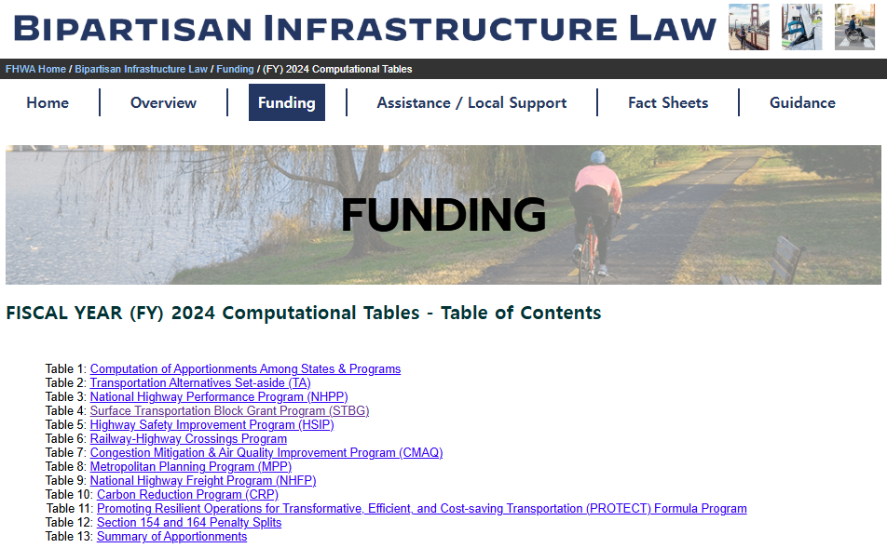
FHWA Computational Tables

Slide 22
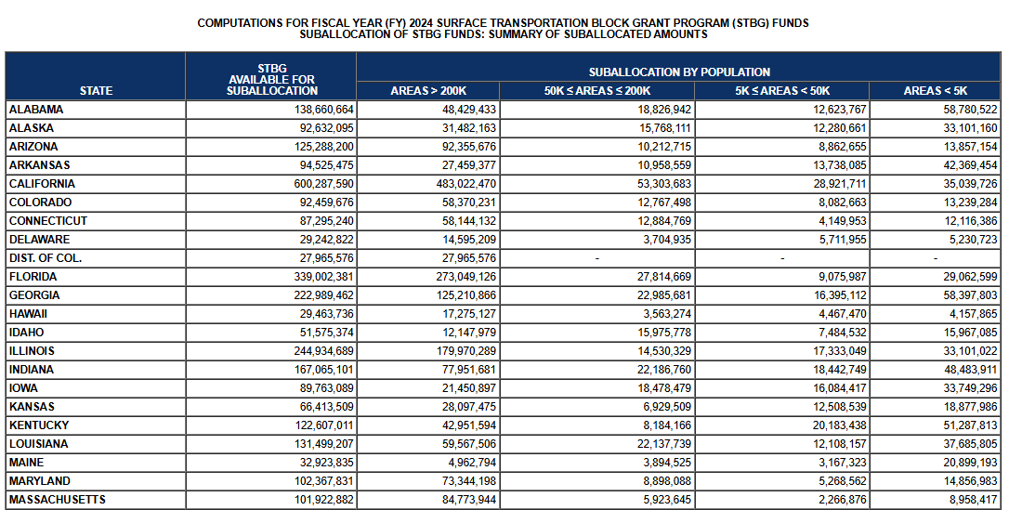
FHWA Computational Tables

Slide 23
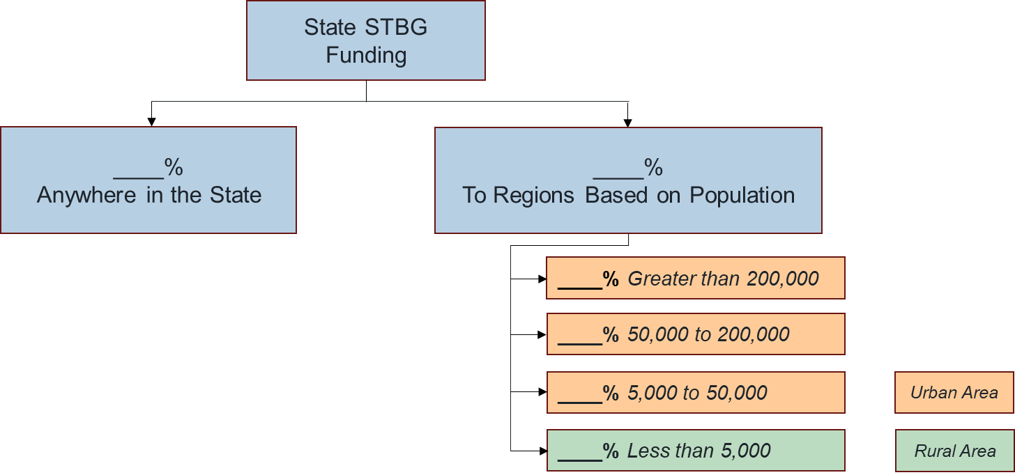
STBG Suballocation
State STBG
Funding
__%
Anywhere in the State
__%
To Regions Based
on Population
___% Greater than 200,000
___% 50,000 to 200,000
___% 5,000 to 50,000
Urban Area
___% Less than 5,000
Rural Area

Slide 24
STBG survey questions
Does your state suballocate per the FHWA Computational Tables?
Does your state suballocate “directly” to local governments or does the state DOT use the funding on state projects in local regions?
Who has project selection / management authority for projects receiving STBG funding in your state?
Notes:
Ben
Maybe add more detail to the trends, nationwide

Slide 25
STBG suballocation split
Notes:
Ben
Range from 90% (Illinois) to 28% (Montana)
Discuss what it means when they don’t suballocate at least 55%
States more likely to suballocate in larger regions and spend funding on state projects in smaller
Ultimately about who makes the decisions.
Bring in more of the nuance that is in the report

Slide 26

Suballocate vs spend $
Subject to interpretation
Project selection
Collaborative
Notes:
Ben

Slide 27
Road usage charge (RUC)
Pay based on miles driven instead of amount of fuel purchased or flat fee
Offset decreased revenues due to EVs and other fuel-efficient vehicles
3 active programs (+ Hawaii in 2025)
Multiple pilot programs
Notes:
Ben

Slide 28
Current US RUC Activity
Legislatively Authorized Active RUC Programs
Pilot(s) Completed
Feasibility/Planning Study Completed
RUC Coalition Member
No RUC Activity
Notes:
Ben
(Check = have done pilots; circle = pilot ongoing)

Slide 29
RUC programs
Utah
2020
Est. $600,000 annual gross rev
Oregon
$0.017 per mile
Voluntary
Virginia
2022
Vehicles >20 mpg
4,088 enrolled
EVs/hybrids
Choice: Flat fee or RUC; lesser of the two
$0.0152 per mile
2015
Est. $240,000 annual gross rev
1,000 enrolled
Est. $1 million annual gross rev
21,000 enrolled
EVs and other vehicles >25 mpg
Rates vary based on fuel efficiency
Choice: Flat fee or RUC; lesser of the two
Notes:
Ben – lots of nuance
Oregon – Reimbursed for fuel tax
increase in fuel tax = increase in RUC
Utah- instead of increased registration fee. Still pay fuel tax.
Virginia – flat fee (extra registration) and rate based on what you would have paid for average gas tax.
Hawaii to start in 2025

Slide 30
Key Takeaways

Slide 31
Takeaways
Local Funding
Property tax most common
Property tax, sales tax, and income tax = highest revenue
Public Transportation
Extremely nuanced; every state is unique
Trends toward more funding and more flexibility
Notes:
Amy

Slide 32
Takeaways
STBG Suballocation
Most states use computational tables
DOTs report collaborative processes
Offset / replace declining gas tax
Providing options is key to public acceptance
Expensive to implement
Who selects the projects?
RUC
Notes:
Amy

Slide 33
Why
What
Results
Next Steps
How
Notes:
Amy

Slide 34
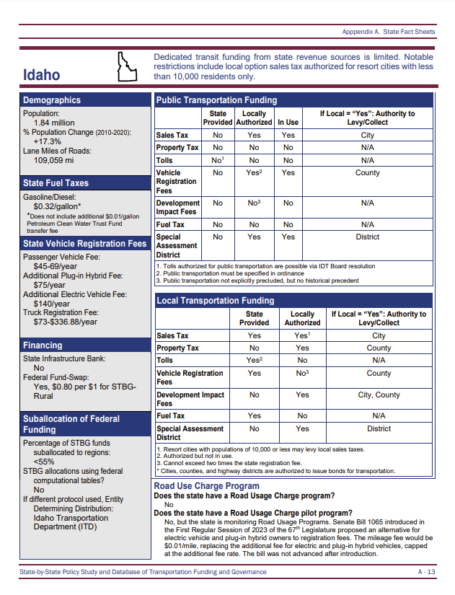
Now what?
Share report
  1-page summaries
Advocate
Dive deeper into innovative ideas
More research?
Update?
Interactive web interface?
Notes:
Amy

Slide 35

Questions and Audience Discussion
What would be most helpful for you?
How would this information be helpful to you?
How do our findings align with what you see in your state / region?

Slide 36


Contact Information
Amy Luft
aluft@compassidaho.org
(208) 475-2229
Benjamin Perez
benjamin.perez@wsp.com
(212) 613-8804

