Slide 1

Dissecting the State Transportation Labyrinth
An inventory of state accountability practices—and what those results mean for federal reauthorization
November 2024

Slide 2
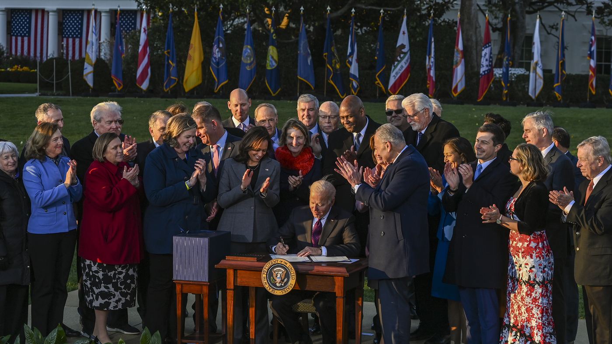
Notes:
President Biden signed the IIJA into law in November 2021, approving more than $850 billion in new infrastructure spending.
In 2024 alone, USDOT sent $61 billion to states via formula – 42% of agency spending.
States are also investing enormous amounts of their own funds into their transportation network. In 2019, states raised about $145.8 billion in own-source revenues.

Slide 3
Are states transparent with how they plan and invest in transportation assets?
How much do states share planning and fiscal resources with their local partners?

Slide 4
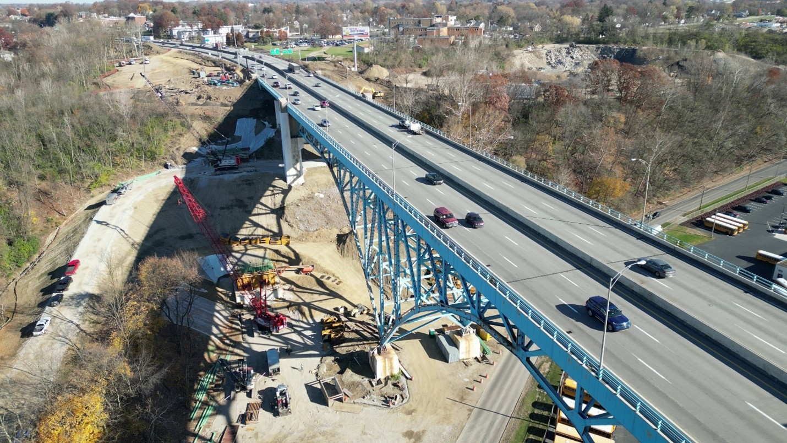
Background
States play a prominent role in this historic federal moment, but their plans and processes are difficult to understand, and comparison is challenging
Objective
State Transportation
Assessment
Map state approaches to planning, budgeting, and project selection, tracking successful and pro-local policies
Create air cover for those pursuing state accountability and support for regional and local needs

Slide 5
Background
States play a prominent role in federal investment, but their plans and processes are difficult to understand and national comparison is challenging
Objective
State Transportation
Assessment
Inventory state approaches to planning, budgeting, and project selection, tracking accountable and pro-local policies
Create air cover for those pursuing state accountability and support for regional and local needs

Slide 6
Long Range Planning
States have clear goals, but measuring progress toward those goals is often imprecise and inaccessible

Slide 7
80%
LRTP goals go beyond federal goal areas
92%
LRTP goals include implementation steps
18% 63%
LRTP goals include performance measures
20% 65%
Data on those performance measures are publicly available
Yes
Partial
Notes:
We found that states generally plan well. Vast majorities of DOTs include goals beyond those federally required, and even more include some strategies or actions they’ll take to implement those goals. However, states generally fail to build in accountability to their plans.
Examples:
Goals: Minnesota and Washington state actually put their transportation goals in statute
Implementation: Maryland and Kentucky both produced lists of specific steps to implement their long-range plans, including the agency or department responsible for each action
Implementation: Caltrans has a website tracking progress for each implementation action
Performance measurement: Rhode Island includes 20-year targets for each performance metric
Performance measurement: Missouri's performance tracker website lets the public understand where the agency is and isn't meeting its targets

Slide 8
Statewide TIPs
States take advantage of weak regulations to make investments that are detached from long-range goals
Notes:
Stress: We didn’t qualify the “good” examples as perfect. Instead, each of these do something that’s admirable and replicable.

Slide 9
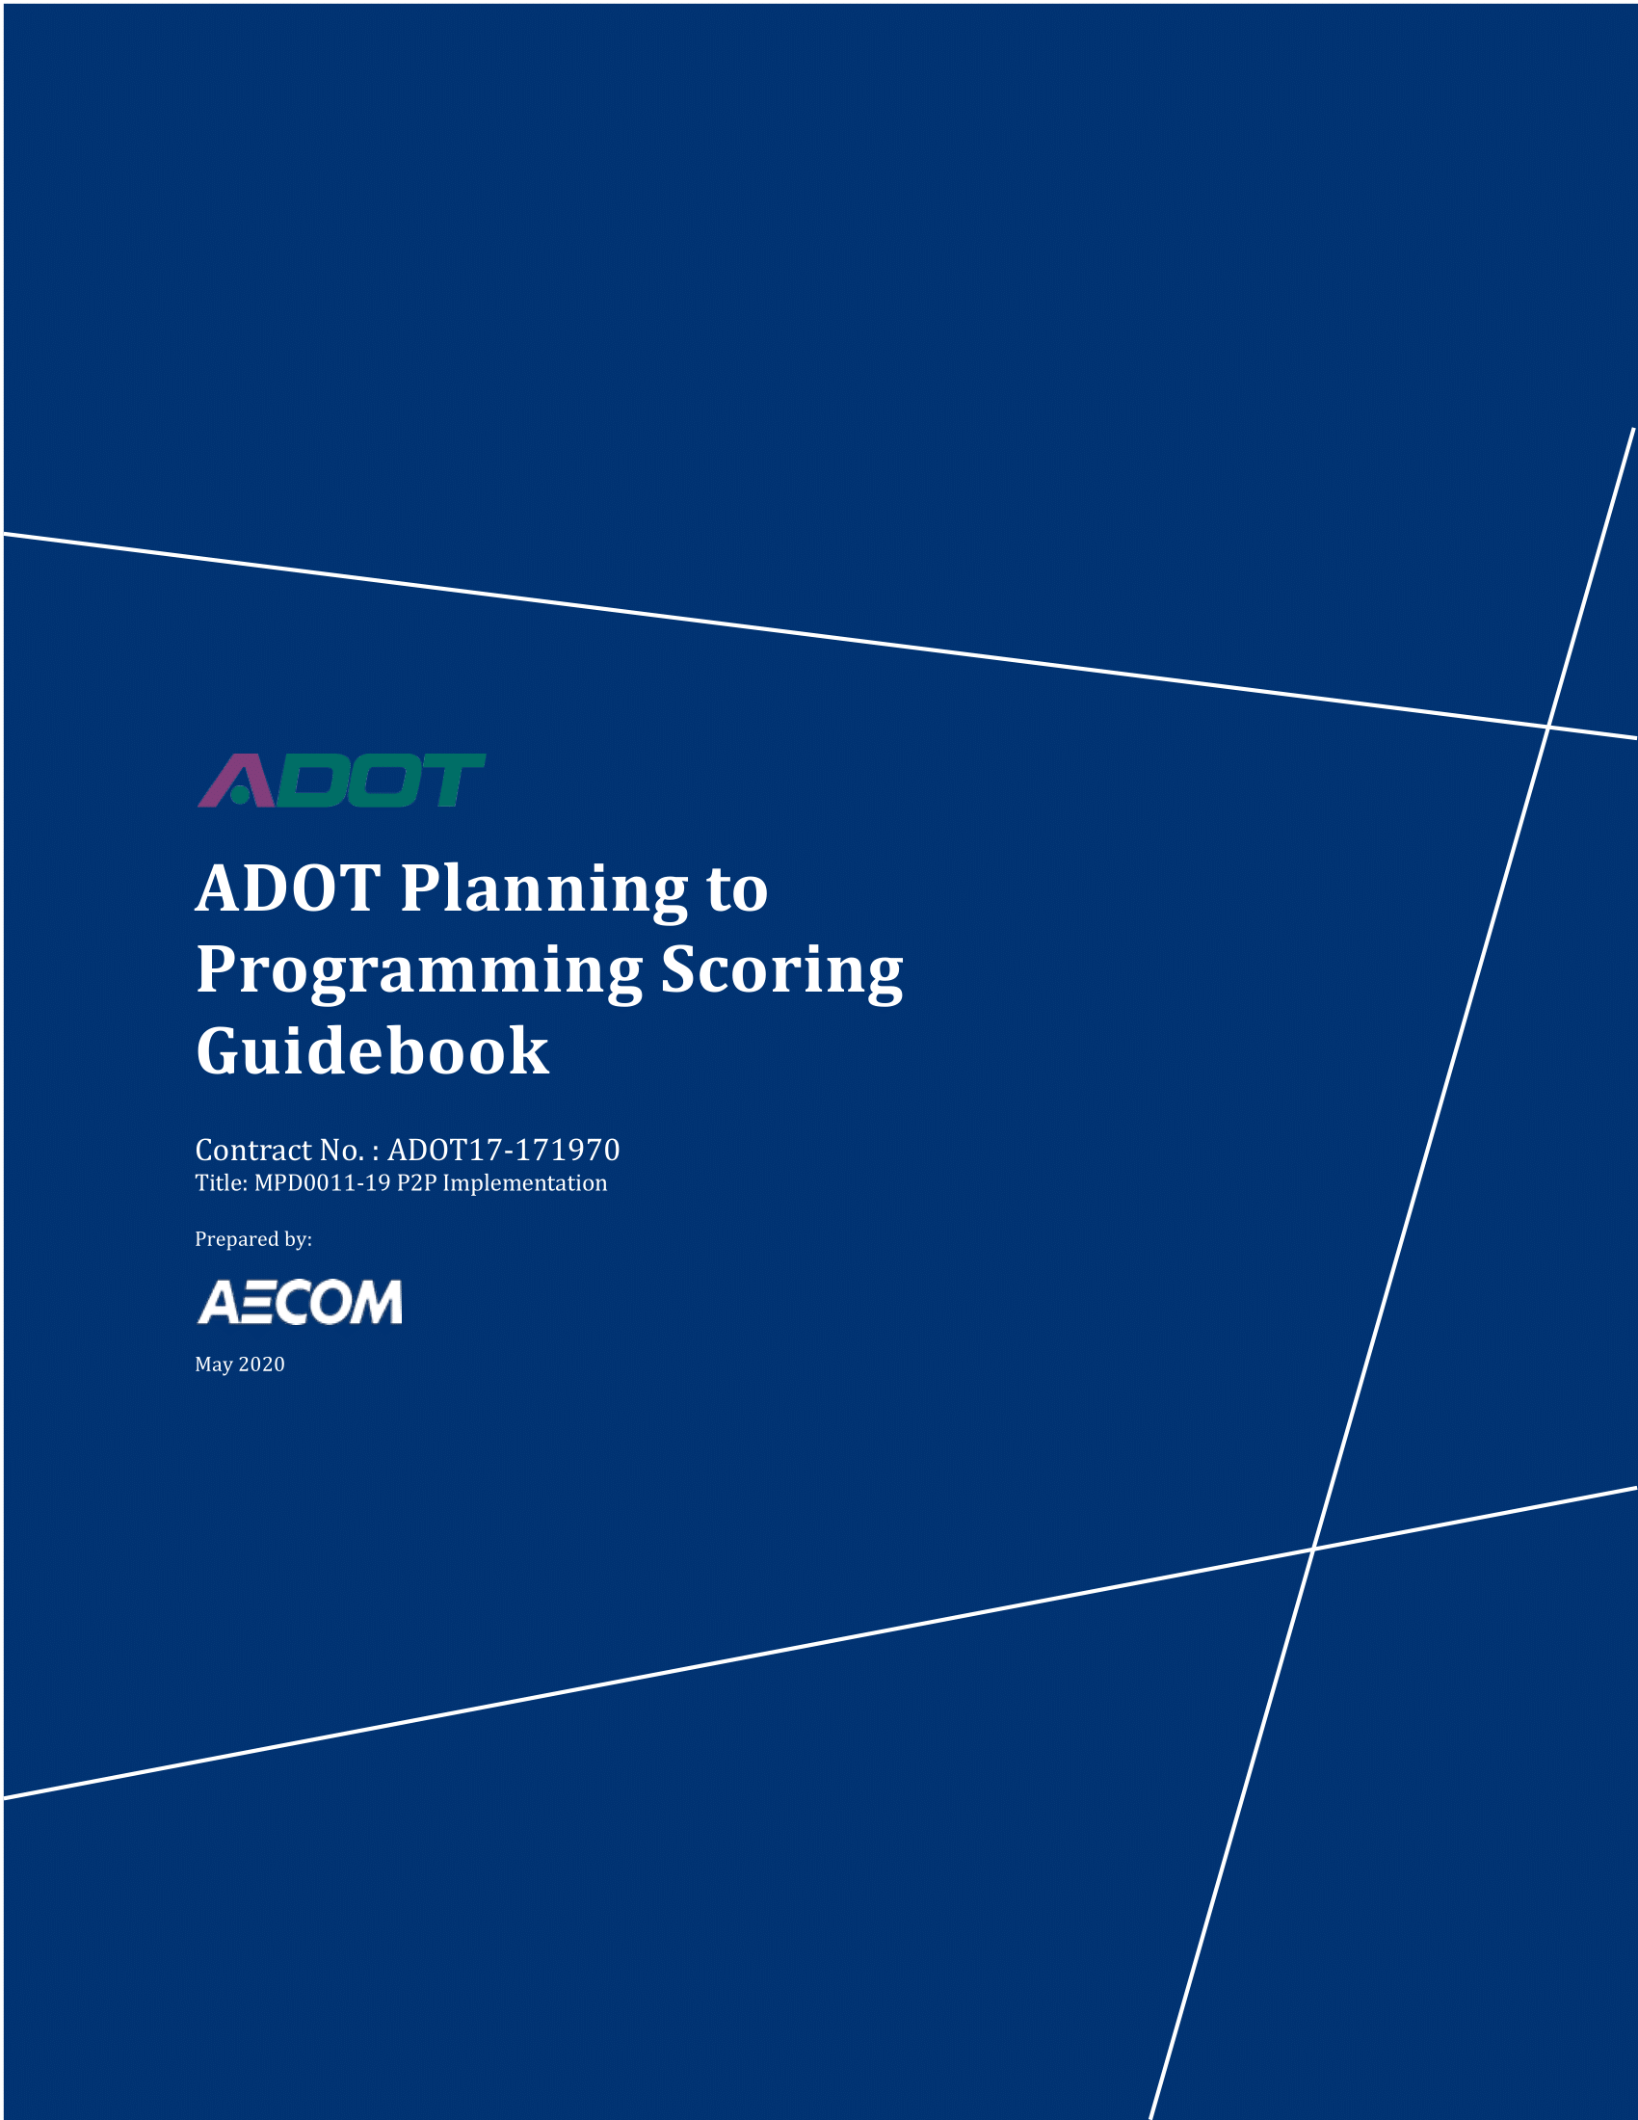
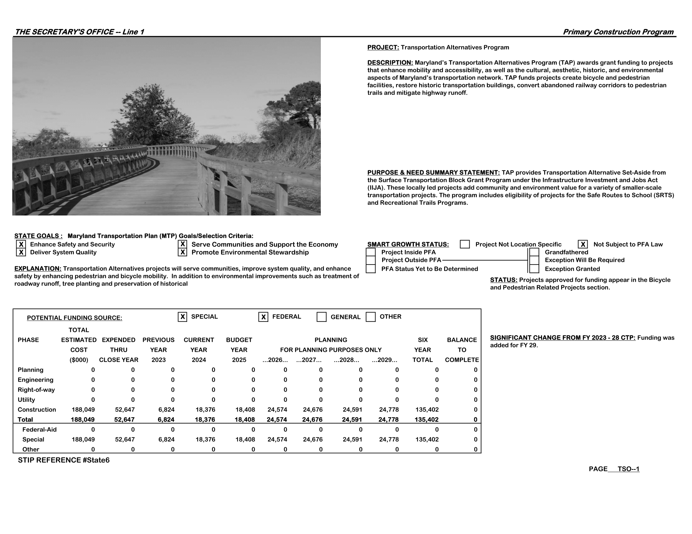
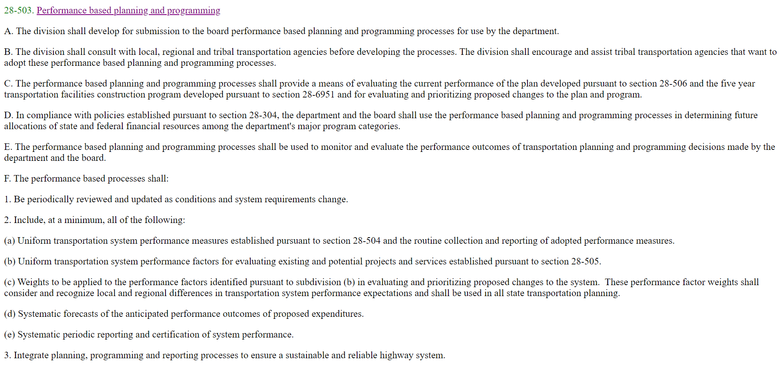
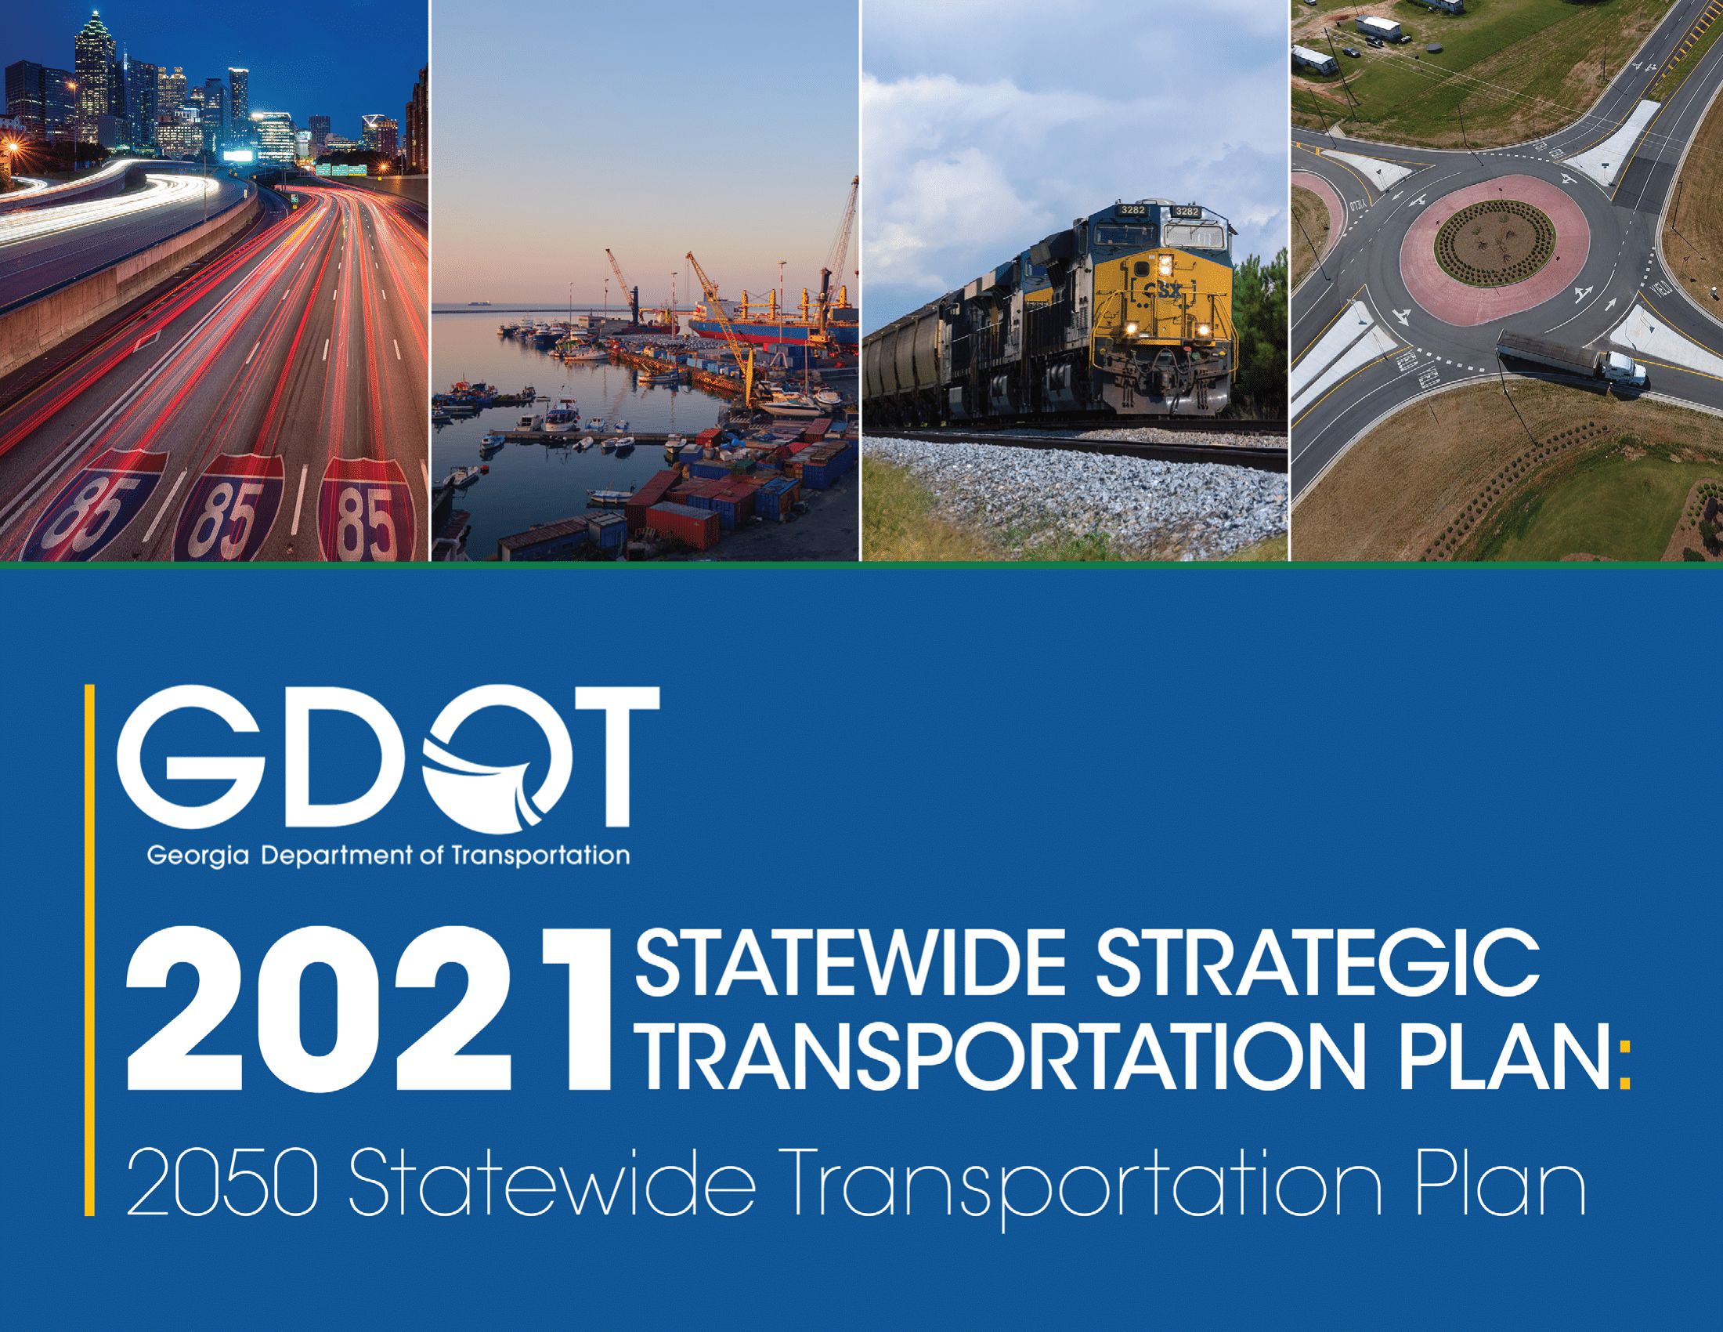

43%
publicly connect long- range planning to their STIP or capital plan
Notes:
Less than half of states have a process, plan, or strategy that meaningfully connects long-range planning to capital planning. This makes it difficult for stakeholders, not just the general public, to understand what motivates state investment decisions
Examples:
Arizona state code requires clear prioritization criteria, based on their long-range goals, when selecting projects on the state highway system
Georgia DOT creates an investment strategy based on their long-range plan every time the LRTP is updated
Maryland DOT lists which long-range plan goals each major project in their capital plan will advance

Slide 10
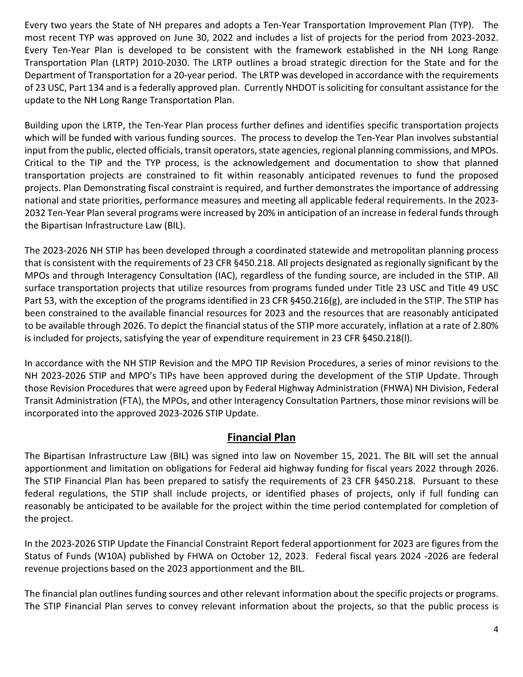
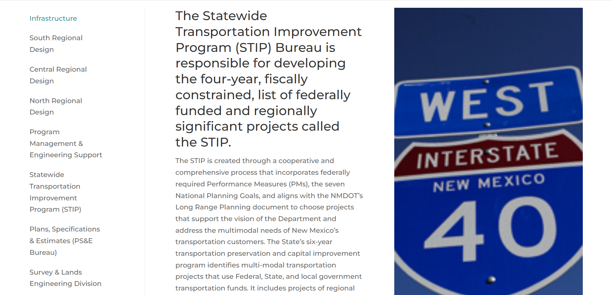
45%
reference their long-range planning in their STIP or capital plan
“Every Ten-Year Plan is developed to be consistent with the framework established in the NH Long Range Plan Transportation Plan (LRTP) 2010-2030.”
“The STIP is created through a cooperative and comprehensive process that […] aligns with the NMDOT’s Long Range Planning document.”
Notes:
Most of the states without a public process (as described in the previous slide) reference their long-range planning in capital plans. This is federally required. The examples from New Mexico and New Hampshire show that these references are often cursory – and their capital plans lack the detail to confirm the stated LRTP-STIP connections
Example:
New Mexico says that their STIP incorporates federal goals and performance measures and aligns with their own state long-range plan, but they don’t show their work
There’s no project evaluation criteria and project in the STIP aren’t connected to long-range goals

Slide 11


29%
have some public project selection process
Notes:
Most transportation stakeholders know about SMART SCALE, but nearly 1/3 states have some project selection process.
Example:
Kentucky’s SHIFT process is a public system that lets them compare capital projects in a constrained environment by splitting out maintenance work, local government projects, and dedicated federal work.
Their evaluation criteria and project scores are available on their website
Whether the system delivers remains to be seen

Slide 12
6%
say when projects were added to their STIP
Notes:
This enables so-called “zombie projects,” projects prioritized in state plans so long ago that the original justification is no longer relevant

Slide 13

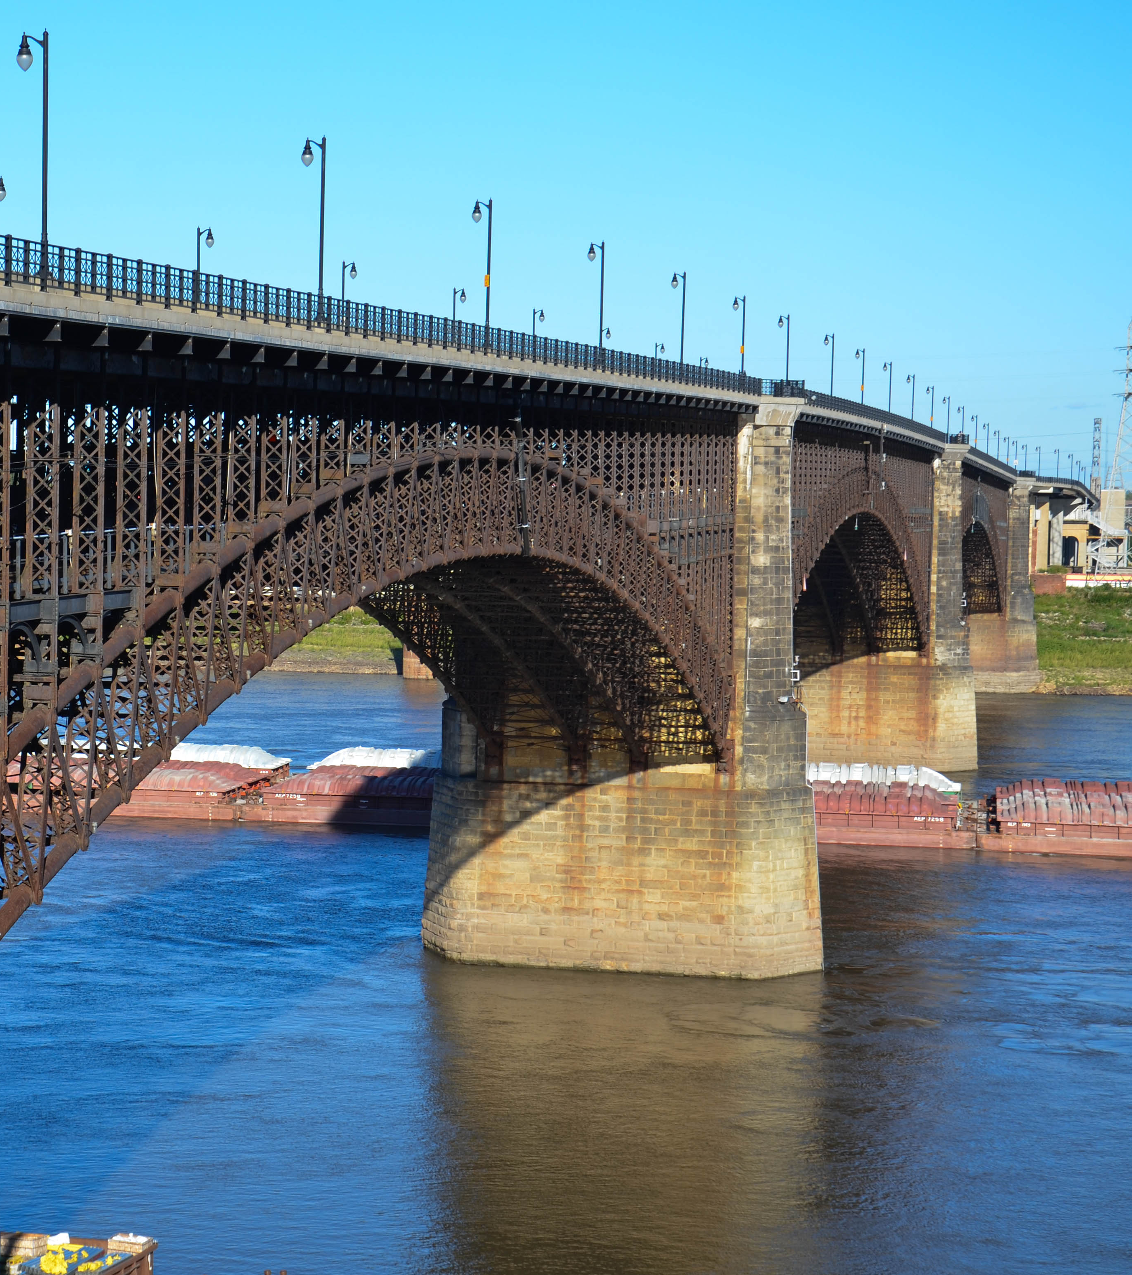
100%
Select projects using asset management principles
Notes:
When the feds make a policy, it works!
Though states are generally in deficit in their justifications of investments and project selection processes, the asset management requirements of MAP-21 have made these principles core to DOT operations.

Slide 14
Approach to Localities
States rarely plan or invest in ways that meet the needs of regional and municipal partners

Slide 15
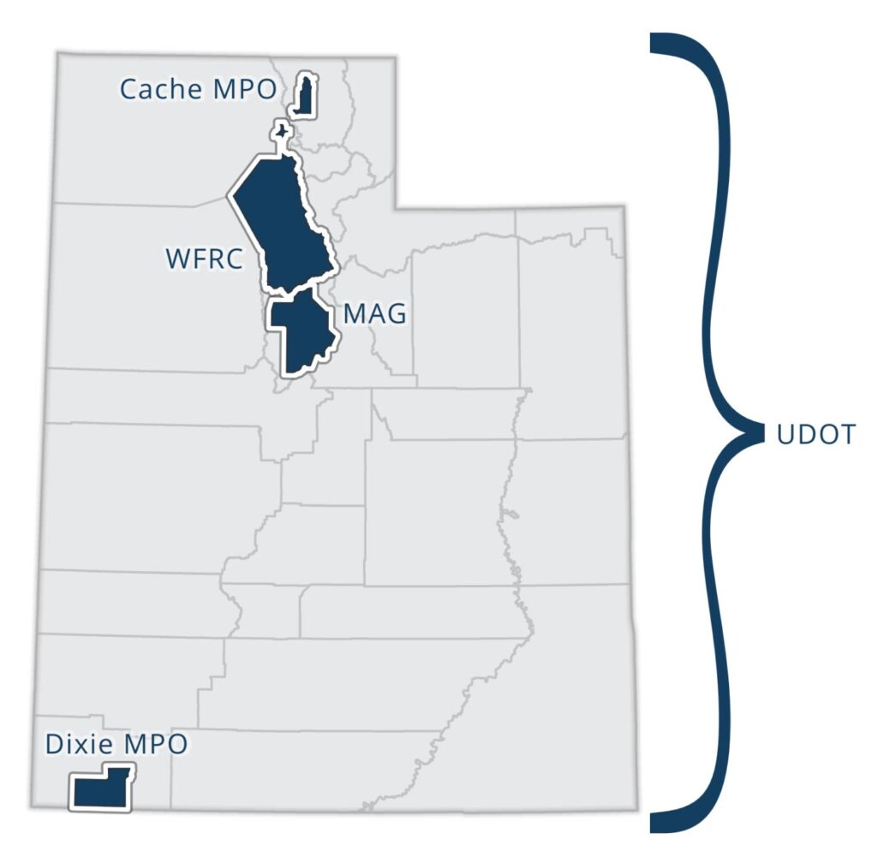
84% collaborate with MPOs on LRTPs in some way
4% draw on MPO project priorities
Notes:
Federal law requires collaboration with MPOs, so we judge whether states effectively incorporate the project priorities of their MPOs.
Only 2 states do this: Utah and Colorado
The remaining states just describe meetings, stakeholder committees, and other ways by which their DOTs communicate with MPOs
As many of you experience, this can be one of the more troubling areas in terms of states throwing their fiscal and legal weight around, pushing MPOs to adjust their LRTPs based on the state’s own goals
Example:
Utah uses a long-range planning process that relies on their MPOs, DOT, and transit agency to generate a long-term, prioritized list of projects using regional recommendations

Slide 16
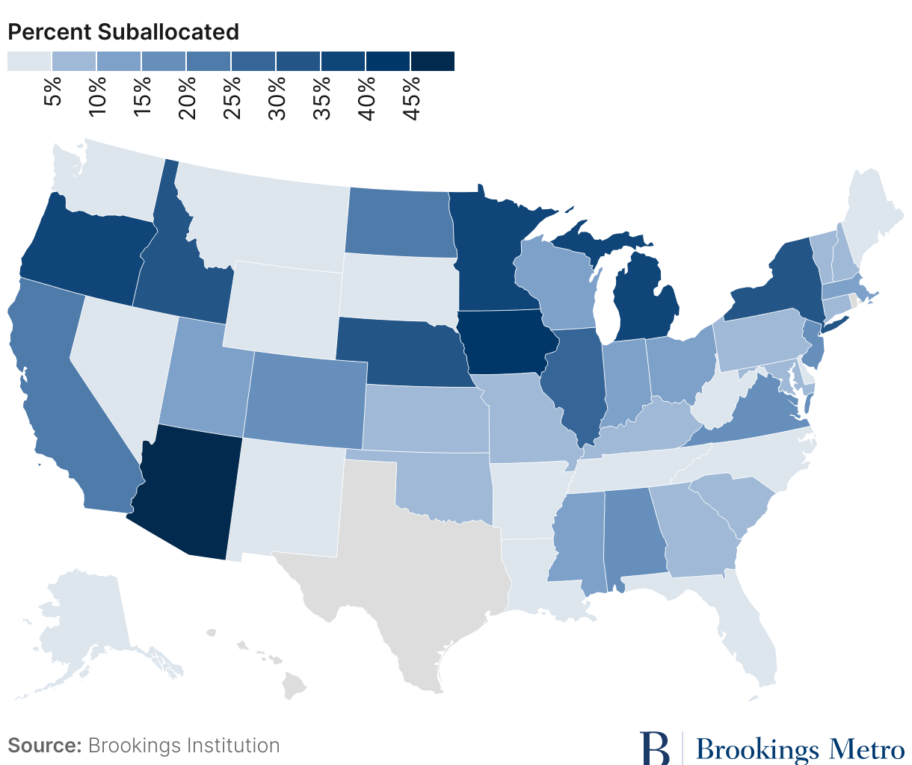
14%
amount suballocated in a state DOT’s budget
average
Notes:
It’s clear that a few outliers pull that average up significantly
(For Rob: we define suballocation as money given directly to regions, cities, counties, and so forth which they have true discretion over)

Slide 17
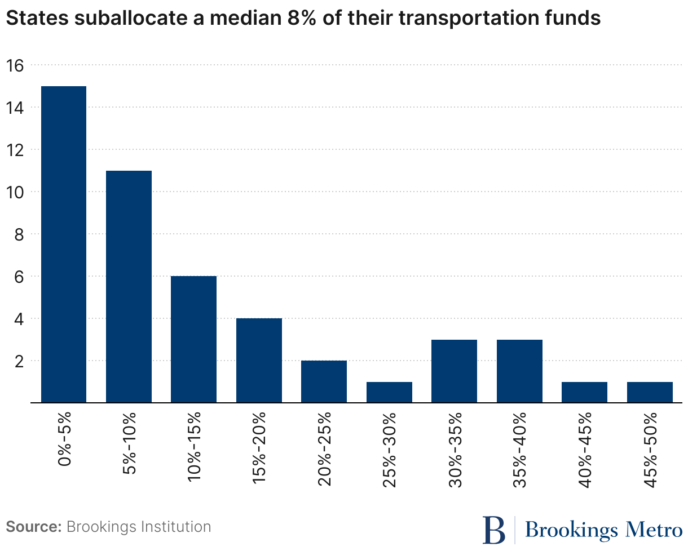
Count of states by suballocated funding share
8%
amount suballocated in a state DOT’s budget
median
Notes:
In contrast to a 14% average, the median state suballocates about 8% of their budget. Essentially, states hold on tightly to their federal and own-source revenues.

Slide 18
Public Involvement
States can do more to educate nongovernmental stakeholders and enhance their participation in transportation planning and investment

Slide 19



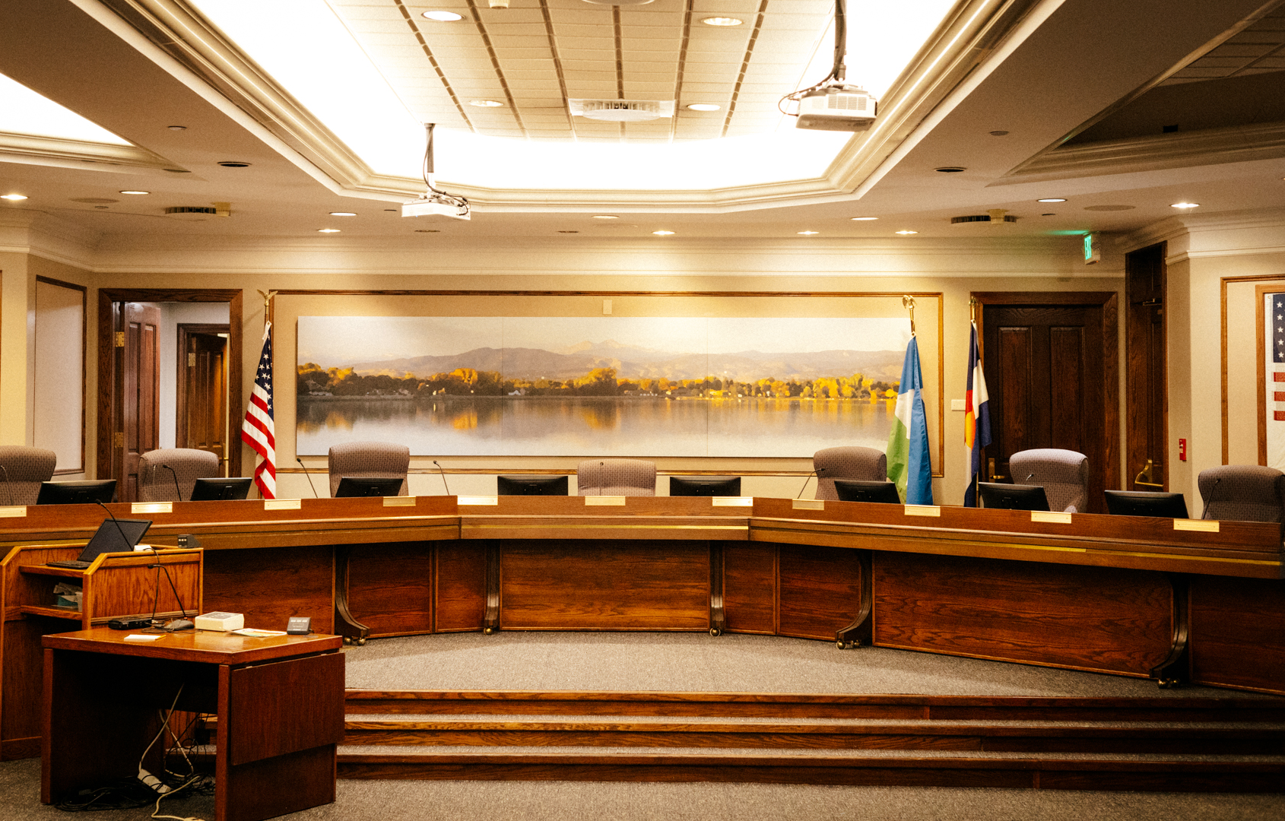
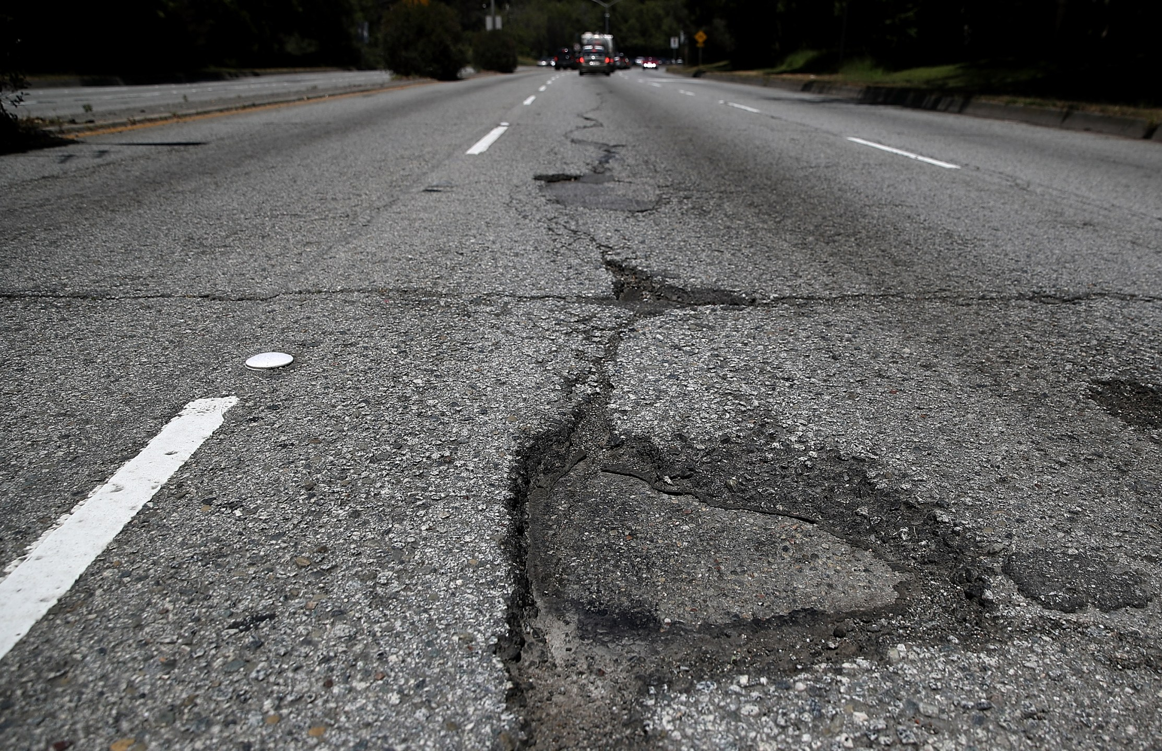
Portal to submit climate-vulnerable infrastructure?
Portal displaying programmed projects?
Does the state have a…
14% 18%
86% 10%
Visual explaining planning and programming processes?
Granular geospatial dataset of pavement and bridge condition?
Public involvement portal?
45% 33%
37% 53%
43% 33%
Notes:
Key highlights: states generally succeed at visualizing their projects for thepublic, but fail to make asset-level condition data for both bridges and pavement available. Without that data, it can be difficult for the public to understand the state's needs.
(For Rob: the number on the left shows the proportion of states with each resource, while the number on the right shows how many states have an incomplete, or less than satisfactory, version.)

Slide 20
Independent Bodies
Most states establish commissions, but their governance structures and legal authority vary widely

Slide 21
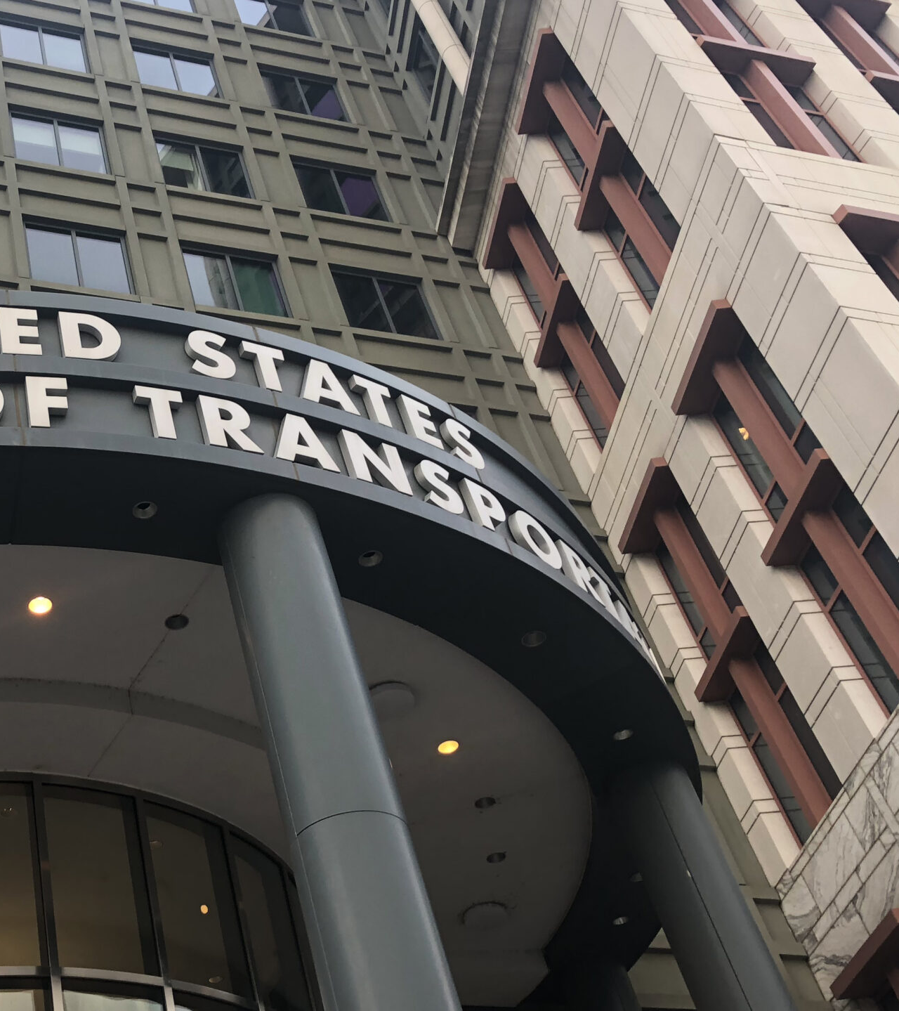
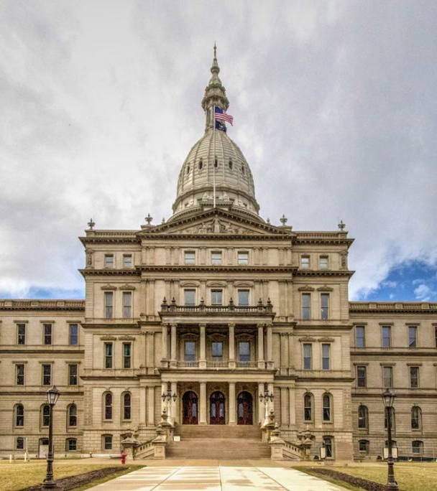
67%
78%
of state DOTs have some independent body that informs or approves their statewide plan
of state legislatures have an independent body that advises their spending
Notes:
In several states, the independent body that informs or approves the statewide plan is not permanent, but is instead convened when the plan is due to be updated

Slide 22
Recommendations

Slide 23




Recommendations |
Congress
Increase direct regional and local funding via formula
Require every STIP to include clear project selection methods
Improve LRTPs via implementation plans and req’d local partnerships
Improve LRTPs via implementation plans and req’d local partnerships
Widen TAMP laws to monitor all roadways
Notes:
The legislative mechanisms for each of these recommendations vary significantly.
For example, US Code governing asset management already requires states to monitor their own assets – we propose a simple expansion to include local roadways.
However, an increase in direct regional and local funding could mean expanded suballocation of current programs, or new programmatic funding entirely.

Slide 24

Recommendations |
Governors and State Legislators
Increase direct regional and local funding via formula
Require every STIP to include clear project selection methods
Improve LRTPs via implementation plans and req’d local partnerships
Push for the creation of independent commissions
Improve LRTPs via implementation plans and req’d local partnerships
Notes:
The recommendations for state legislators are nearly the same as those for federal, because states have the authority in so many cases to proactively improve their own processes – the only change is our recommendation that states create independent commissions for increased accountability and engagement.
Our report gives examples of peer states that are succeeding in nearly all of these areas.

Slide 25


Recommendations |
State DOT Officials
Enact a grand bargain: locals gain more project selection authority; states lead more on project construction
Update public-facing communication practices
Monitor and report locally-owned asset quality
Notes:
There may be political will for a “grand bargain."
We believe locals need greater discretion to choose projects that serve their residents, communities, and regions
At the same time, state DOTs have proven their ability to manage funds, bid, contract, engineer, and crucially, build
Allowing state DOTs to lead on construction of locally selected projects may address the issues of state-local collaboration

Slide 26
Dissecting the State Transportation Labyrinth
An inventory of state accountability practices—and what those results mean for federal reauthorization
November 2024

Slide 27
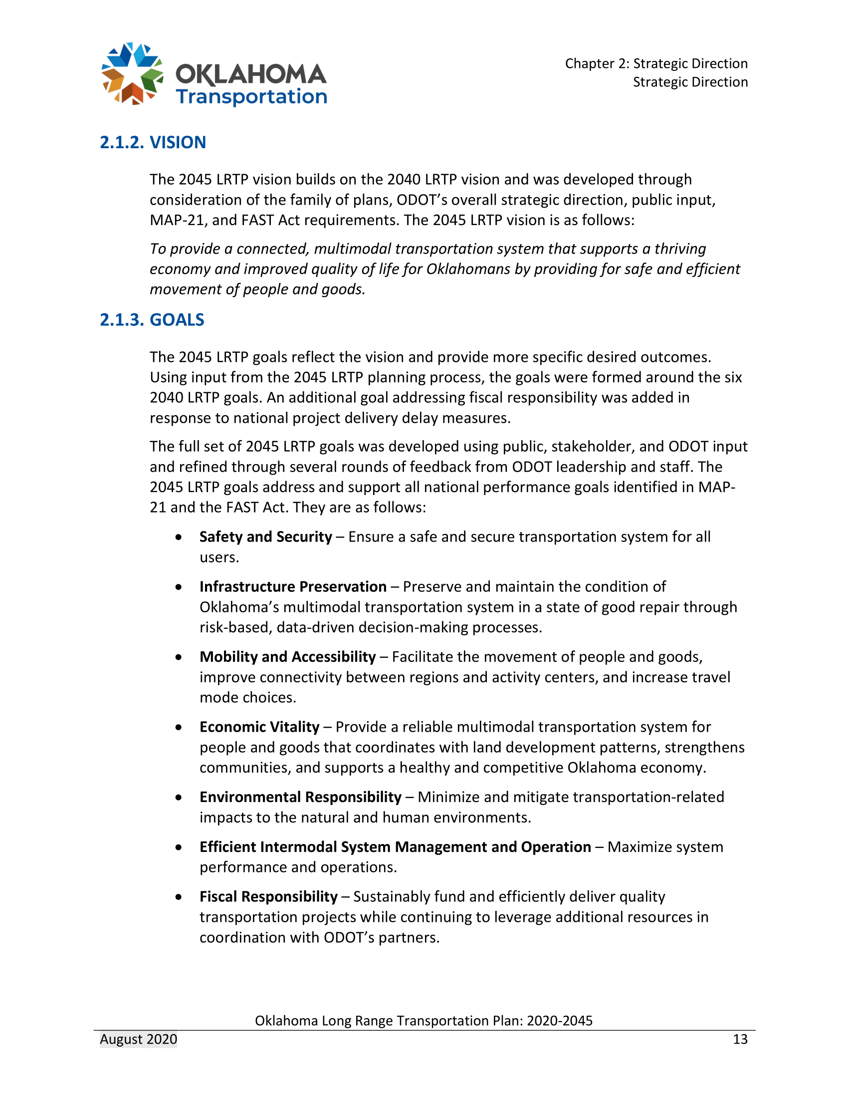
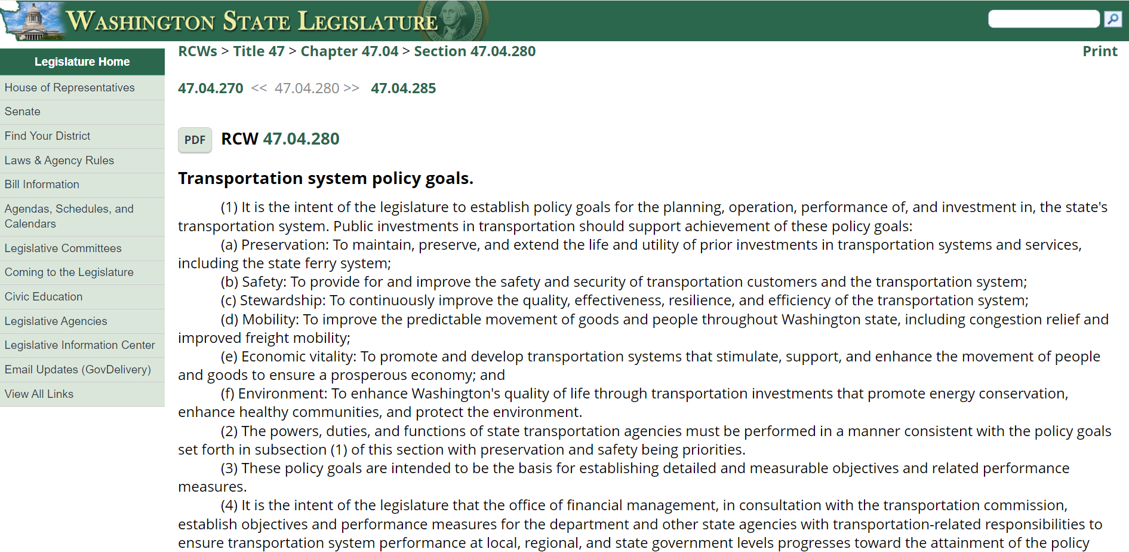
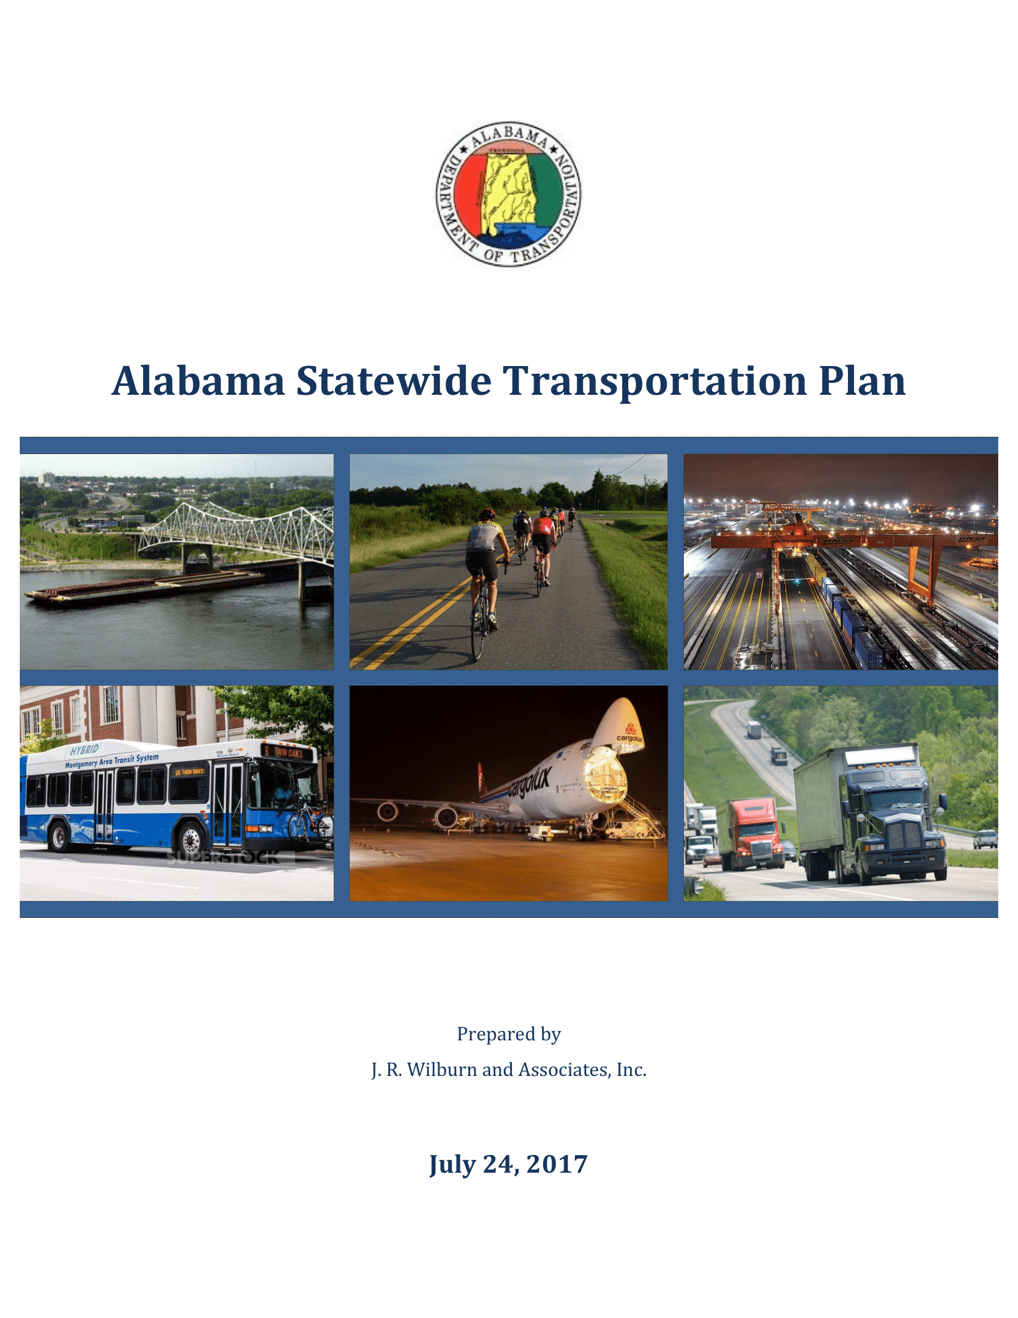
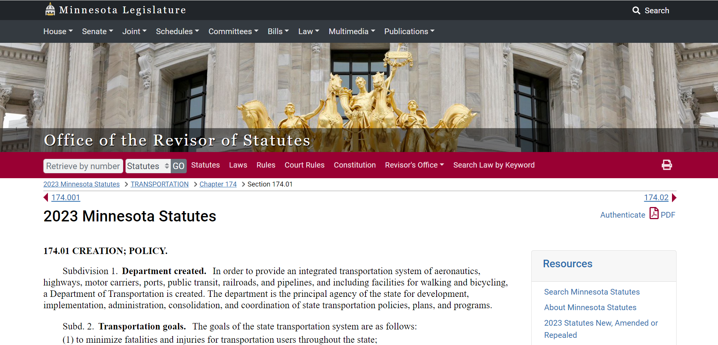
Goals
Notes:
OK + AL: Goals are strictly in-line with federal goals
WA + MN: Hard-wires goals into state code

Slide 28
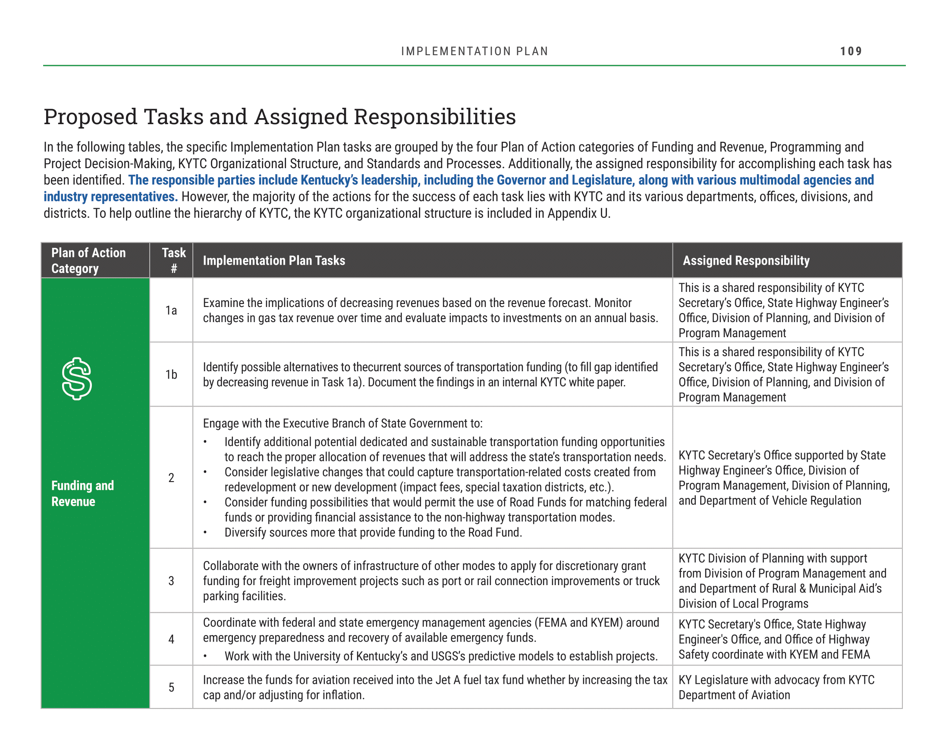
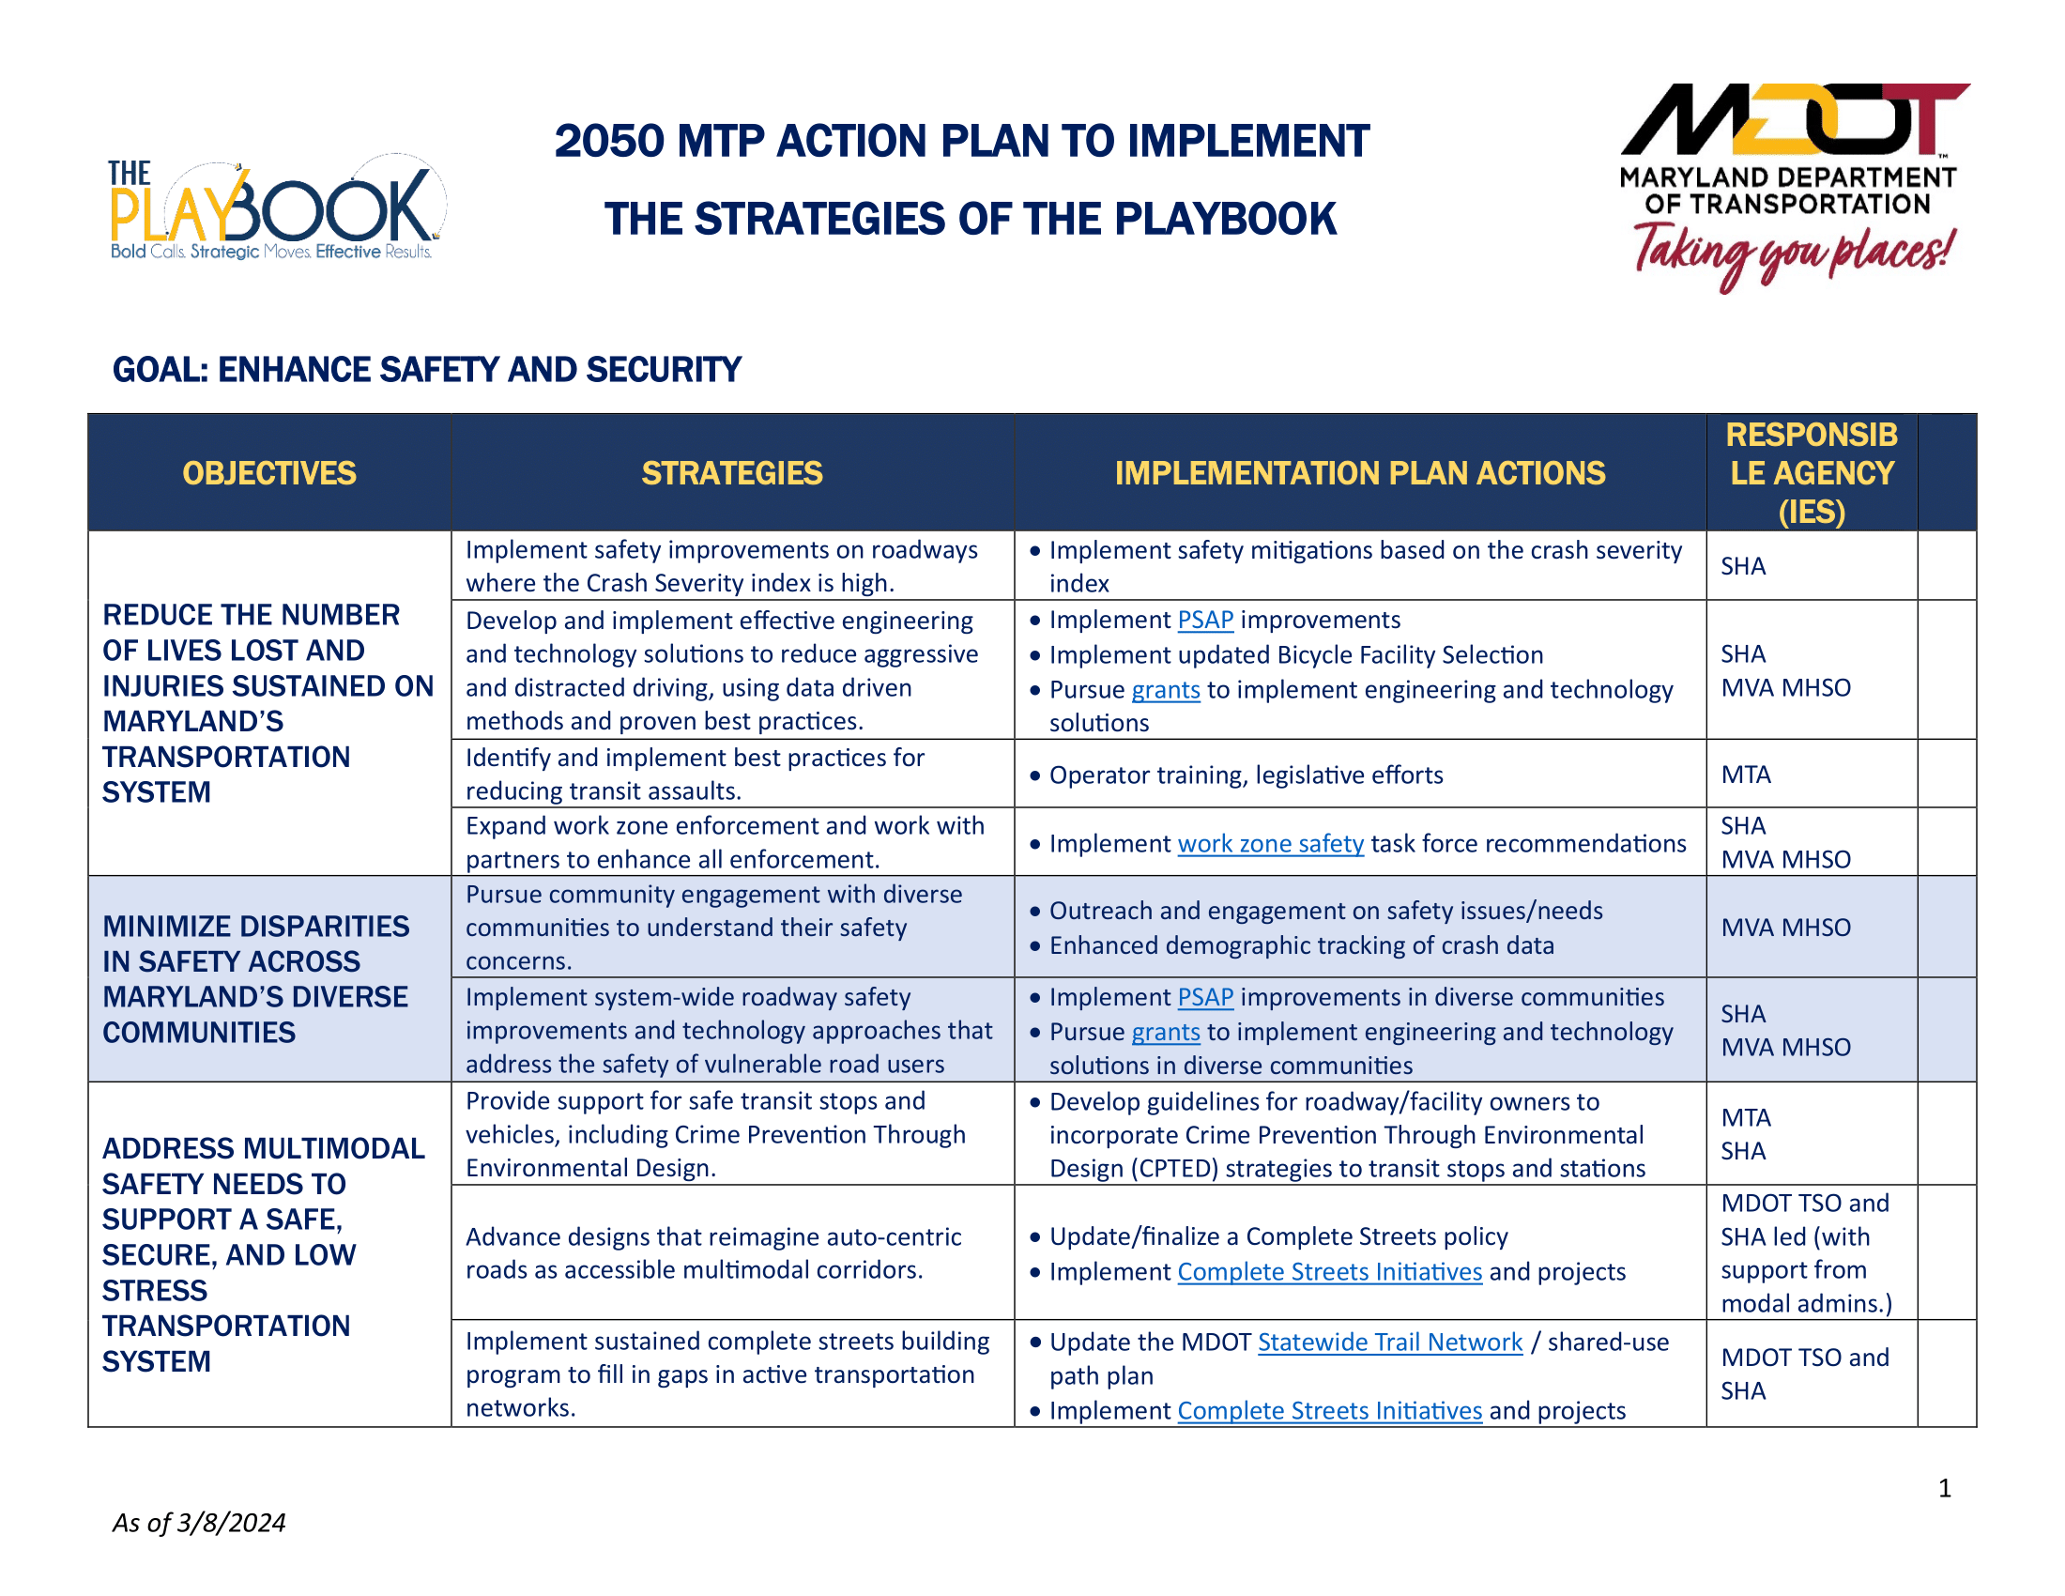
Implementation
Notes:
Speaker Note (to say to crowd): Many of these slides have no red states—because they’re bad due to the absence of anything. Find some smooth way to say that.
KY + MD: Includes multiple tasks and action steps around each goal area, plus clear responsibilities

Slide 29
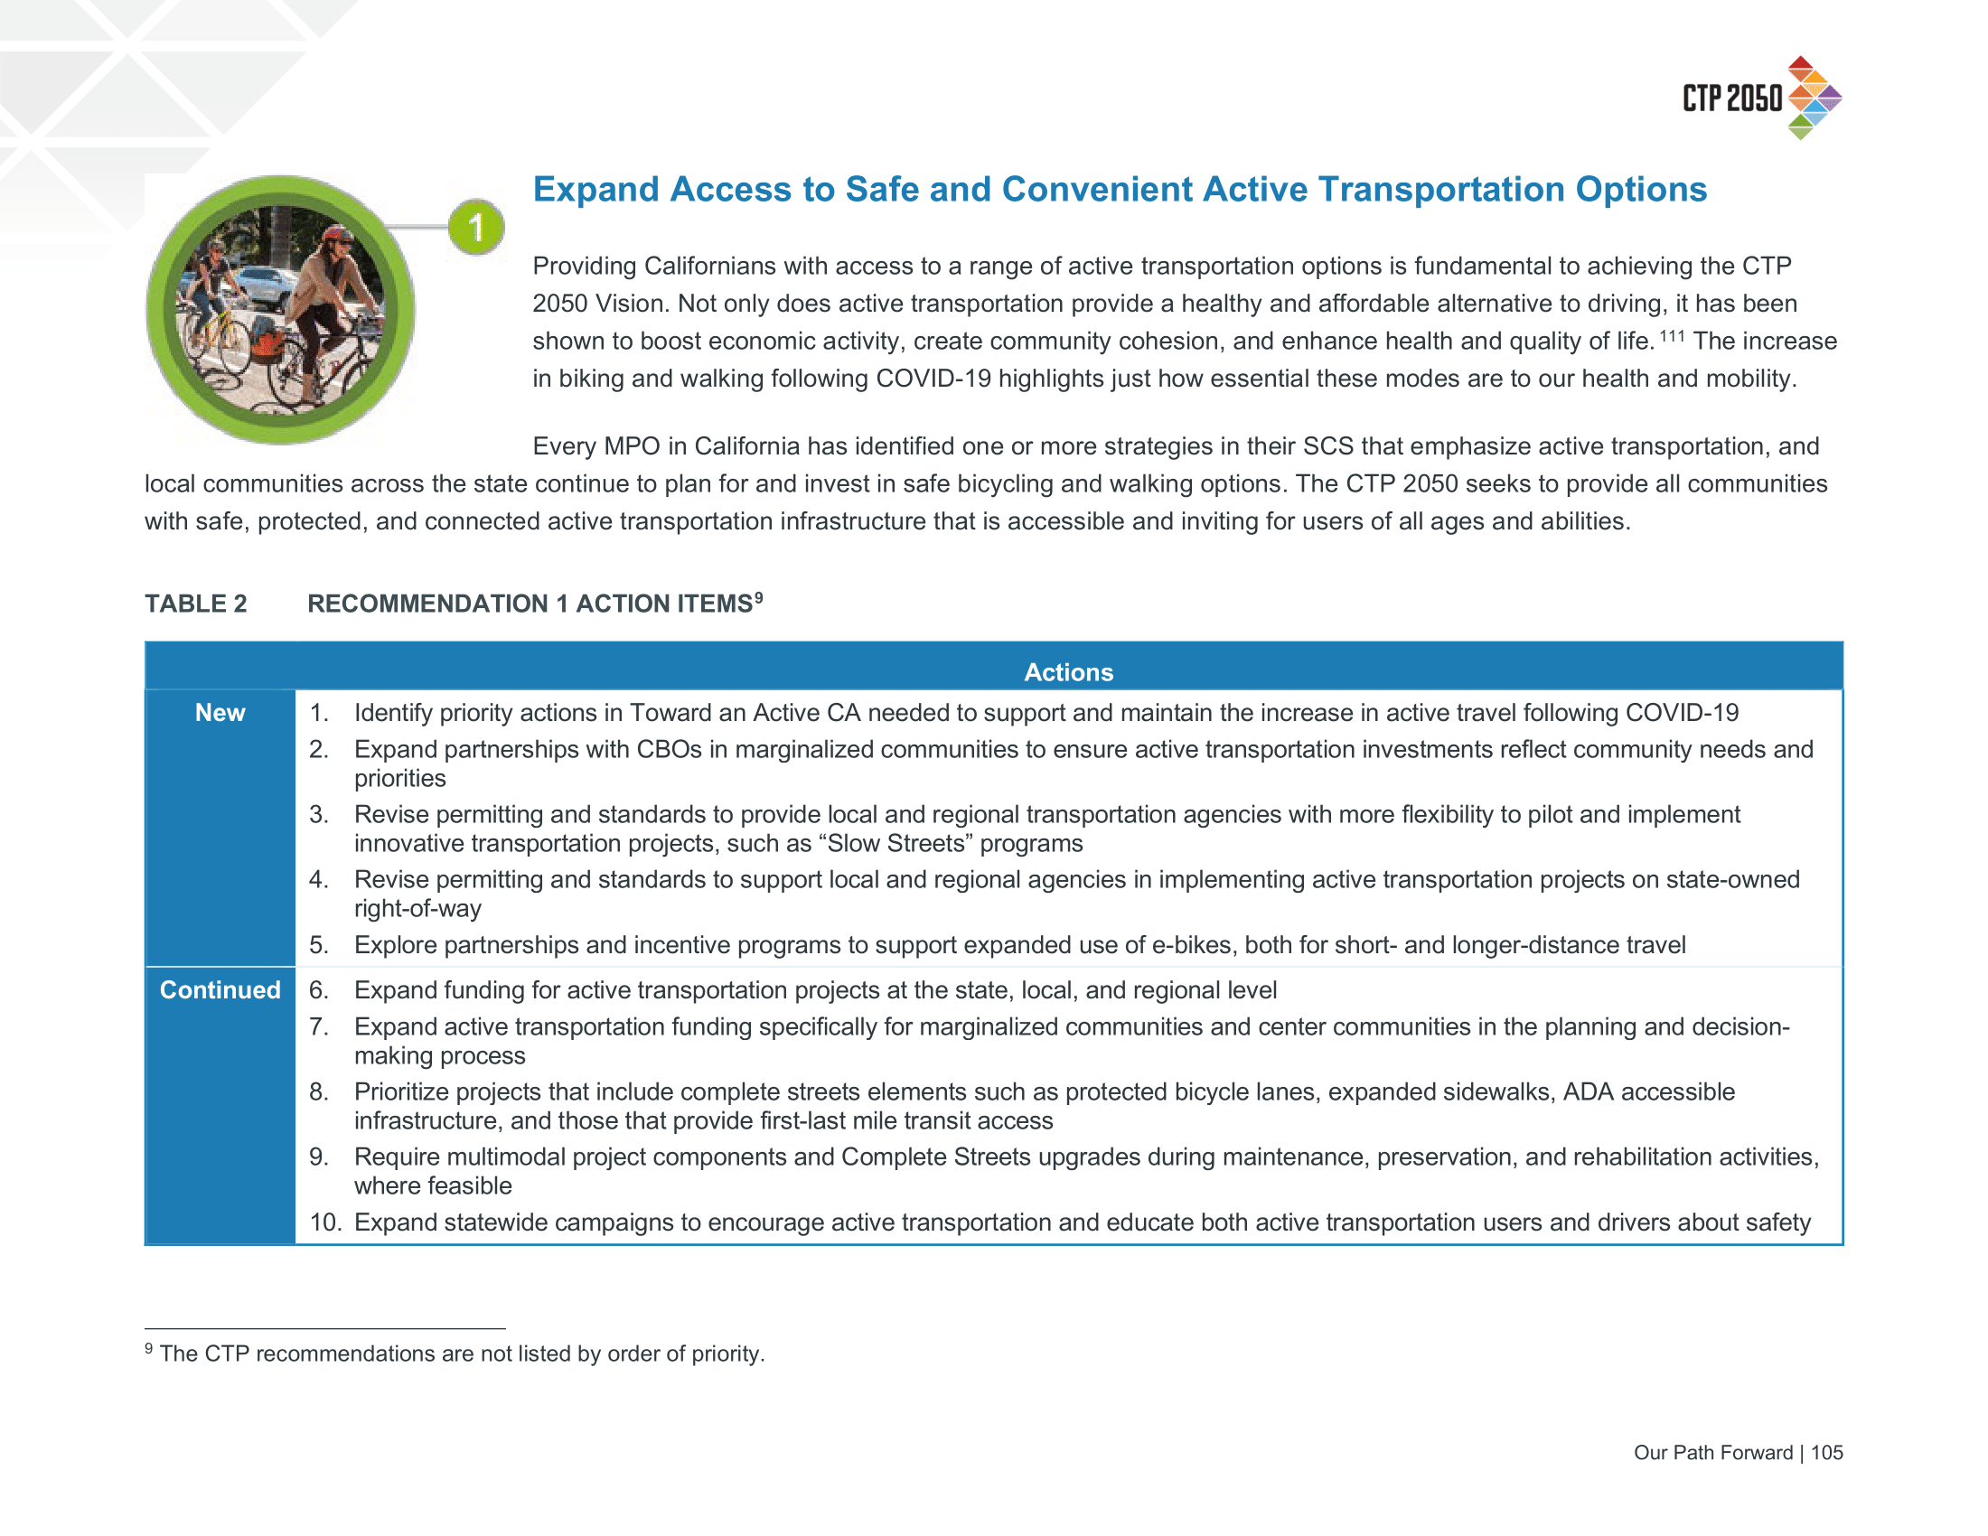
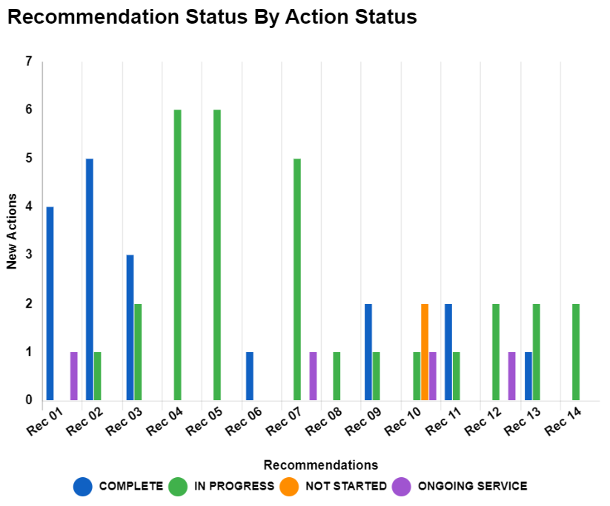
Implementation
Notes:
CA: For the ____ goal areas—Equity, Climate, Accessibility, and Quality of Life / Public Health—there are multiple action items. But the real kicker is how they track progress.

Slide 30
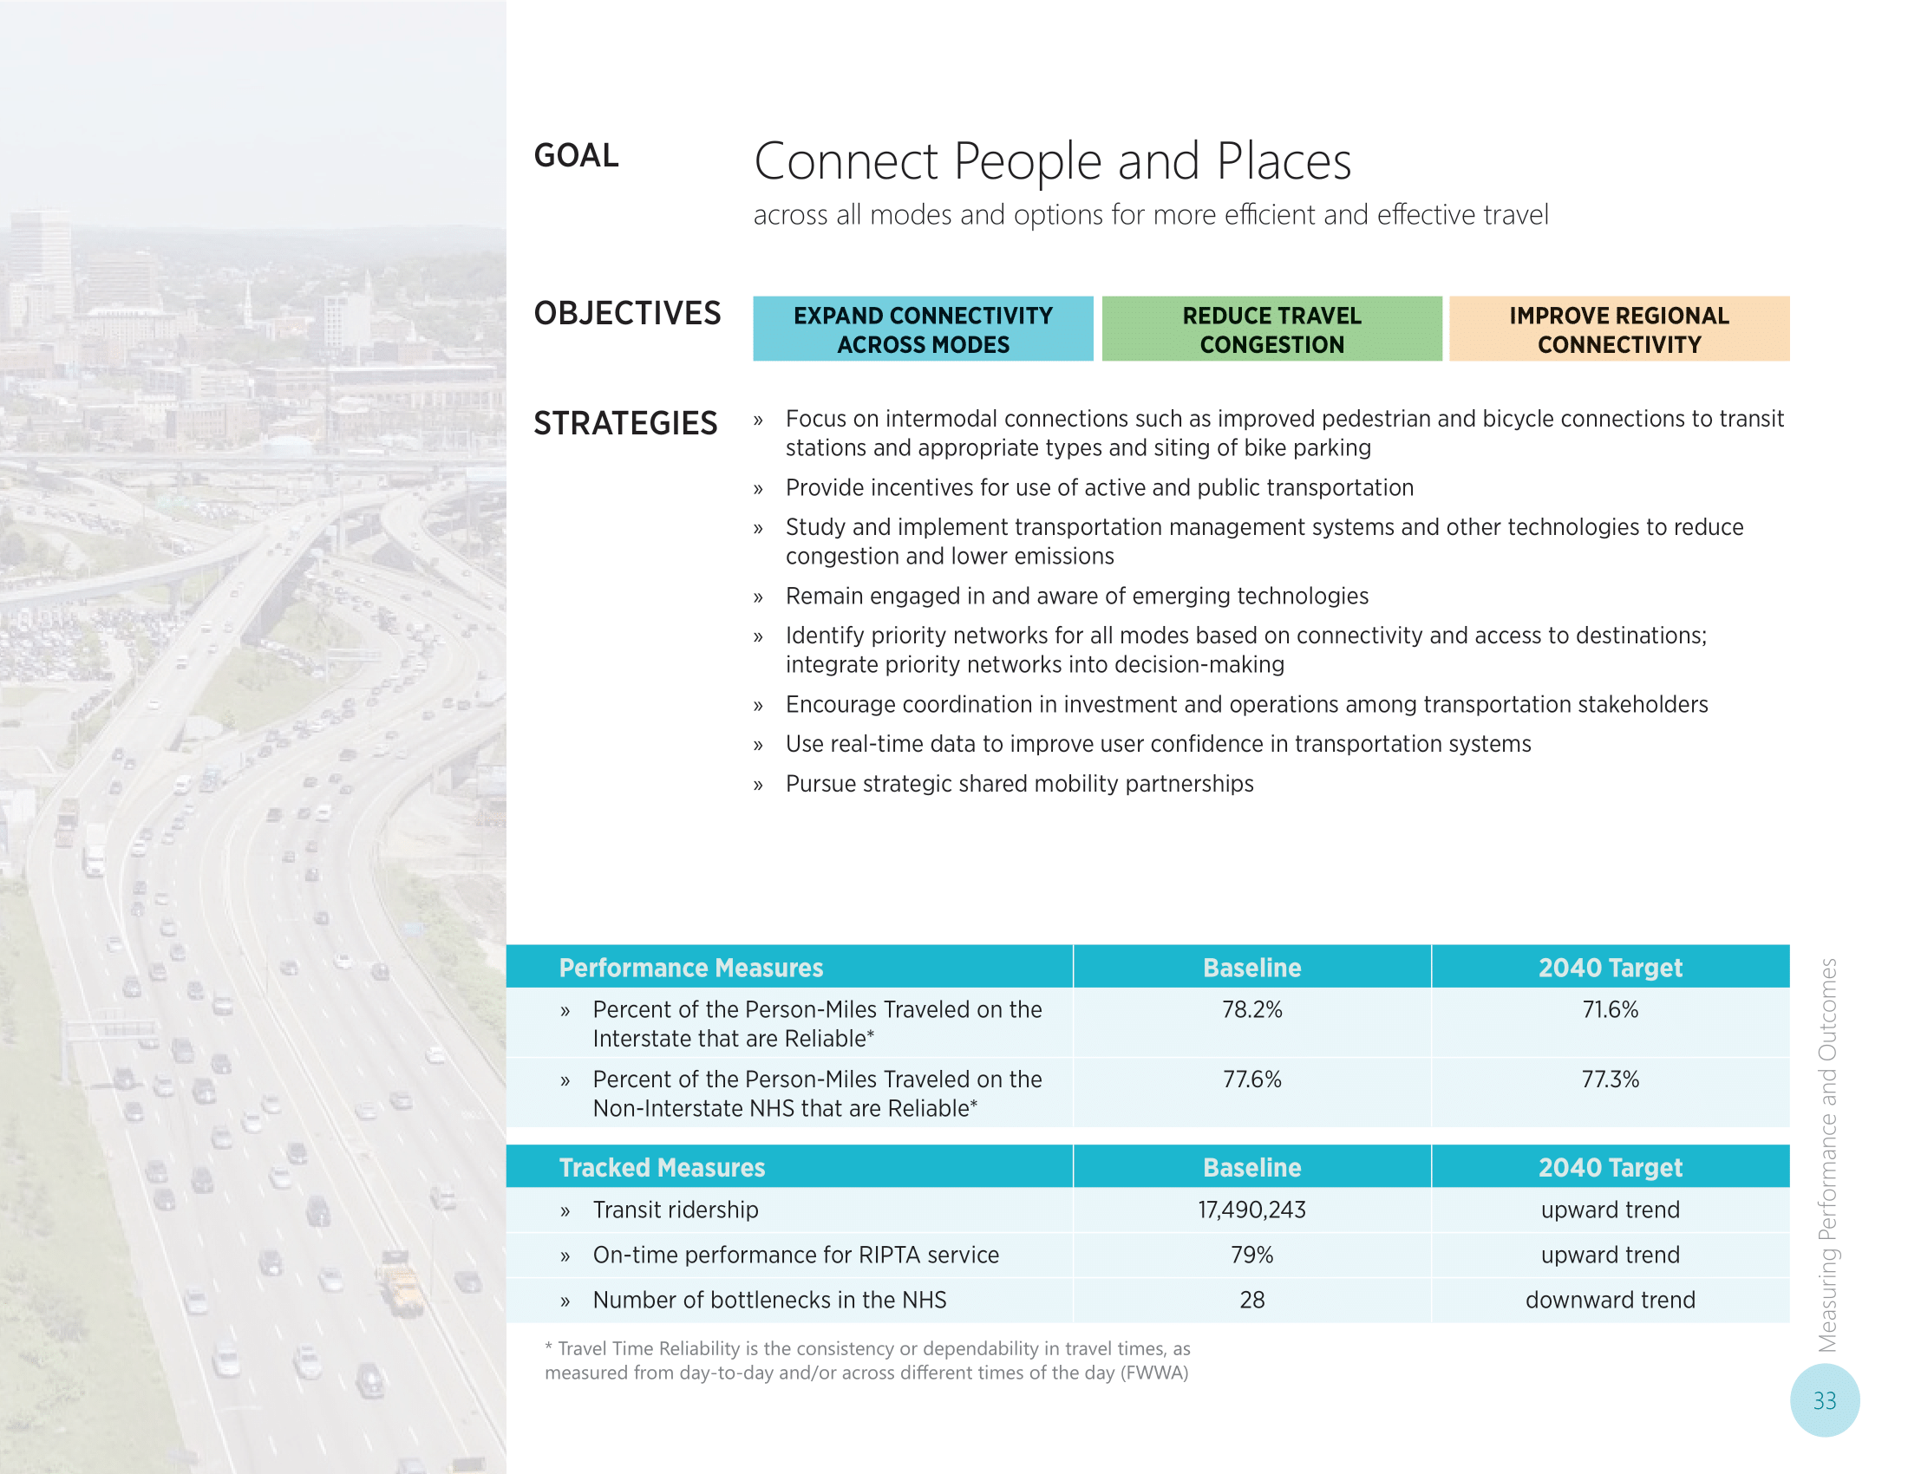
Performance Measurement

Slide 31
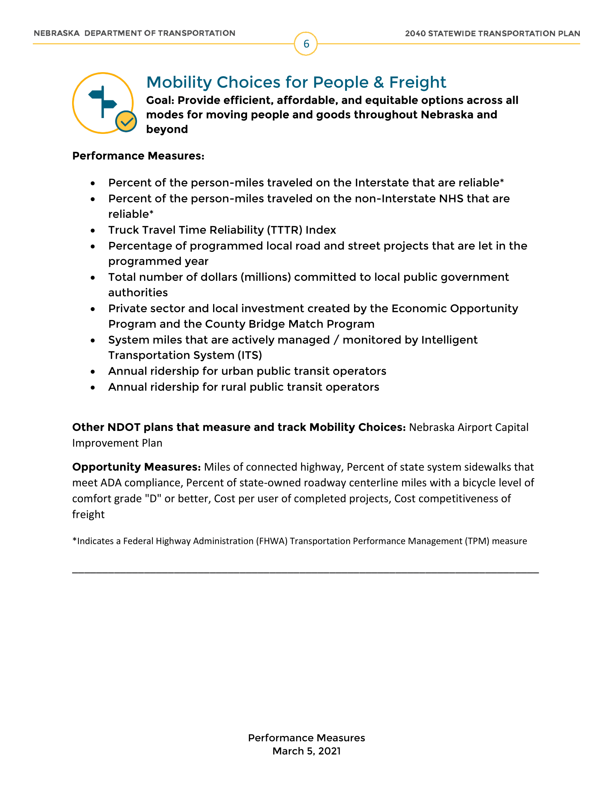
Performance Measurement

Slide 32
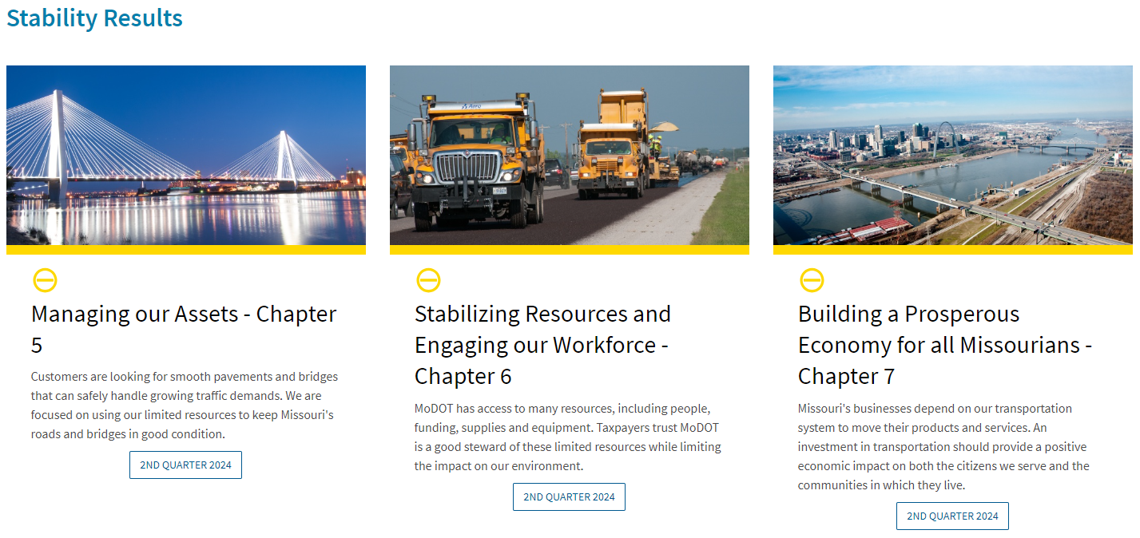
Performance Measurement

Slide 33

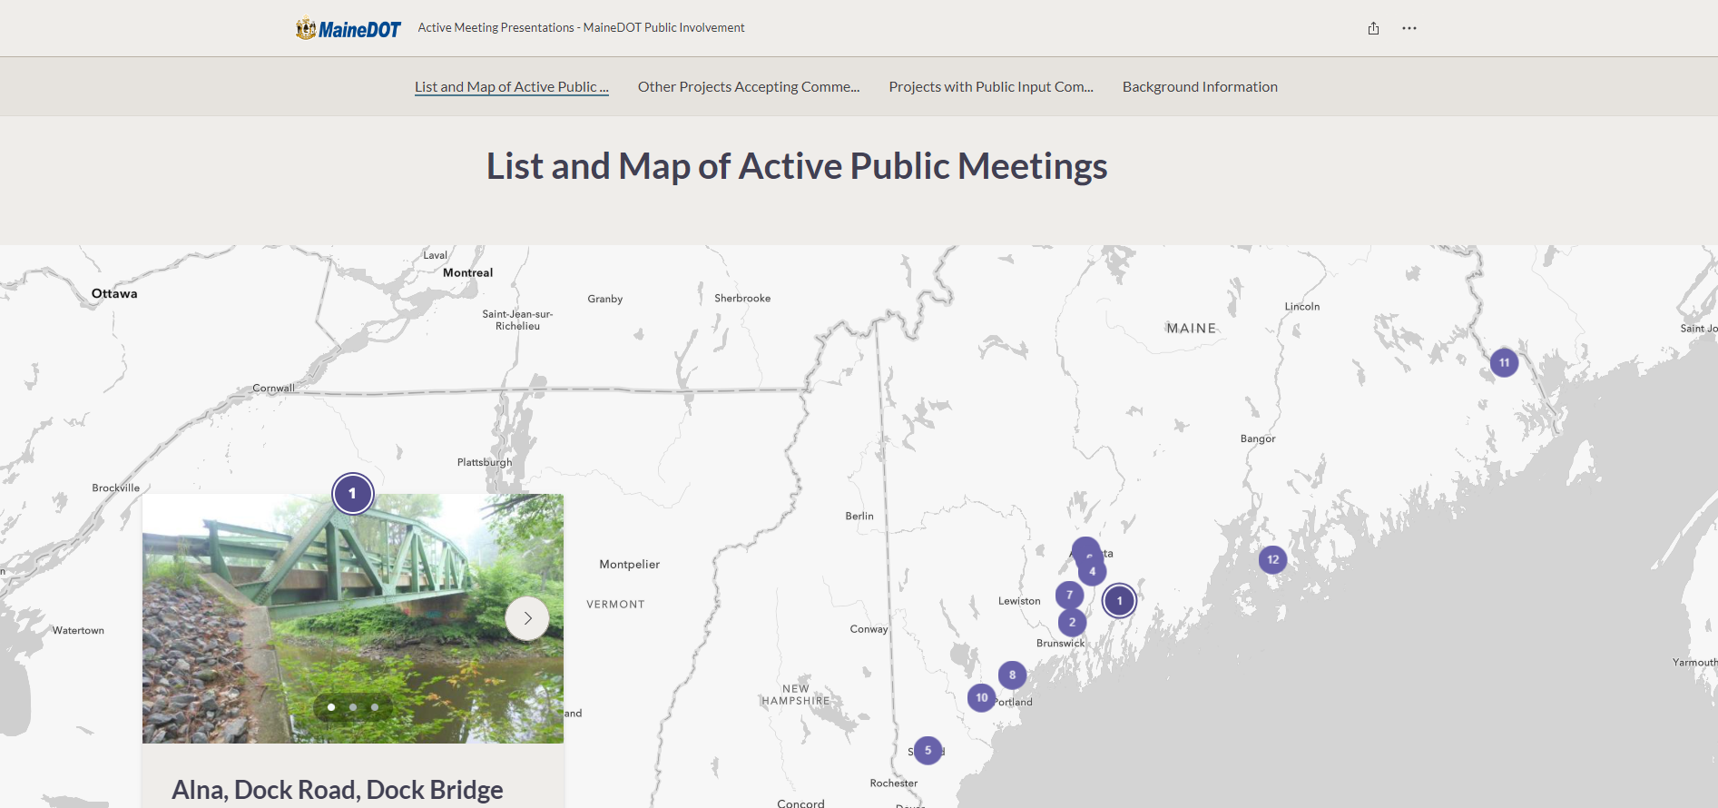
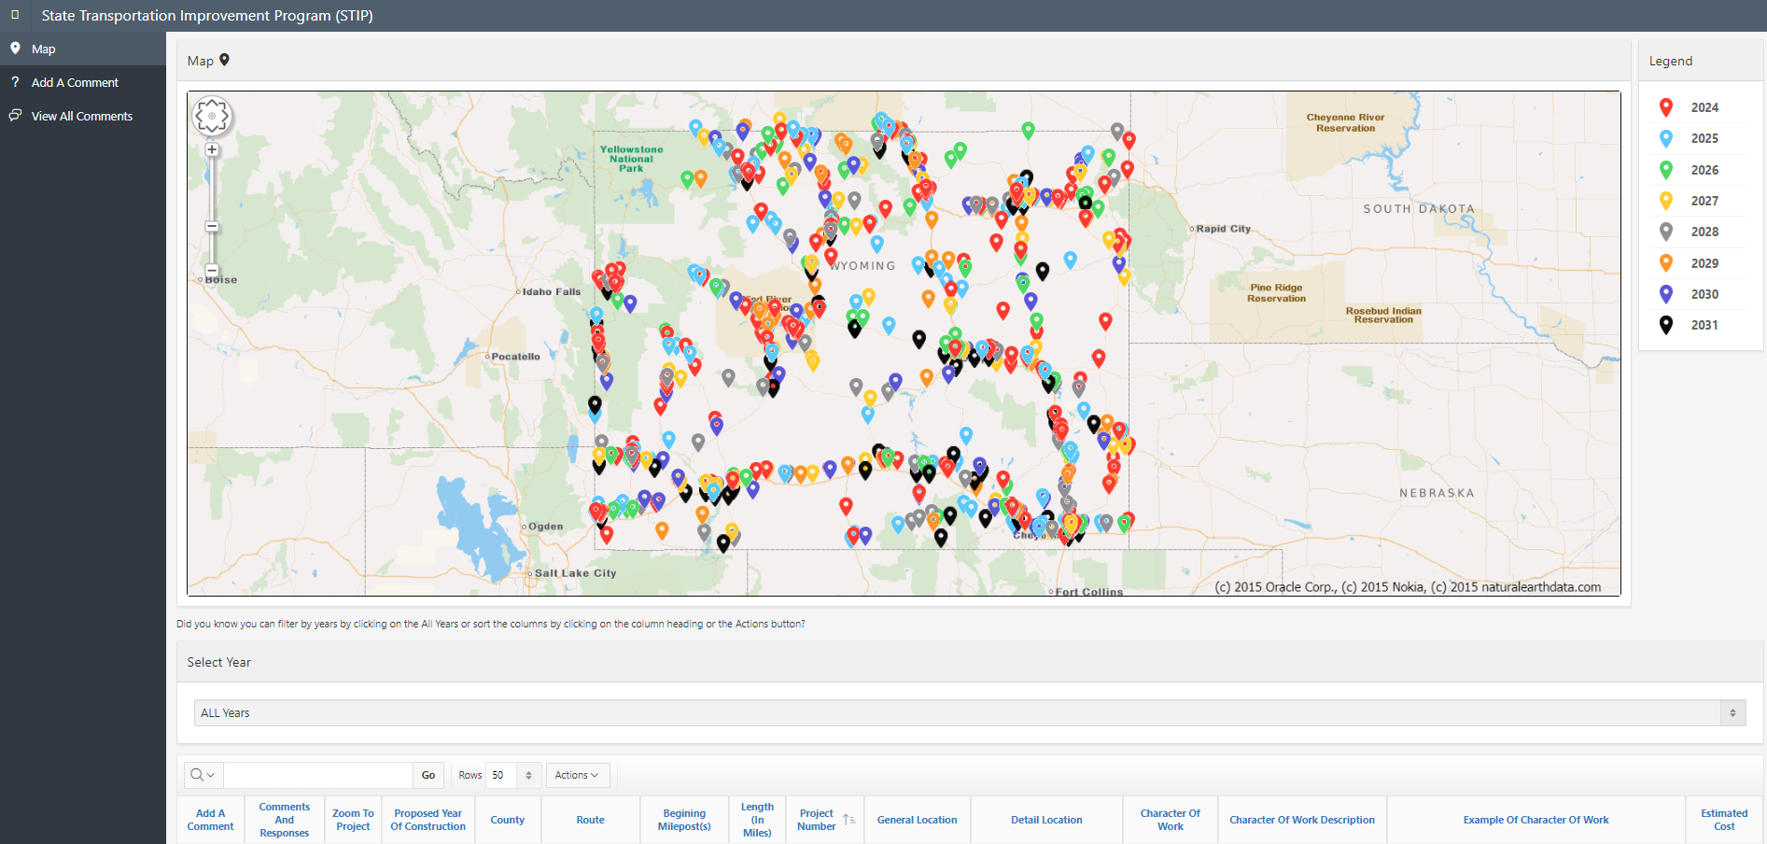
Does the state have a…
Portal to submit climate-vulnerable infrastructure?
14% 18%
Public involvement portal?
37% 53%
Notes:
DC: Allows direct reporting of assets in need of maintenance
ME: Accepts comments on specific projects, shows where active meetings are happening, and provides more background info
WY: Allows direct commentary on STIP projects

Slide 34
43%
publicly connect long-range planning to their STIP or capital plan
Notes:
Macro Stat: Reminder, we’re not even into specific projects. This is just the broader capital plan: is there any public-facing system where the macro approach is informed by published goals
MD: For each major project, there is a Project Information Form (PIF). Each PIF contains a description of the project, its status, its justification, its compliance status with smart growth, and a brief explanation of how it fits with the goals of the MTP.

Slide 35
43%
publicly connect long- range planning to their STIP or capital plan
Notes:
GA: Legally requires their investment strategy to connect back to goals
Senate Bill 200 (SB 200), as passed during the 2009 legislative session, required the creation of an SSTP, which is to serve as the official, intermodal, comprehensive, fiscally constrained transportation plan which includes programs and other activities to support implementation of the state’s strategic transportation goals and policies. The SSTP sets the strategic direction and makes the business case for increased transportation investment within the state. The current SSTP has a “horizon year” of 2050. The SSTP is required to be updated every two years.

Slide 36
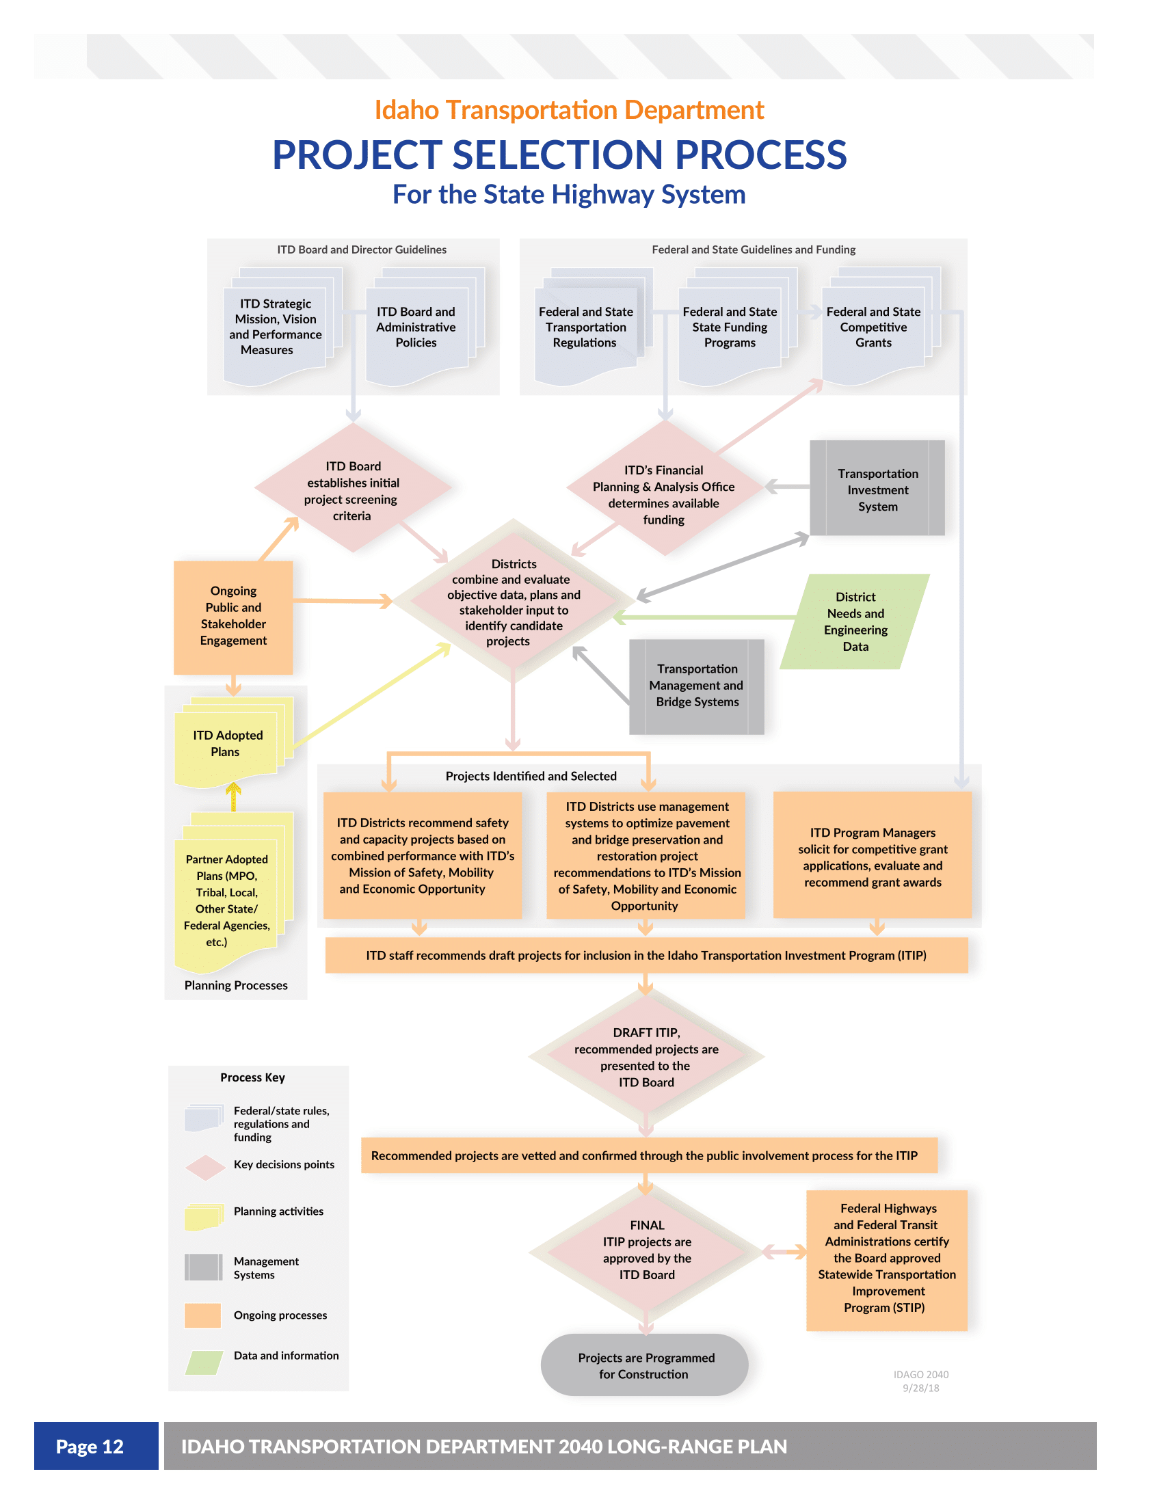
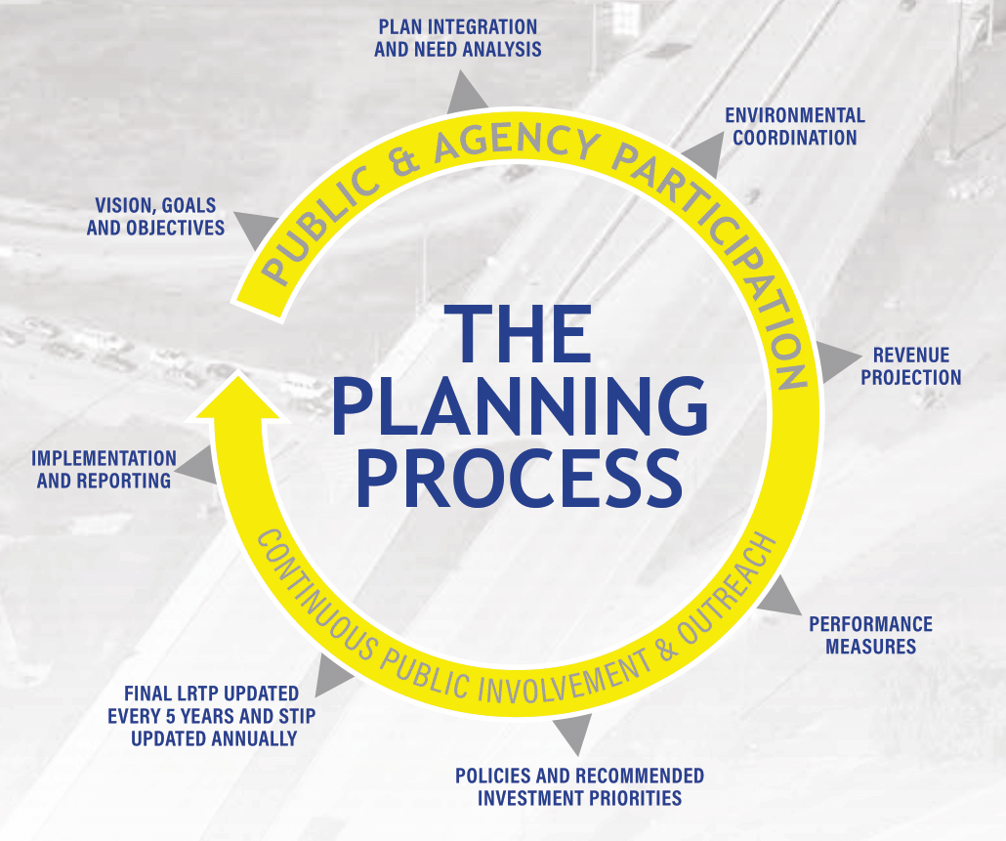
Does the state have a…
Visual explaining planning and programming processes?
45% 33%
Notes:
ID:
IN:

Slide 37
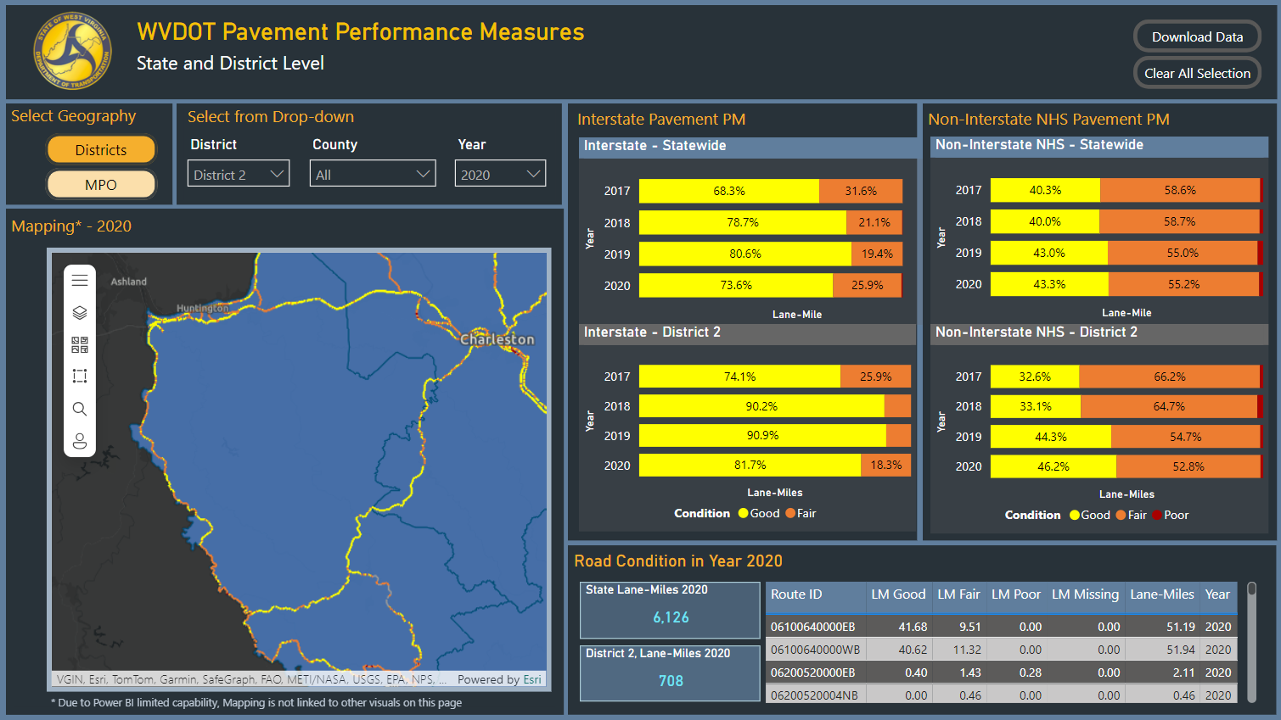
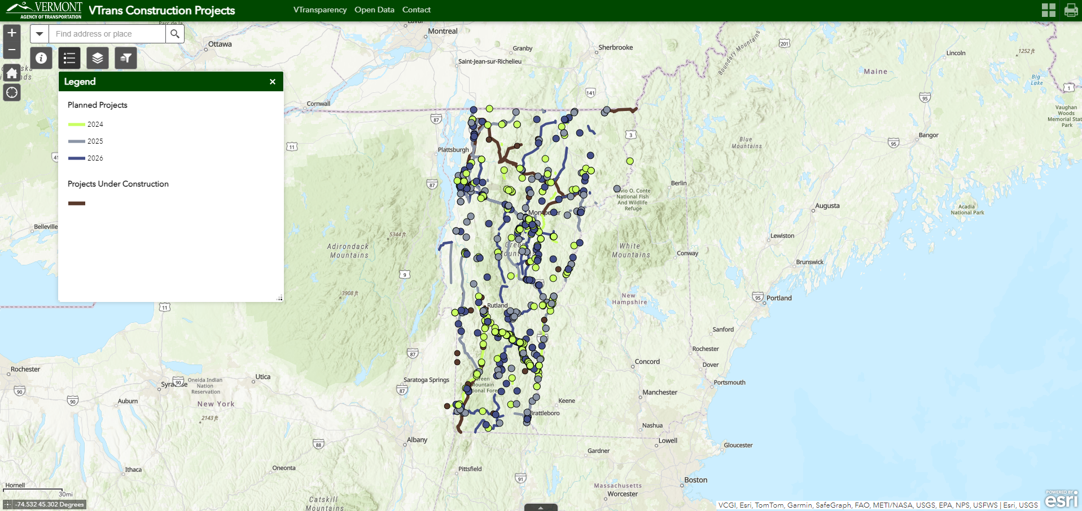
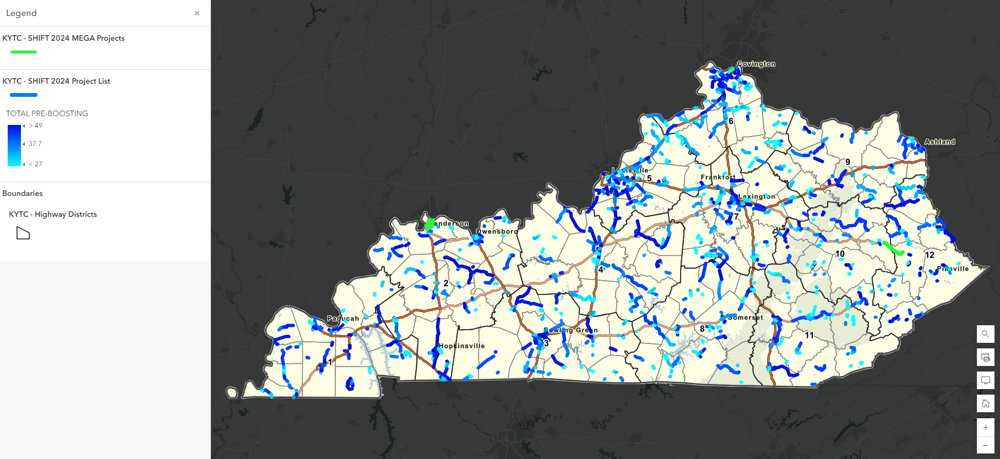
Does the state have a…
Granular geospatial dataset of pavement and bridge condition?
43% 33%
Portal displaying programmed projects?
86% 10%
Notes:
WV: Makes it easy to see all NHS conditions
VT: Shows all projects
KY: Shows all projects, including connections back to the SHIFT program we showed you earlier

