Slide 1
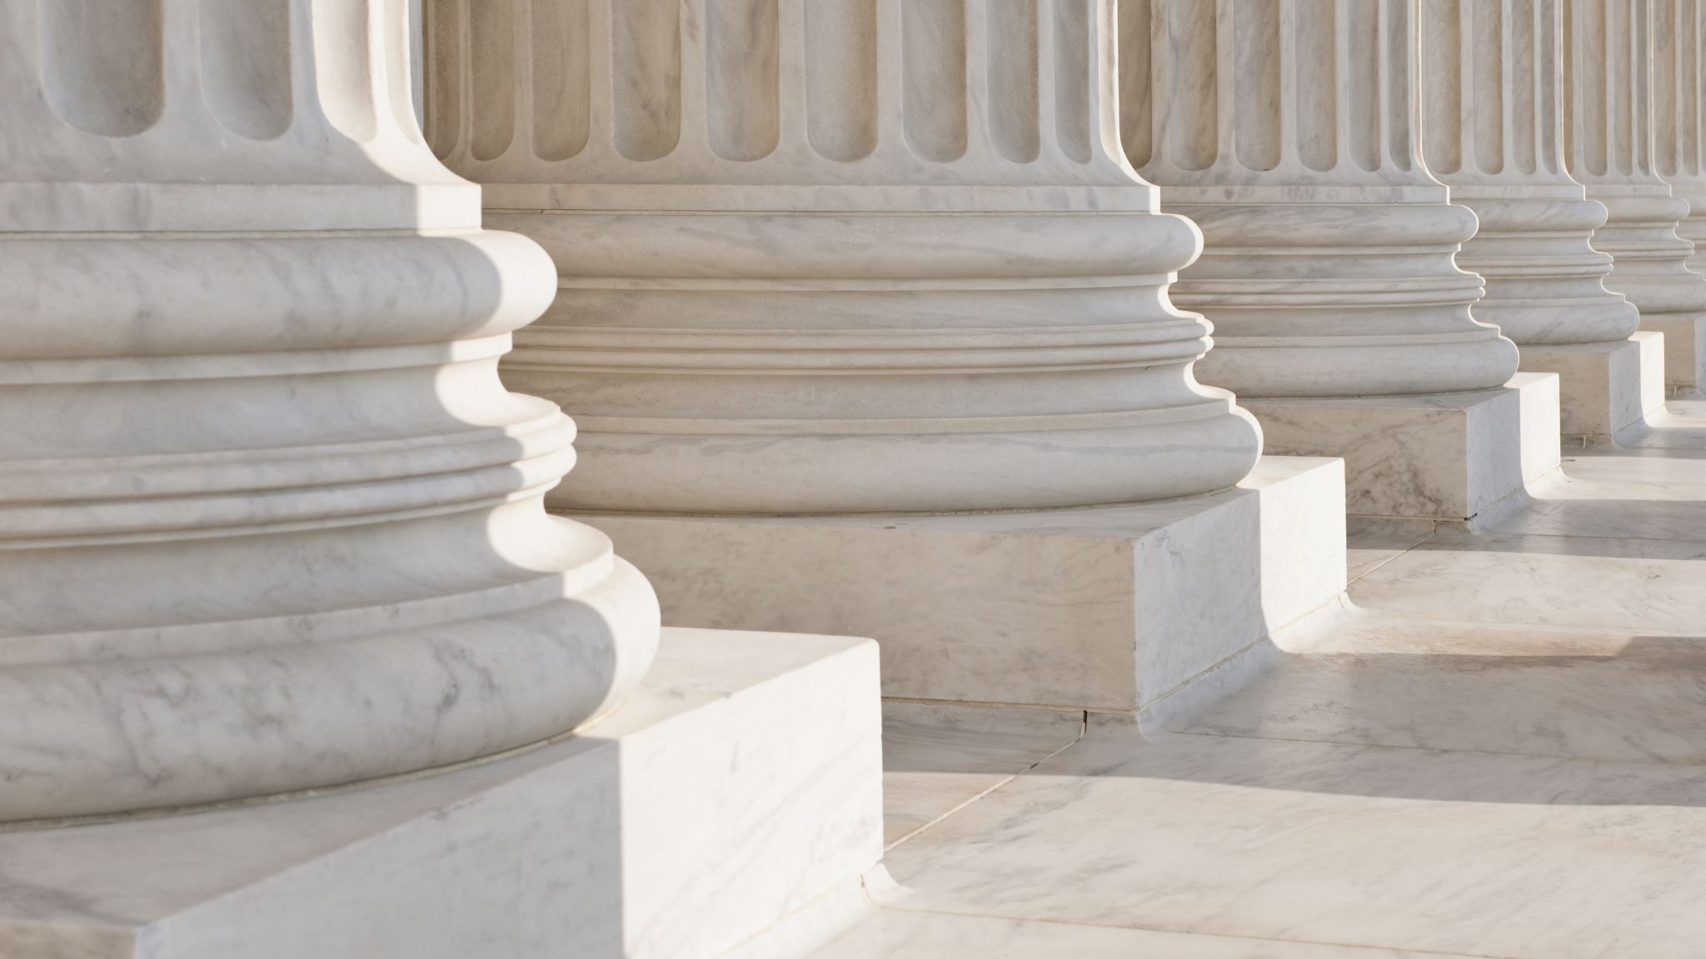
Supreme Court Update: 2023-2024 Term Recap & 2024-2025 Term Preview
By: Amanda Karras (Executive Director / General Counsel)
International Municipal Lawyers Association

Slide 2
IMLA
Membership organization for local government attorneys. Provide education and advocacy services for local governments.
File 30-40 amicus briefs in the lower courts and at the Supreme Court each year in support of local governments.
Put on conferences and webinars for local government attorneys. Come to New Orleans in 2025 and Salt Lake City in 2026!

Slide 3
Local Government Legal Center
Coalition formed between NLC, NACo, IMLA, GFOA, and ICMA to advocate on behalf of local governments at the Supreme Court.
The LGLC’s mission is to raise awareness of the importance of Supreme Court cases to local governments and to help shape the outcome of cases of significance to local governments at the Supreme Court through persuasive and effective advocacy
The LGLC will serve as a resource to local governments and local government officials on issues related to the Supreme Court.

Slide 4

2024-2025 Term Preview
Barnes v. Felix – Fourth Amendment /law enforcement seizures
Garland v. VanderStok – ghost guns
San Francisco v. EPA – Clean Water Act case / clarity for NPDES permits
Seven County Infrastructure Coalition v. Eagle County - NEPA
Ames v. Ohio Department of Youth Services – Title VII “majority group” discrimination
E.M.D. Sales v. Carrera – FLSA exemptions
Stanley v. City of Sanford – ADA & post-retirement health benefits
Catholic Charities Bureau v. Wisconsin Labor & Inst. Com’n – First Amendment / religion clauses and exemption to government programs
FCC v. Consumers’ Research – Viability of the Universal Service Fund
McLaughlin v. McKesson – Court deference to FCC rulemaking and orders
Lackey v. Stinnie – attorney’s fees for preliminary injunctions under Section 1983
Perttu v. Richards – PLRA/ jury trial

Slide 5

Barnes v. Felix
Issue: Whether courts should apply the “moment of the threat” doctrine when evaluating an excessive force claim under the Fourth Amendment.

Slide 6
Moment of Threat Doctrine
“The excessive-force inquiry is confined to whether the officers or other persons were in danger at the moment of the threat that resulted in the officers’ use of deadly force.”
“Any of the officers’ actions leading up to the shooting are not relevant for the purposes of an excessive force inquiry in this Circuit.”

Slide 7
Totality of the Circumstances Test
Courts must pay “careful attention to the facts and circumstances of each particular case,” and balance “the nature and quality of the intrusion on the individual[]” “against the countervailing governmental interests at stake.”
This requires considering, “the severity of the crime at issue,” “whether the suspect poses an immediate threat to the safety of the officers or others,” and the “relative culpability” of the victim and those the officers sought to protect. Scott v. Harris, 550 U.S. 372, 384 (2007).

Slide 8
Facts
Officer Felix initiated a traffic stop for a vehicle with toll violations. Officer asked for license and proof of insurance. Barnes indicated that his girlfriend rented the car he “might” have the documentation in the trunk.
Felix ordered Barnes to open the trunk, and he does so. Felix orders Barnes to get out of the vehicle. Barnes opens the door, but also turns the vehicle back on.
Officer Felix draws his weapon and shouts “don’t f’ing move” and Barnes’s vehicle begins moving. The officer then steps onto the moving car with his weapon drawn and while the car is moving, he shot Barnes.

Slide 9

Lower Court Holding
Found there was no constitutional violation because the officer did not draw his weapon until Barnes turned the car back on. The court further found that the officer’s actions prior to the moment the threat occurred justifying deadly force including that he “jumped onto the door sill” had “no bearing on the officer’s ultimate use of force.”
Held that the “moment of threat occurred in the two seconds before Barnes was shot. At that time, [Officer] Felix was still hanging onto the moving vehicle and believed it would run him over, which could have made Officer Felix reasonably believe his life was in imminent danger.”

Slide 10
Parties Arguments at the Supreme Court
Petitioner and federal government propose a “narrow” ruling rejecting the moment of threat doctrine and remanding to the lower court to apply the totality of the circumstances test.
The Respondent argues that Supreme Court precedent - Graham v. Connor - applies and the focus under Graham’s reasonableness inquiry is of the officer’s actions at the moment force is used.
  Courts should not review irrelevant factors. “If a suspect is pointing a gun in an officer’s face, it does not matter whether the underlying offense was armed robbery or jaywalking.”
  Courts have already rejected officer created danger tests.

Slide 11
Oral argument highlights
Majority of Justices seem skeptical of moment of threat doctrine.
Justice Barrett: “So you're happy with the -- you're happy with the narrow -- I'm going to call it narrow in the sense that if we said moment of the threat is wrong and we don't articulate a precise standard, other than saying our regular totality-of-the -circumstances test applies, as Justice Sotomayor said, that's really what you're asking for?”

Slide 12

Garland v. VanderStok
Whether “a weapon parts kit that is designed to or may readily be completed, assembled, restored, or otherwise converted to expel a projectile by the action of an explosive,” 27 C.F.R. 478.11, is a “firearm” regulated by the Act.
Whether “a partially complete, disassembled, or nonfunctional frame or receiver” that is “designed to or may readily be completed, assembled, restored, or otherwise converted to function as a frame or receiver,” 27 C.F.R. 478.12(c), is a “frame or receiver” regulated by the Act.
In plain English, whether “ghost gun” part kits are subject to the Gun Control Act of 1968.
This Photo by Unknown Author is licensed under CC BY-SA

Slide 13
Facts
The GCA imposes licensing, background-check, recordkeeping, and serialization requirements on persons engaged in the business of importing, manufacturing, or dealing in firearms. In the Act, Congress delegated to the Attorney General the authority to promulgate “such rules and regulations as are necessary to carry out” the Act.
ATF issued a regulation to clarify that the definition of firearm under the GCA includes products and kits that can “readily be converted” into an operational firearm or a functional frame or receiver.

Slide 14
Public Safety Implications of the Case
There has been an exponential increase in the availability and use of ghost guns. In 2022, DOJ recovered nearly 26,000 ghost guns domestically – 7,000 more than 2021 which was already a 1000% increase from the year 2017.
Ghost gun kits are available online and allow minors and felons that are otherwise prohibited from purchasing firearms under federal law to obtain them without any background checks or serialization requirements.
This lack of serial numbers has created significant hurdles for law enforcement when a firearm is used in the commission of a crime.

Slide 15
Oral Argument Highlights
Both parties focused on the statutory language but there were a lot of colorful examples throughout oral argument. Is a set of ingredients (eggs, ham, peppers) an omelet? Is a pad and paper a grocery list?
The federal government focused on public safety: “They’ve advertised the products, in their words, as ‘ridiculously easy to assembly and dummy-proof’ and touted that you can go from opening the mail to have a fully functional gun in as little as 15 minutes, no serial number, background check, or records required.”
Both the Chief Justice and Justice Barrett seemed skeptical of the challengers’ arguments. “I’m suggesting that if someone who goes through the process of drilling the one or two holes and taking the plastic out, he really wouldn’t think that he has built that gun,” Roberts asked, “would he?”

Slide 16

San Francisco v. EPA
Issue: Whether the Clean Water Act allows EPA (or an authorized state) to impose generic prohibitions in NPDES permits that subject permitholders to enforcement for exceedances of water quality standards without identifying specific limits to which their discharges must conform.

Slide 17
Background
Under the Clean Water Act, dischargers of pollutants must obtain a permit (NPDES permit) and comply with the terms of the permit.
Compliance with the permit standards shields the permittee from liability. But a violation can lead to civil and criminal penalties.
San Francisco has a combined sewer and storm water system and EPA issued a NPDES permit to SF for that system.

Slide 18
Facts
The EPA SF’s NPDES permit included numeric limitations and comprehensive management requirements.
But it also added two unspecific, generic prohibitions: a discharge may “not cause or contribute to a violation of any applicable water quality standard. . . .” and no “discharge of pollutants shall create pollution, contamination, or nuisance as defined by California Water Code section 13050.”
San Francisco argued that the generic prohibitions do not allow it to understand its compliance obligations as there are other sources of pollution in the Pacific Ocean besides its own.

Slide 19
Lower Court Holding
Ninth Circuit concluded that the Generic Prohibitions are “consistent with the CWA and its implementing regulations.” The majority found that CWA provisions empower the EPA and States to impose generic prohibitions against violating water quality standards anytime they find it “necessary” to do so.

Slide 20
Implications for Local Governments
Clarity in NPDES permits is critical for local governments to comply with their obligations under the CWA.
Permit shield protection unavailable if locality is not deemed in compliance
The CWA imposes severe consequences for violation. Even a negligent violation can be punished criminally, and in civil enforcement actions, the suit can seek civil penalties exceeding $66,000 per day for each permit violation, as well as injunctive relief.

Slide 21
Oral Argument Highlights / Predictions
Justice Kavanaugh was interested in the onerous penalties pointing out EPA was seeking millions.
Justice Gorsuch focused on the lack of notice to permittees.
Based on questions at oral argument, Justices are likely to side with San Francisco.

Slide 22
Seven County Infrastructure Coalition v. Eagle County
Issue: Whether the National Environmental Policy Act requires an agency to study environmental impacts beyond the proximate effects of the action over which the agency has regulatory authority.

Slide 23

National Environmental Policy Act
NEPA requires agencies to take a “hard look” at the environmental consequences of a proposed major federal action.
When an agency determines that a major federal action will have potentially significant environmental impacts, it must prepare an environmental impact statement (EIS).
Under NEPA, an agency must consider an environmental effect of a proposed major federal action if there is a “‘reasonably close causal relationship’ between the environmental effect and the alleged cause.”
This Photo by Unknown Author is licensed under CC BY-NC-ND

Slide 24

Facts
Seven Utah counties applied to the Surface Transportation Board (“Board”) for authority to construct an 85-mile-long rail line connecting the resource-rich Utah Basin in Eastern Utah to the national rail network.
The Board determined that the transportation merits satisfied the standard under the law subject to an EIS.
Eagle County, Colorado challenged the preliminary decision to grant the railway.

Slide 25
Court of Appeals Decision
Held that the Board should have considered the upstream environmental impacts of increased oil development and the downstream effects of refining that oil in the Gulf as a part of its NEPA analysis.
The court also indicated that the Board should have considered increased risk of rail accidents and increased risks of wildfires as well as impacts on water resources downline on the Colorado River.
Based on the inadequate NEPA analysis, the court of appeals vacated the Board’s exemption to build the railway.

Slide 26
Implications for Local Governments
Case cuts both ways for local governments as evidenced by the fact that counties are on both sides of the case.
Local governments have an interest in both protecting the environment and boosting economic development through infrastructure and transportation projects that are subject to NEPA.
Local governments that receive federal infrastructure funding must follow NEPA. And NEPA can be administratively burdensome for localities if they are seeking to comply.

Slide 27

Ames v. Ohio Department of Youth Services
Issue: Whether, in addition to pleading the other elements of Title VII, a majority-group plaintiff must show “background circumstances to support the suspicion that the defendant is that unusual employer who discriminates against the majority.”
This Photo by Unknown Author is licensed under CC BY-SA

Slide 28
Facts
Ames, a heterosexual woman, worked for the Ohio Department of Youth Services. During the relevant performance evaluation, her supervisor said that Ames met “expectations” in ten competencies and exceeded them in only one.
Ames sought a promotion and was passed over and the Dept. hired a gay woman. Ames was subsequently demoted for performance reasons and her replacement was a gay man.
Ames sued under Title VII claiming discrimination based on sexual orientation. While her immediate supervisor was gay, the two decisionmakers for the promotion and demotion were both heterosexual.

Slide 29

Sixth Circuit Holding
Concluded Ames met the prima facie factors for a typical discrimination claim under McDonnell Douglas.
But, because Ames is heterosexual and part of the majority group, the Sixth Circuit required that she also show “background circumstances to support the suspicion that the defendant is that unusual employer who discriminates against the majority.”
Plaintiffs typically make the additional showing with evidence that a member of the relevant minority group (here, gay people) made the employment decision at issue, or with statistical evidence showing a pattern of discrimination by the employer against members of the majority group.
The court concluded she could not meet that burden as she conceded the ultimate decisionmakers were heterosexual and she pointed to no statistical evidence to support her claim.
This Photo by Unknown Author is licensed under CC BY

Slide 30
Parties’ Arguments
Petitioner / employee classifies the background circumstances test as a “heightened bar” to proving discrimination and argues that contradicts Title VII.
Respondent / employer argues that the “background circumstances” test is an application of existing case law under McDonnell Douglas – and absent the test, the prima facie case becomes meaningless. Emphasizes that this is not a heightened burden for majority plaintiffs.

Slide 31

EMD Sales v. Carrera
Issue: Whether the burden of proof that employers must satisfy to demonstrate the applicability of a Fair Labor Standards Act exemption is a mere preponderance of the evidence or clear and convincing evidence.

Slide 32
Facts / Lower Court Ruling
Under the FLSA, employers must pay overtime pay at a rate of time and a half for work done above 40 hours per week. There are many exemptions to the overtime requirement.
The employer argued the standard to determine if the exemption applied is a preponderance of the evidence or more than 51%. The employees argued for a clear and convincing evidence standard, which is much higher and more difficult to prove.
The Fourth Circuit used the clear and convincing standard (more employee friendly).
In this case, an employer believed the employees met one of the exemptions. The employees sued under the FLSA, claiming they should have been paid overtime.

Slide 33

Implications for Local Governments
These claims are common and costly: FLSA claims are extremely common and make up 45% of all new federal labor cases filed in court. Damages in FLSA cases include double and treble damages as well as attorney’s fees.
There are 34-exemptions from the FLSA’s minimum wage and overtime requirements, and the proper burden of proof implicates them all and could tip the scales in favor of more plaintiff friendly rule.
This Photo by Unknown Author is licensed under CC BY-NC

Slide 34
Supreme Court Ruling (9-0)
The Supreme Court held that to prove that an exemption to the FLSA’s minimum wage and overtime requirements, an employer need only do so by a preponderance of the evidence rather than a more demanding clear and convincing evidence standard.
Good result for employers / local governments.

Slide 35
Stanley v. City of Sanford
Issue: Can a former employee sue under Title I of the Americans with Disabilities Act for discrimination in post-employment distribution of fringe benefits?

Slide 36
Facts
Stanley was a firefighter from 1999 until shortly after she was diagnosed with Parkinson’s disease in 2016. Her disease left her incapable of performing her job and she was forced to take disability retirement in 2018.
Under the policy when Stanley joined the fire department, she was entitled to receive free healthcare until age 65 if she retired for a qualified disability reason. The City changed its policy in 2003 and under the new policy, which was effective when she went on disability leave, disability retirees are only entitled to free health insurance for 24 months after retiring.
She sued after she retired on disability, arguing the City’s decision to jettison the health insurance subsidy discriminated against her because of her disability

Slide 37
Implications for Local Governments
This case has significant implications for the public fisc. As many local governments are looking for cost-saving mechanisms to balance budgets, some may look to ballooning retirement / post-employment benefit liabilities as a place to potentially cut costs. Local governments are often caught between a rock and a hard place on this issue and need flexibility to make these difficult decisions without threats of lawsuits.

Slide 38
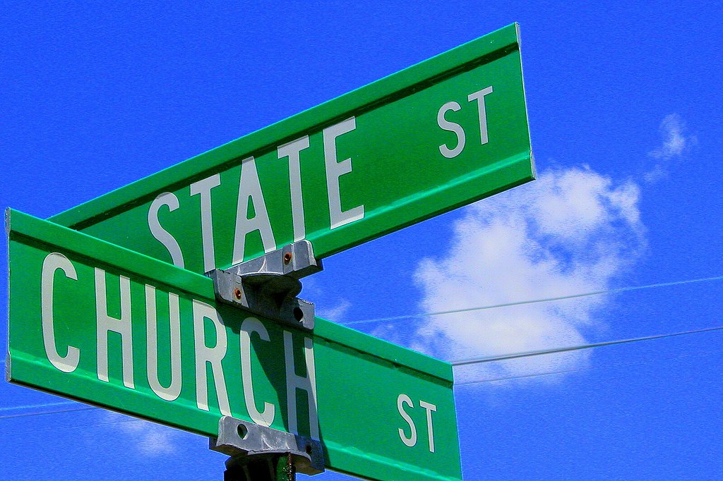
Catholic Charities Bureau, Inc. v. Wisconsin Labor & Industry Review Commission
Issue: Whether a state violates the First Amendment’s religion clauses by denying a religious organization an otherwise-available tax exemption because the organization does not meet the state’s criteria for religious behavior.
This Photo by Unknown Author is licensed under CC BY-SA-NC

Slide 39
Facts
Wis. State law provides unemployment taxes need not be paid by those “in the employ of an organization operated primarily for religious purposes and operated, supervised, controlled, or principally supported by a church or convention or association of churches.”
The petitioners are several sub-entities of Catholic Charities which provide services to individuals with developmental and mental health disabilities.
These sub-entities maintain they are “operated primarily for religious purposes” and that any contrary interpretation of the unemployment statute would violate the First Amendment’s Religion Clauses.

Slide 40
Wisconsin Supreme Court Ruling
Held that under the plain text of the statute; to meet the exemption, courts must examine both the motivation and activities of the organization. And that in this case, while the court did not question the sincerely held religious motivation of Catholic Charities, it concluded that its activities were not “operated primarily for religious purposes” within the meaning statute.
The court reasoned that if it agreed with Catholic Charities’ position and looked “to the church’s purpose in operating the organization only, then any religiously affiliated organization would always be exempt.”
The court concluded that the activities were primarily charitable and secular and not imbued with religious faith. Could have been performed by any secular group.

Slide 41
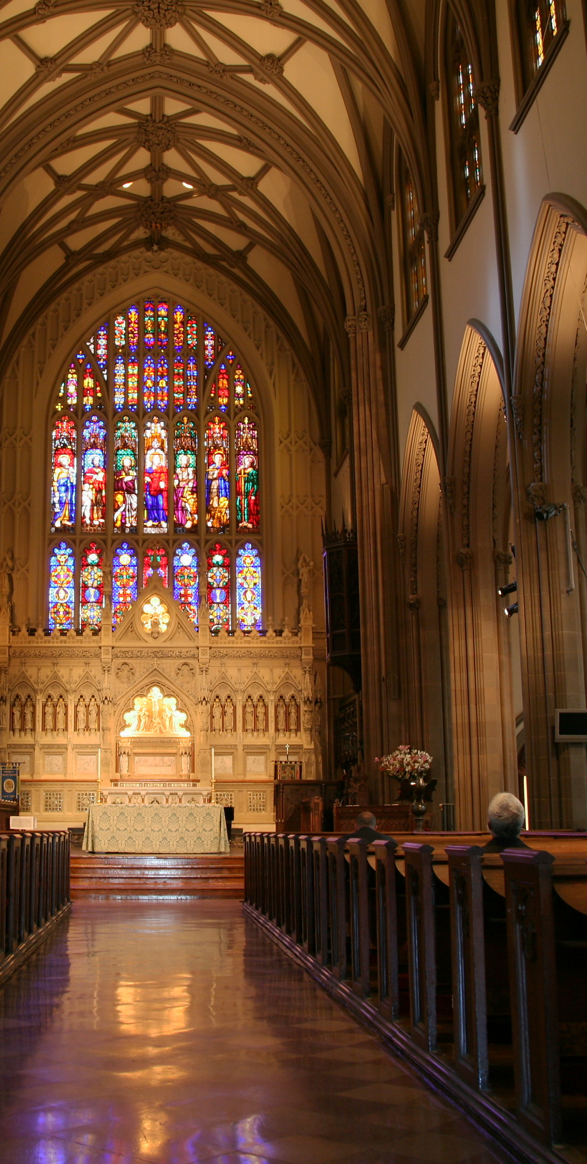
Free Exercise Arguments
Catholic Charities argued that the court was excessively entangling the state with religion by examining its activities via an “intrusive inquiry into the operations of religious organizations.”
Also argued that the Bureau’s interpretation of the law violates the Free Exercise Clause by penalizing Catholic Charities for its “beliefs regarding how [they] must serve those most in need.”
This Photo by Unknown Author is licensed under CC BY-SA

Slide 42
Implications for Local Governments
Could have implications for local governments that exempt religious organizations from various government taxes (sales, property, income) and programs. It could come up in the context of fees, zoning, and local antidiscrimination laws.
Depending on how broadly the Court rules, the decision could prevent governments from even making inquiries into an entity’s religious activities to determine if the exemption applies.

Slide 43
FCC v. Consumers’ Research
Issues: (1) Whether Congress violated the nondelegation doctrine by authorizing the FCC to determine, within the limits set forth in 47 U.S.C. § 254, the amount that providers must contribute to the Universal Service Fund; (2) whether the FCC violated the nondelegation doctrine by using the financial projections of the private company appointed as the fund's administrator in computing universal service contribution rates; (3) whether the combination of Congress’s conferral of authority on the FCC and the FCC’s delegation of administrative responsibilities to the administrator violates the nondelegation doctrine.

Slide 44
What is the Universal Services Fund?
One of the FCC’s core missions is to “make available, so far as possible, to all the people of the United States, … a rapid, efficient, Nation-wide, and world-wide wire and radio communication service with adequate facilities at reasonable charges.”
In 1996, Congress created a new framework to achieve universal service which directs the FCC to establish a set of programs known as the Universal Service Fund. Carriers that provide interstate telecommunications services must “contribute” to the Fund in accordance with the statute and FCC regulations. The Commissioner then uses the money in the Fund to subsidize universal service.

Slide 45

USF Programs
Lifeline Program – helps make communication services more affordable for low-income consumers.
High Cost Program – ensures consumers in rural / high cost areas have access to modern communications networks
Schools & Libraries (E-Rate) Program: Makes telecom and information services more affordable for schools and libraries.
Rural Health Care Program – provides funding to eligible health care providers for telecommunications and broadband services.

Slide 46
Fifth Circuit En Banc Concludes Congress Violated the Nondelegation Doctrine
Congress “may have delegated legislative power to the FCC” by conferring tax power without supplying an “intelligible principle to guide FCC’s discretion.”
And the FCC “may have impermissibly delegated the taxing power to private entities.”
Court was skeptical of both of these actions but ultimately held that it was the combination of them that violated the nondelegation doctrine. (Impermissibly delegating Congress’s Legislative power).

Slide 47
Importance of this Case
USF programs provide vital support to local governments. The 4 sub-programs all play a significant role in supporting local governments and dismantling the USF would harm communities around the country, particularly more rural communities.
For example, improved connectivity expands the reach of communication networks needed for 9-1-1 and other public safety services in remote areas.

Slide 48
Questions?
Amanda Karras: akarras@imla.org or 202-742-1018
Become a IMLA member: https://imla.org/become-a-member/

