Slide 1

Macro & Micro Trends in Communications
National Association of Regional Councils
Annual Conference, June 10, 2025

Slide 2
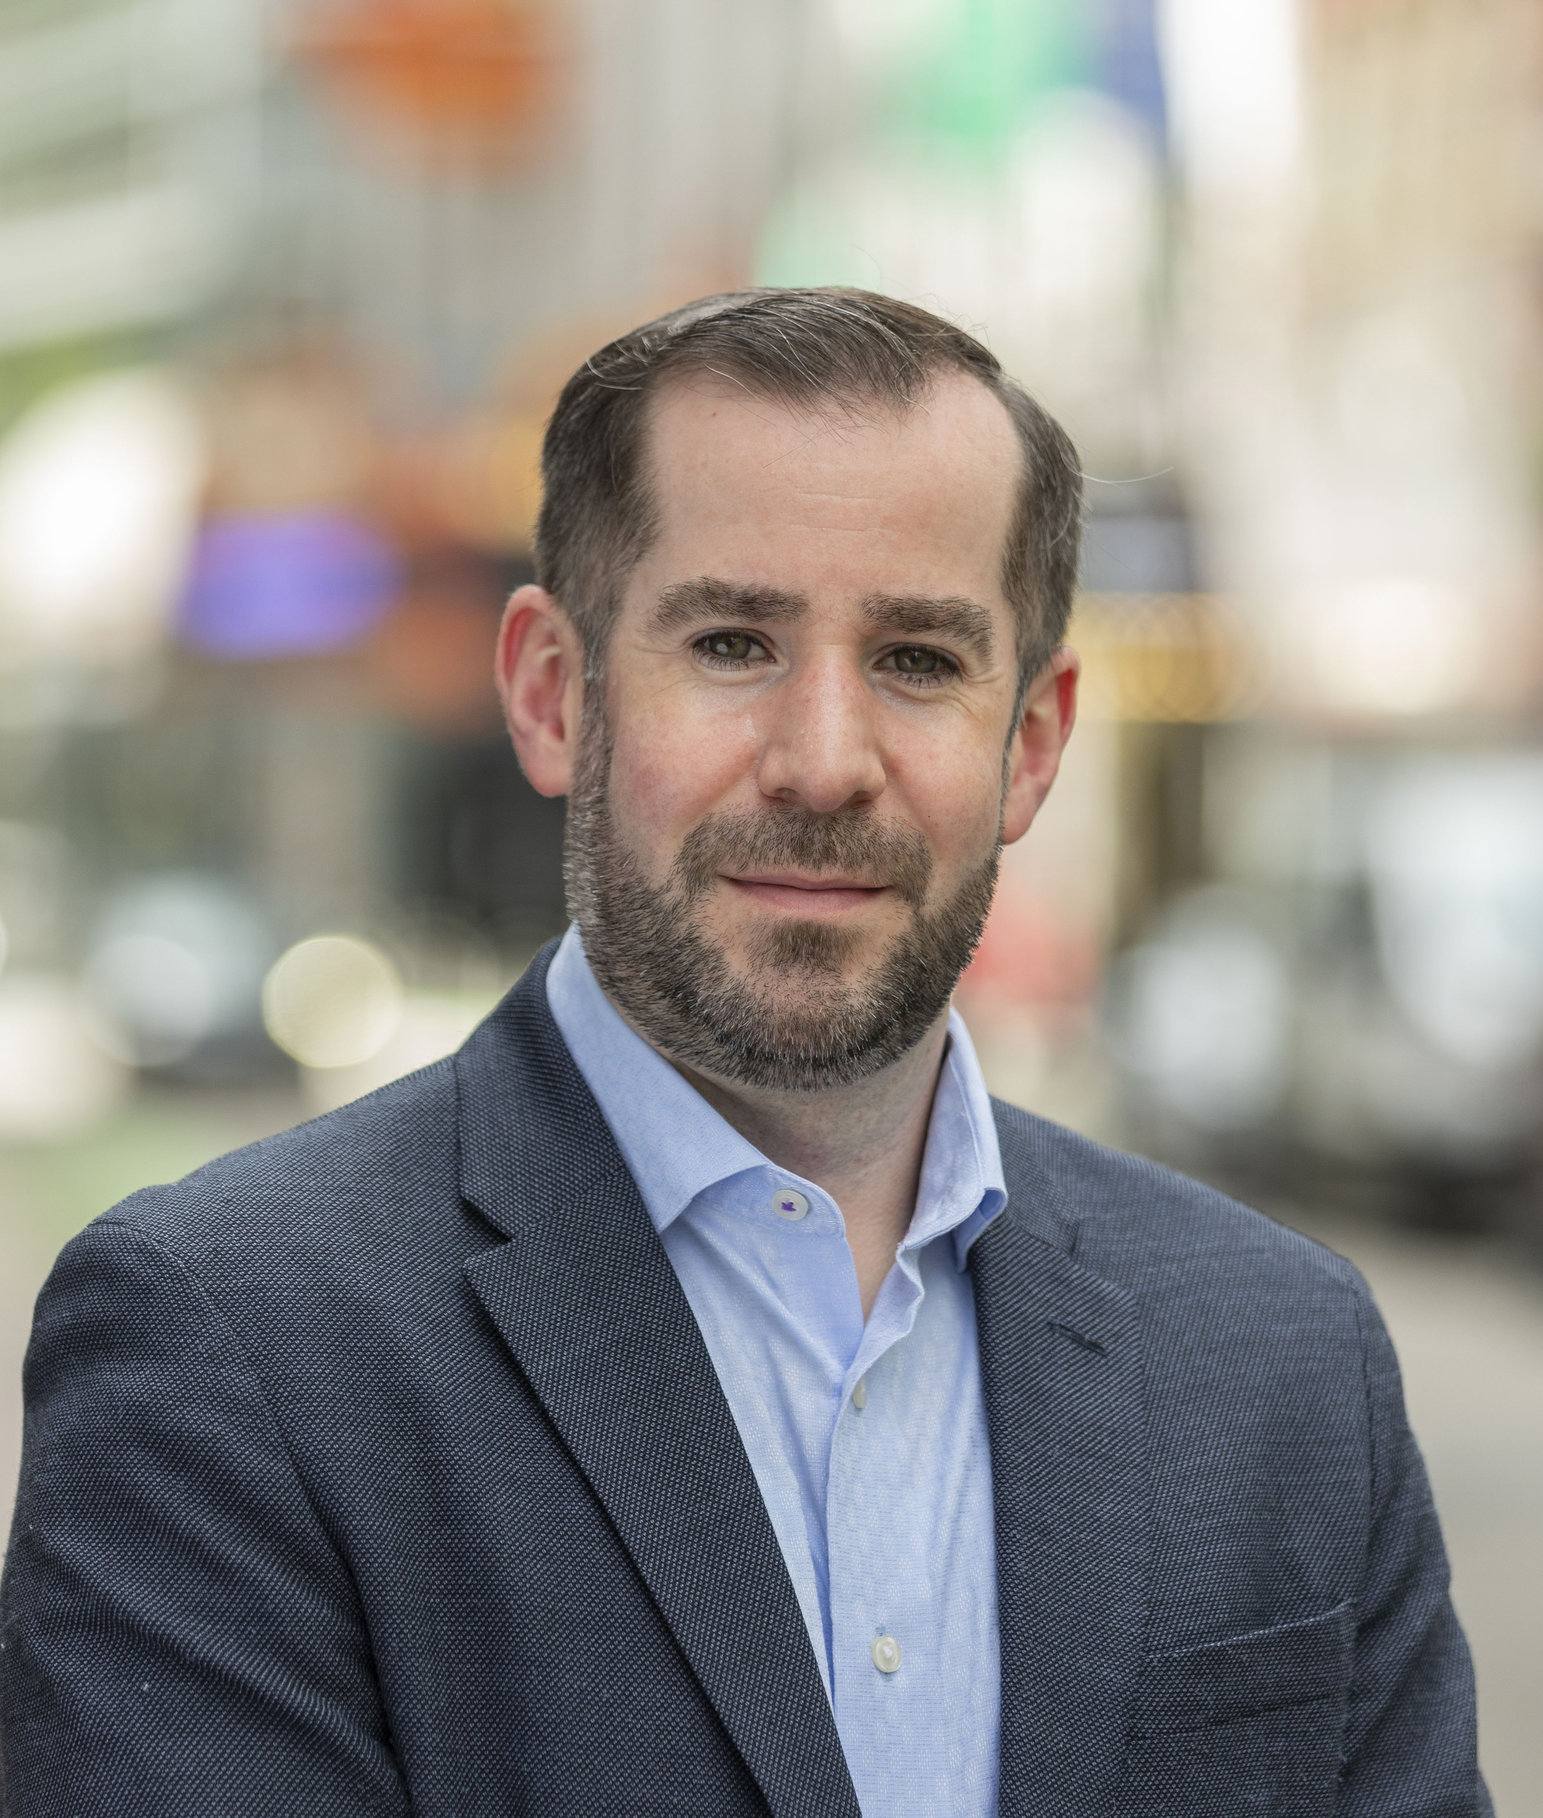

Speakers
Tim Viall
Senior Communications Specialist
Metropolitan Area Planning Council
Emma Koontz
Council Engagement Specialist
Metropolitan Area Planning Council

Slide 3
Presentation Overview
1. We’ll Start Back in 1963
2. MAPC and Our Region
3. Council & Engagement
4. Community Engagement
5. Council Approach & Evaluation
6. Case Study: Communication Strategies
7. SWOT Analysis
Communication Recommendations
National Trends
Questions and Conversation

Slide 4
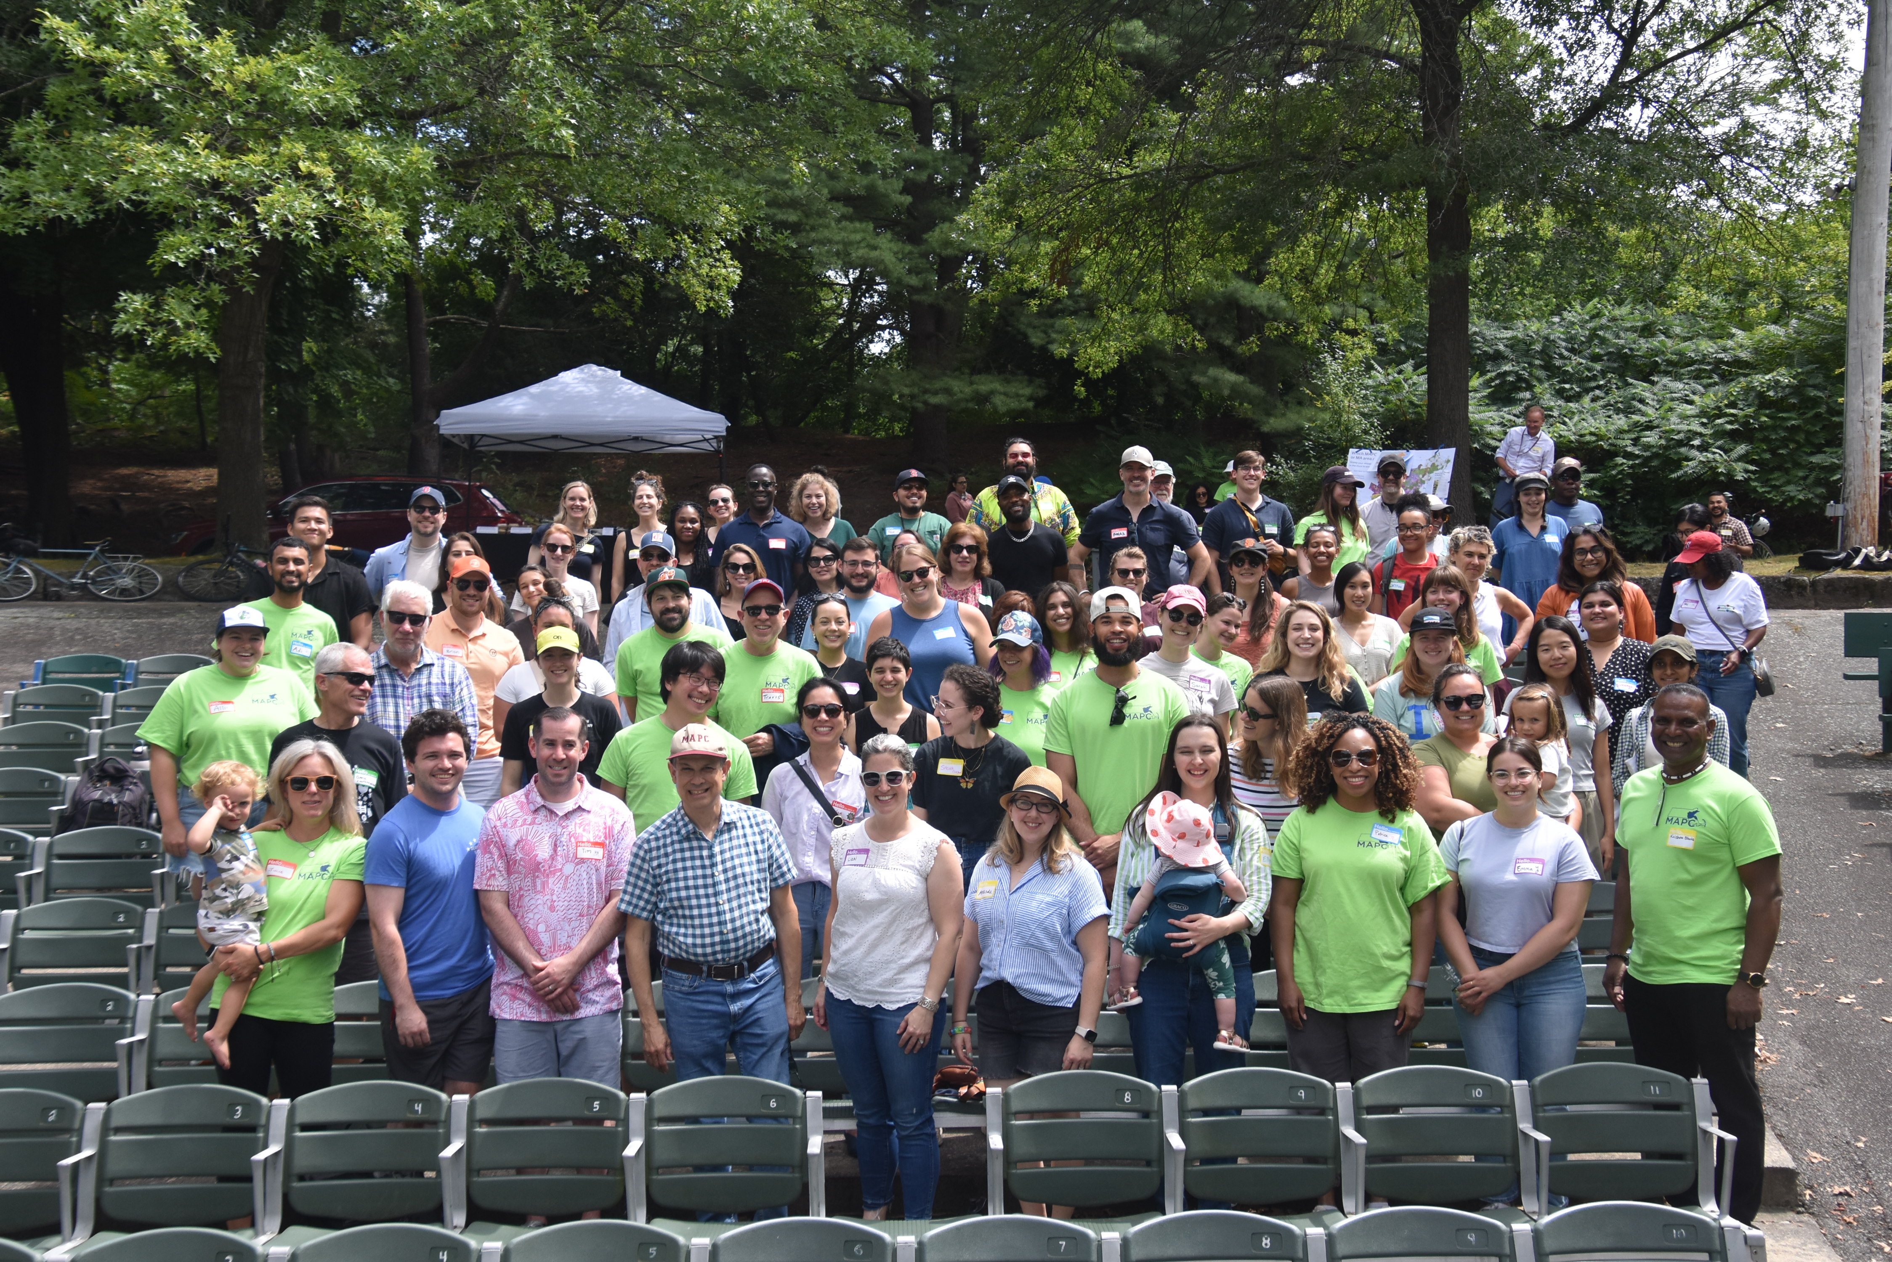
What is the Metropolitan Area Planning Council?
The Metropolitan Area Planning Council (MAPC) is the regional planning agency serving the people who live and work in the 101 cities and towns of the Metropolitan Boston region. Massachusetts Towns by Population (2020 census)
We are divided into eight Subregions
Our governing body is a council of 134 voting members + alternates. 25 of which are elected to serve convene more frequently and get deeper into the weeds.
MAPC 2024 Summer Outing

Slide 5
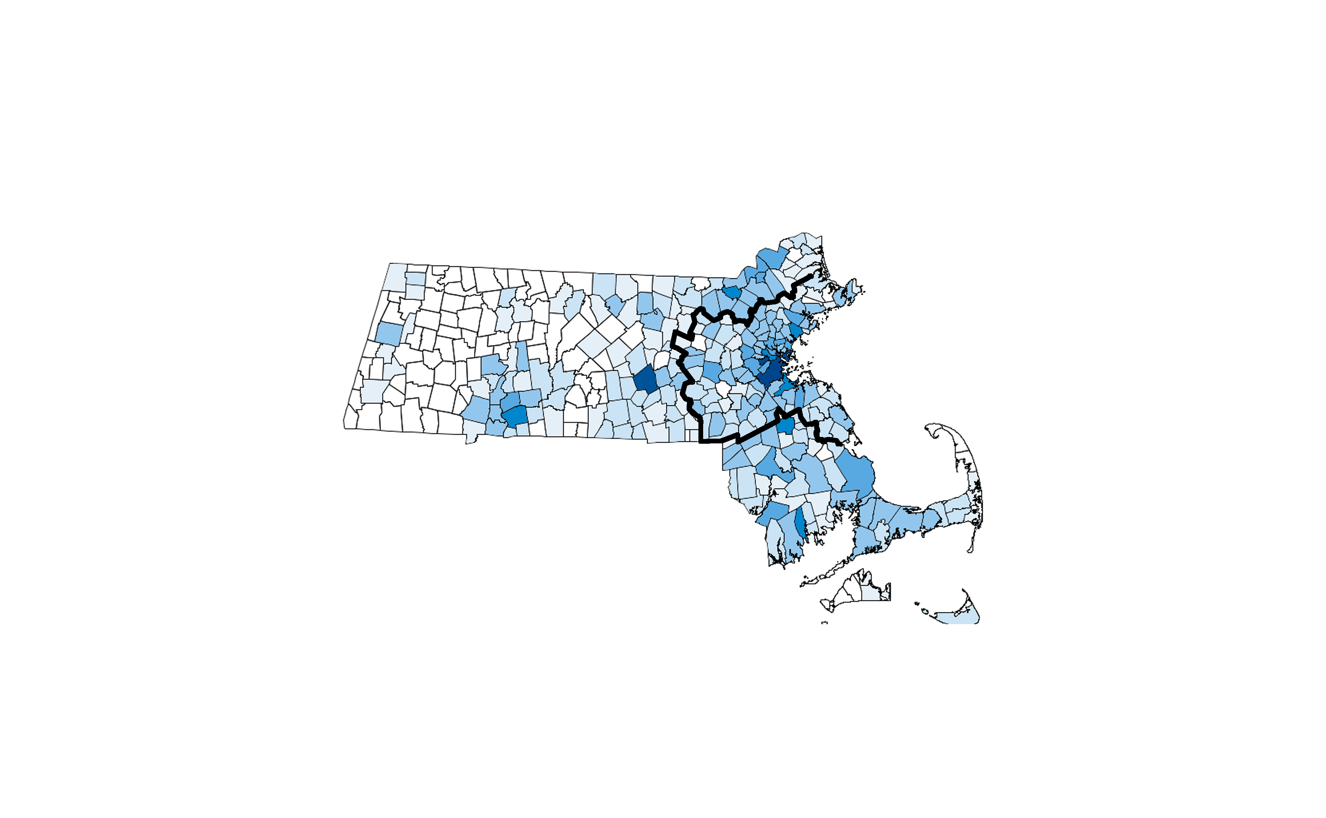
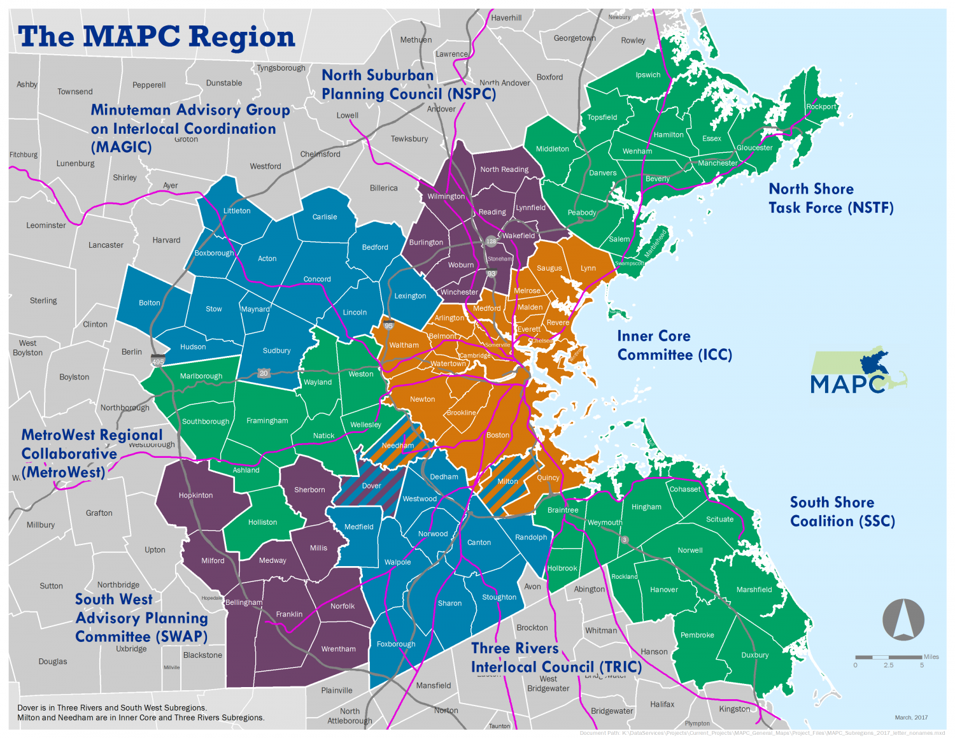
Geography
Massachusetts Towns by Population (2020 census)
MAPC Region and Subregions

Slide 6

Council Structure
Council Members
Executive Committee
Officers

Slide 7
What does a Council Engagement Specialist Do?
Communication
Council Members Bringing Value
Council Member Representation
Internal Systems
Relationship Building
Community Engagement

Slide 8
Council Engagement Value
Better
Informed
decisions​
More opportunities for collaboration​
Deeper connection to what’s happening on the ground

Slide 9
Impact
Since September 2024 (9 months):
33 seats filled
Council Orientation (46 attendees) - approximately 50% more than usual.
Winter Council Meeting - 81 council members (27% increase) with 75 seats represented.

Slide 10
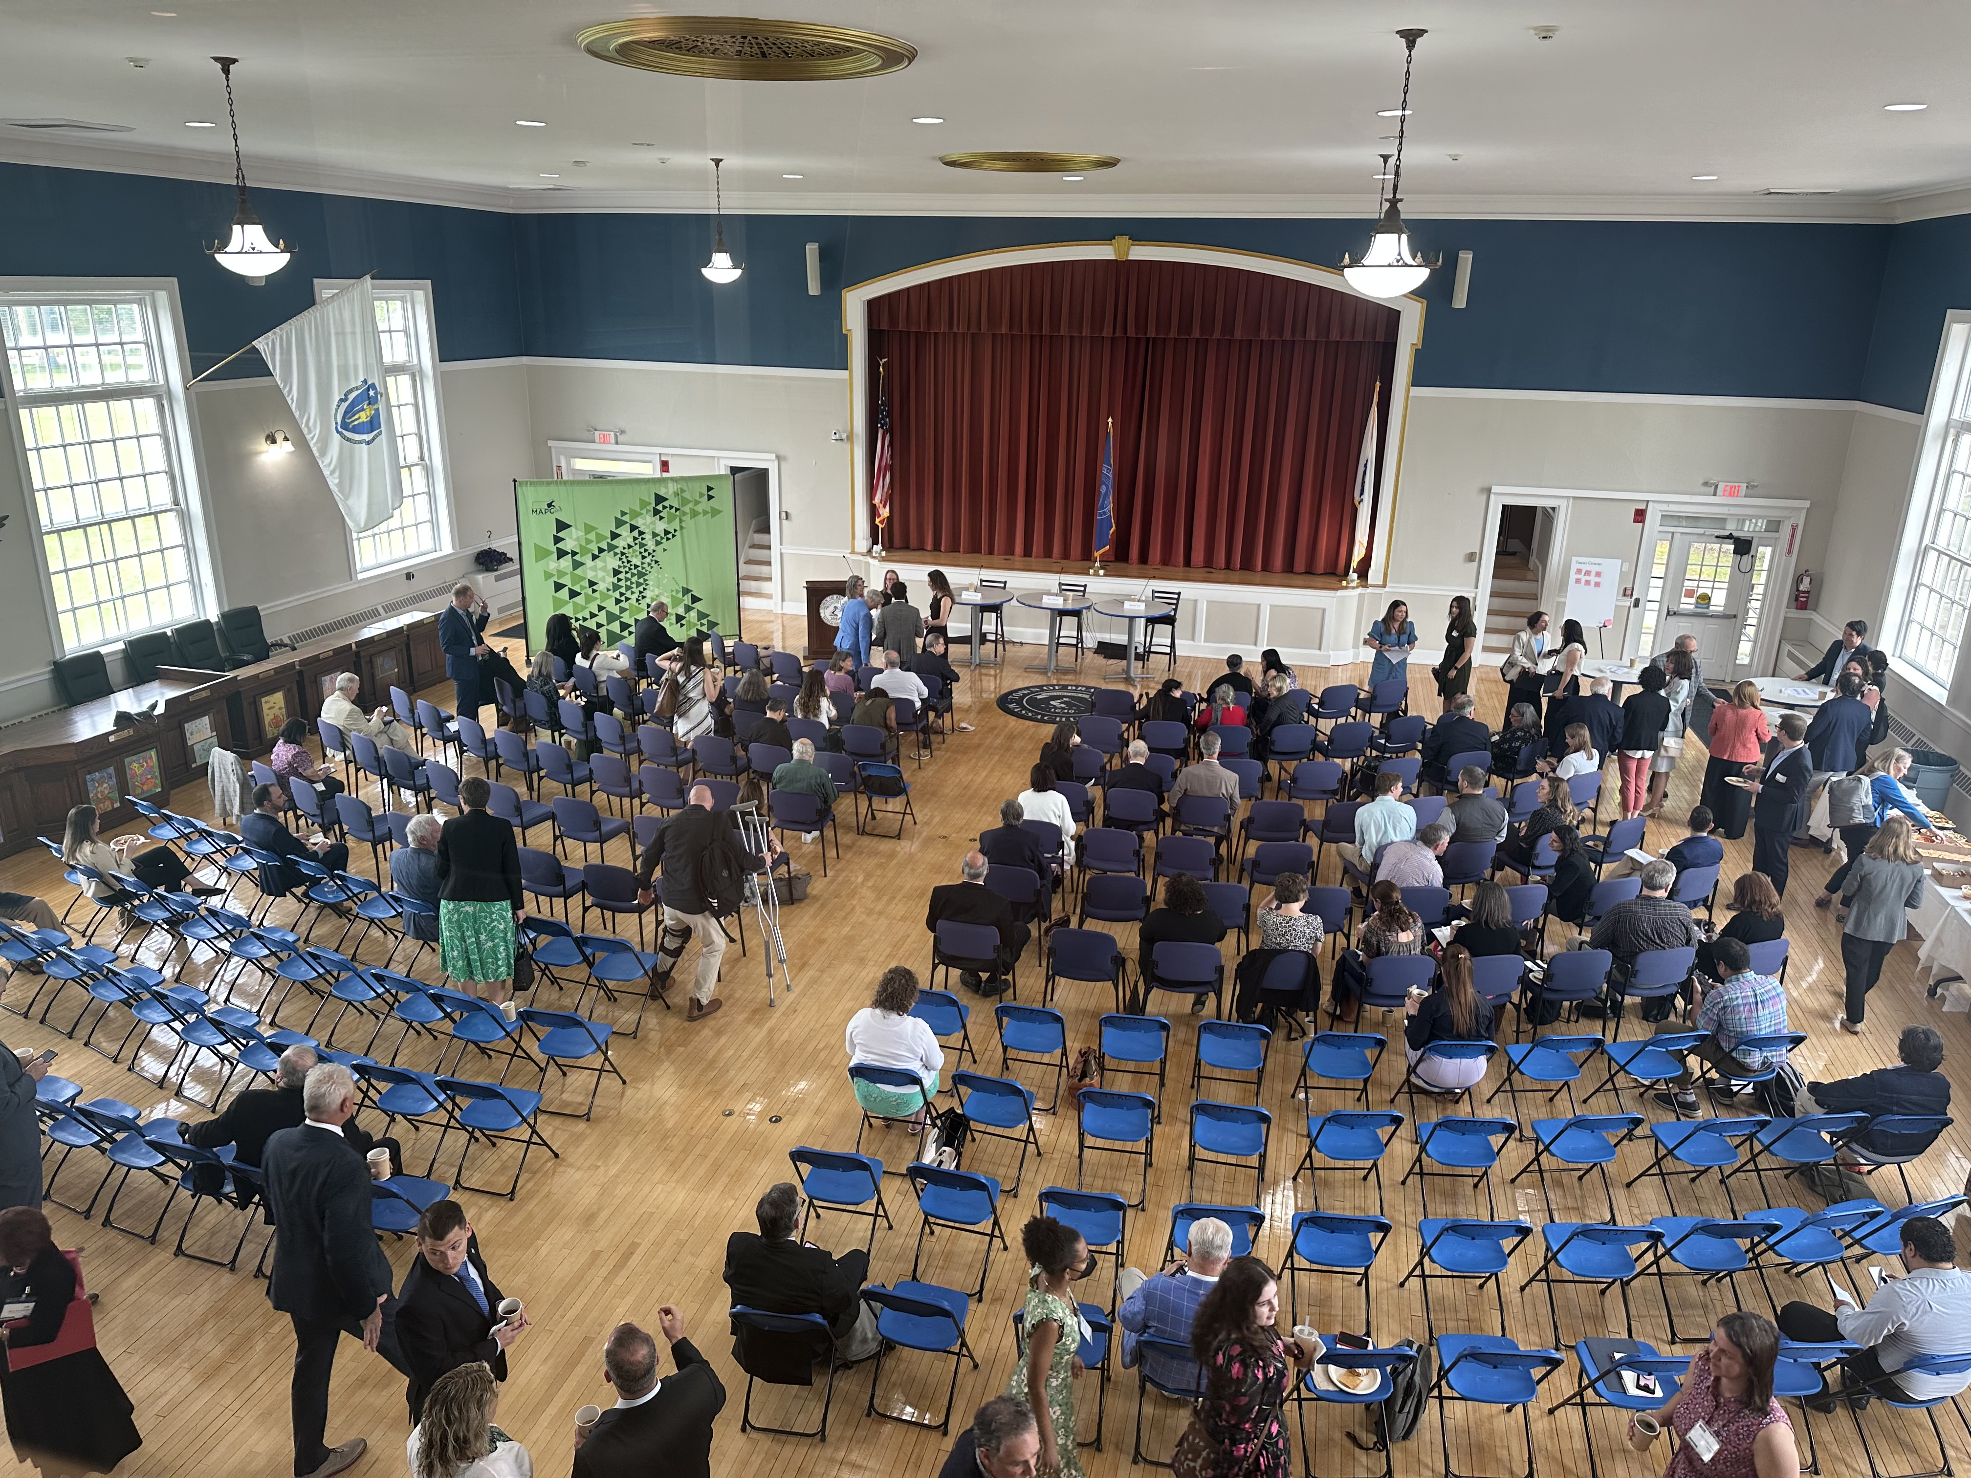
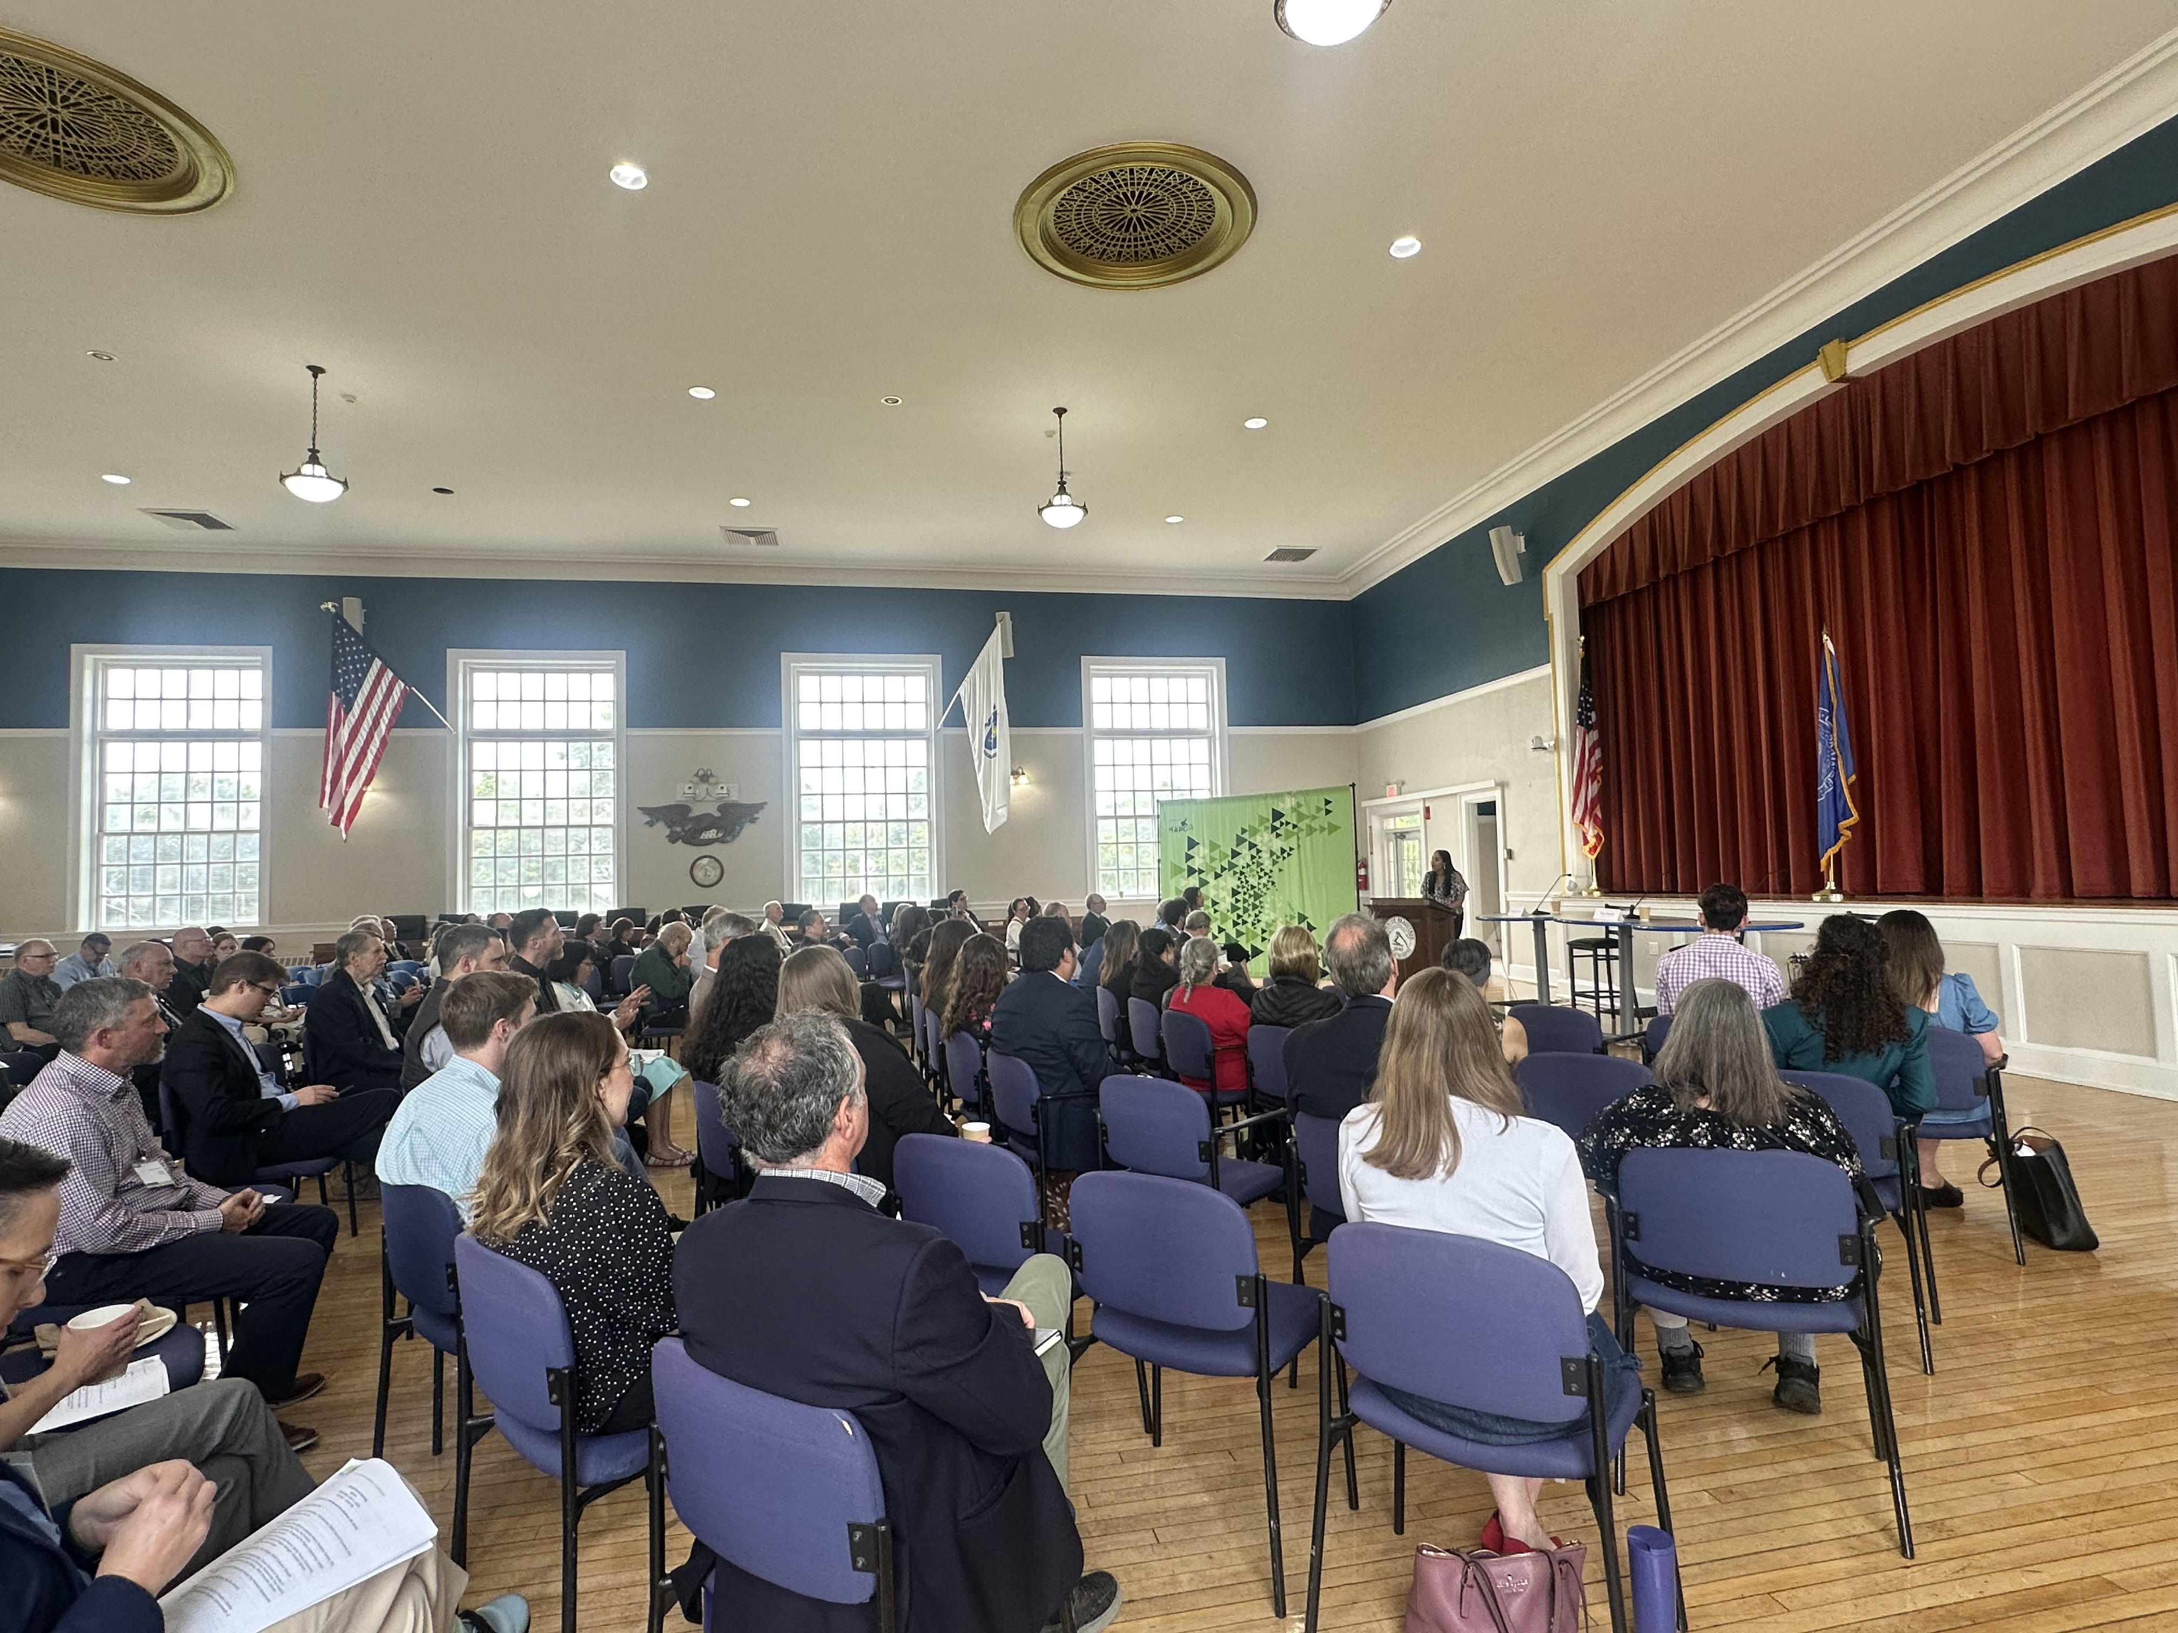
2025 Annual Council Meeting
June 4, 2025 Braintree, Mass.

Slide 11
Quick Council Tips
Responsive and Timely – ideally within a business day at most within a week
Personal Outreach – work with Subregional Coordinators
Scaffolded Networking – let folks connect with each other
One-on-Ones – get to know council members as people
  What brought you to the work?
  What brought you to the council?
  What if anything would you change?

Slide 12
Community Engagement Process
Purpose of Engagement
Landscape Analysis
Evaluation
Approach
= Close Triangles

Slide 13
Landscape Analysis
One-on-One Conversations
Meeting Folks Where They’re At
Leadership
Council Meeting
MAPC Staff
Subregions
Council Members
ExComm

Slide 14
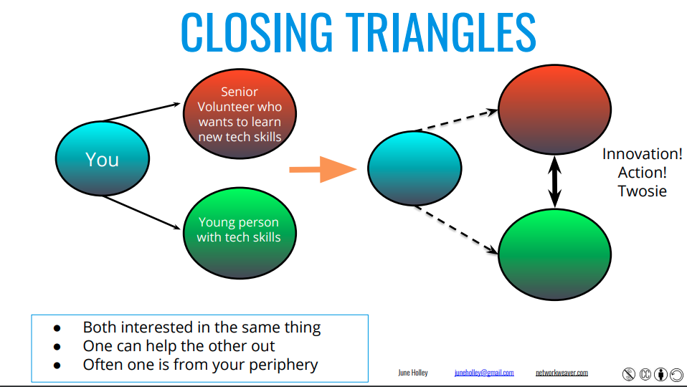
Closing Triangles

Slide 15
Council Approach
Increase Touchpoints: If I left, how would council members still feel connected to MAPC?
Build staff understanding of the council and find ways to showcase staff work
Source potential council members from staff based on who they’re working with on projects
Invite council members to other MAPC events
Connect Council Members to each other

Slide 16
Council Tactics Evaluation
Metrics
Talking to council members in one-on-one
Council Members’ perceived value of the meeting
Meeting attendance
Seats filled
MAPC staff awareness of the council

Slide 17
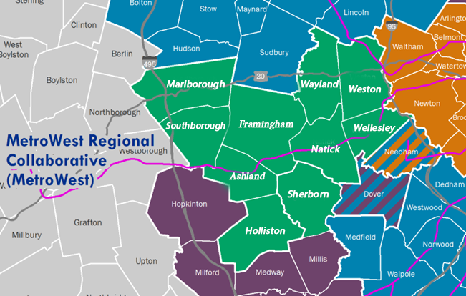
Case Study: Reporting on Communication Strategies and Opportunities in MetroWest
2 cities, 8 towns
Framingham ~72,000
Marlborough ~41,179
Natick ~37,000
Wellesley ~29,600
Ashland ~18,800
Holliston ~15,000
Wayland ~14,000
Weston ~11,900
Southborough ~10,500
Sherborn ~4,400

Slide 18
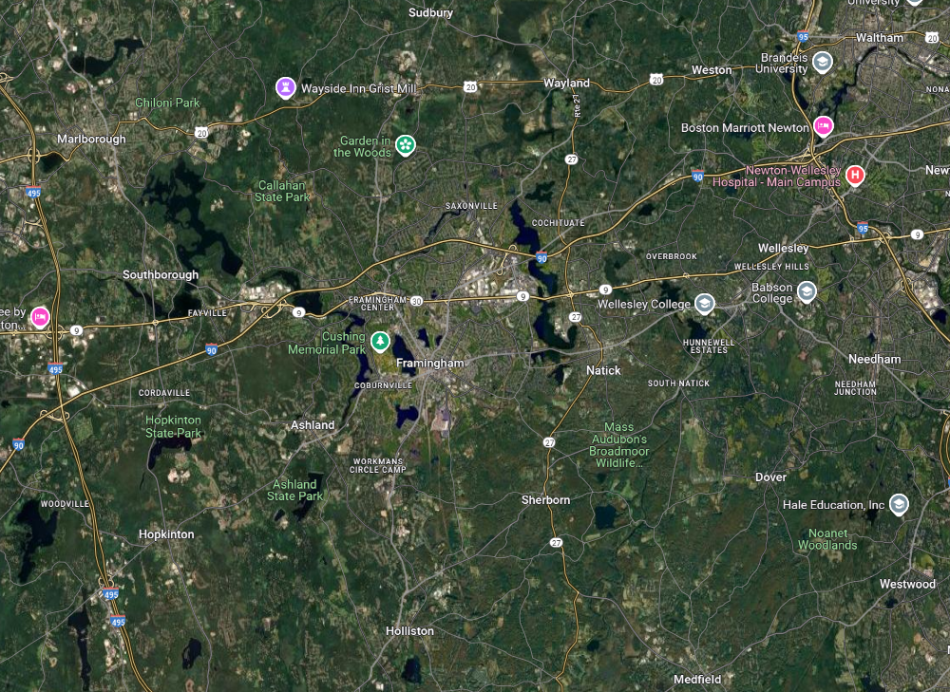
Google Maps Satellite View, MWRC

Slide 19
Community & Project Fast Facts
Spoke with:
  Town managers, assistant town managers, executive assistants to the town manager, PIOs, one communications director, two DEI directors/officers
Home to Framingham State University, Mass. Bay Community College, Babson College, Wellesley College, Regis College
70+ languages spoken in Framingham Public School System
One community doesn’t translate anything
One community uses 10+ social media channels
One of the wealthiest towns in Massachusetts
MAPC Staff
Subregional Coordinators
Subregions
One-on-One Conversations
MAPC Staff
Council Members

Slide 20
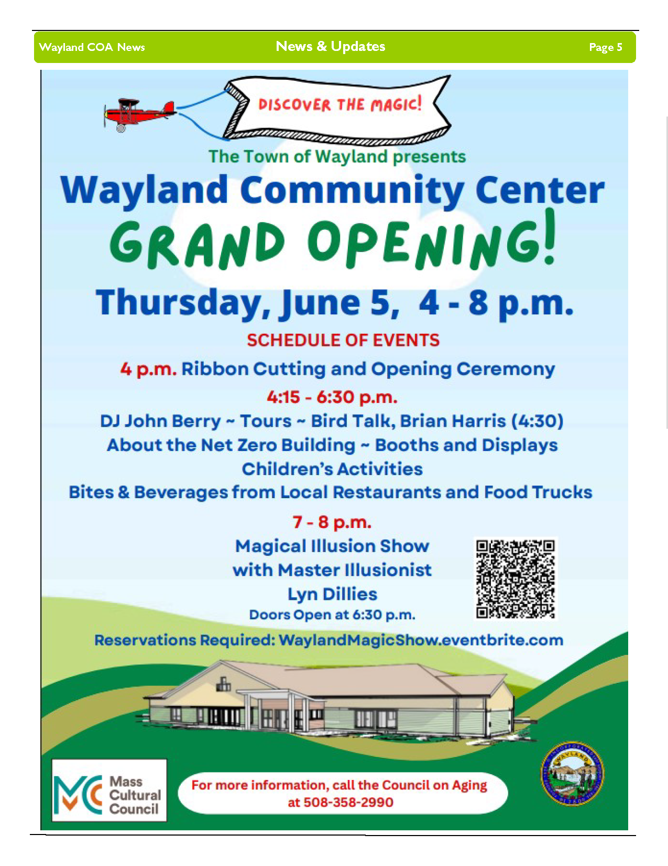
Communication Strengths
Partnerships
  Libraries, senior centers, local TV/cable access stations, some school districts
  Other departments – most communications still run through a centralized structure, or hub & spoke model
When municipal teams are local – can live in the community they serve
Cultural Diversity
Newsletters
Technology expanding access; availability of information online
Wayland, Mass. newsletter
Notes:
Newsletters – some communities have 1,000 subscribers, some have 5,000, some are just getting theirs started
Framingham has largest Brazilian pop. Outside of Brazil
Local newspaper
Goes to one community free of charge
Individuals who are generall content, satisfied, good turnout at town meeting
“Most of our communities, the residents who live there are very satisfied and don't need to be spoon fed.

Slide 21
Technology Expanding Access
“I know several people that have hearing loss, and let’s face it, some of our rooms are not great acoustically. We’ve got fans that blow, microphones that sometimes you can’t hear in the back of the room. That’s just the perspective of a few people that I know.”
“They hear much better when they dial in on Zoom. So they’re engaged and listening to what the select board is saying. That’s something I hope that never goes away, basically a silver lining with COVID.”
Fear of public speaking
Avoid going out at night or in bad weather
No need to secure childcare
More convenient for individuals with disabilities

Slide 22
Communication Weaknesses
Choices to access information
Pockets of community that, no matter what, can’t be reached
Not enough staff, or time
  Web masters, communications director, HR responsibilities
Shoestring budgets
Websites
Lack of local newspapers
Not being customer friendly
Notes:
Access to information – all of your options of consuming info are online – and residents last internet access?
feeling the need to be on every platform.
- rush to join new platforms that only reach small pockets of community
talking to the same group of engaged people over and over again (5) – same people showing up to town meeting
“having” to keep town hall opent o 7 p.m. for people to do things in-person. Staffing issue. “And you know, I think as I consider the cost of local government and therefore the end result, which is higher local taxes, I'm always looking for ways to mitigate that.” The efficiencies I can find all rely on people beginning to utilize certain things remotely and then I could free up a lot of availability of other resources or reduce costs.”
(6). Also young people in 20s, 30s, with no kids (2);
“If you have the staff you should”
Not reaching a diverse, linguistical and racial community representation
newsletters take “an incredible amount of time”
not having a dedicated webmaster. Not having user-friendly websites; not having full control of websites after updates: “- Like, I mean, you literally have to. You have to search or you have to know the department or you have to know these. I mean the answer is everything cannot be on the front page of the website, but that's a common refrain.” Holliston
- residents not knowing what keywords to search for on website
- competing departments for “top spot” on website
communications not being a priory of prior administrations / shifting priorities
“having” to keep town hall opent o 7 p.m. for people to do things in-person. Staffing issue. “And you know, I think as I consider the cost of local government and therefore the end result, which is higher local taxes, I'm always looking for ways to mitigate that.” The efficiencies I can find all rely on people beginning to utilize certain things remotely and then I could free up a lot of availability of other resources or reduce costs.”
work split with HR – overworked staff
Mass. only uses 2-3 vendors for sites. All look the same.
Spending thousands of dollars on website updates w/out central control

Slide 23
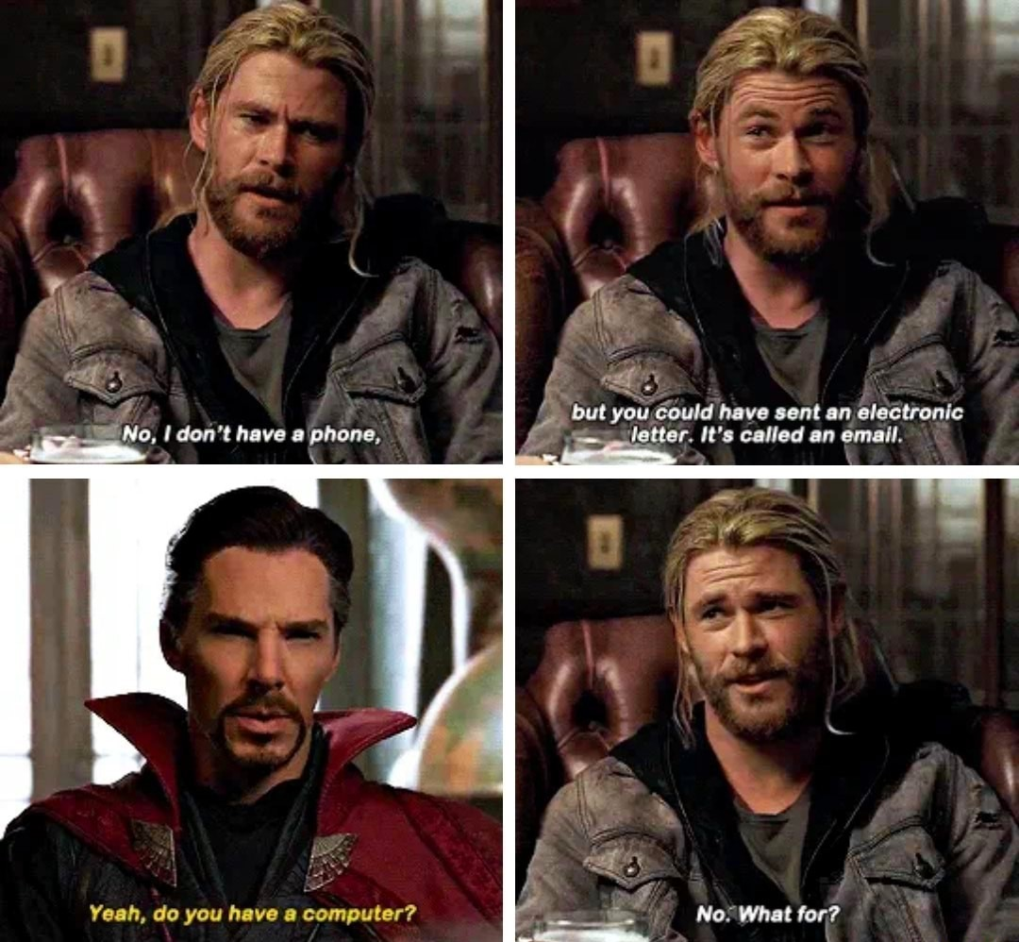
“It's never enough. Not everyone gets information or wants the information in the same manner. You know some people don't want you to clog up their inbox with a bunch of emails about what's going on in the town. Some people are expecting that they're going to get something mailed to them saying, you know, hey, there's a meeting on Thursday, you should be aware of.”
“Often times I feel like people want me to start a newspaper, and I’m like no, that’s not my job.”

Slide 24
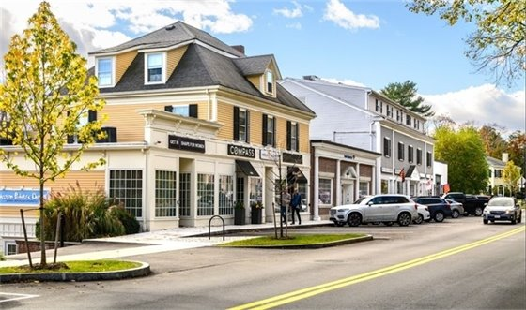
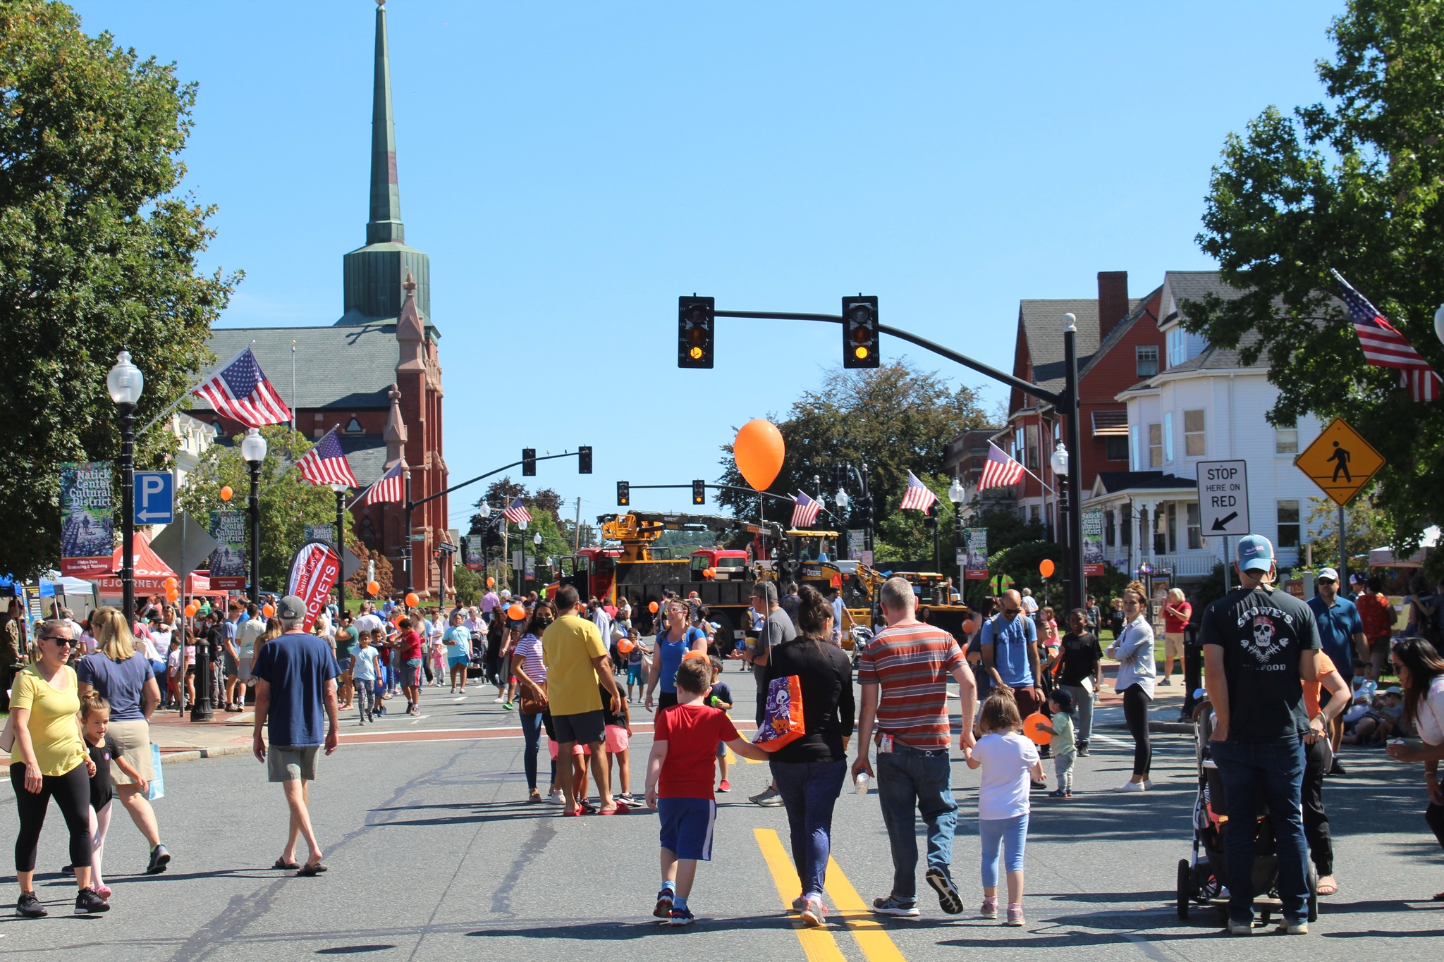
“There’s not a central gathering place in town. We're a very residential community. There's not a big business district, so there's not really that like centralized place that the community has to go to, and get information. So, outside of going to every door in the community. We don't really have that ability to get to where people are because there really isn't a place where the people are.”
Weston, Mass.
Natick Center Cultural District
Notes:
– no centralized business district

Slide 25
Communication Threats
Misinformation
An “us vs. them” attitude
Language barriers, lack of access to the internet,
  digital divide
Social media
Mandates, legal requirements, lack of internal support
“People think they know everything. People who disagree only for the sake of arguing. Posting negative thoughts on our happy posts, even ones with kids. The negativity turns other people away, and people can spew whatever they want… It’s a microcosm of what’s wrong with social media.”
Notes:
A citizens academy is “designed to educate and engage residents about how local government works,”

Slide 26
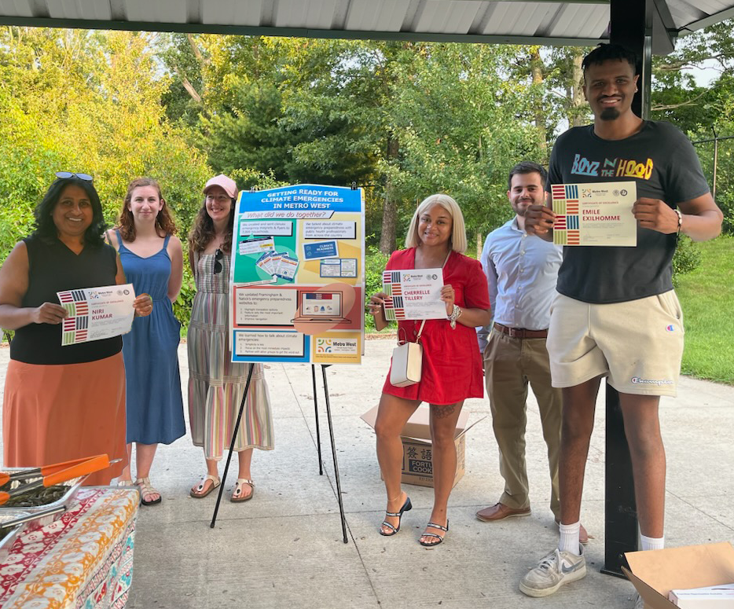
Communication Opportunities and Recommendations
Citizens academies
Communications liaisons
“How-to” videos
Building relationships
University, college, and high school interns
“I'm focused on figuring out how to build those relationships, not just with the organizations or the nonprofits, but the individual residents who can have this, like huge impact on the community.”
MetroWest Climate Liaisons
Notes:
A citizens academy is “designed to educate and engage residents about how local government works,”

Slide 27
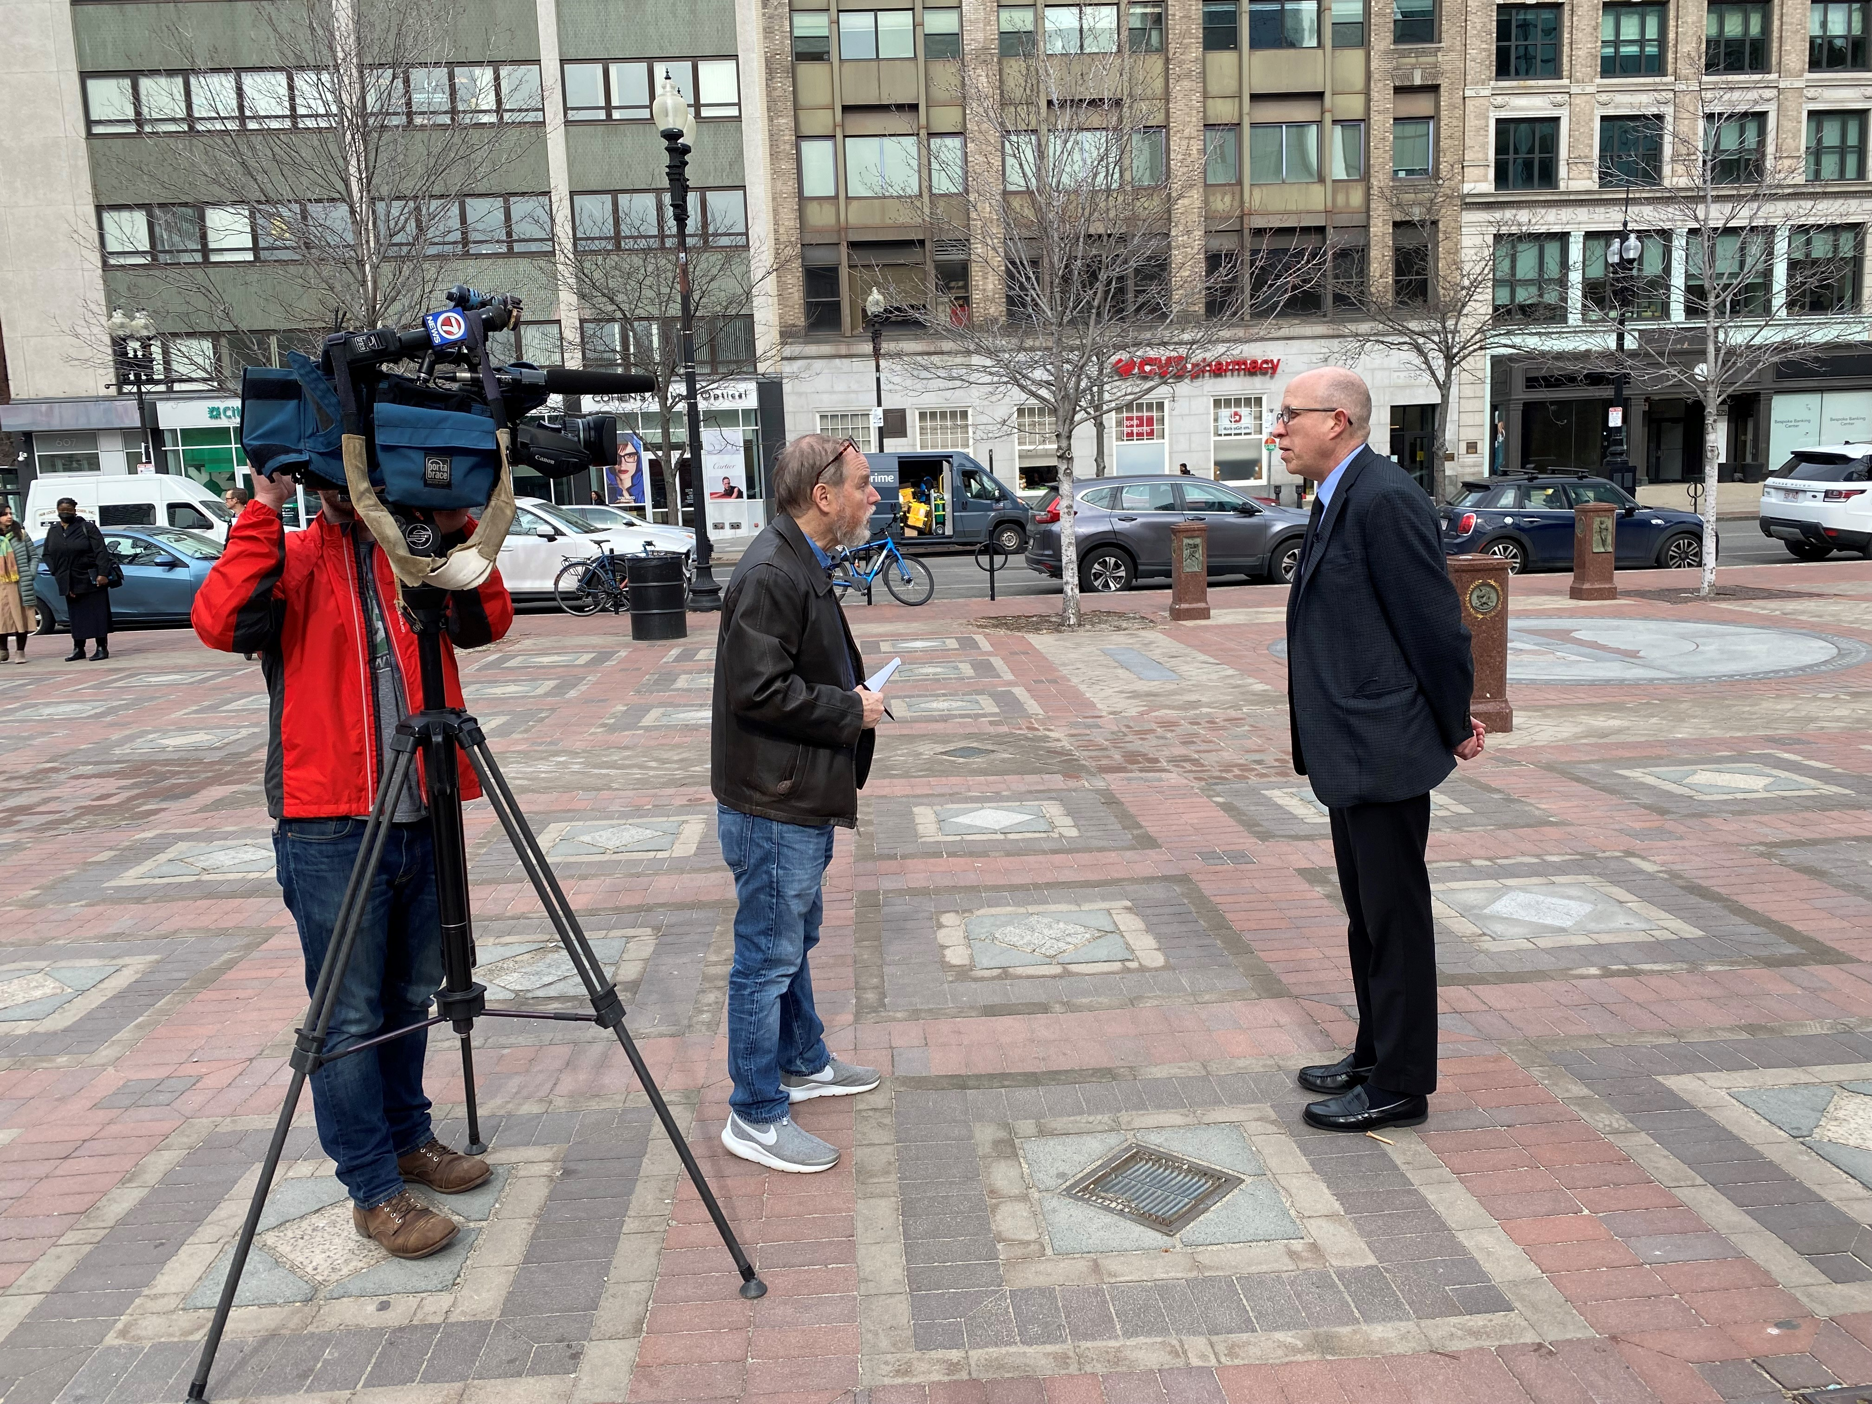
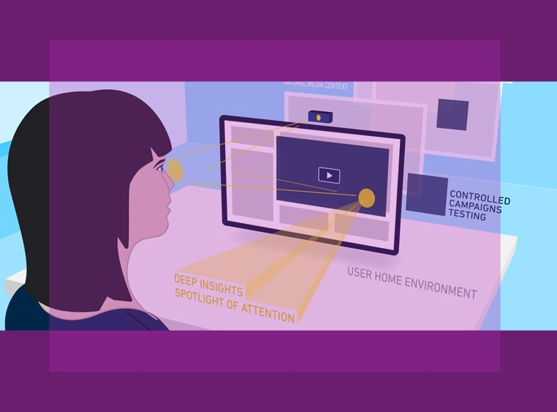
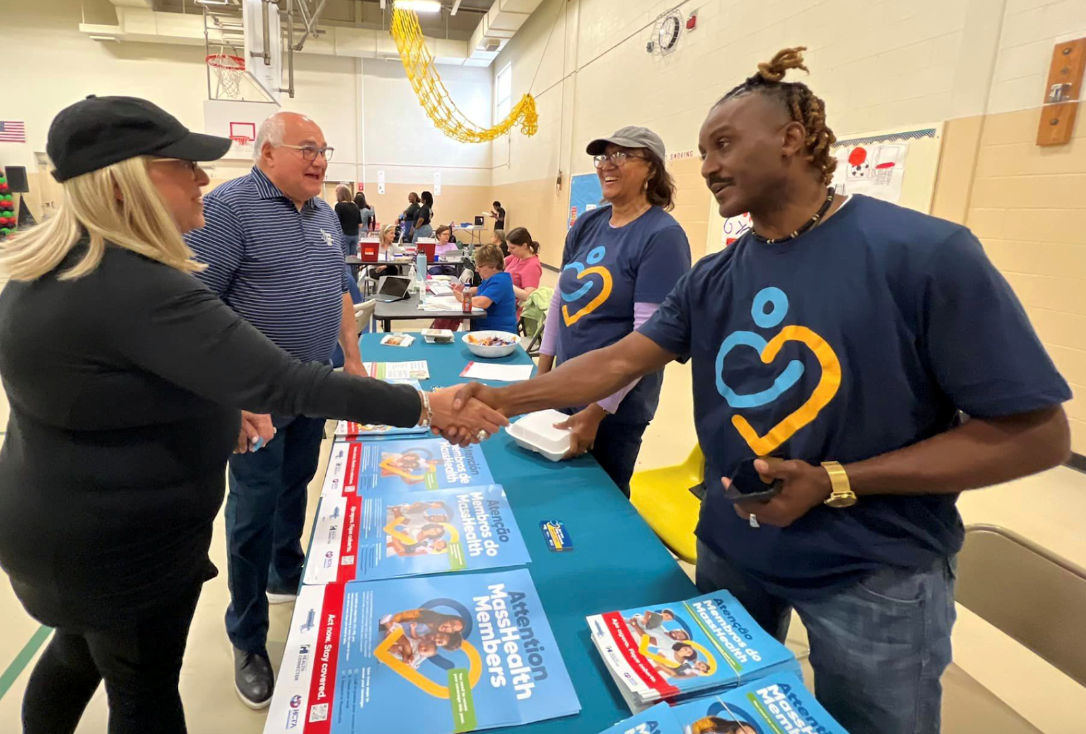
Communication Opportunities and Recommendations
Trainings
Online tools
Technical assistance for communication-focused projects
Engage “younger” audiences
Show the great work
Notes:
Communication is both a science and an art
GARE ACT Principle
eye tracking

Slide 28
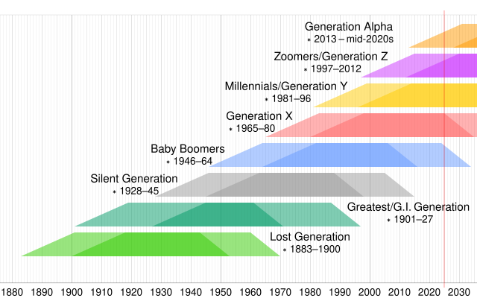
National Trends
Almost a third of Gen Z lives with their parents — the highest percentage in the past century – 2025 APA Trend Report
Taking a “digital detox” has become an increasingly common practice.
  Avoiding online news; worry about distinguishing real and fake information
Digital detox hangouts
Epidemic of loneliness
Conflict resolution
Use of libraries
Notes:
Generation Z, born between 1997 and 2012, will be between 13 and 28 years old. As the first social generation to have grown up with access to the Internet and portable digital technology from a young age, members of Generation Z have been dubbed "digital natives"[6] even if they are not necessarily digitally literate[7] and may struggle in a digital workplace.
due to declining housing affordability, higher unemployment rates, and delays in marrying and starting families.
In the U.S., nearly half of
Gen Z says they wish major social
platforms were never created, and
almost all of them try to reduce
screen time.
A 2024 Reuters
report found that 72 percent of
Americans are worried about distin
guishing
between real and fake in
formation
in online news.
Disconnecting from high end digital tech or
In the Netherlands, there’s a growing movement for screen-free public spaces and
it
highlights the importance of both
online and in-person experiences.
Planners will likewise need to bal
ance
digital public engagement with
face-to-face interactions, fostering
meaningful communication and
empathy within communities.
Disconnecting from high end digital tech or taking a “digital detox” has become an increasingly common practice.
encouraging people to disconnect from their devices to foster better communication and personal connections.
constructed play areas, while others
offer sports equipment rental and
free hearing aid batteries. In rural
communities, libraries can be a
source of food and clean drinking
water, and some are serving as cli
mate
resilience hubs. Planners
should be aware of the many ways
in which libraries can support the
local community, which can also
serve as a signal of municipal
Libraries step up to fill social
shortcomings.
service gaps
The role of libraries as public spaces
continues to evolve as they increas
ingly
expand the number and types
of services available. Today’s librar
ies
may lend out clothing along with
books and provide language prac
tice,
health screenings, and job ap
plication
assistance. Some have
The persistence of the “epi
demic
of loneliness“ has impacted
some cities’ approaches to planning.
In February 2024, San Mateo
County, California, became the first
local government in the U.S. to clas
sify
loneliness as a public health
emergency, and policymakers in the
Belgium municipality of Woluwe-
Saint-Pierre must now consider
how their legislation impacts single
people. The
today’s diverse and polarized communities, the human skills
of active listening, cultural humility, and self-awareness are
essential. Fostering trust and collaboration requires planners to
communicate effectively about sensitive topics, such as climate
change and equity.
Conflict resolution is another critical skill for planners.
APA’s online training Mastering Conflict for Effective Planning
teaches strategies to diffuse tensions and uncover community
concerns, while Empathy, Equity, and You emphasizes using
compassion to co-create equitable solutions.

Slide 29

The perfect escape from our online world
Why the new luxury is flip phones and vinyl LPs
Newsletters returning to print (and being mailed out)
Concern with generative AI
Embrace of analog technologies like flip phones
Cultivating in-person interaction, like social and members clubs
“While society is nowhere close to abandoning computers writ large, there are signs that we are reaching peak digital saturation. This has felt especially true in the years following the screen-addled pandemic, in which there’s been a concerted push towards spending more time in person.”
Notes:
Written in Sep 12, 2024
Sales for flip phones or “dumb phones” without real access to the internet, have been on the rise for the past two years
A group of flip phone-carrying teens who formed a “Luddite club” embodied the face of a new youth movement after they were covered by the New York Times.
“Print, too, is on the rise, from books to magazines to newspapers. Print book sales had a pop with the pandemic in 2020, and have continued to maintain sales of more than 750 million units sold each year. Meanwhile, even though they’re cheaper, sales for ebooks are down slightly, which may be owed to the fact that younger readers, much like older generations, overwhelmingly prefer printed formats.

Slide 30
Your Thoughts and Questions
Tim Viall
tviall@mapc.org
Emma Koontz
EKoontz@mapc.org
Thank you for joining us!
Notes:
A citizens academy is “designed to educate and engage residents about how local government works,”

