Slide 1
Transforming Regional Economic Potential and Quality of Life Through Active Transportation
NARC ANNUAL CONFERENCE 2025
Mary Ellen Koontz
TrailNation Collaborative Lead
Rails to Trails Conservancy
Notes:
INTRO
Were any of you on the trail tour yesterday or have gotten out to see the incredible bike/ped infrastructure across Salt Lake City the last few days?
How many folks are involved in active transportation in your professional life?

Slide 2
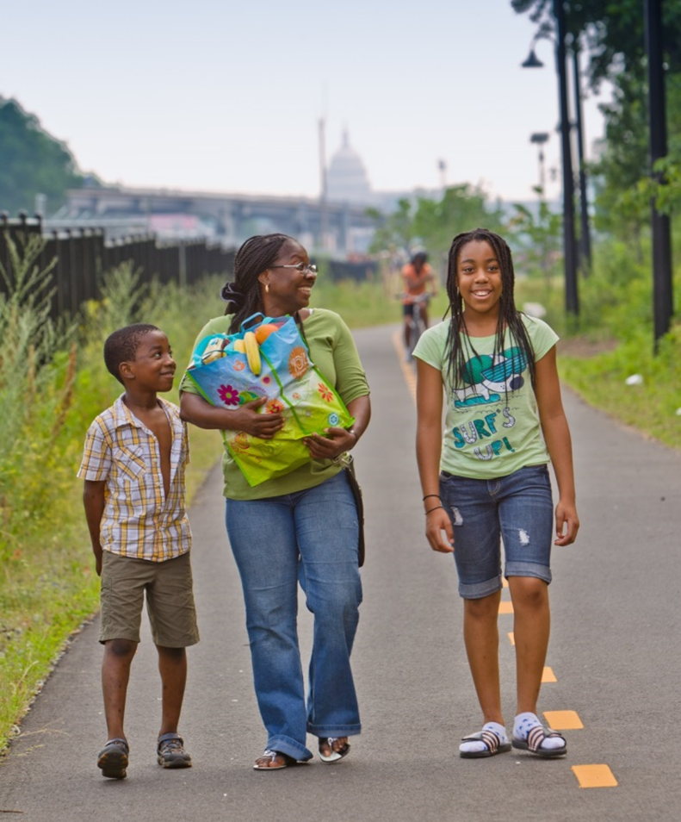
Our Mission
We are building a nation connected by trails, reimagining public spaces to create safe ways for everyone to walk, bike and be active outdoors.
Notes:
So let’s get into it.
RTC is the nation’s largest trails organization – we reach millions of people, hundreds of partners and elected officials each year in our effort to make trails and other active transportation infrastructure available, accessible and well-known to everyone in America.
Our mission
At Rails to Trails Conservancy, we are building a nation connected by trails. We reimagine public spaces to create safe ways for everyone to walk, bike and be active outdoors.
We work every day towards a future where trail networks like the Golden Spoke are prioritized as essential to the well-being of people, communities and the environment.

Slide 3
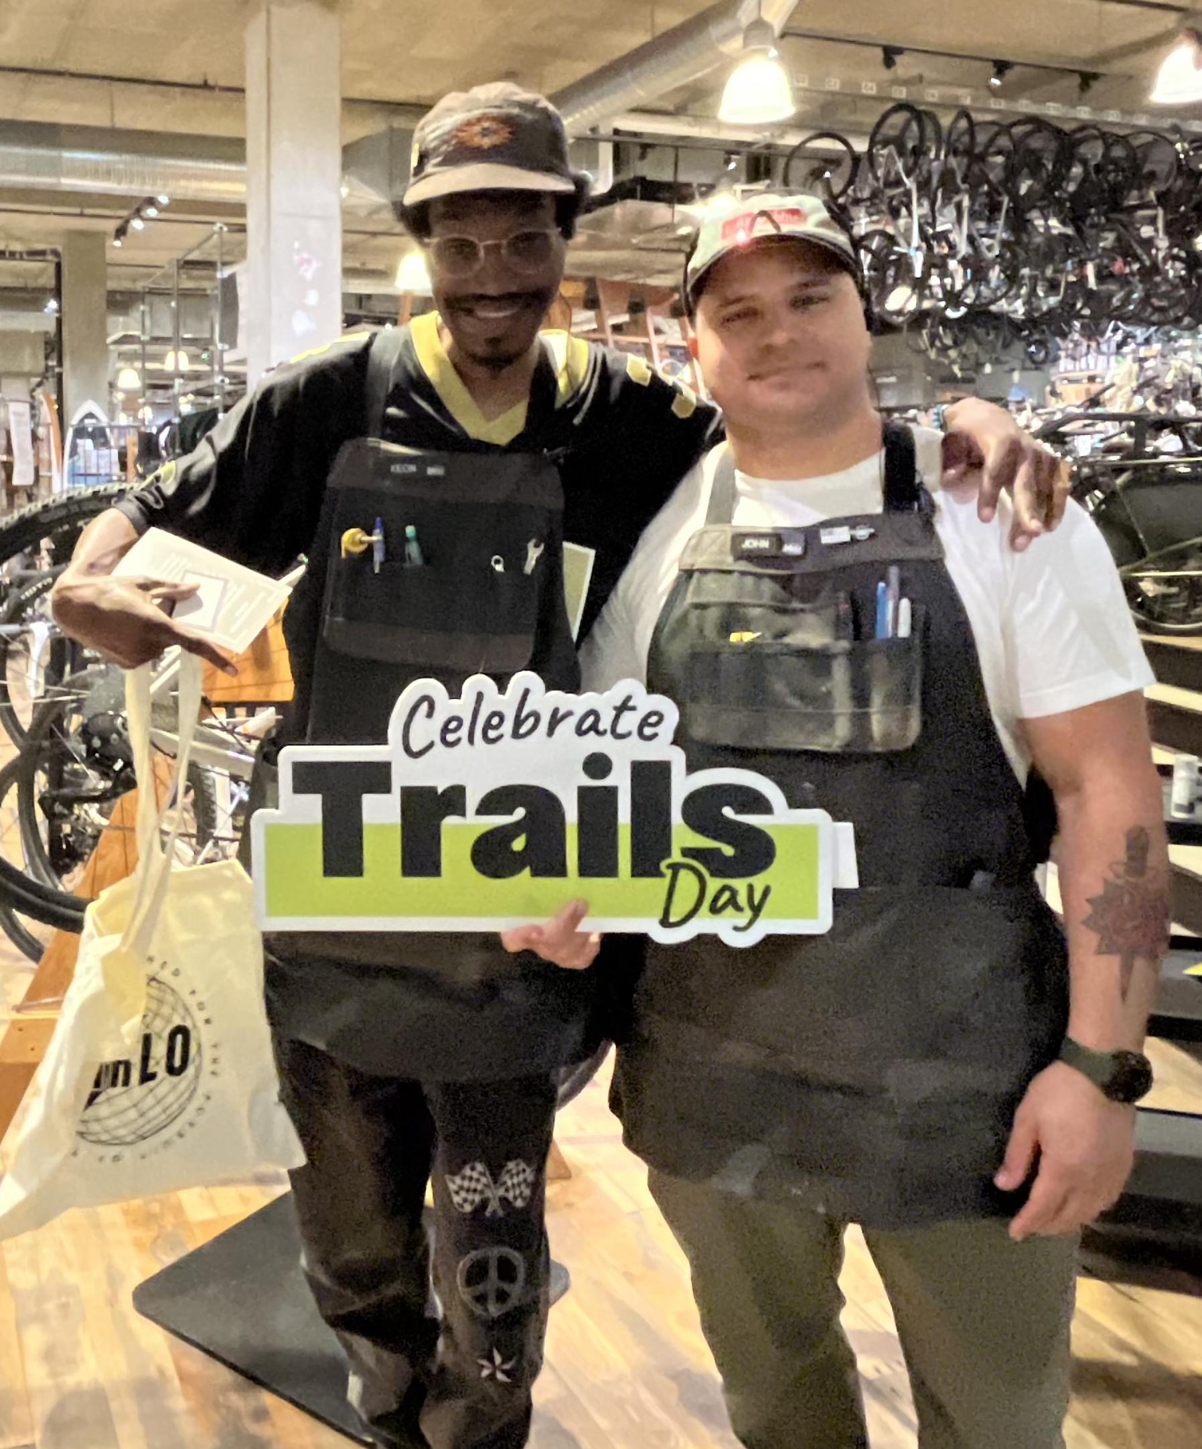
What we do
OUR WORK
WE ADVOCATE
WE COLLABORATE
WE PROVIDE RESOURCES
WE MOBILIZE
WE PROTECT TRAILS
Celebrate Trails Day 2024 at the Washington, D.C. REI Co-op along the Met Branch Trail
Notes:
In service of this mission,
We advocate for investment and trail-friendly policies at the federal, state and local levels.
We collaborate with nationally respected organizations; federal, state and local agencies; public leaders; and trail advocates to build trails and educate Americans on their value.​
We provide resources in the form of capacity-building grants, technical support and best practices for rural, suburban and urban communities seeking to build trails and connect trail systems.​
We mobilize trail supporters and the public to advocate for safe walking and biking infrastructure. In their communities and beyond. Changemakers for Trails.
We protect trails, continuing to lead a 30+ year effort to shape the legal framework around rail-trails and defend them in the courts

Slide 4
RTC’s Role
Developing Wisconsin’s Multi-Use Trail Network
Convene broad array of partners & facilitate discussions across states and jurisdictions
Advocate for trail priorities and funding at all levels
Provide trail planning assistance to close gaps
Perform trail mapping and analytics
Offer communications support and strategy
Conduct research essential for advancing trail initiatives
Iowa’s Raccoon River Valley Trail | Photo by Thomas Bell
Notes:
RTC supports local and state partners by investing time, expertise, and resources, with our role varying based on the specific needs and capacities of each project (what resources and capacities are available through the coalition). However, we often serve as a convener, whether in regional visioning or network execution, to bring together stakeholders and drive progress.
We are also using our unique position as a national organization to
facilitate discussions between states and across jurisdictions – with regular meetings, organized city swaps through the Collaborative
advocate for local and state trail priorities and for funding at various levels – whether through grassroots campaigns and calls to action, or engaging with elected officials and decision-makers
Provide trail planning assistance for completing trail gaps – IHTC – Led feasibility studies which then provided guidance for communities along those projects to start closing gaps
perform trail mapping & analytics – RTC worked closely with our partners to map the Capital Trails Network, and we meet annually with each of the six jurisdictions to update the map, tracking progress and changing priorities.
provide communications support and strategy to advance trail priorities – Trail Moments Campaign; The Circuit Trails Coalition is a robust and well-organized coalition, and the MPO takes the led on managing the different projects. Here RTC leads the communications strategy, aligning it with the strategic goal of equitable access and representation on the trails. Also in Baltimore, RTC contracted a survey of voters to gauge sentiments towards the trail, and they were overwhelmingly positive.
and conduct research critical to advancing trail priorities – provide case studies to reassure win over trail opponents, studies on the economic impact of the GRT, or IHTC

Slide 5
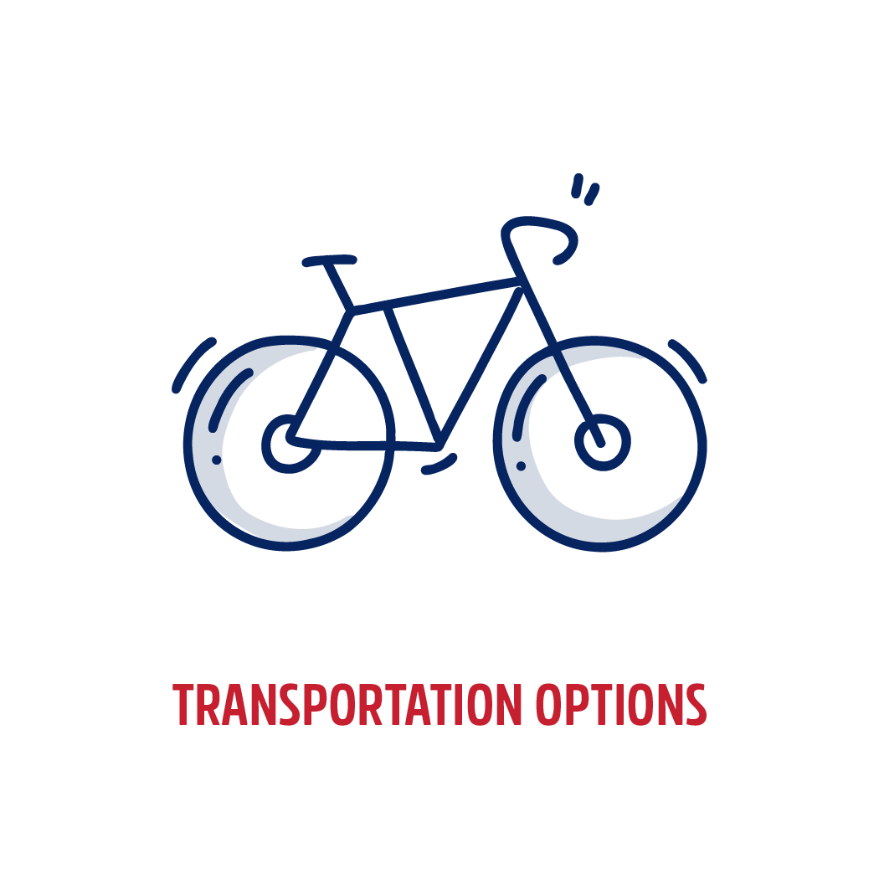
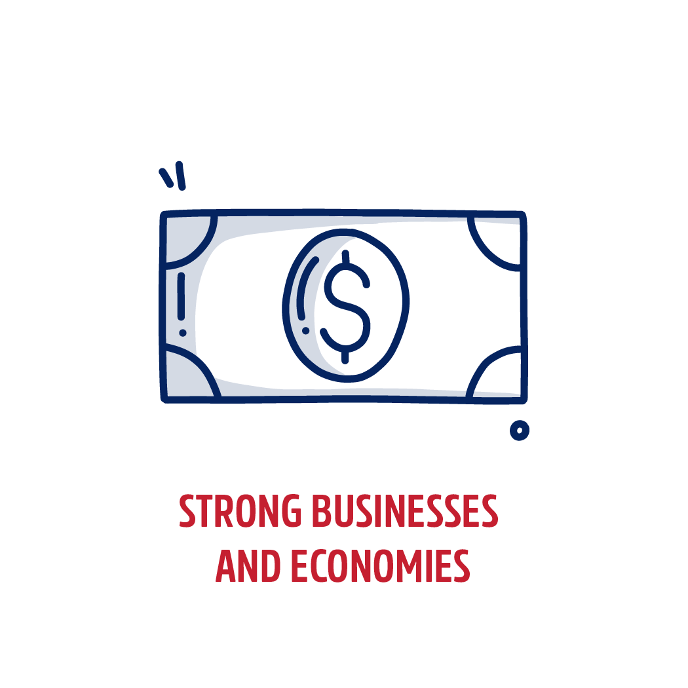


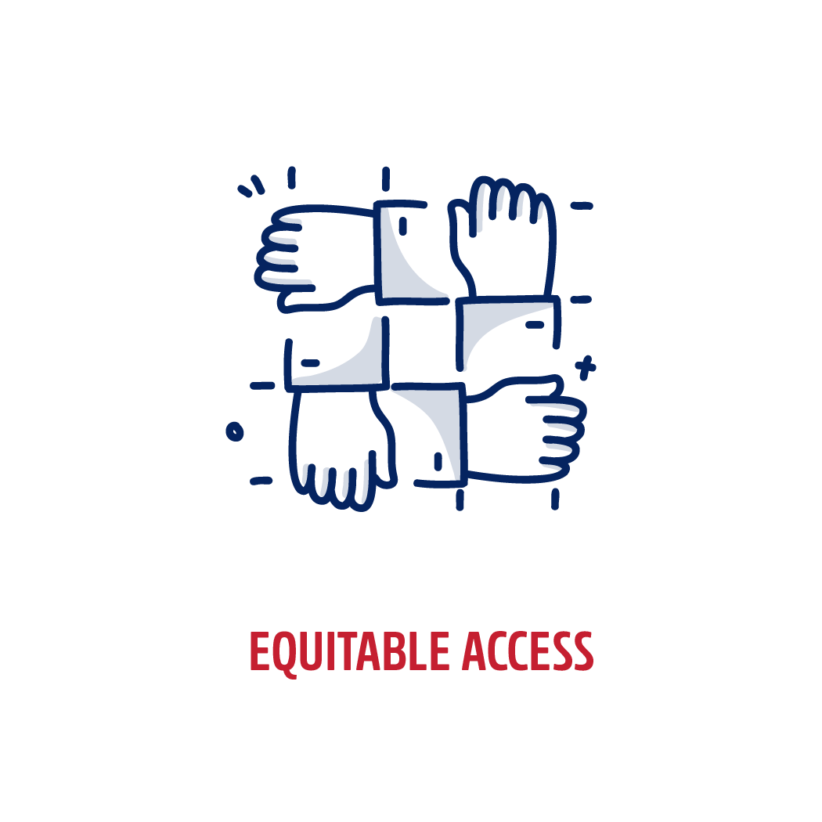
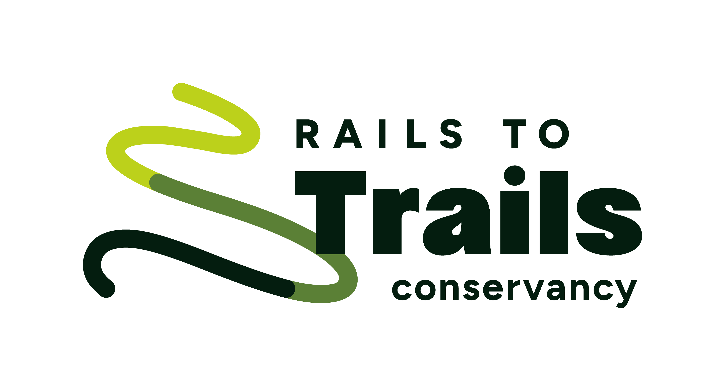
Why trail networks?
Notes:
You may be wondering why a organization named for Rail Trails is so focused on trail networks. Well, we now have over 40,000 miles of multiuse trails in the US (that’s about the size of the interstate highway system) and we’ve seen the outsized impact CONNECTED Trails have on their communities.
These connected networks help provide:
Transportation choice
Support strong economies and local businesses
Preserve and protect natural environments – including the reduction of green house gas emissions
Give us opportunities for Health and Wellness that are inexpensive and accessible for all
Promote Social Equity when we make sure everyone is included in the process.

Slide 6
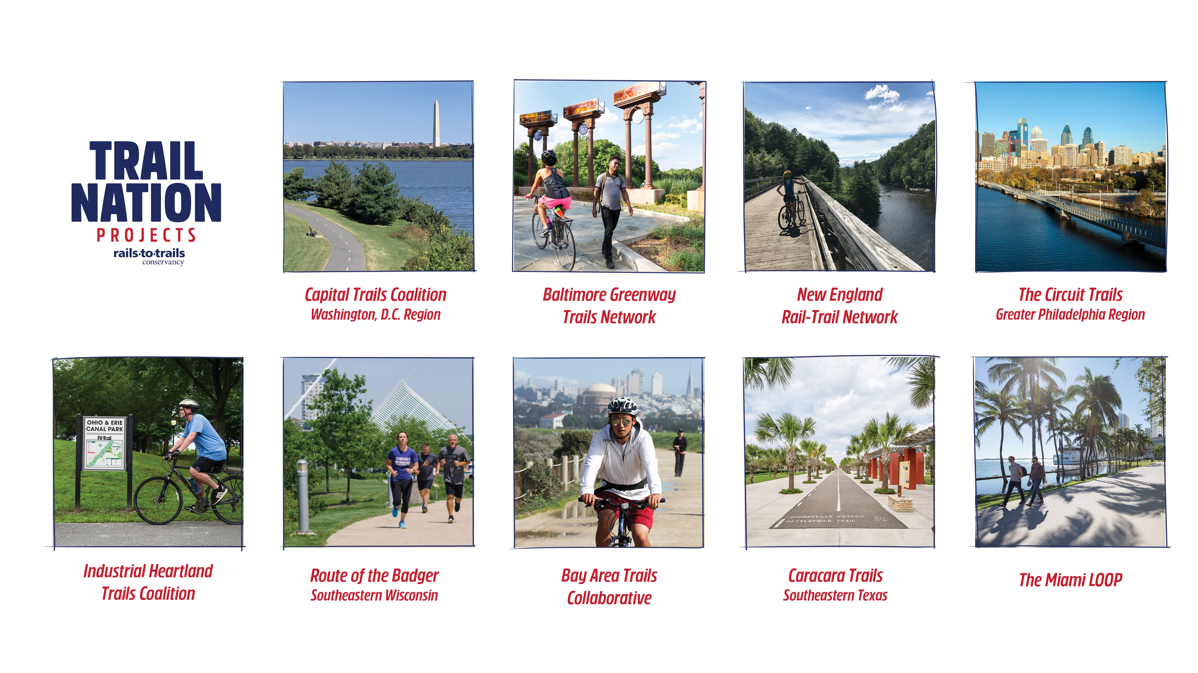
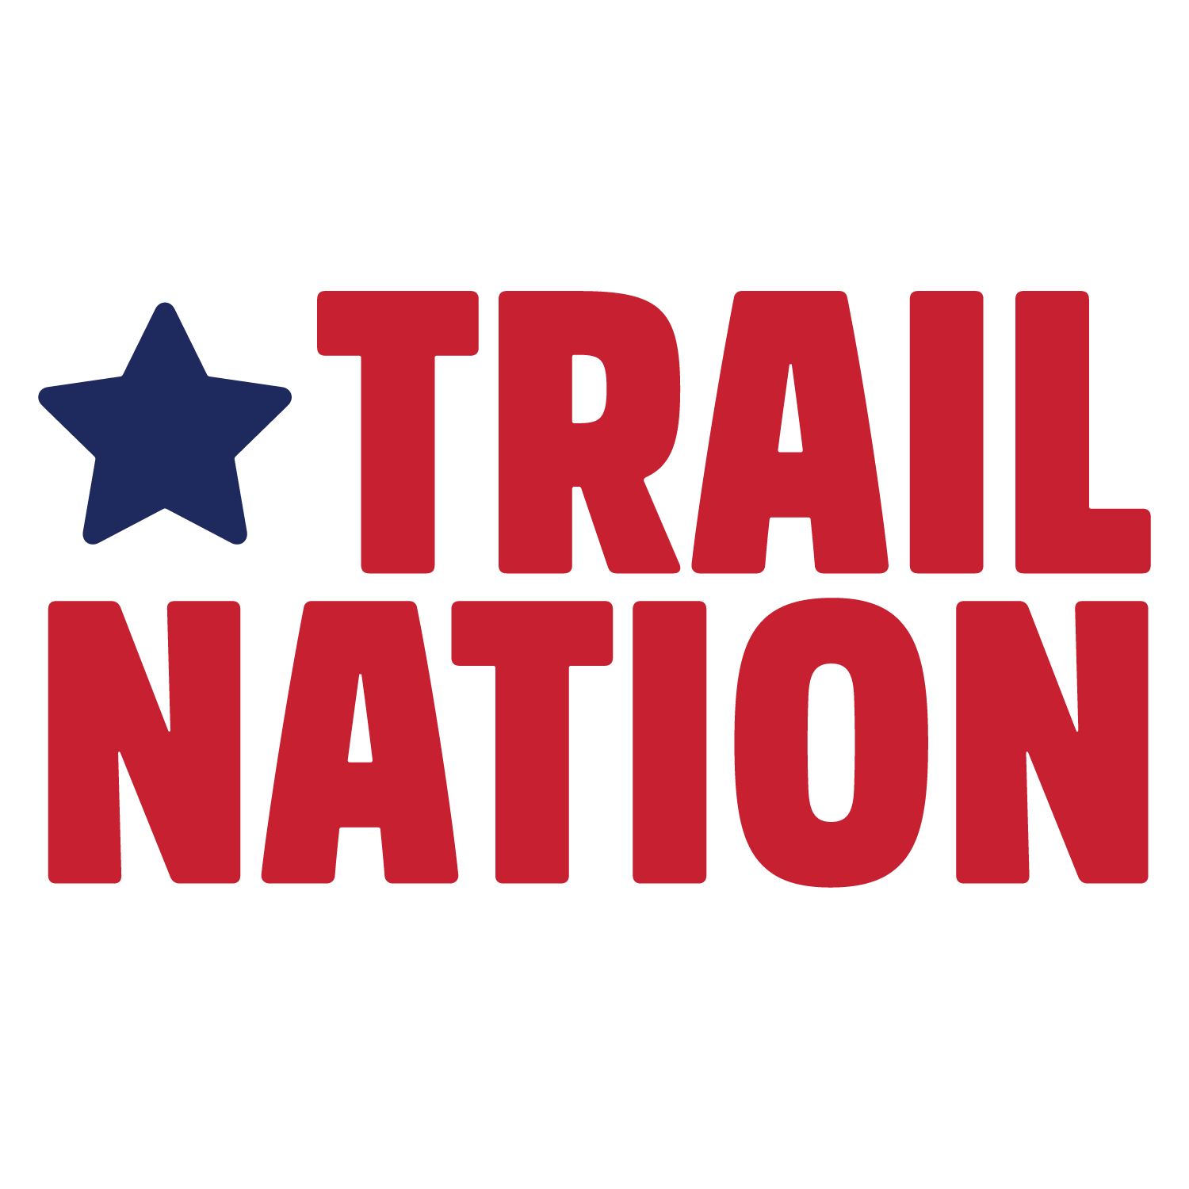

Notes:
As a national organization, we support trail network development across the country, but we're also making deep investments in these 9 communities and those across the route of the Great American Rail-Trail. For about the last 15 years, we’ve been working on our TrailNation projects– these 9 places function as our learning laboratories for… (NEXT SLIDE)

Slide 7
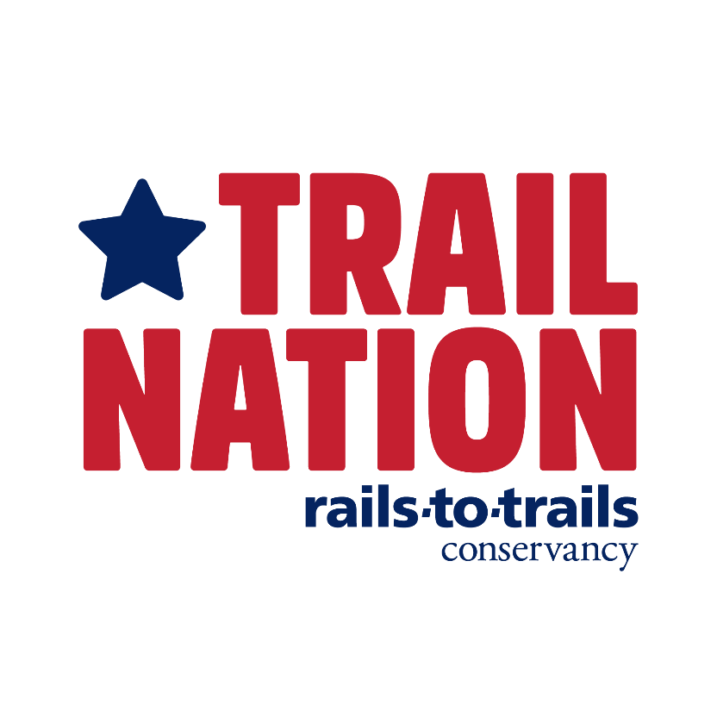
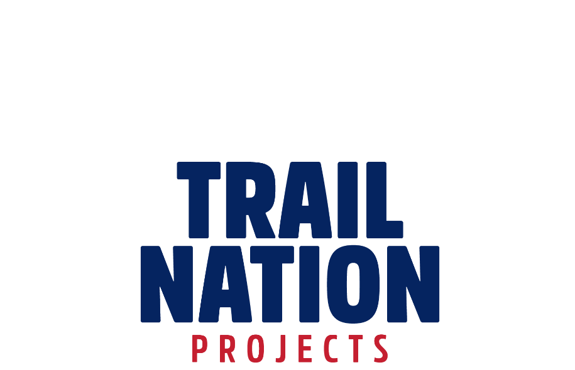
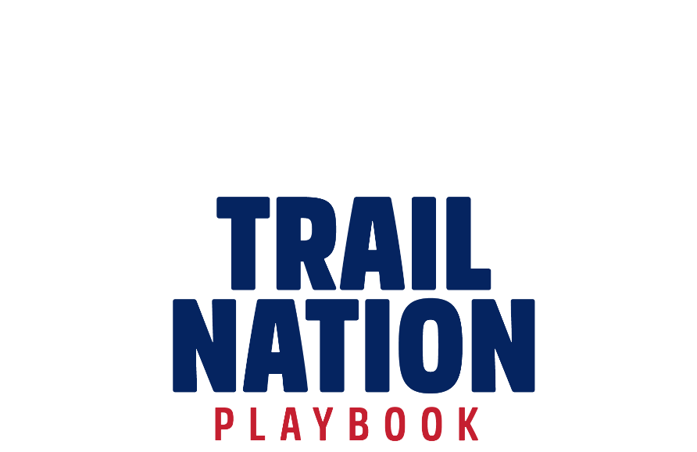
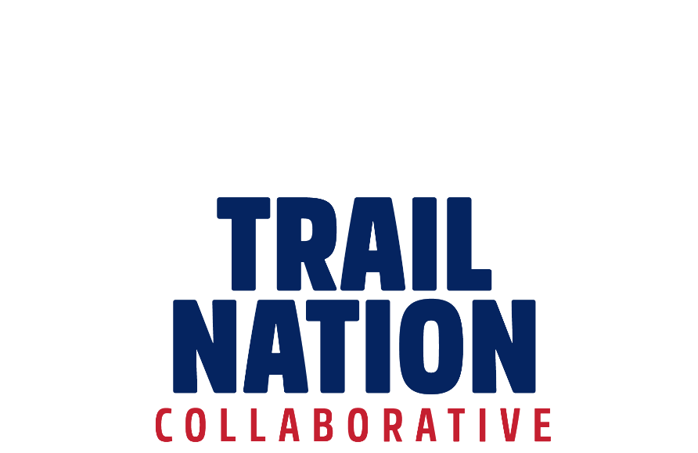
Notes:
…our larger trailnation initative which now includes the TrailNation Playbook, our compendium of resources, and the TrailNation Collaborative, our peer-to-peer learning network for all those in the ecosystem of active transportation.

Slide 8
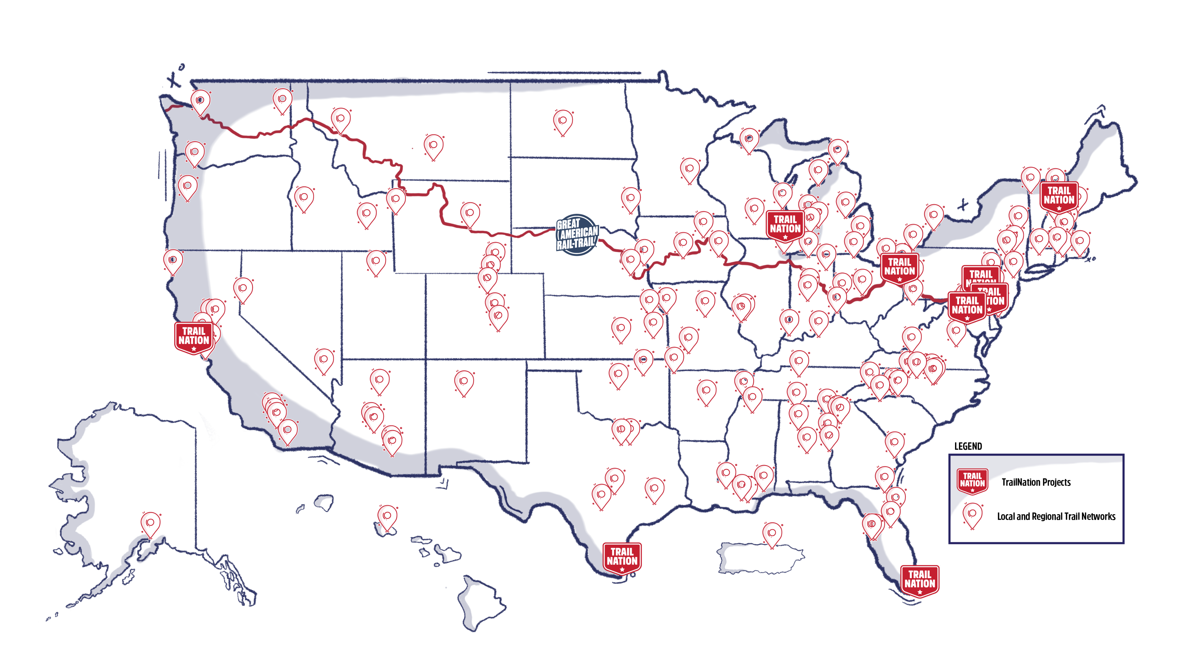
railstotrails.org/trailnation/#map
Notes:
This is all done in support of the more than 150 trail networks emerging across the U.S. Today we'll talk about a few of the networks emerging in the midwest where the economic benefits of trails are transforming communities.

Slide 9
Trails Transform Communities
KEY MESSAGE POINTS
The economic impact of trail and active transportation networks is incredible—the country’s trail system already generates more than $34 billion in economic activity annually and can more than quadruple as trail systems are connected.
This infrastructure is critical to delivering the quality of life that people want.
Connecting communities with safe walking and biking infrastructure isn't just about recreation or transportation—it's about creating more vibrant places to live that are healthier and safer for children and families.
Notes:
For every $1 invested in one-time trail construction, $1.72 is generated annually from local business revenue, sales tax revenue and benefits related to health and transportation.
Job creation: Trails, walking and biking projects create 17 jobs per $1 million spent: more than any other mode (AASHTO)
Investing in local economies: The Erie Canalway Trail in New York increases tourism, but residents drove almost 90% of use, generating over $165 million in their own communities
Growth sector: In 2023, Utah’s “outdoor recreation economy grew to $9.5 billion in value-added and now contributing 3.4% of Utah’s GDP and supporting 71,898 jobs”
Cost savings: A study of Lincoln, Nebraska, found that every dollar spent on trails returned $2.94 in direct medical benefits
Return on investment: For every $1 invested in trails, $1.72 is generated annually from local business revenue, sales tax revenue and benefits related to health and transportation.
Source: “Evaluating the Economic Contribution of Shared Use Paths in NC.”

Slide 10
Economic Impact
Job creation: Trails, walking and biking projects create 17 jobs per $1 million spent: more than any other mode (AASHTO)
Investing in local economies: The Erie Canalway Trail in New York increases tourism, but residents drove almost 90% of use, generating over $165 million in their own communities
Growth sector: In 2023, Utah’s “outdoor recreation economy grew to $9.5 billion in value-added and now contributing 3.4% of Utah’s GDP and supporting 71,898 jobs”
Cost savings: A study of Lincoln, Nebraska, found that every dollar spent on trails returned $2.94 in direct medical benefits
Return on investment: For every $1 invested in trails, $1.72 is generated annually from local business revenue, sales tax revenue and benefits related to health and transportation.
Notes:
For every $1 invested in one-time trail construction, $1.72 is generated annually from local business revenue, sales tax revenue and benefits related to health and transportation.
Source: “Evaluating the Economic Contribution of Shared Use Paths in NC.”

Slide 11
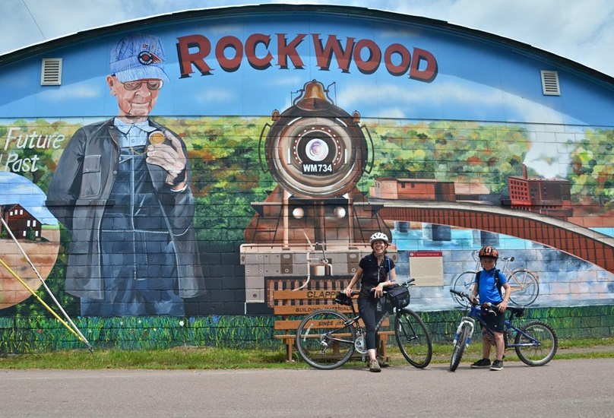
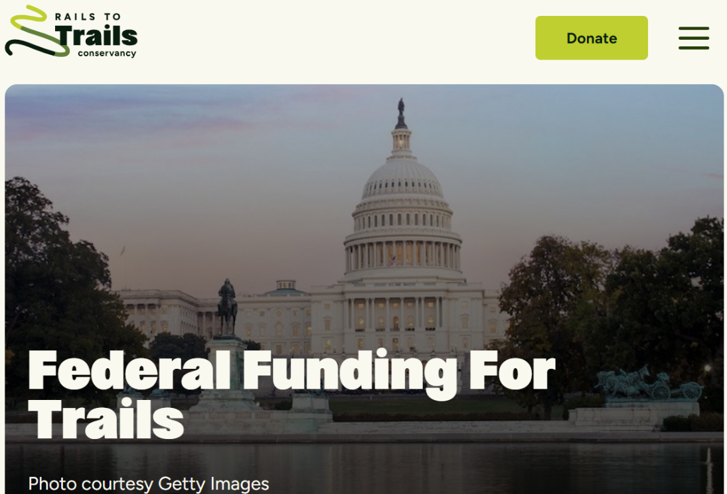
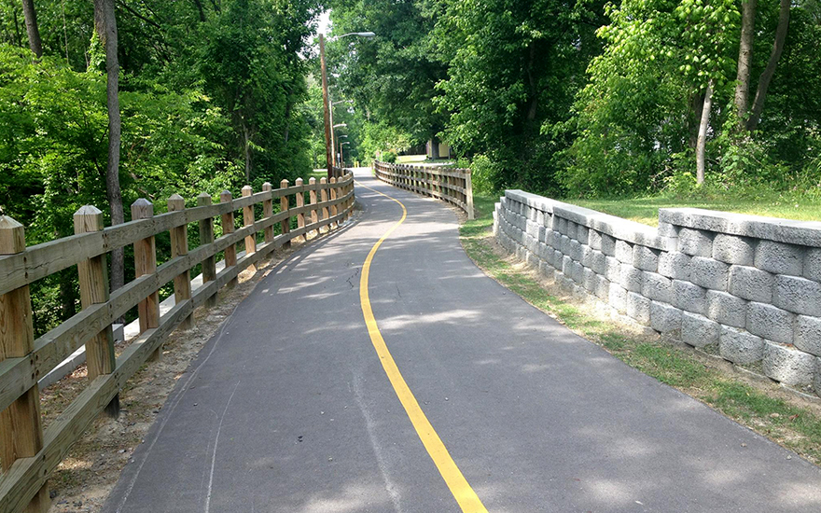

Resources & Tools
RESOURCES
Trail-building
Toolbox
Federal Funding Resources
Technical Assistance
The basics for creating a joyful, vibrant trail in your region.
The latest information about potential federal funding opportunities for trails and active transportation
Quick assist technical assistance on various trail development topics.
Notes:
Will discuss more at the plenary
Trail-Building Toolbox, provides guidance and best practices for trail development, covering every aspect of the process from property acquisition through planning, design and maintenance. For those interested in learning about multiuse trail development, that’s often the first place I will point them to.
We just talked about the playbook, but just know that while the trail-building toolbox is useful for individual trails, with the Playbook, the emphasis case studies and promising practices for trail networks.
We also provide up to date information on federal funding opportunities for trails and active transportation. The link will also be dropped in the chat.
We also provide technical assistance by email or by phone. You can email rail-trails @ railstotrails.org

Slide 12
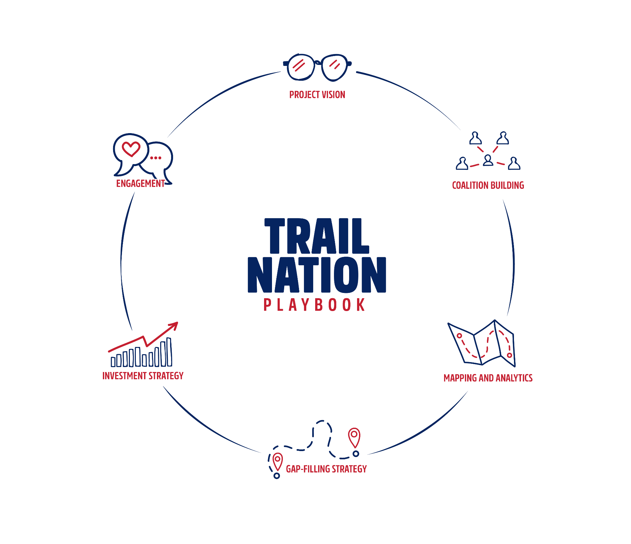

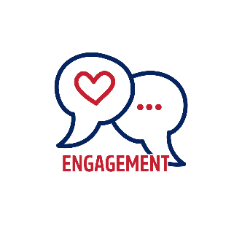
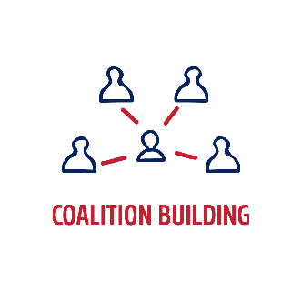
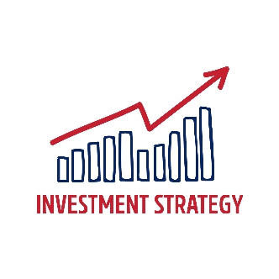
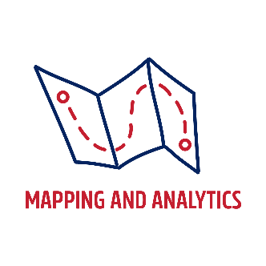
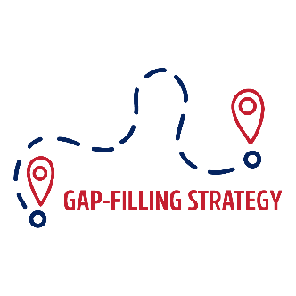
Notes:
The TrailNation Playbook centers on these 6 strategies we see as key for the development of networks. We’ll focus on 2 today.

Slide 13
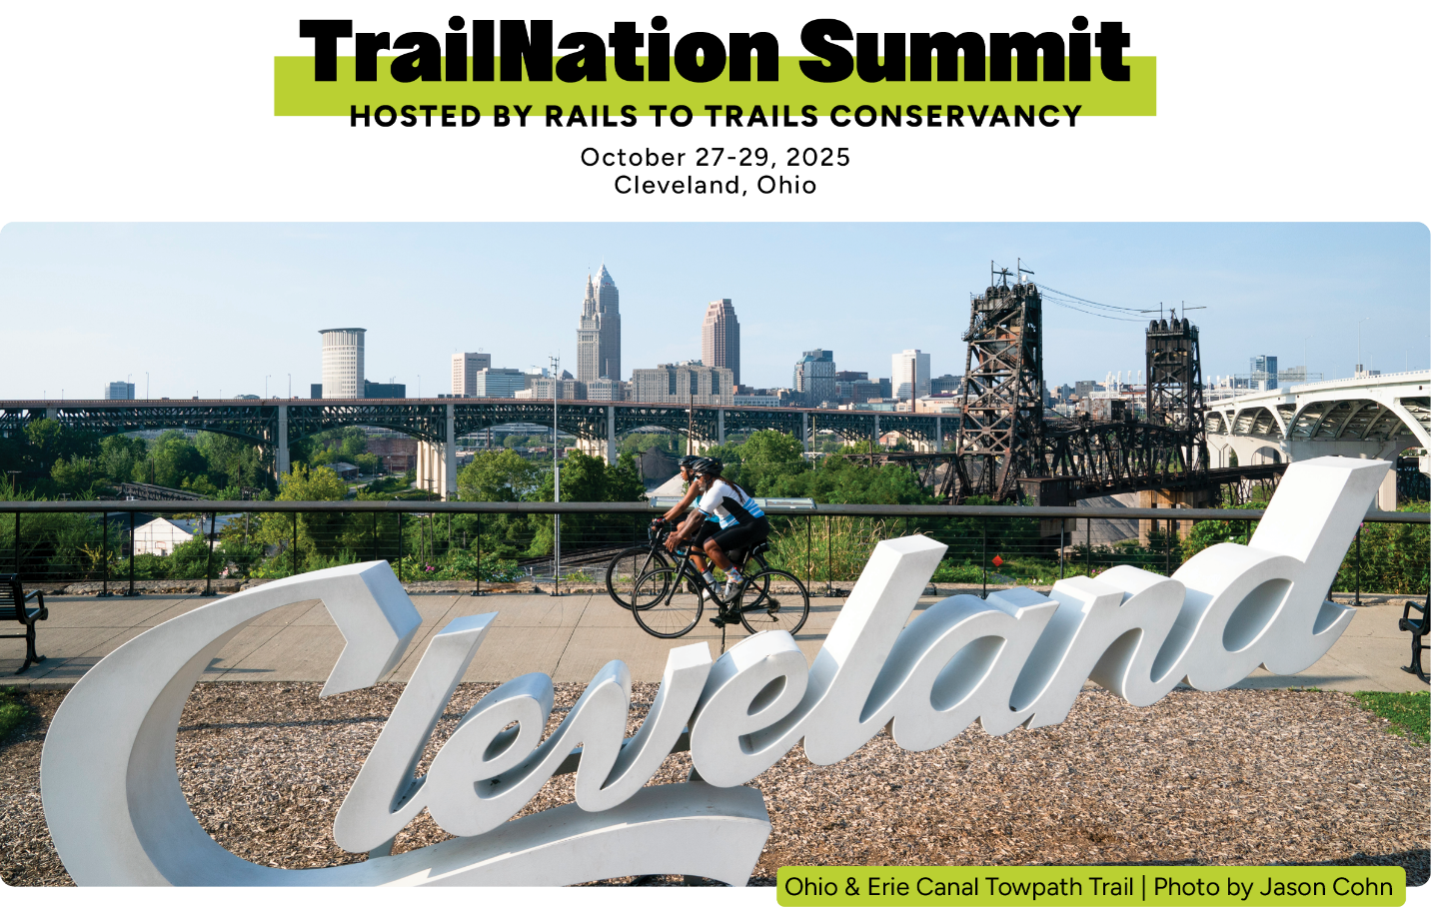

Register Today: railstotrails.org/trailnation
Notes:
Thanks for these great presentations! Before we jump into Q&A, a quick reminder to add your questions to the Q&A box below.
I'm also excited to share the TrailNation Summit with you all. I hope you'll join RTC in Cleveland this October where we will dive into innovative strategies for creating and expanding trail and active transportation networks through dynamic mobile workshops, immersive learning opportunities, and strategic conversations. Discounted early bird registration is now open at railstotrails.org/trailnation.

Slide 14
TrailNation Summit
Daily keynote and plenary sessions
Deep-dive master class sessions, grouped by rural, suburban and urban cohorts, to help you develop targeted solutions
Opportunities to make meaningful connections to accelerate learning and action in support of trail network development
At least 10.0 AICP CMs available – more sessions being added!
NARC Member Discount Code: Partner

Slide 15

TrailNation Collaborative
The TrailNation™ Collaborative is a peer learning community from Rails-to-Trails Conservancy (RTC) where advocates, public leaders and professionals can come together to share their experiences, their challenges and their strategies for accelerating the pace of equitable and connected trail and active transportation infrastructure.
Member Benefits: Monthly webinars and virtual dialogues, dedicated Facebook group, regular newsletter, grant announcements, early warning system alerts,
railstotrails.org/trailnation/#collaborative or trailnation.org/#collaborative
Join the Collaborative!
Notes:
PLEASE INCLUDE IN YOUR EXTERNAL PRESENTATIONS

