Slide 1
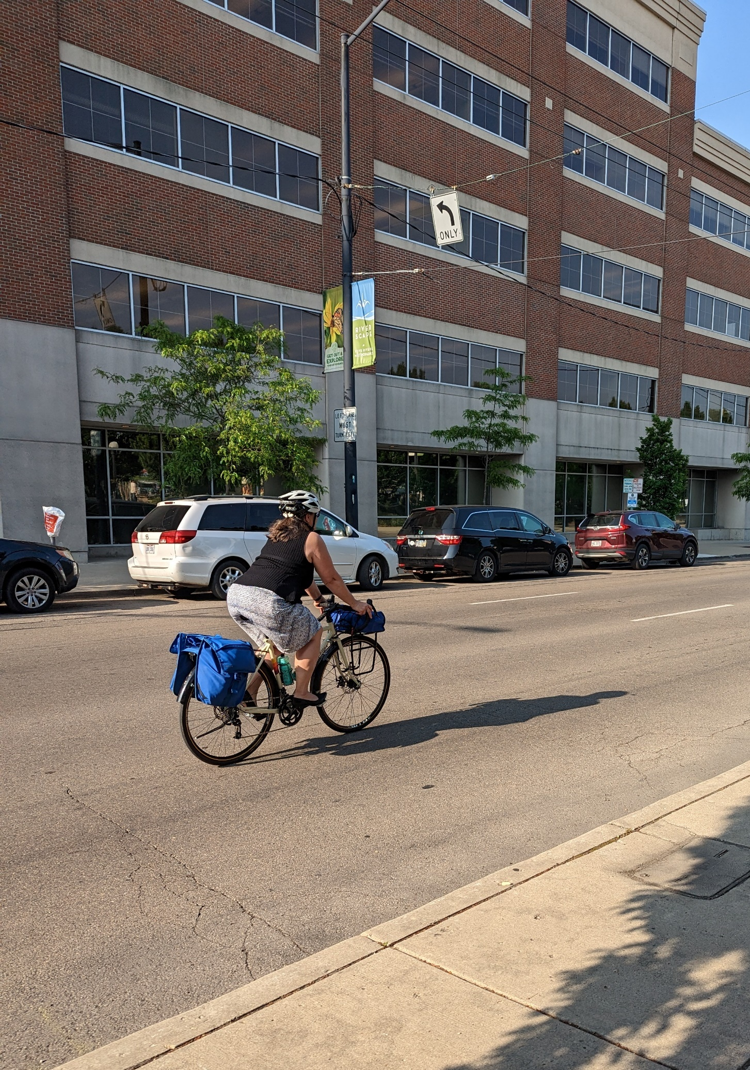
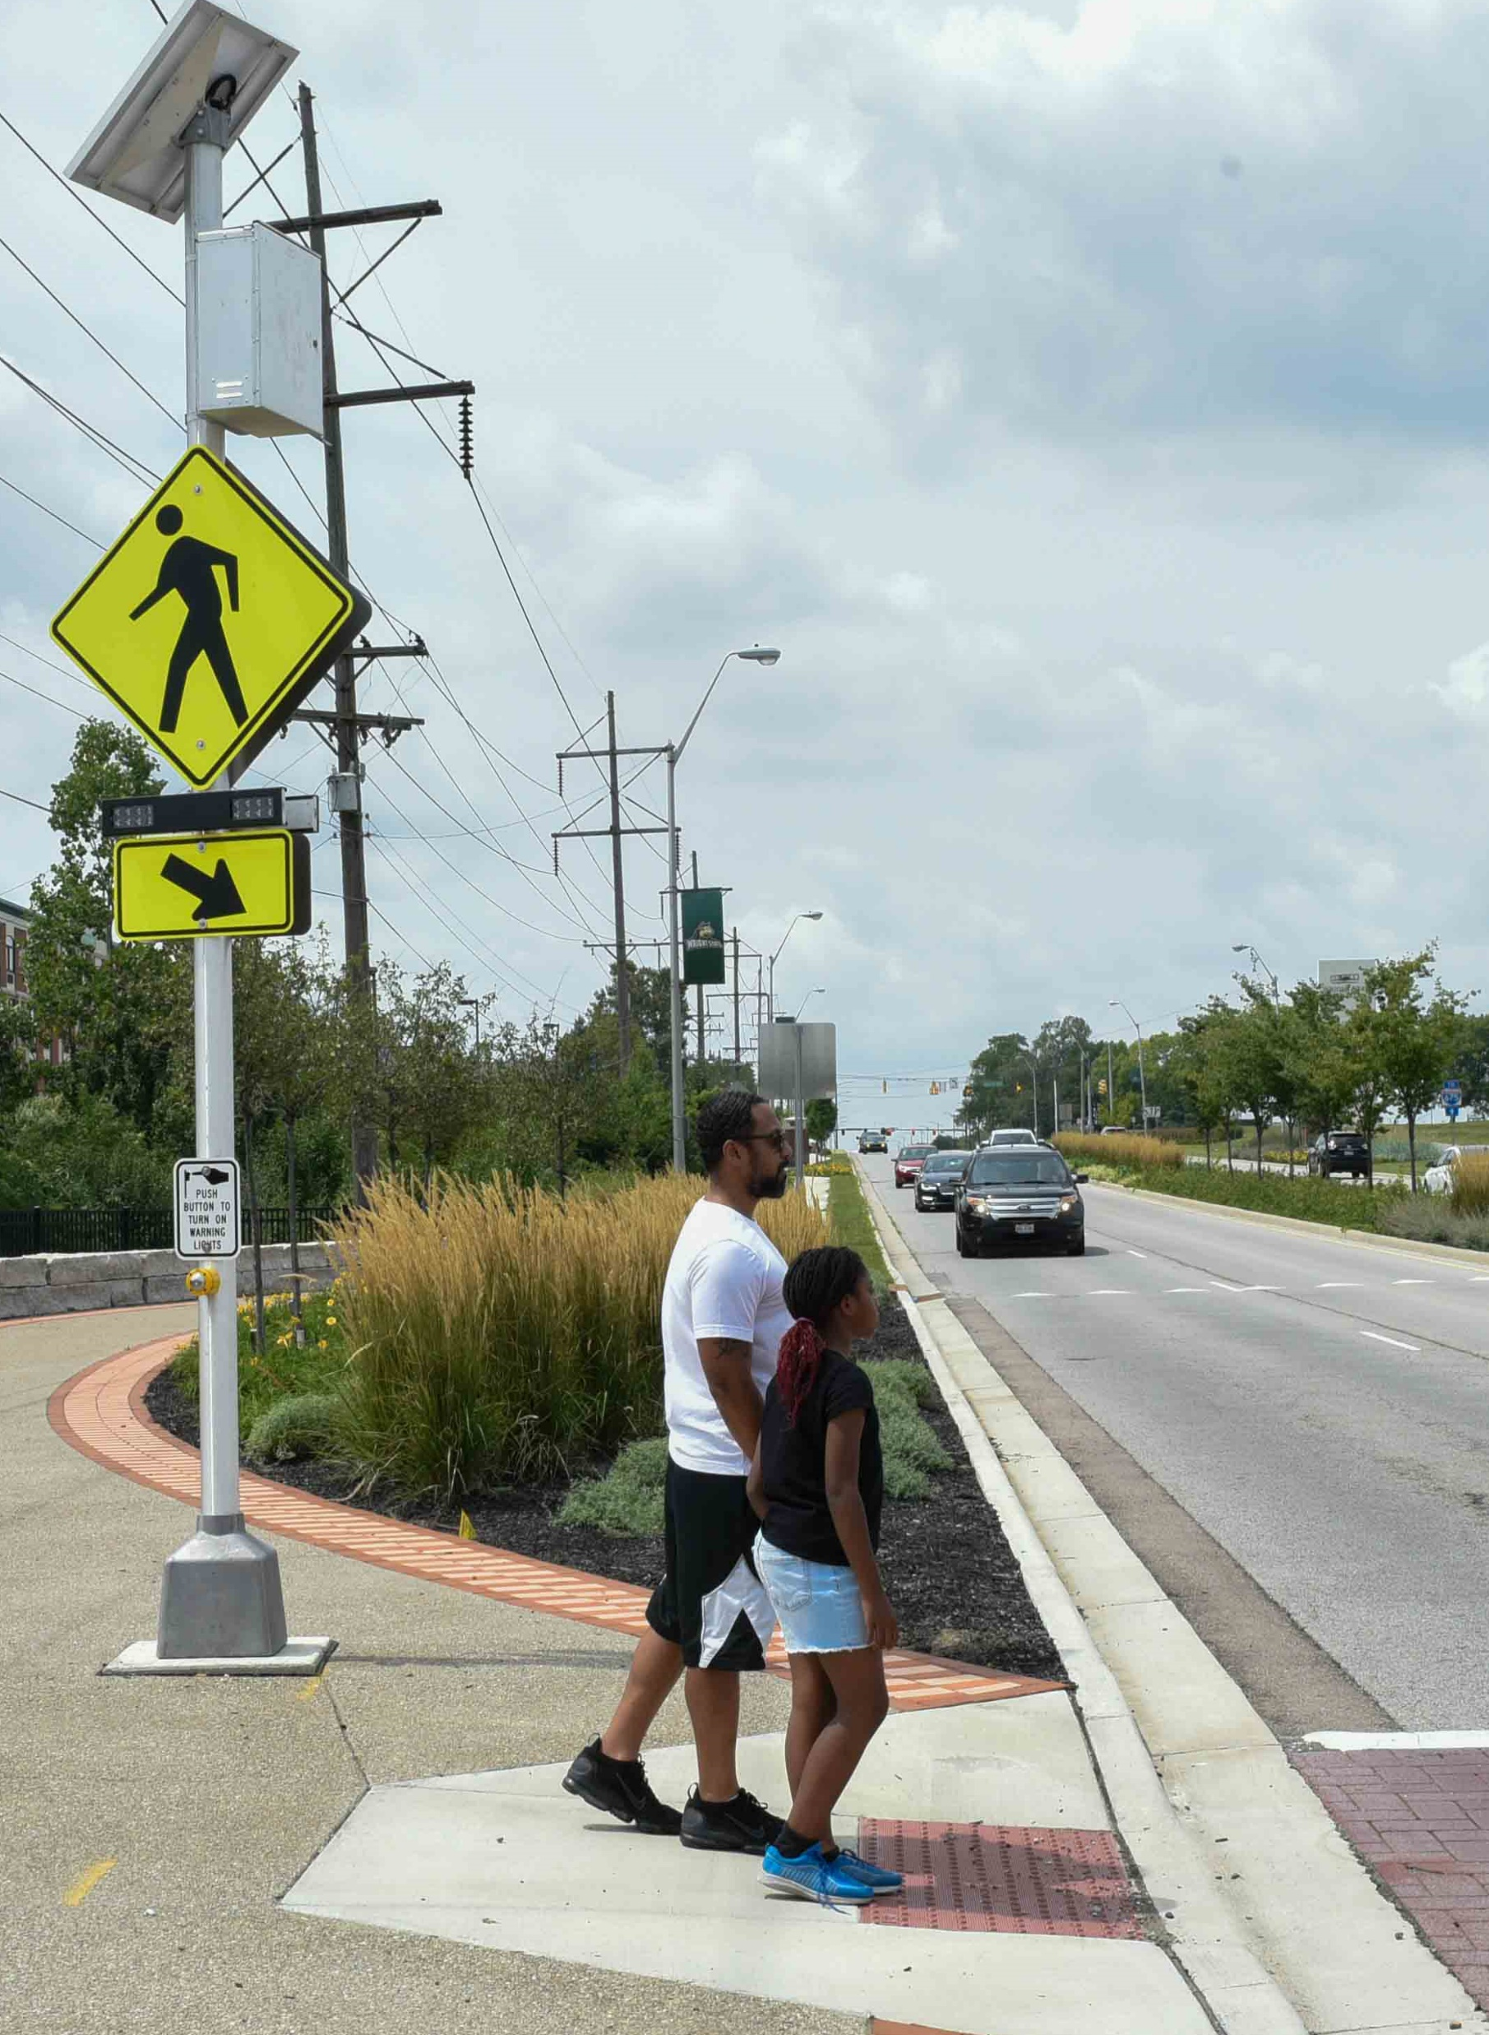
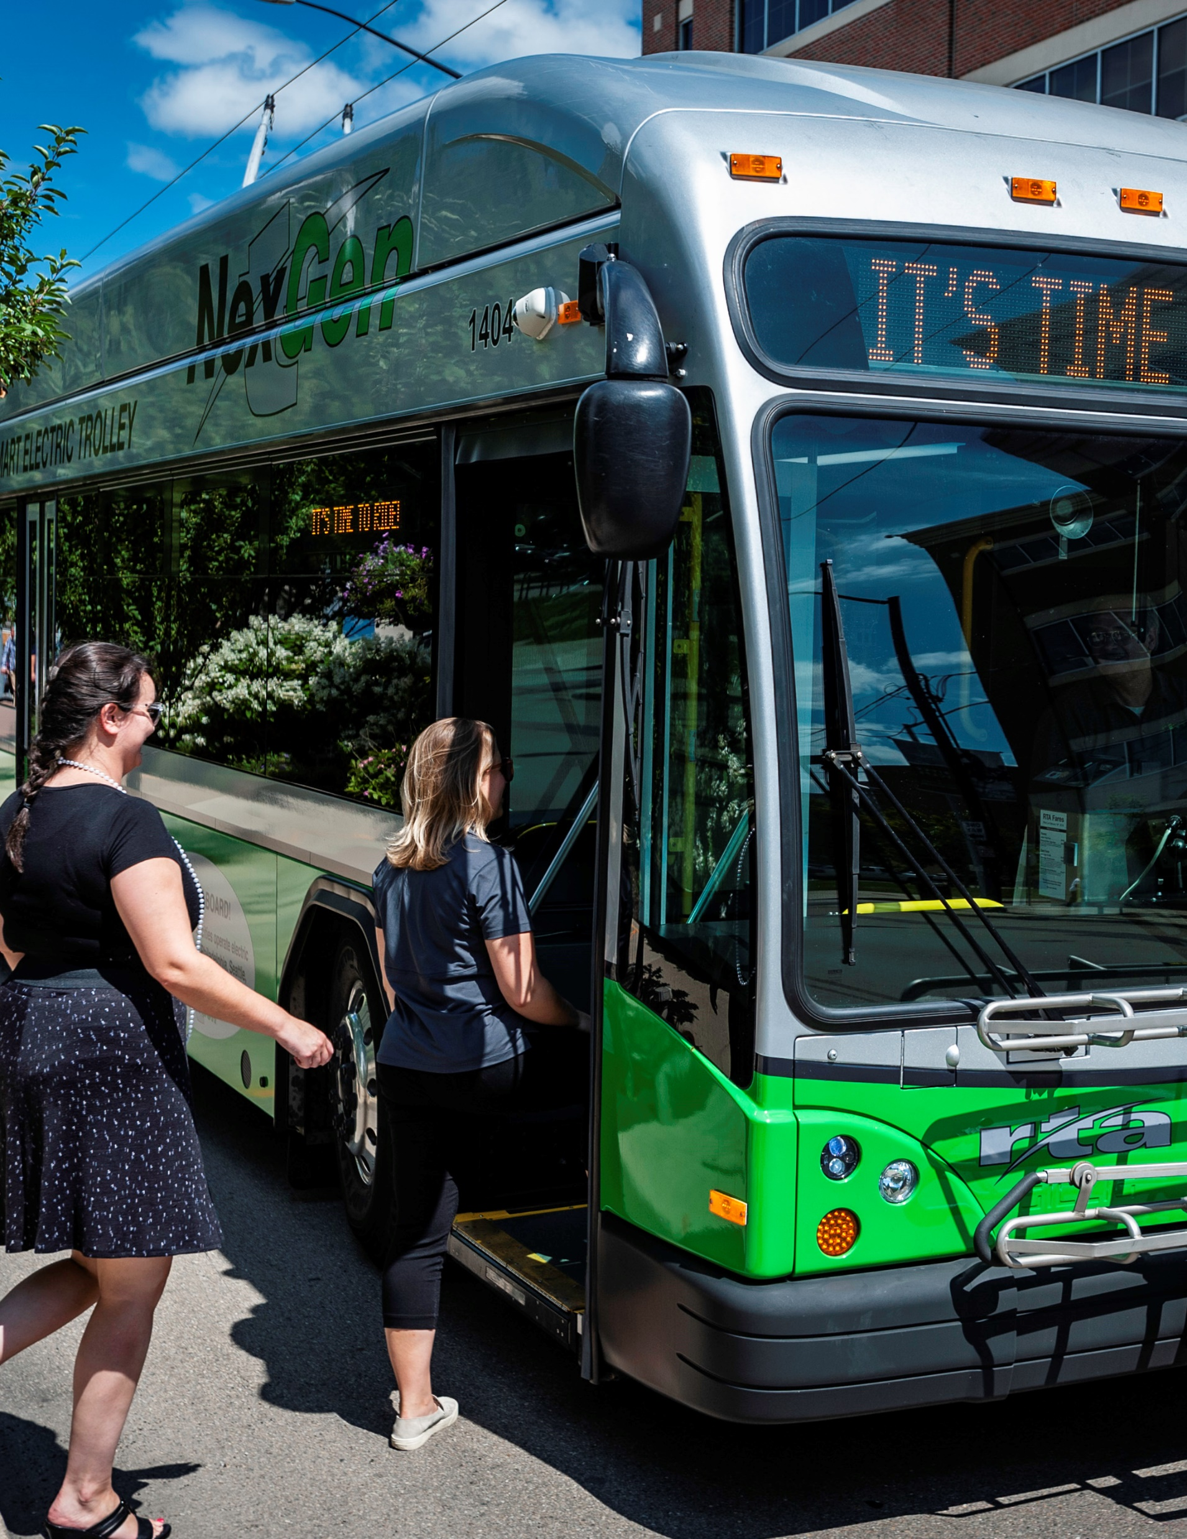

The Miami Valley Region and
the Outdoor Adventure Capital of the Midwest
Brian Martin, AICP, Executive Director
2025 NARC Annual Conference June 8 - 11 Seattle, WA

Slide 2
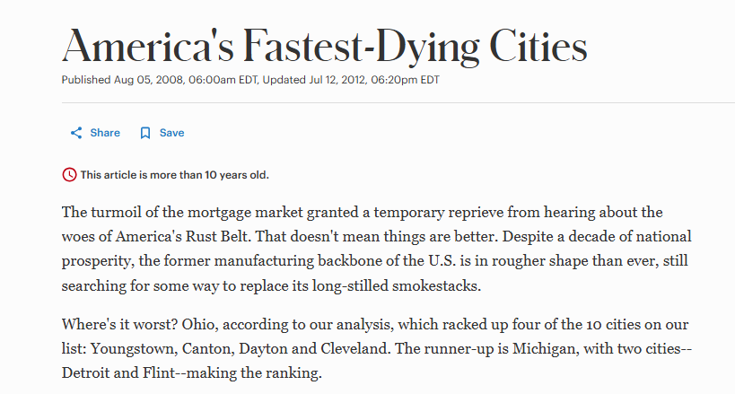
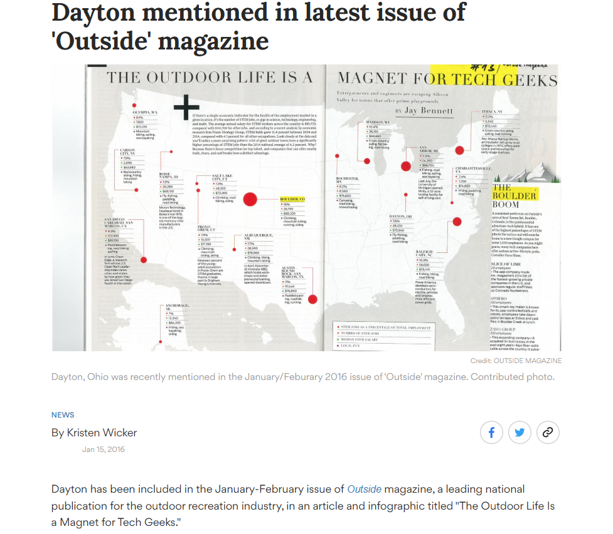
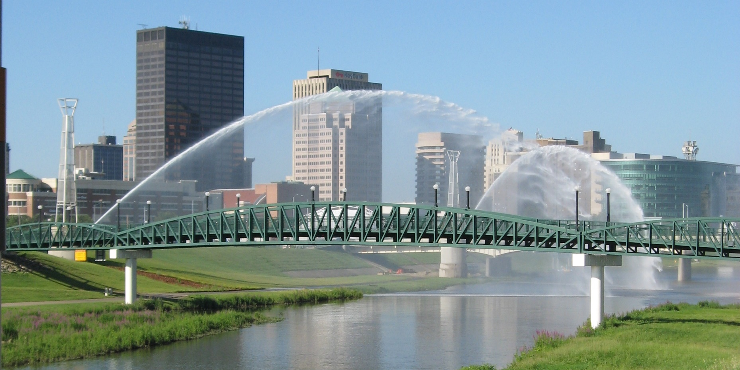
From Dying to Thriving

Slide 3
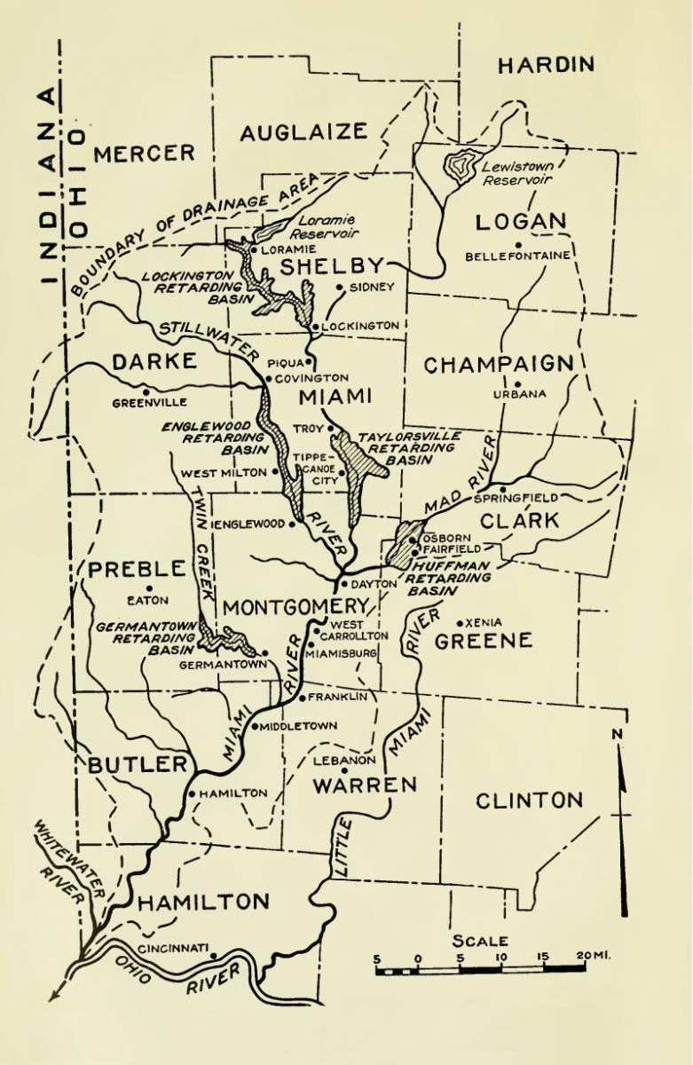
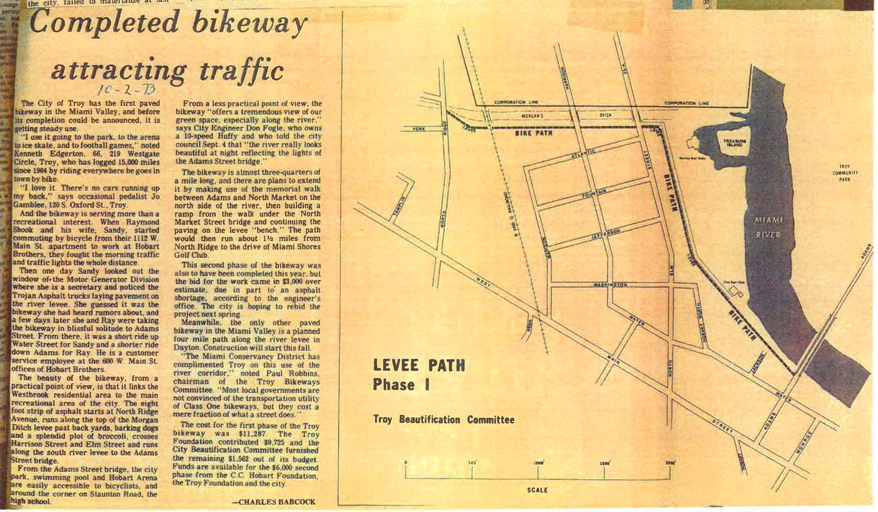
Our History: Rivers, Trails and Cycling
History of Cycling and Trails: Wright Brothers/Huffy
Flood of 1913 & Innovative Flood Protection
“Blue-Greenway” Connecting Trails to Rivers to Parks
Spirit of Collaboration: “It takes a Village”
  Public-Private Partnerships
  Multi-Stakeholder Approach
Shared Vision and Leadership

Slide 4
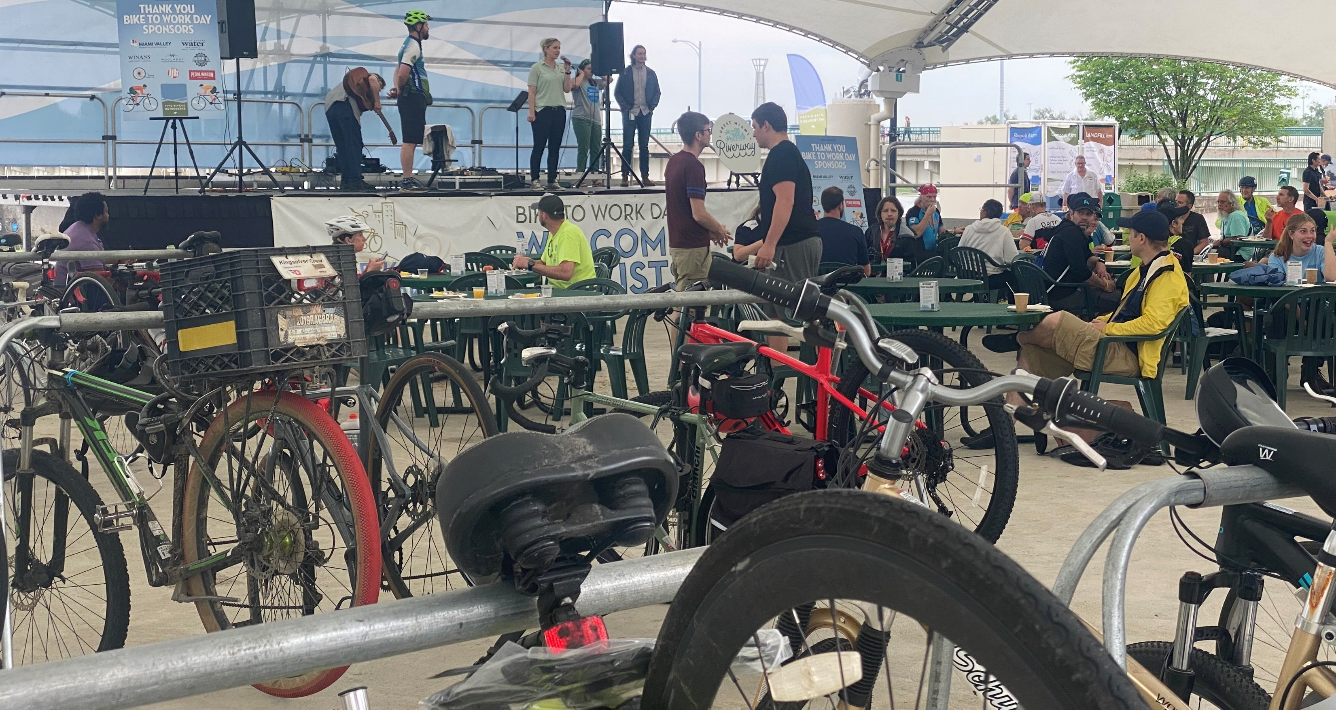
Building a Destination: Cycling and Trails
Over 375 Miles Paved, Off-Road, Connected Trail: Largest Network in the Country
Variety of mountain biking opportunities from beginner to expert: MOMBA
Home to the RiverScape MetroPark Commuter Bike Hub
Multiple Bike Pump Tracks: Indoor and Outdoor
  Mike’s Bike Park, Dayton Pump Track
Home to the Underground Railroad Bicycle and Great Miami Alternate Route
Home to the Chicago to New York City Bicycle Route
US Bicycle Route 50
Advocacy Groups
  Bike Miami Valley: Miami Valley Cycling Summit
  Rails-to-Trails Conservancy Office
  Major Taylor Bicycle Club

Slide 5
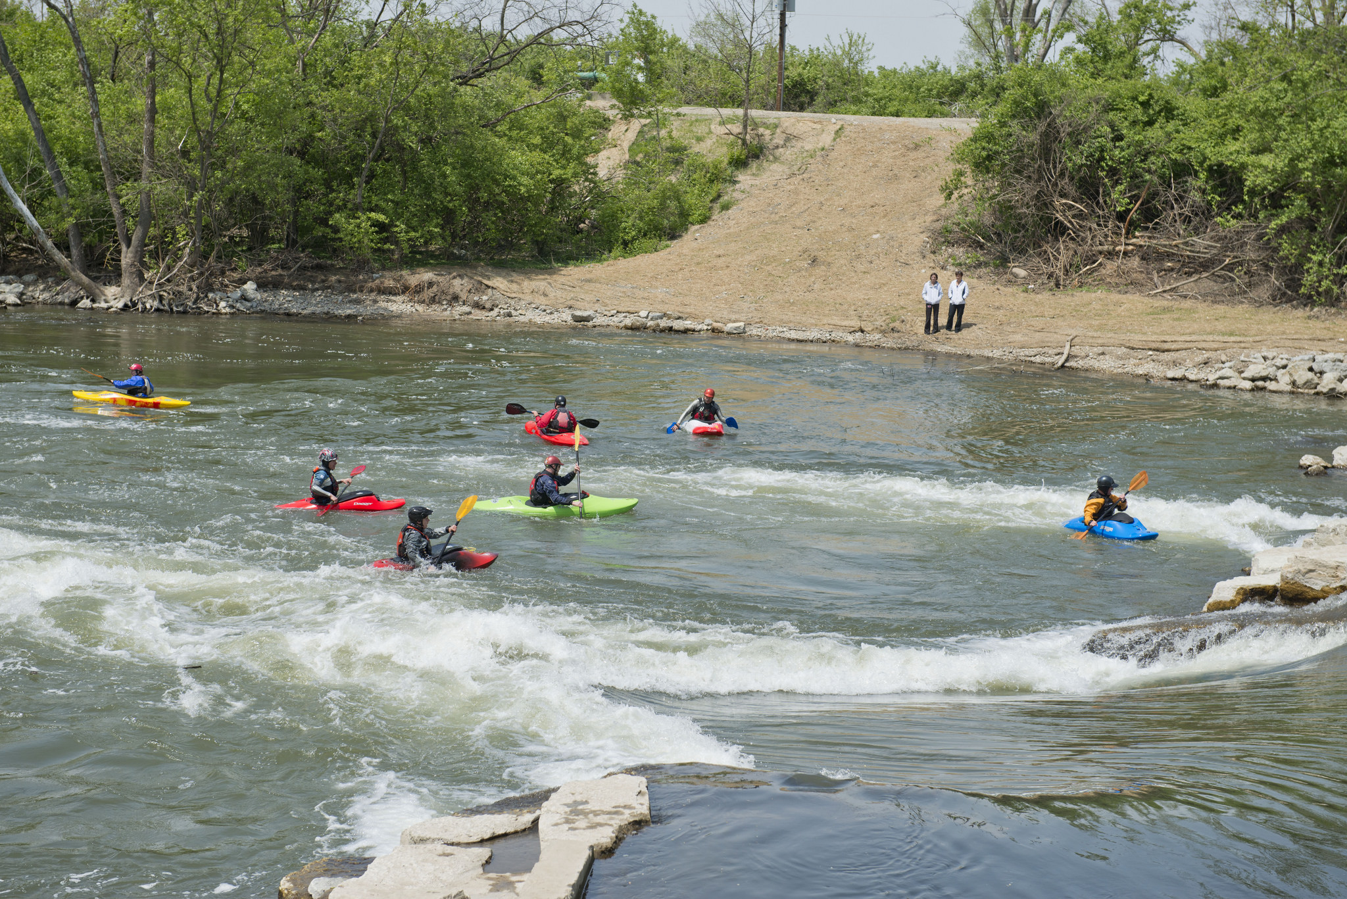
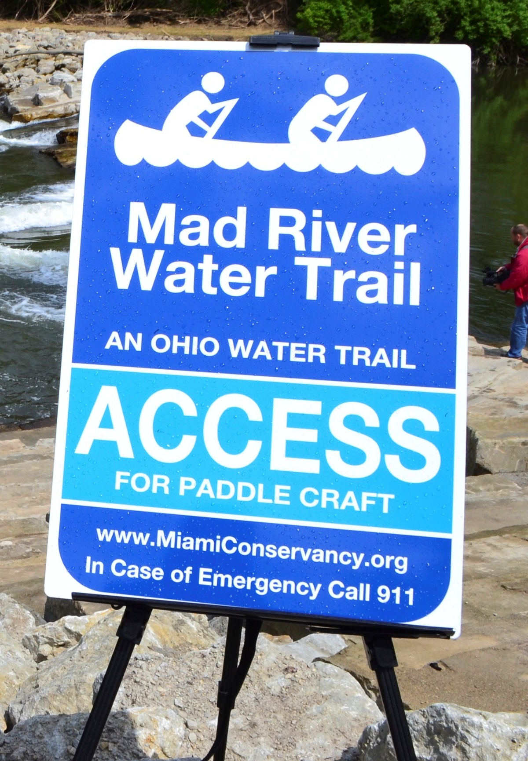
Building a Destination: Rivers
400 miles of Blueways and Water Trails
First National Scenic River in the Country: Little Miami River
3 State Designated National Park River Trails
  Great Miami, Mad, Stillwater Rivers
Little Miami River Watershed Network
  OSU Economic Study of the River
Great Miami Riverway
  99 Mile Corridor Connecting
  12 Historic Downtown Riverfront
  17th Annual Riverway Summit on May 2, 2020
Downtown Riverfront Park Development:
  Dayton, Hamilton, Troy, Piqua, Miamisburg, West Carrolton
RiverScape River Run
  Surf Dayton

Slide 6
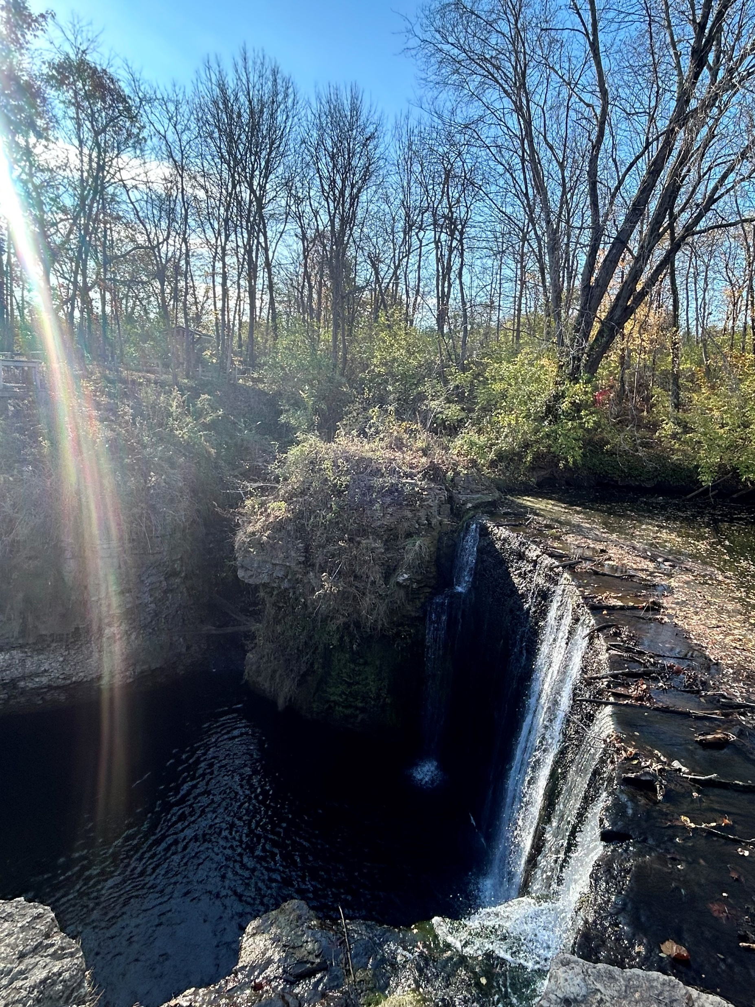
Building a Destination: Hiking and Walking Trails
More than 300 miles of natural surface hiking trails
  Twin Valley Creek Backpacking Loop
North Country National Scenic Trail
Buckeye Trail, Ohio’s Millennium Legacy Trail
Dayton: Designated Buckeye Trail Town
Conservation Park District: Five Rivers MetroParks
Wagner Subaru Midwest Outdoor Experience
Adventure Summit
Local Park Districts
County Park Districts
Greene County Parks
Miami County Parks

Slide 7
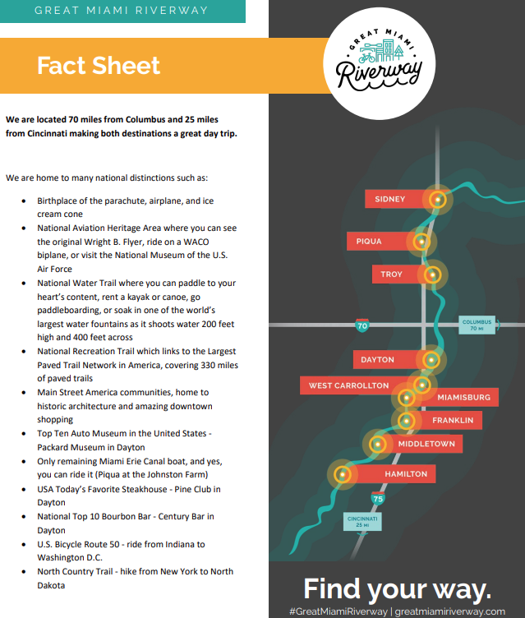
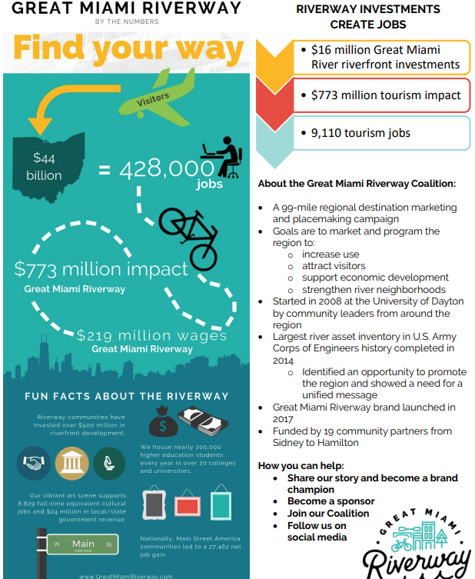
The Miami Valley Region’s Outdoor Economy: Great Miami Riverway

Slide 8
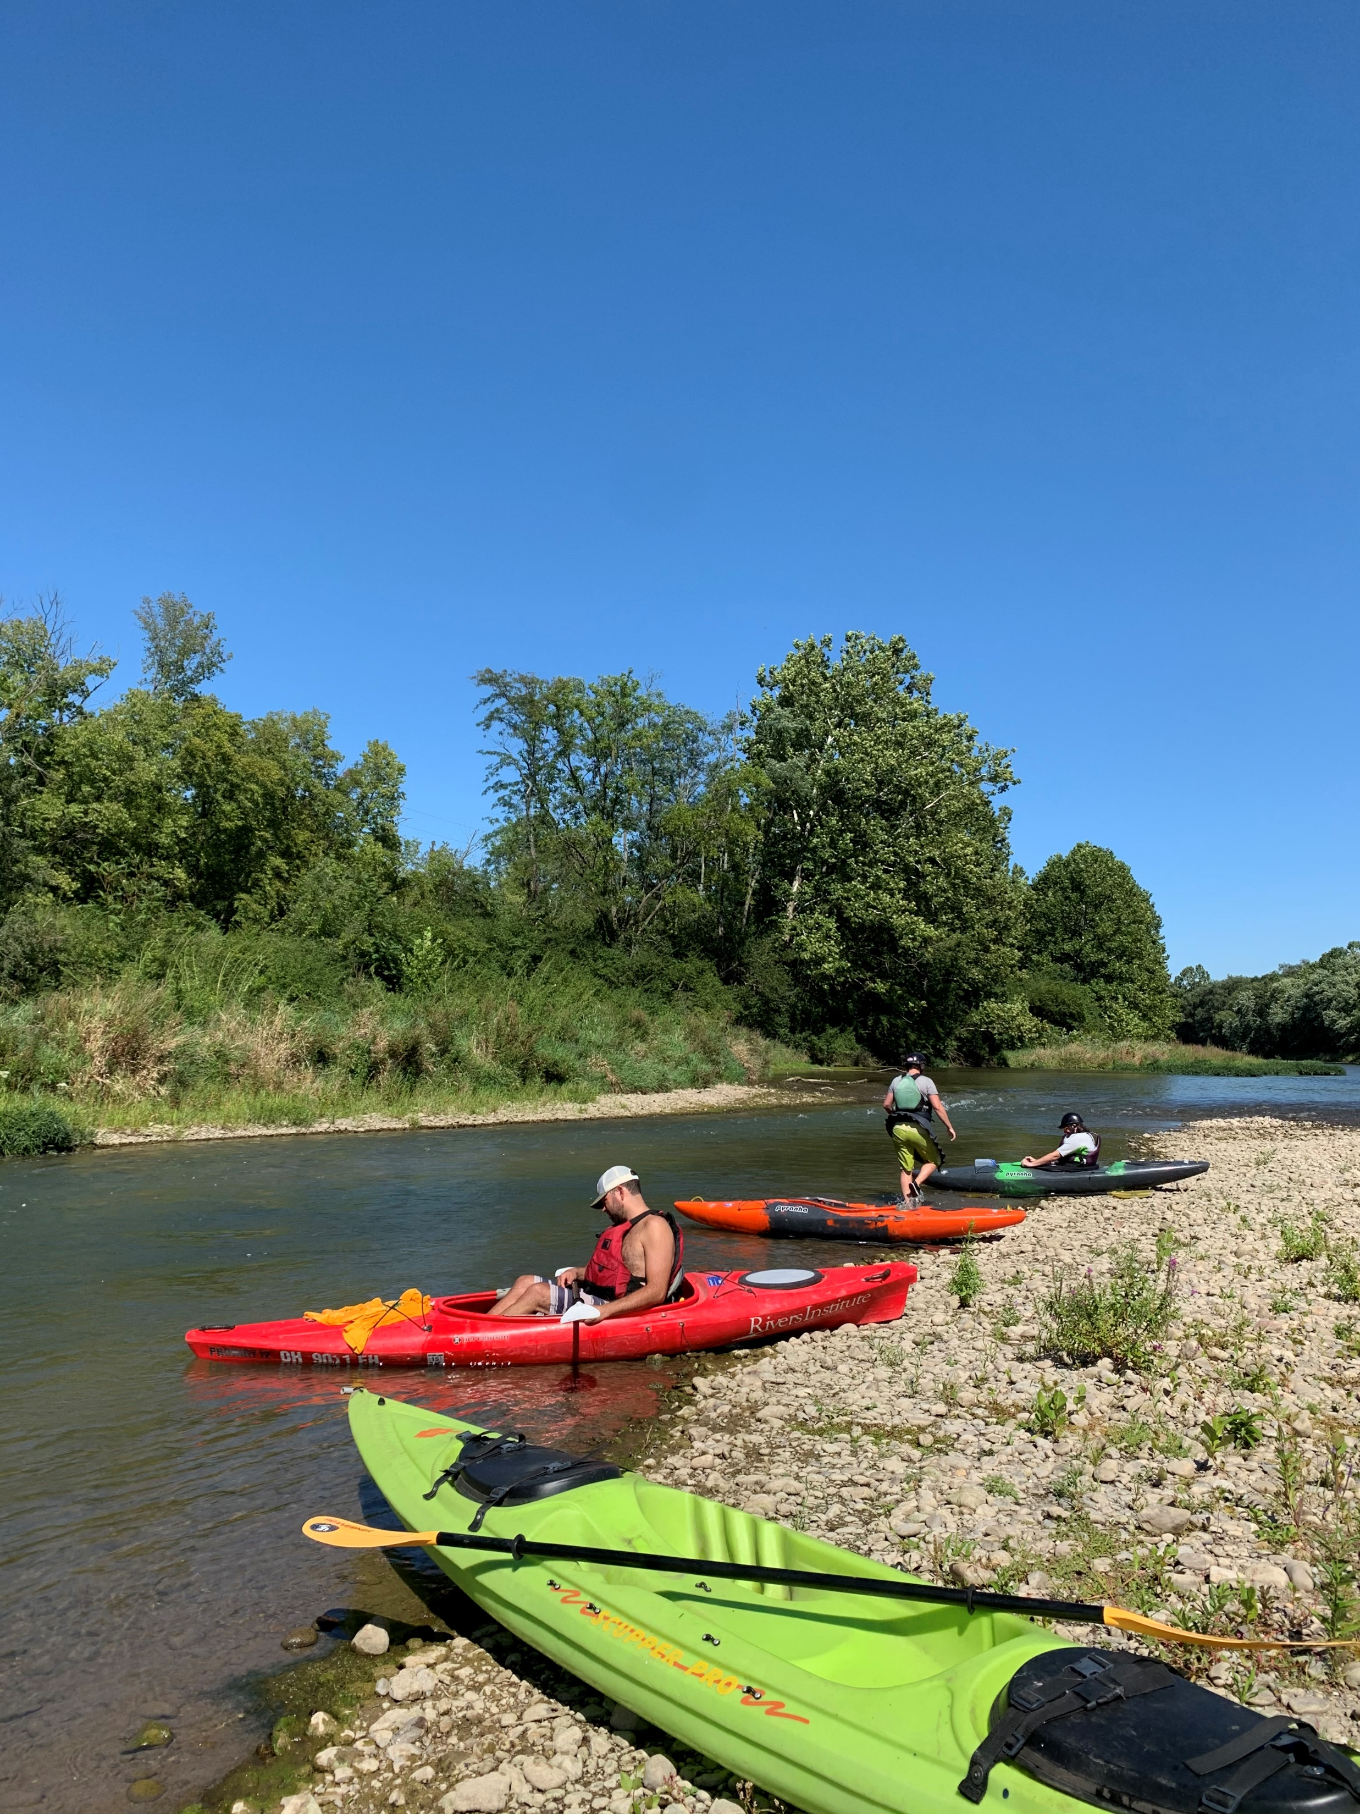
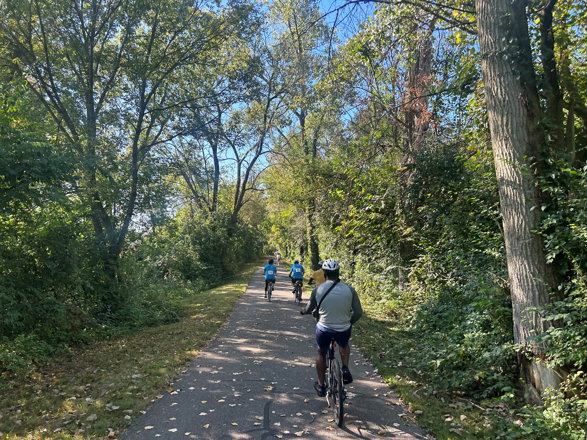
The Miami Valley Region’s Outdoor Economy: Little Miami River
Little Miami River OSU Economic Study
  2021 Study of 43 Miles of River
  806,446 Trips to the 45 Sites Surveyed
  Recreational Value is ~$10.1 Million Per Year
  Largest # of Trips and Highest Value
    Walking and Hiking
    Biking Paved Trails
    Fishing and Paddling

Slide 9
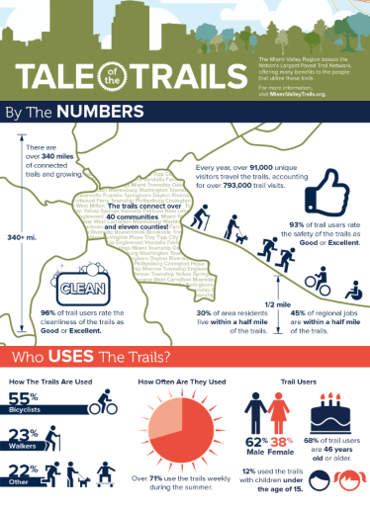
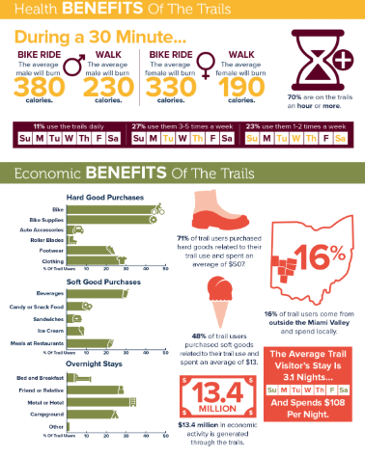
The Miami Valley Region’s Outdoor Economy: Miami Valley Trails

Slide 10
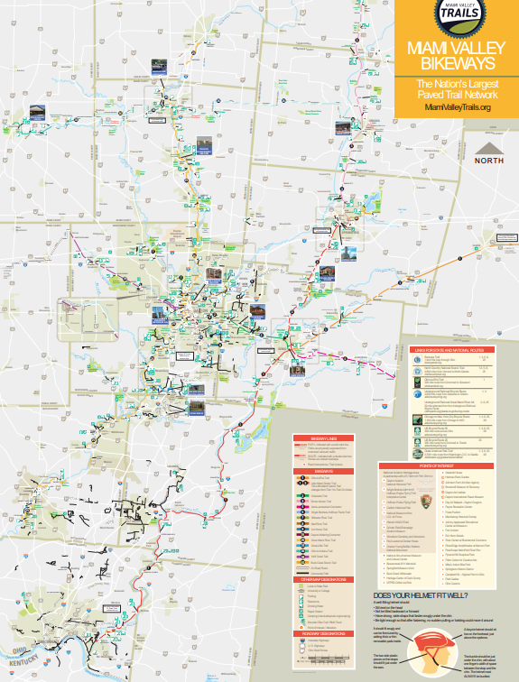
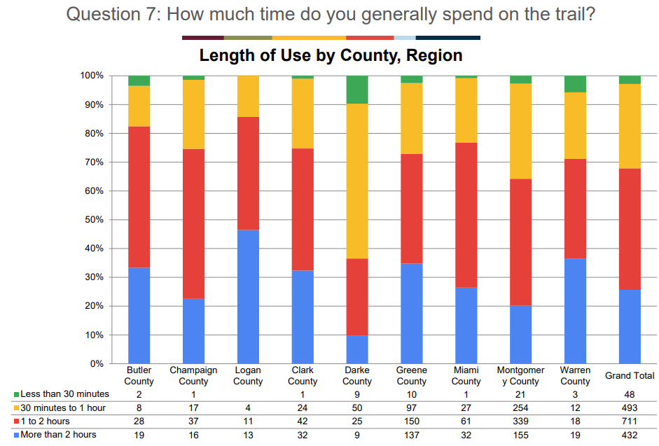
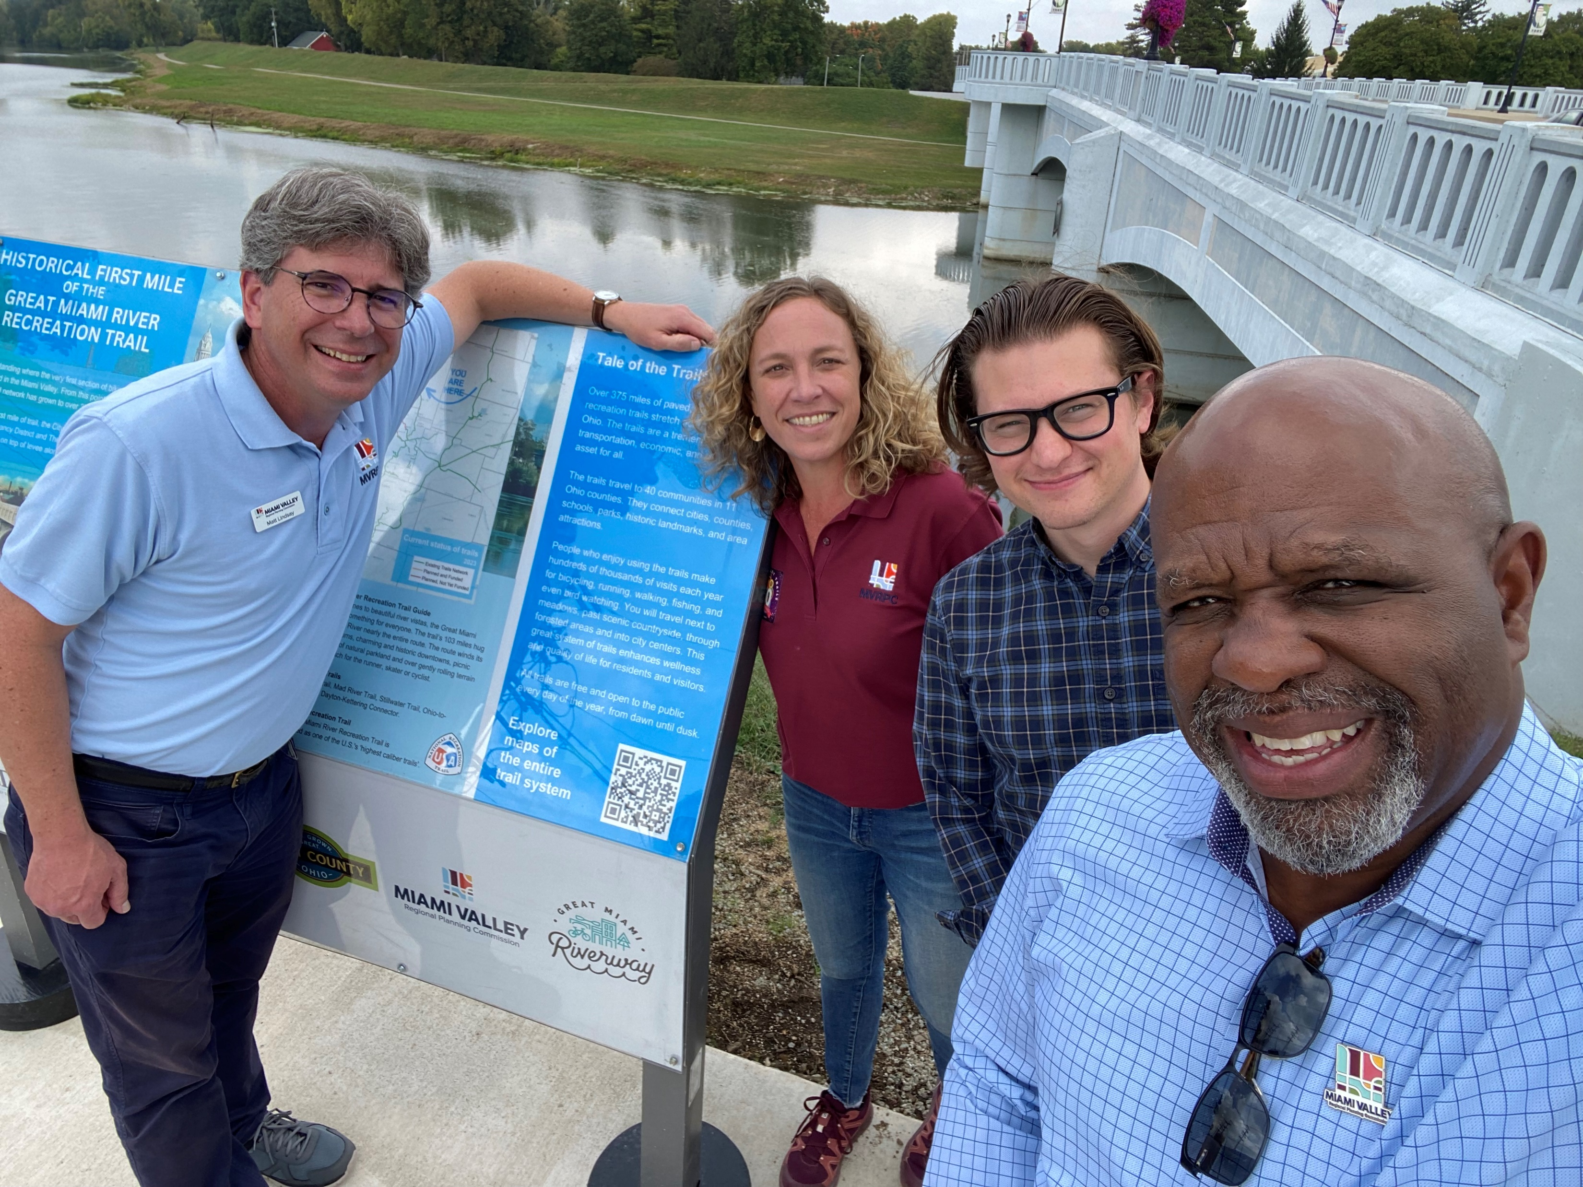
MVRPC’s Role
Region’s Transportation Planning Agency
  Transportation Funding
Active Transportation Planners
Regional AT Plan
Regional AT Map
Trail User Survey
Miami Valley Trails Website
Technical Services
  Walking and Cycling Audits
  Local AT Planning Support
  Grant Writing

Slide 11
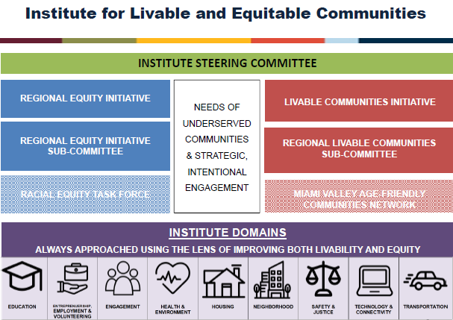
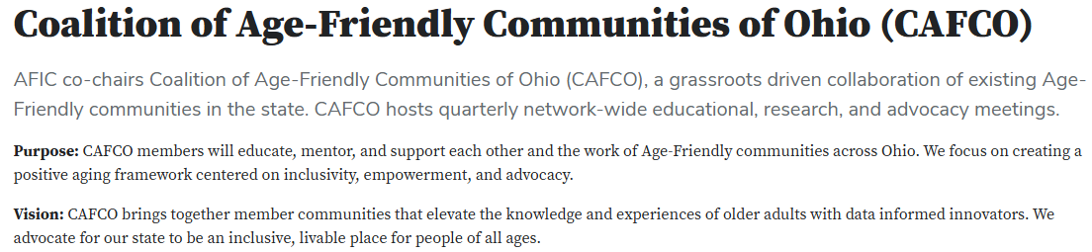
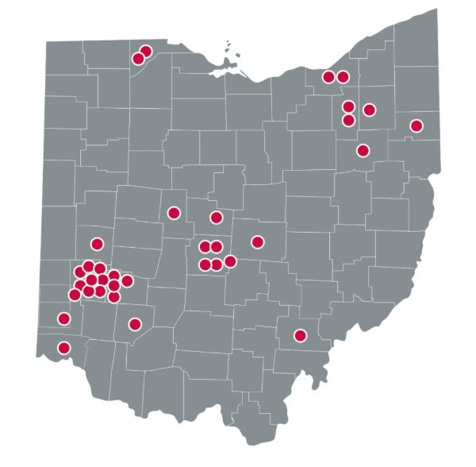
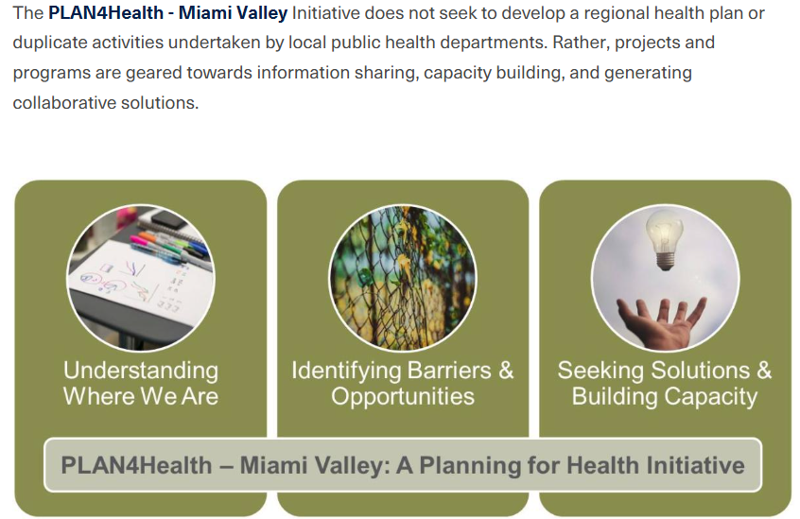
Looking Ahead: Miami Valley Regional Livable and Age-Friendly Communities

Slide 12
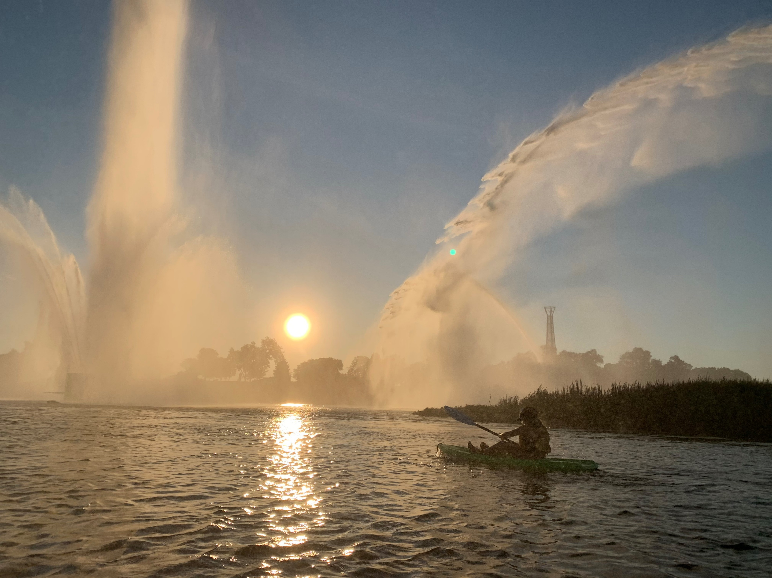
Thank you…and Come Visit the Miami Valley
Brian O. Martin, AICP
bmartin@mvrpc.org

