Slide 1


State of the Trails Report
National Association of Planning Councils Conference ׀ 6/10/2025

Slide 2
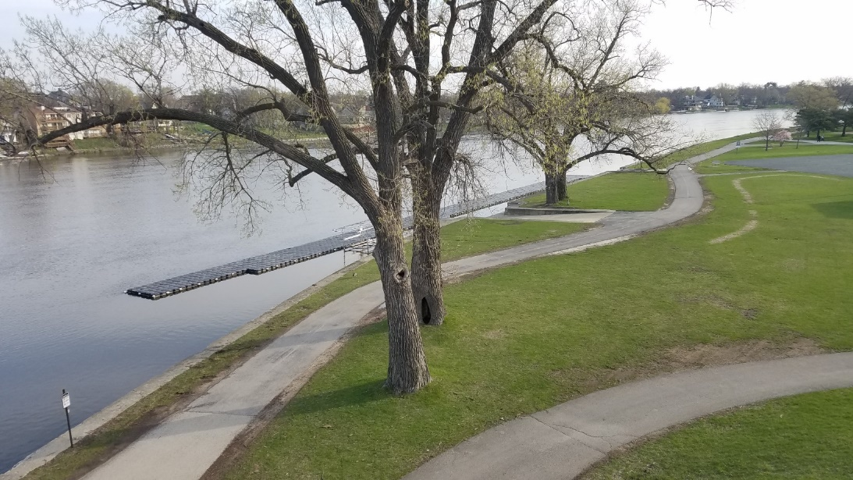
Why?
  Shared-use paths & trails are the highways of the bicycle network;
  They provide recreational opportunities and serve as greenways;
  The region’s shared-use paths & trails are aging, with many built 20+ years ago; and
  Condition complaints are frequently raised by the public but are often not addressed due to a lack of data and funding.
Notes:
Shared use paths and trails are also separated from roadways completely, providing additional safety benefits
Tell the story of the condition degradation and funding problem – prioritized maintenance is critical
RPD raised concerns about rising number of condition complaints from the public, maybe even from people in this room, in fall/winter of 2023. RPD and several other local jurisdictions met with R1 at this time to develop a scope for an application to IDOTs Statewide Planning and Research, or SPR, grant program.

Slide 3
Project Scope
Awarded Funding through an IDOT Statewide Planning & Research (SPR) Grant
  Develop a robust inventory of paths, trails, and related assets and amenities;
  Identify the condition of path and trail segments to inform local jurisdictions maintenance plans;
  Provide local jurisdictions with strategies to maintain and construct resilient trails;
  Educate the public on the importance of paths and trails and the unique challenges they provide to local jurisdictions; and
  Develop a data collection bike that can be used to repeat the assessment in the future.
Notes:
The following scope was submitted to IDOT in Spring of 2024, and awarded in summer of 2024, with the project to take place throughout 2025. the five main elements of the scope include.

Slide 4
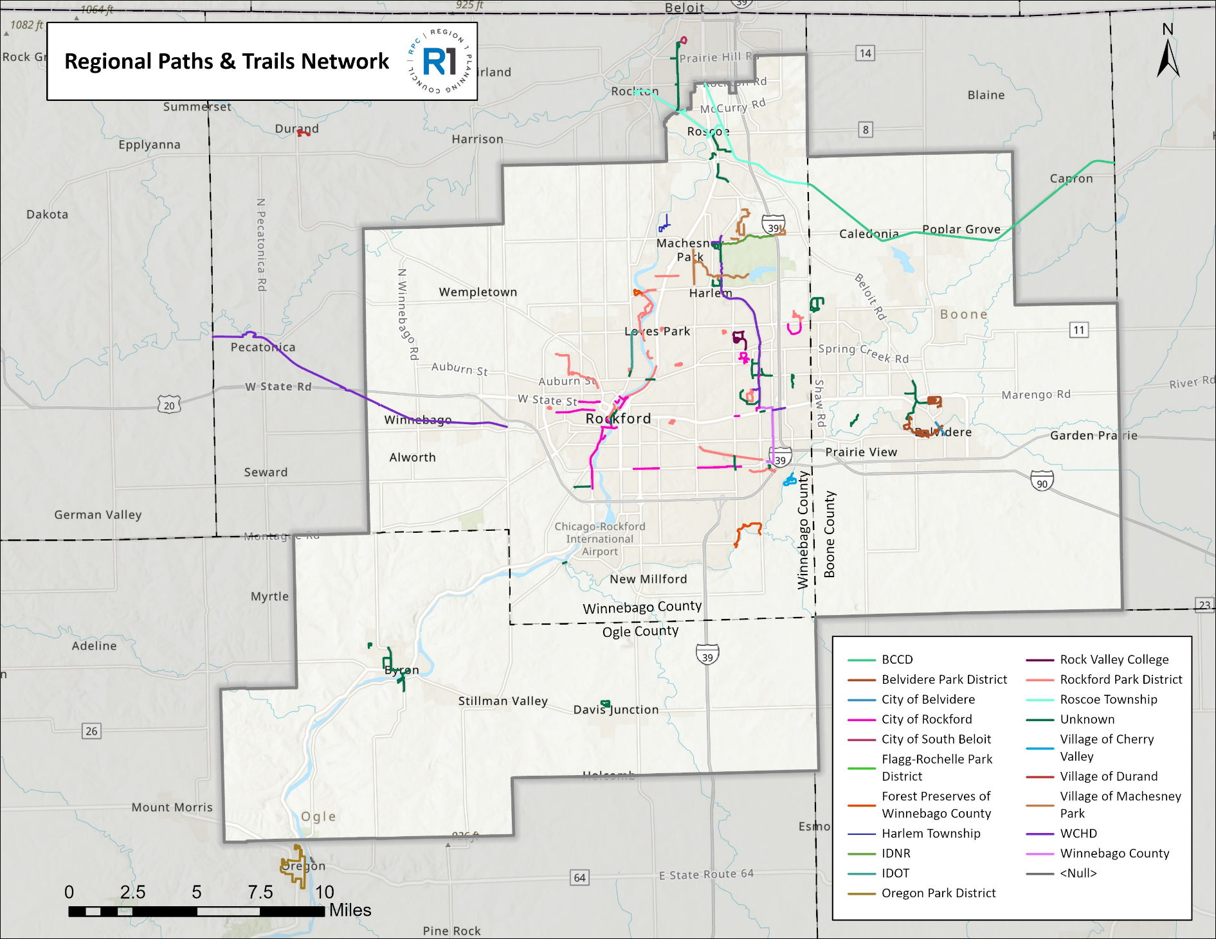
What data is being collected?
Approximately 178 miles of shared-use paths and trails

Slide 5



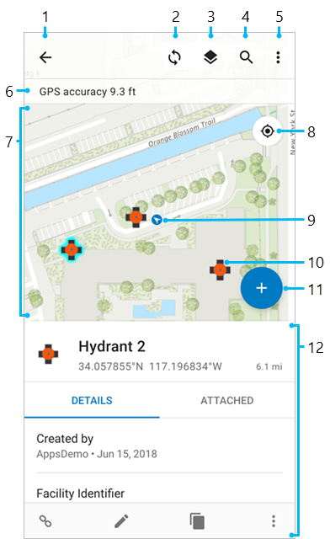

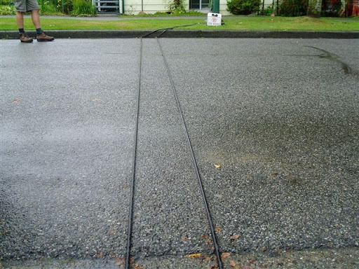
How is the data being collected?
Electric Bicycle – Specialized Haul LT
SensorLog App – On iPhone SE
Camera - GoPro Hero 11
Tube Counters
Ricoh Theta X
ArcGIS FieldMaps
Notes:
Bike – provides consistent speed
Sensor log – detects movement on three plans using internal sensors and gyros
Gopro- pavement images
Ricoh theta X – 360 degree StreetView images
Trimble – spatial logging of amenities and non pavement concerns
Tube counters – count users when passed over

Slide 6
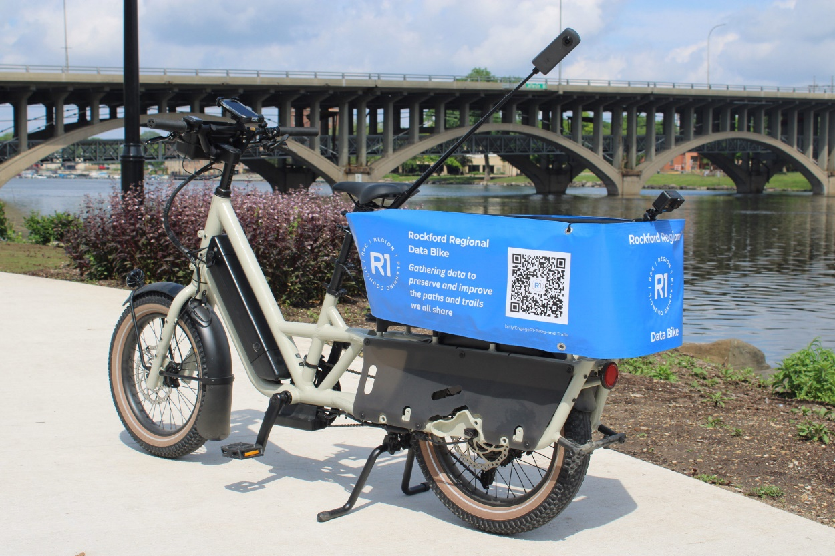
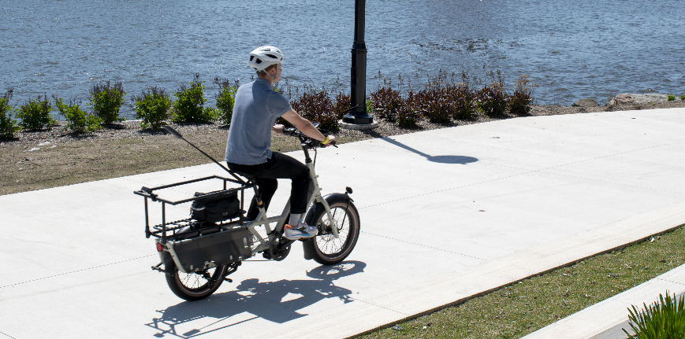
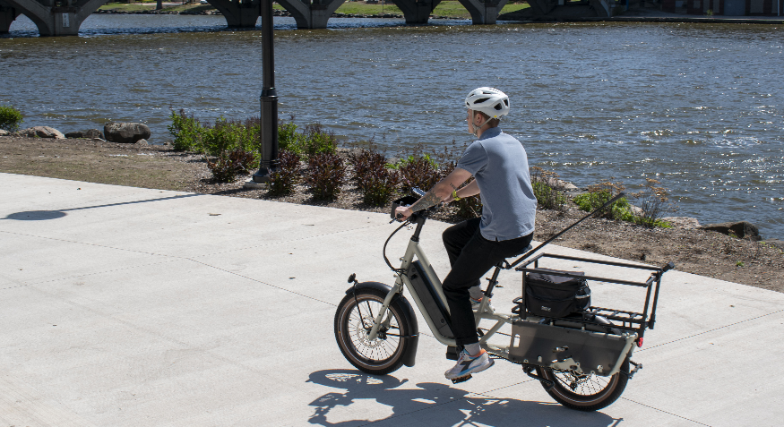
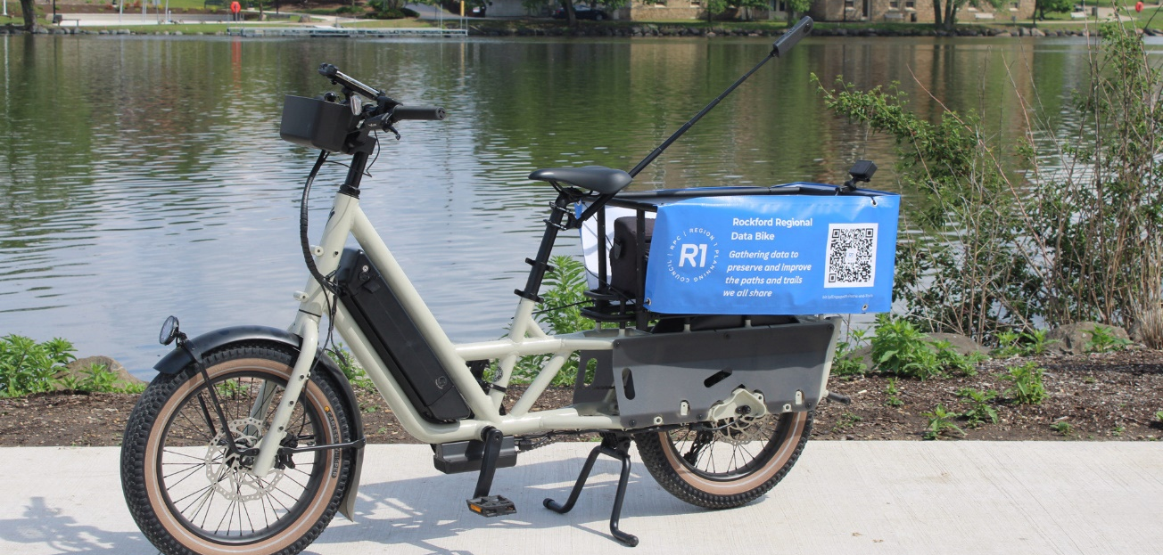
Rockford Regional Data Bike

Slide 7
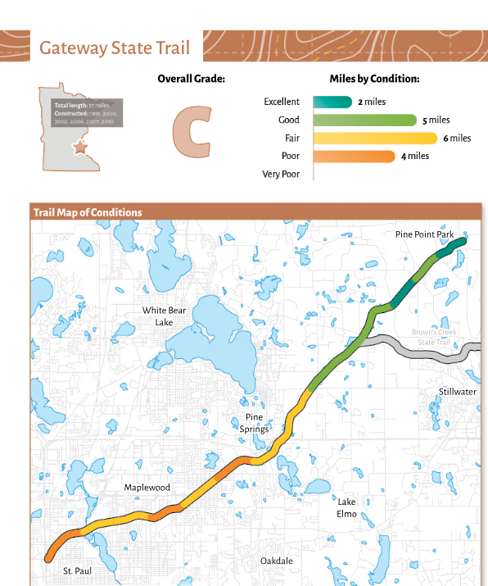
Final Report Product
Report Contents
  Introduction
  The Role of Paths & Trails
  Data Bike & Methodology
  Executive Summary of Findings
  Detailed Condition Reports
  Recommendations
  Conclusion
Parks & Trails Council Minnesota
Notes:
2. Brief description, informed by Greenways Plan
3. components, methodology explained
4. System wide overview
5. Trail/path specific reports
6. Potential priority maintenance lists
More recommendations for pavement treatments in greenways plan

Slide 8
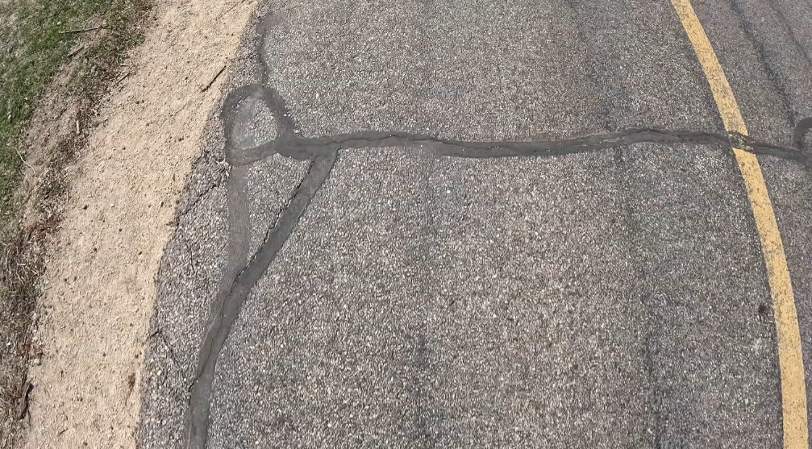
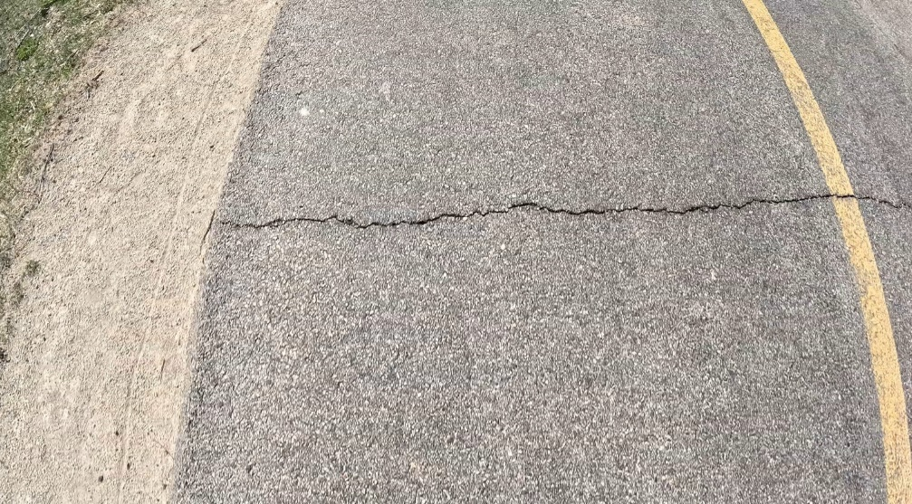
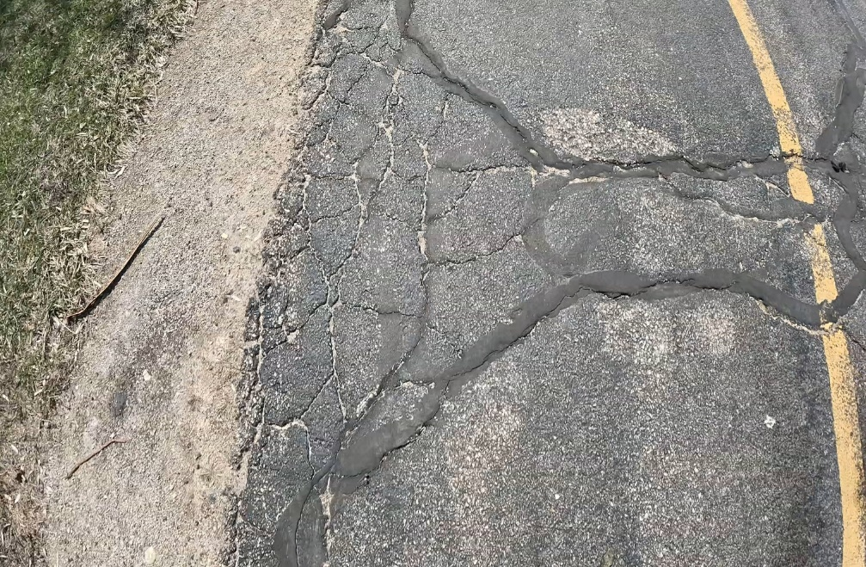
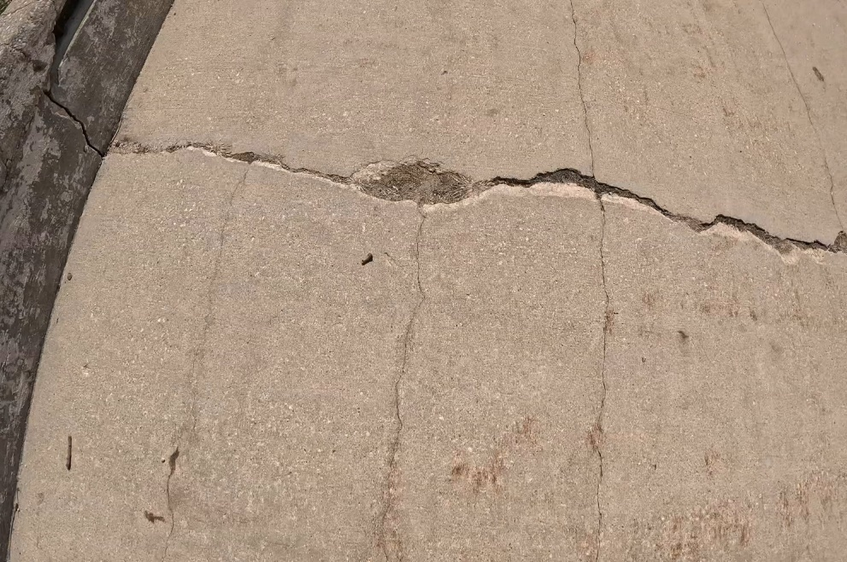
Sample PAVEMENT condition data

Slide 9
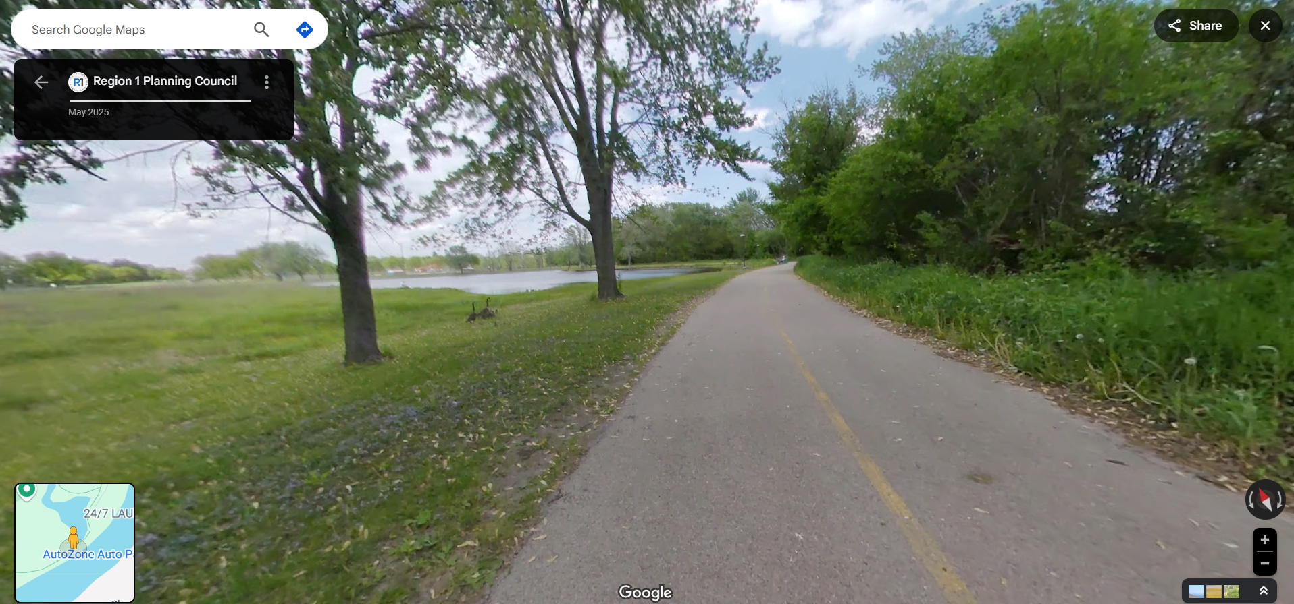
Sample Google sTREETVIEW data
Notes:
Rock River Recreational Path, Mel B Anderson Memorial Path, West State Street Path, Pecatonica Prairie Path, and more are all available on google StreetView at this time

Slide 10
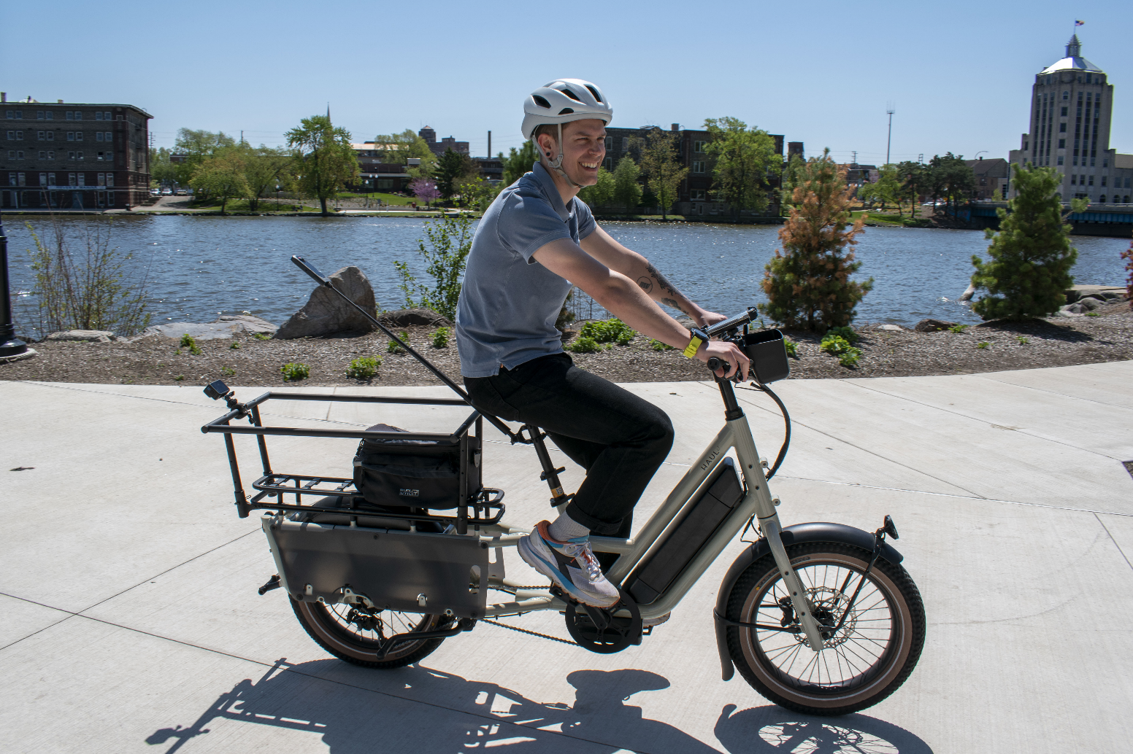

Next steps
PROJECT CONTACT
Tim Verbeke,
Director of Planning
TVerbeke@R1planning.org
bit.ly/EngageR1-Paths-and-Trails

