Slide 1

Forging stronger connections
to a region’s municipalities
A scalable model

Slide 2




Our agenda for this session
1
Who are we?
What is the Local Government Network?
How is the network managed, and how might it work for you?
Discussion
2
3
4
Notes:
I'm Pat Day and I've been a city planner for 17 years, in a variety of places, and now with the Chicago Metropolitan Agency for Planning. I'm excited to talk to you today about the LGN, this project we've been working on for about 5 years. I'm going to give you some background, sort of orient you to where we come from – and then my colleagues Mai and Mike are going to talk about the details of how to roll this out and some successes we've had. We hope to have time at the end for questions and discussion. Now, let me back up and tell you who we are.

Slide 3
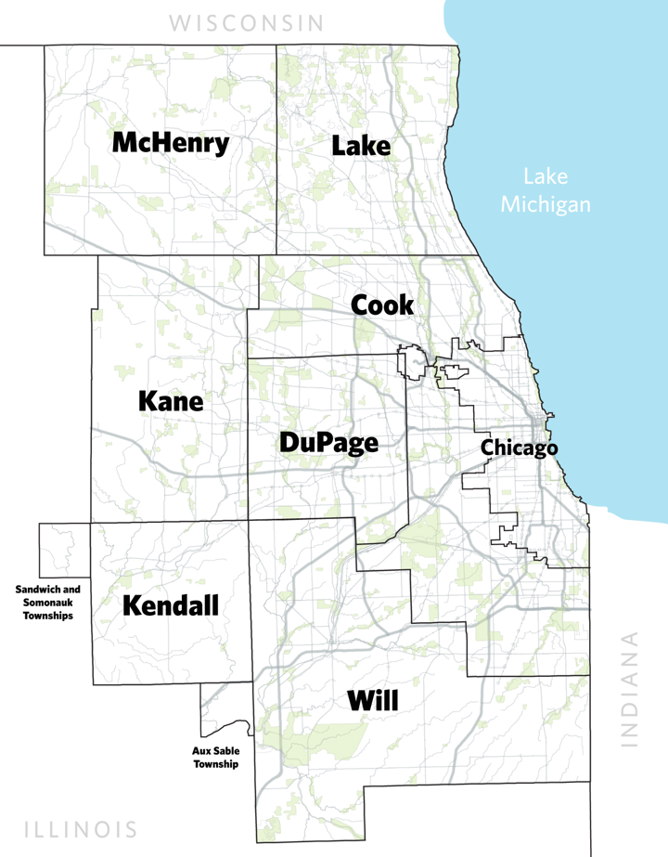
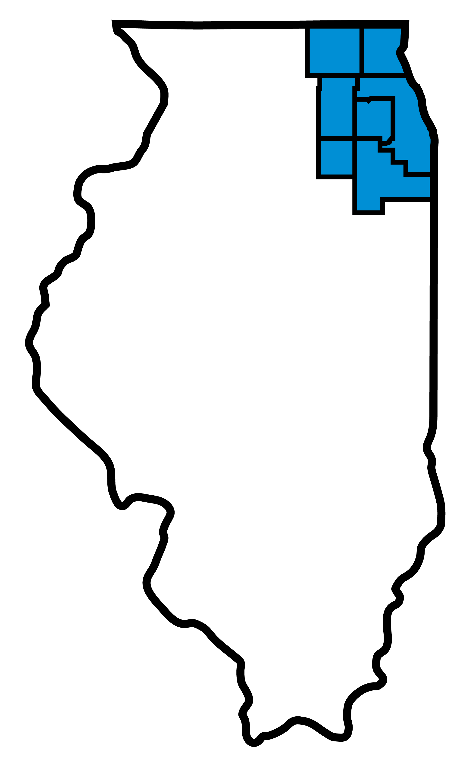




CMAP serves
8.6 million people
284 municipalities
7 counties
4,071 square miles
Lake Michigan
Notes:
We're CMAP! Some of you know us, others maybe not. City of Chicago is our largest municipality, but really for today's purposes, our focus is on connections to the other 283 municipalities. Whose characteristics are very diverse. Cities with 200k population to villages with 300. Mayors who mow all the town's lawns, to mayors you're more likely to find on a trade deligation in rotterdam. Our service area is the size of the state of Delaware!
Rural to exurban to suburban to inner legacy suburbs, and all the forest preserves, waterways, trails in between.

Slide 4

Our region:
Birthplace of His Holiness
Notes:
Northeastern Illinois has a singular claim to fame that none of you can boast.
To the world, he’s His Holiness Pope Leo the fourteenth. At CMAP.... we also know him as Bob from 141st & Indiana. So we have that going for us, which is nice.

Slide 5

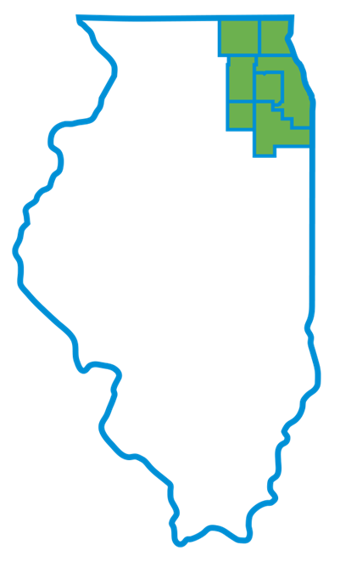

Federal
metropolitan planning organization (MPO)
State
regional planning agency
United States Code Titles 23 and 49;
Section 134 of Title 23 of the Federal-Aid Highway Act and Section 5303 of the Federal Transit Act
Illinois Public Act 095-0677/(70 ILCS 1707/)
Regional Planning Act
Notes:
We are both the region’s federally designated metropolitan planning organization (MPO) AND a state-authorized regional planning agency.

Slide 6



How does CMAP serve the region?
Plan regionally and locally
Influence change
Invest strategically
Long-range regional comprehensive plan
Technical assistance, training and resources
Research and analysis
Data science
Authoritative data source
Inform and shape policy
Program federal transportation funds
Transportation Improvement Program
Collaborate and convene
Foster dialogue and participation
Notes:
For our particular agency, this is how we consider our service to the region.
We don’t implement but rather use a set of levers to advance our region’s vision and goals and make lasting change. LGN works across all of these.

Slide 7

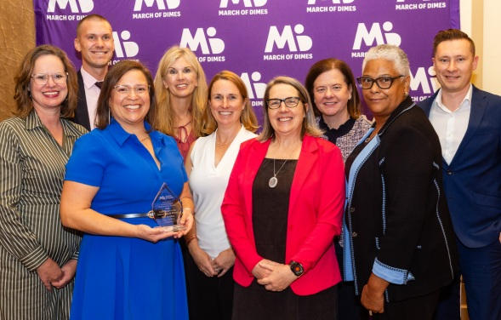

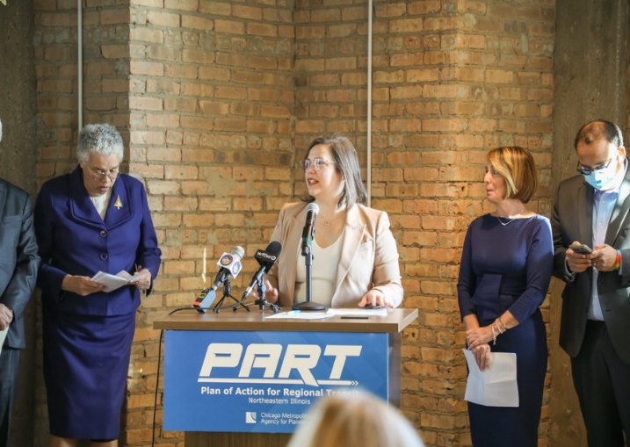
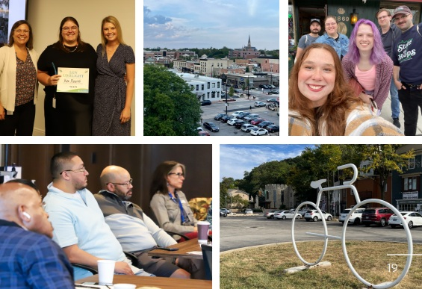
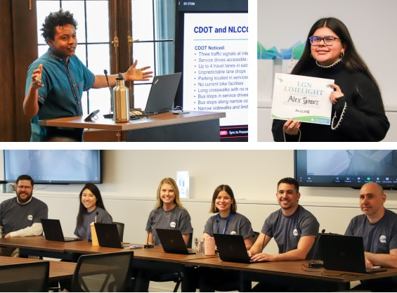
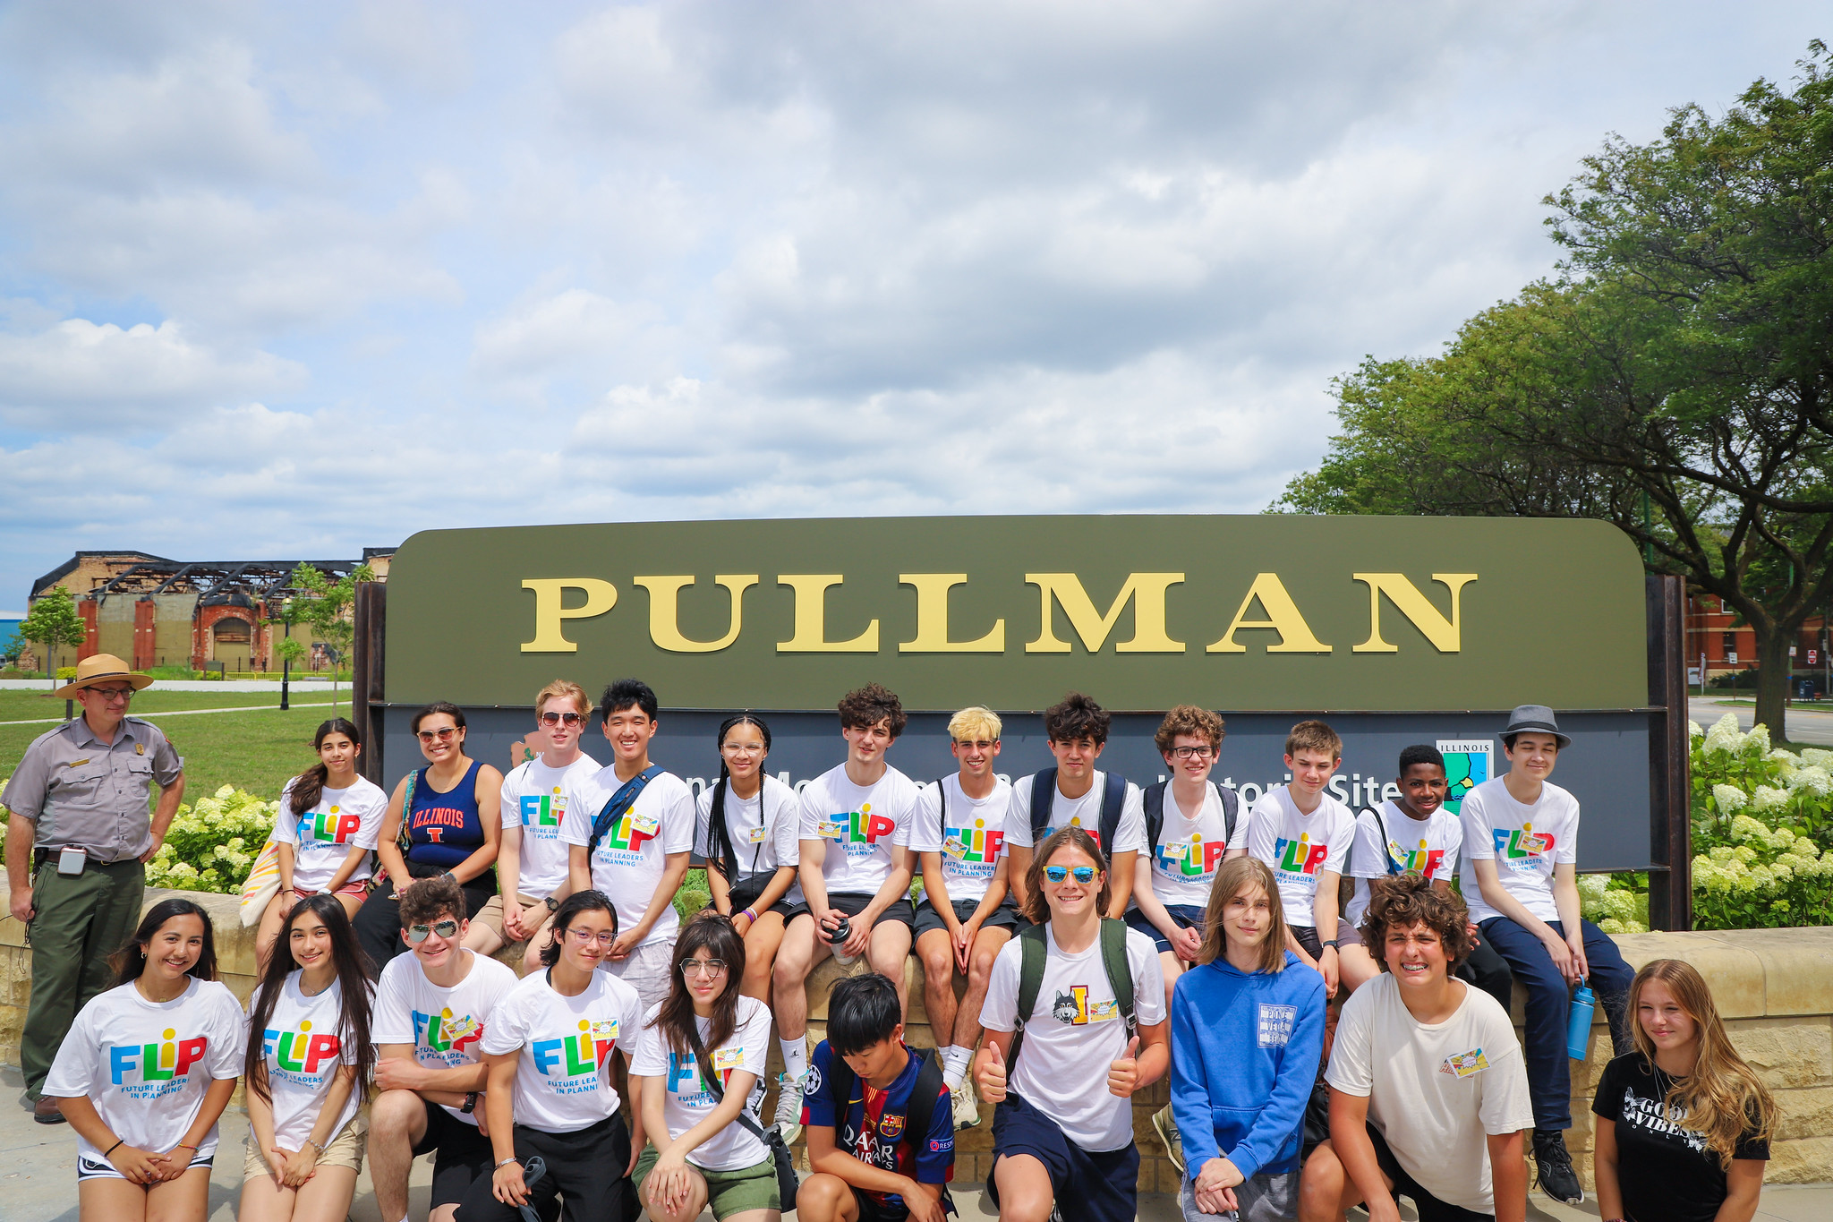
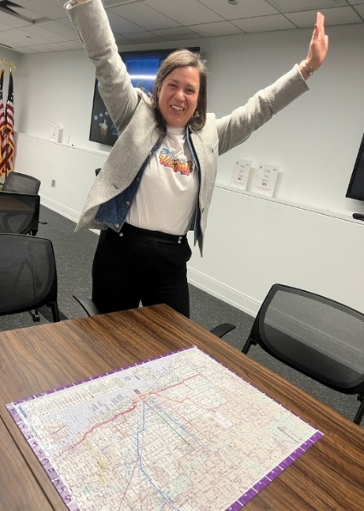
130 employees who serve with passion and excellence
Notes:
We're a big agency! 130 staff across 5 divisions.
And I want to acknowledge, that while many of our peers have far fewer staff, we think the model we're discussing today is scalable to whatever size of region you serve or number of staff you have.

Slide 8


Establishing and maintaining connections with municipal partners is tough
Notes:
Now I know No One in here has experienced any challenges maintaining connections with partners...but we at CMAP have.... I'm about to describe a couple. And perhaps a feeeew might sound familiar to you....you know...as issues your rival regional planning organizations have had.

Slide 9

Many challenges exist in establishing and maintaining connections with municipal partners
  Partners may be unaware you exist
  Partners might be unsure why you exist
  Municipal staff move around
  Elections happen regularly

Slide 10
Not addressing these challenges has costs
  Your organization is unknown to key partners
  Participation is minimal
  Plan goals go unrealized
  Funding gets left on the table

Slide 11

In 2020, things changed
Notes:
All the challenges I just described had been there forever, but in 2020, at the beginning of the pandemic, the situation called for addressing communication challenges in a new way.
ED request in 2020, to meet emergent need for region-wide communication
Forced to reconsider how we connect with one another, and with an entire region
Pulled together a framework, informed by a variety of lessons learned. The Local Government Network was born.
After building out this network of confirmed contacts during that point it time, we figured, hey that worked really well, let's keep it, and use it for more stuff

Slide 12

So, what is the Local Government Network?
  A regional communication framework
  Matched human beings serving as reliable primary contacts for CMAP and for each of the region’s local governments
  An excel file, ideas, and people

Slide 13




Brings awareness to agency data and tools
Obtains valuable planning information
Reliable, ongoing two-way communication
Serves emergent needs

Slide 14

Brings awareness to agency data and tools
Obtains valuable planning information
Promotes reliable, ongoing two-way communication
Serves emergent needs

Slide 15

Brings awareness to agency data and tools
Obtains valuable planning information
Promotes reliable, ongoing two-way communication
Serves emergent needs

Slide 16
Brings awareness to agency data and tools
Obtains valuable planning information
Promotes reliable, ongoing two-way communication
Serves emergent needs

Slide 17

What are key strengths of the model?
  We relentlessly pursue accurate contact info, ask preferences and respond to them
  We limit our use of it
  We empower our "liaisons“ – CMAP staff - to establish personal connections with customizable materials
Notes:
We get the right people. It allows us to strategically include or exclude them from initiatives, only reaching out when relevant. That's huge.
We don't overuse it. We only do a handful of initiatives per year. Both of these are in service of maintaining relevance.
We encourage staff to deepen their understanding of their assigned municipalities. And we heavily favor accessible speech in our communications, and

Slide 18
What makes it a viable model for you?
  You may already be doing it
  Simplicity of operations
  It’s rewarding for your staff and helps them be more effective in serving the region
  Small investments are leveraged for a variety of benefits to your organization

Slide 19

What do we use the network for?

Slide 20
35+ initiatives to leverage the network, to date
COVID-19 Regional Recovery Survey
Community Data Snapshots Distribution
Census Undercount Policy Brief
Shared Services Webinar
2021 Invitation to Apply for Technical Assistance
County Emergency Rental Assistance
Choose Chicago Tourism
Regional Excellence Awards
Reminder to Claim ARPA Allocations
2022 Invitation to Apply for Technical Assistance
LGN Contacts Confirmation & Cook County ARPA Summit
LGN Liaison Feedback
HSIP Call for Candidate Projects
Updated Community Data Snapshots
2023 Invitation to Apply for Technical Assistance
Registration for ADA Training
Promote Climate Action Planning
Request Zoning Information
Community Data Snapshots
Invitation to CMAP Technical Assistance Workshops
Cook County FEMA Assistance
Energy Efficiency and Conservation Block Grant
2024 Invitation to Apply for Technical Assistance
ADA Trainings
Speed Management and Transportation Safety Planning
Community Data Snapshots
Delta Institute Water Technical Assistance Involvement
Household Travel Survey
Municipal Survey
Reminder to Claim EECBG Funding
Safe Travel for All
Regional Transportation Plan Questionnaire
2025 Invitation to Apply for Technical Assistance
Northeastern Illinois Development Database
Local Housing Profiles
Regional Planning Act Advocacy
New Mayors Welcome
. . . . and beyond!
Notes:
We finished 038 last month. I won't go thru each one, but will focus on a handful in the next few slides.

Slide 21



Claiming American Rescue Plan (ARPA) funds
ARPA directed financial assistance to local governments. LGN assisted with funding eligibility notifications.
100% of municipalities in the CMAP region claimed their ARPA funds
Secured over $37 million in funding for the region
Notes:
In 2021, we were contacted by the State of Illinois to collaborate with them on an initiative. The state was in the process of distributing ARPA funds to certain local governments, and a portion of the communities in our region hadn’t claimed their funds yet. Claiming their funds was quite simple - they just needed to log into a portal and claim the money by a deadline. But the DCEO was struggling to fill some gaps in their outreach, which is where they asked CMAP to come in and help.
We leveraged the local government network to reach out to communities who hadn’t claimed their ARPA funds yet, and provided instructions of how to claim the funds, as well as a contact at the DCEO who they could reach out to with questions. After a couple rounds of follow up, along with some conversations with communities about the purpose and benefits of ARPA funds, 100% of the communities in our region claimed their ARPA funds.

Slide 22
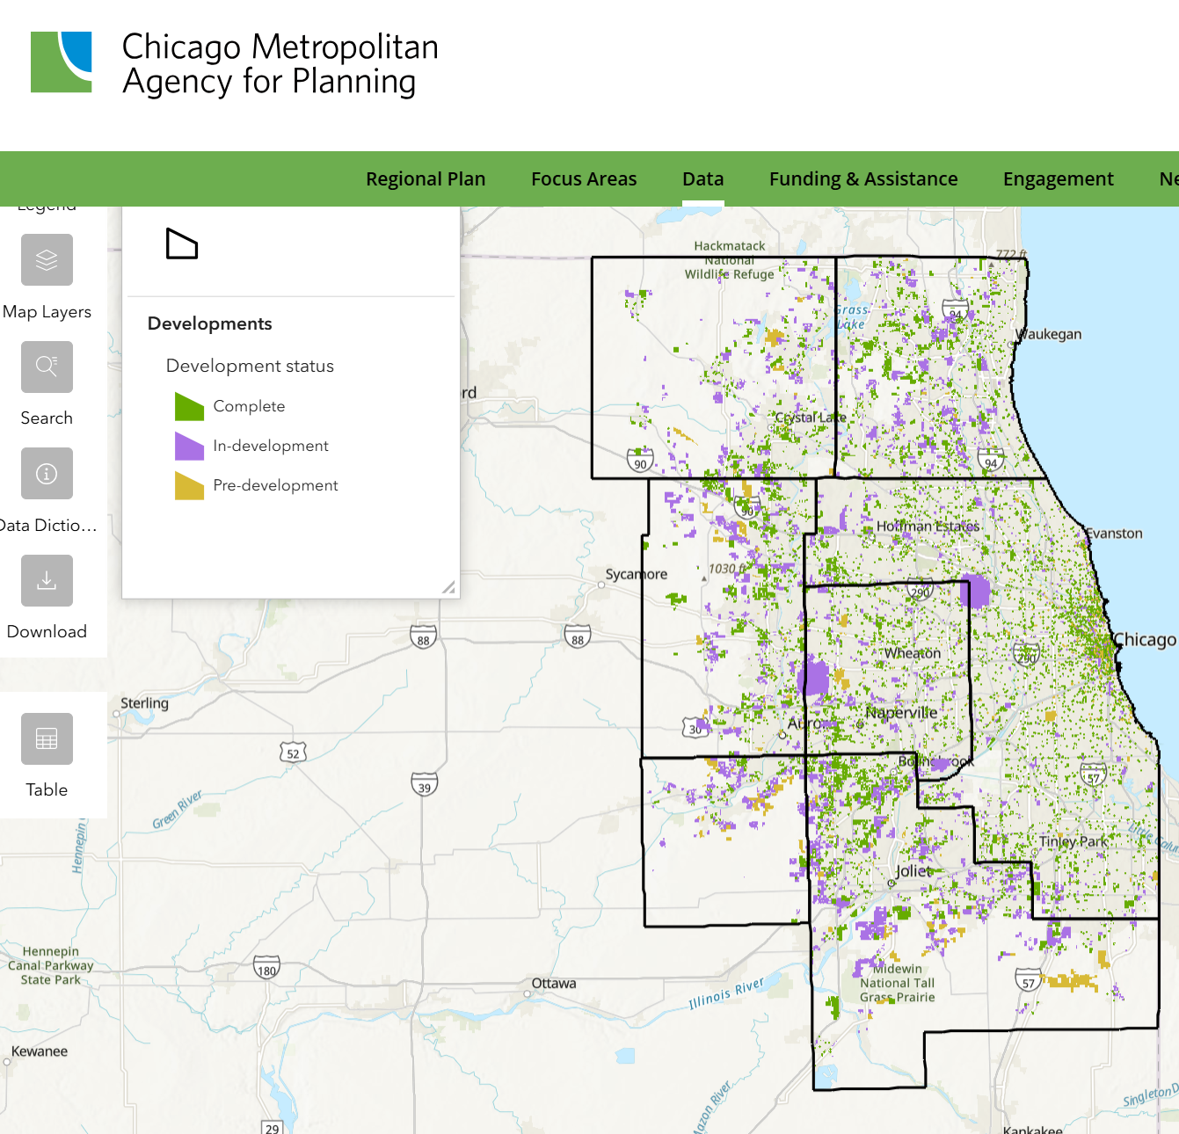

Obtaining data for the Northeastern Development Database (NDD)
Updates NDD & web map to view, filter and better understand current and planned development in the region.
Clarified the ask, improved response rate and database accuracy
CMAP SMEs cc'ed on all emails to quickly answer technical questions
Learn more
Notes:
Broke down tech barriers to demystify the request to add additional developments, from 2021 through today, as well as anticipated future projects. Plus, promote it's use. Which many have now done.

Slide 23
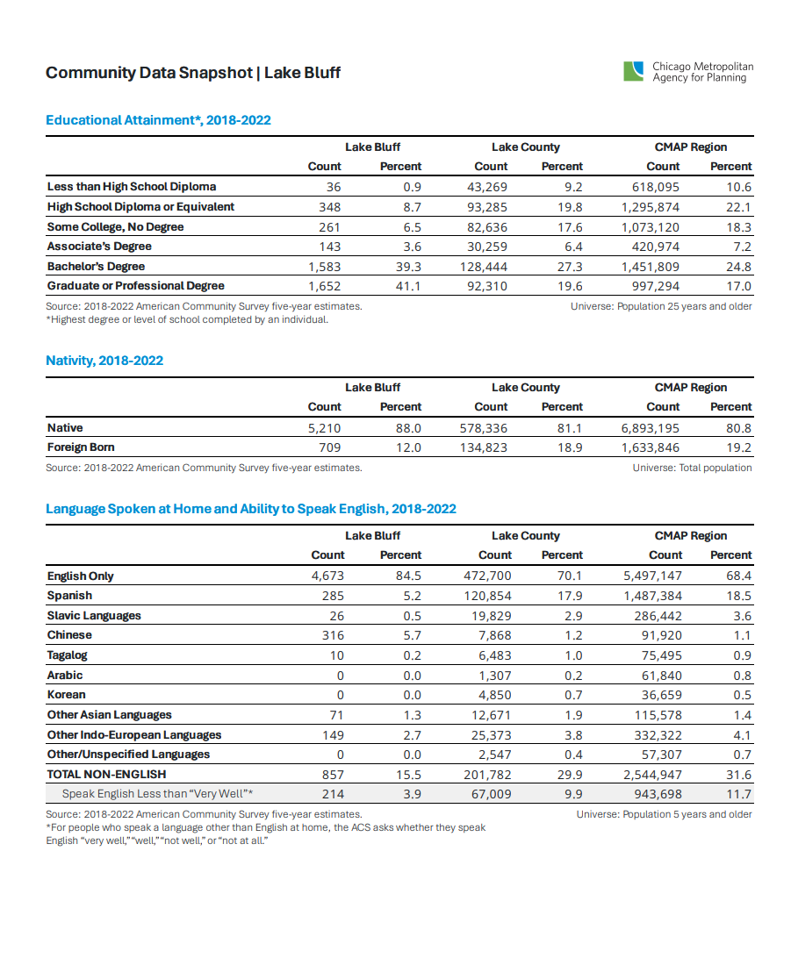
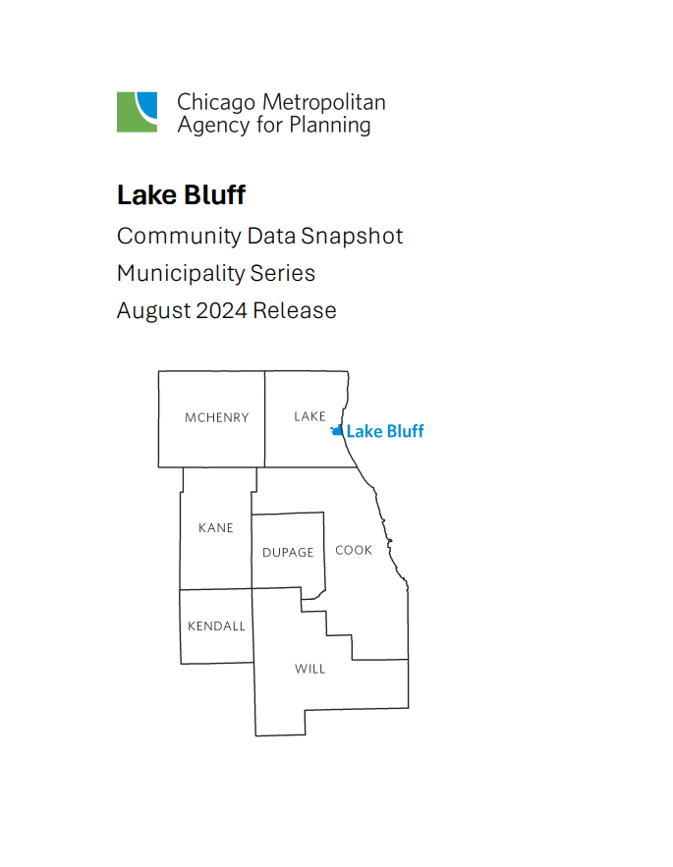


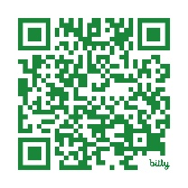
Community Data Snapshots
Annually updated data profiles for every municipality featuring basic demographic and community planning data
Most viewed CMAP data resource
Informs local plans
Learn more

Slide 24

So, how does LGN work exactly?
Notes:
Let’s walk through the steps of creating an LGN initiative outreach emails from the perspective of the network’s project manager
(Tell them what you're going to tell them)

Slide 25
Key components of an LGN initiative
Completed Initiative Request Form
"Office hours" calendar invite
Community contact database specific
to the initiative
Initiative announcement
Initiative email template
Any supplemental materials
Notes:
There are a few items needed to ensure each LGN initiative meets CMAP and community needs. Here are the "Ingredients" :)
We'll be using the CMAP's most popular data resource, the community data snapshots, as an example as I walk us through initiative creation

Slide 26
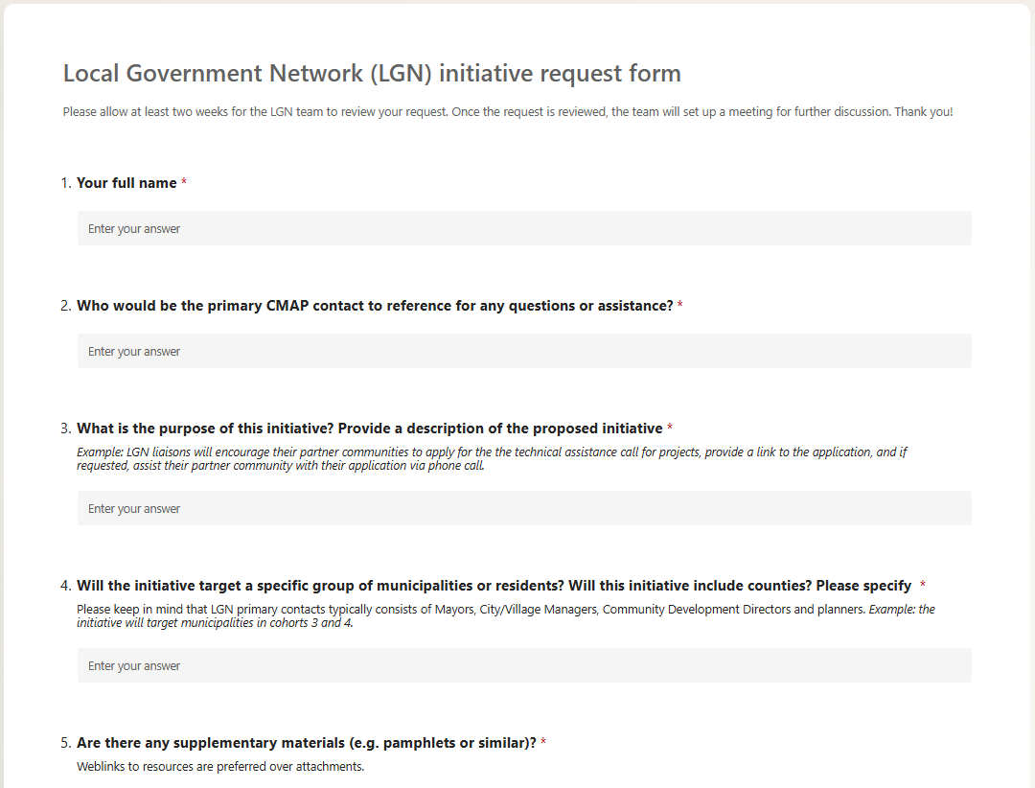
LGN initiative requests
Identify initiative details via Initiative Request form
Meet with subject matter expertise (SME) project team to discuss details
Notes:
LGN initiative requests can come from the LGN team itself or SME project teams who identify an opportunity for an initiative
An LGN initiative request form is typically completed to ensure all initiative details are accounted for
Once a form is a complete, the LGN project manager meets with the requestee to discuss these details prior to making a final determination whether to move forward with a proposed LGN initiative.

Slide 27
Considerations for proposed LGN initiatives
Notes:
I'm sure everyone in this room has experienced irrelevant and impersonal mass emails that are easy to ignore. To prevent that, when reviewing the initiative request forms, there are a few considerations needed to ensure we meet both CMAP and community needs.

Slide 28
Considerations for proposed LGN initiatives
  Purpose – What is this initiative trying to accomplish?
Notes:
When an LGN initiative is proposed, it's important to consider the core purpose of outreach. Does the initiative intend to spread awareness of resources and tools, distribute a survey to gather data, or grant funding opportunities?
In the case of CMAP's community data snapshot, the purpose of the initiative is to spread awareness of a data resource

Slide 29
Considerations for proposed LGN initiatives
  Purpose – What is this initiative trying to accomplish?
  Targeted audience – All municipalities in region or targeted group?
Notes:
Second, the project manager should consider the target audience for an initiative. Sometimes, resources could in theory be distributed to all municipalities in a region, but would benefit most if distributed to a smaller, target group of municipalities.
Since CMAP generates data for all 284 communities in the region and 7 counties, all municipalities will be included in this initiative

Slide 30
Considerations for proposed LGN initiatives
  Purpose – What is this initiative trying to accomplish?
  Targeted audience – All municipalities in region or targeted group?
  Launch dates – Are there ideal time frames or deadlines?
Notes:
Time frames are important to consider when distributing resources as well. Federal funding opportunities or surveys often have deadlines attached, so initiative deadlines need be communicated to liaisons in advance.

Slide 31
Considerations for proposed LGN initiatives
  Purpose – What is this initiative trying to accomplish?
  Targeted audience – All municipalities in region or targeted group?
  Launch dates – Are there ideal time frames or deadlines?
  Any supplementary materials – Links or attachments?
Notes:
Supplementary materials, supplied by the subject matter expertise project team, can also help or hurt an initiative.

Slide 32
Considerations for proposed LGN initiatives
  Purpose – What is this initiative trying to accomplish?
  Targeted audience – All municipalities in region or targeted group?
  Launch dates – Are there ideal time frames or deadlines?
  Any supplementary materials – Links or attachments?
  Other forms of outreach – Are there any potentially duplicative forms of communication?
Notes:
E-blast newsletters, website updates, or in-person mentions of opportunities can be helpful to reinforce the LGN initiative message. other times multiple streams of efforts can be potentially duplicative and devalue the personable nature of LGN

Slide 33
Considerations for proposed LGN initiatives
  Purpose – What is this initiative trying to accomplish?
  Targeted audience – All municipalities in region or targeted group?
  Launch dates – Are there ideal time frames or deadlines?
  Any supplementary materials – Links or attachments?
  Other forms of outreach – Are there any potentially duplicative forms of communication?
  Impact – How do we determine initiative success?
Notes:
Finally,

Slide 34

Deploying an LGN initiative
1
Send optional office hours invitation and create initiative email template
2
Develop initiative
announcement and
community contact database
3
Announce initiative and distribute outreach template
4
Confirm date of outreach in the community contact
database
Notes:
Next, we'll talk about deploying an LGN initiative.

Slide 35
Deploying an LGN initiative
1
Send optional office hours invitation and create initiative email template
2 – 3 weeks prior to launch
2
Develop initiative
announcement and
community contact database
3
Announce initiative and distribute outreach template
4
Confirm date of outreach in the community contact
database

Slide 36
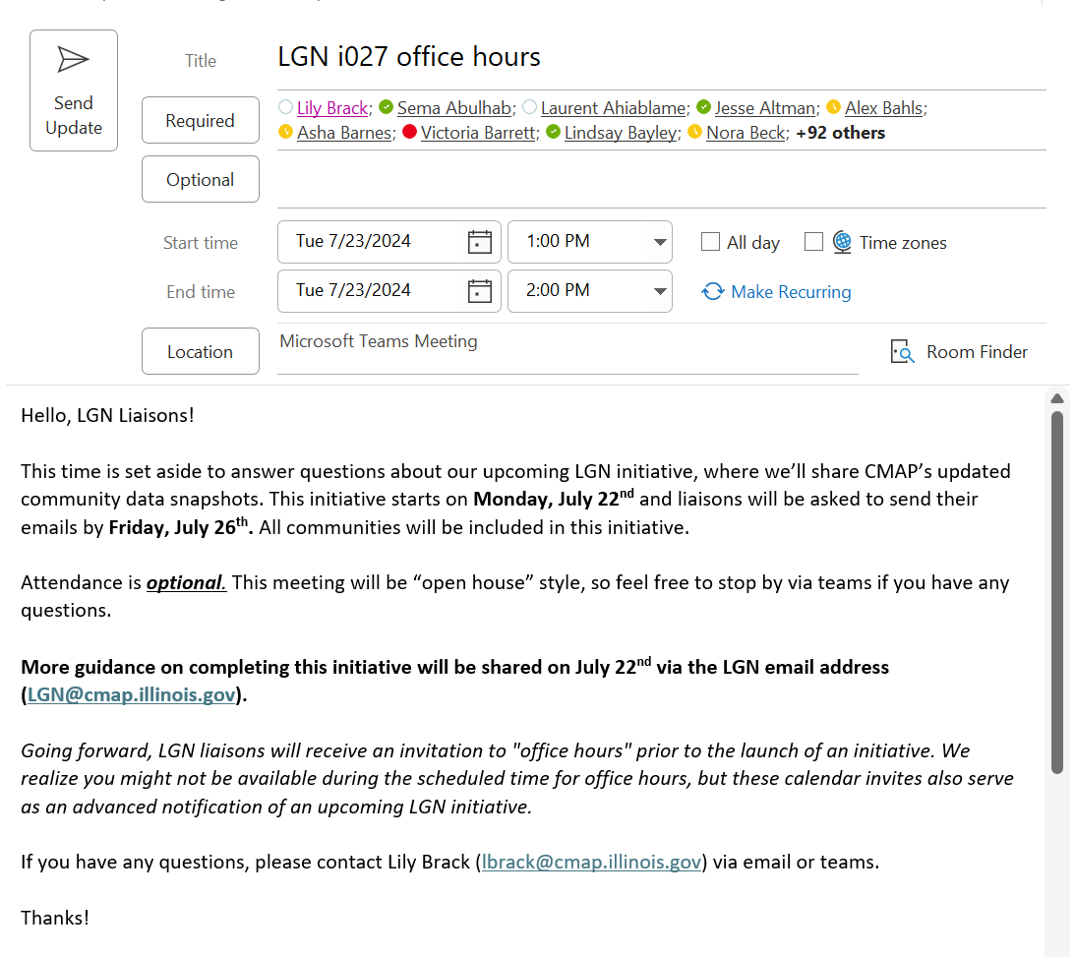
Optional "Office hours" calendar invitation

Slide 37
Deploying an LGN initiative
1
Send optional office hours invitation and create initiative email template
2
Develop initiative
announcement and
community contact database
1 - 2 weeks prior to launch
3
Announce initiative and distribute outreach template
4
Confirm date of outreach in the community contact
database

Slide 38
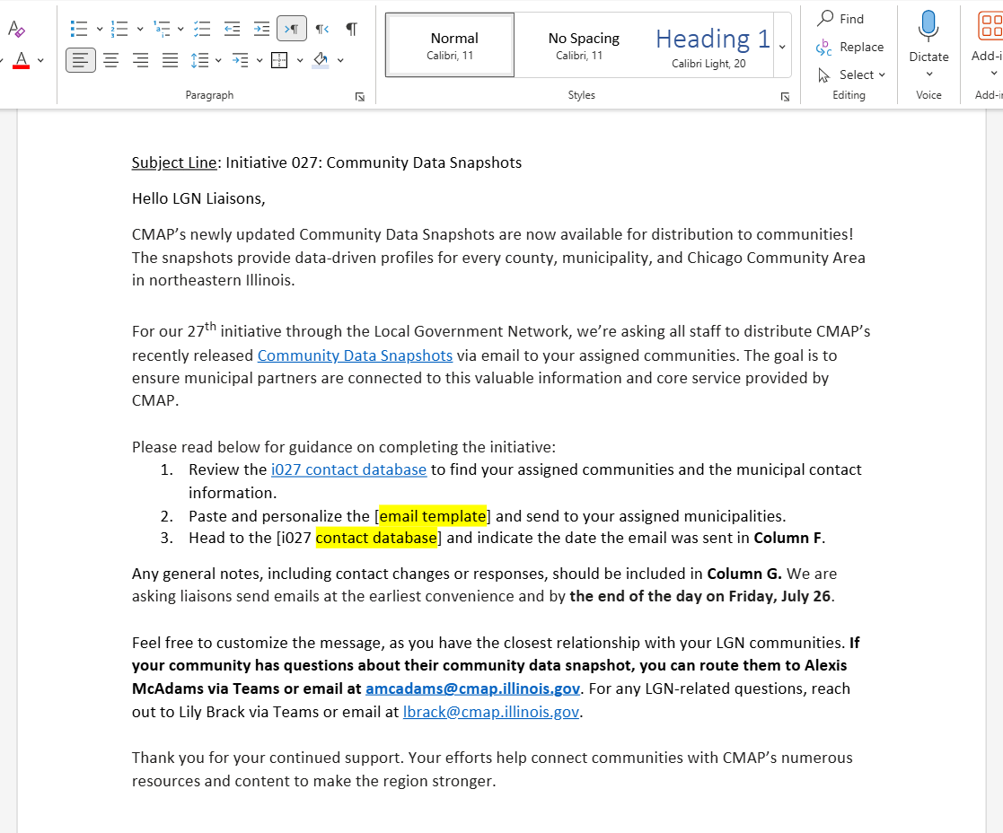
Initiative announcement email

Slide 39
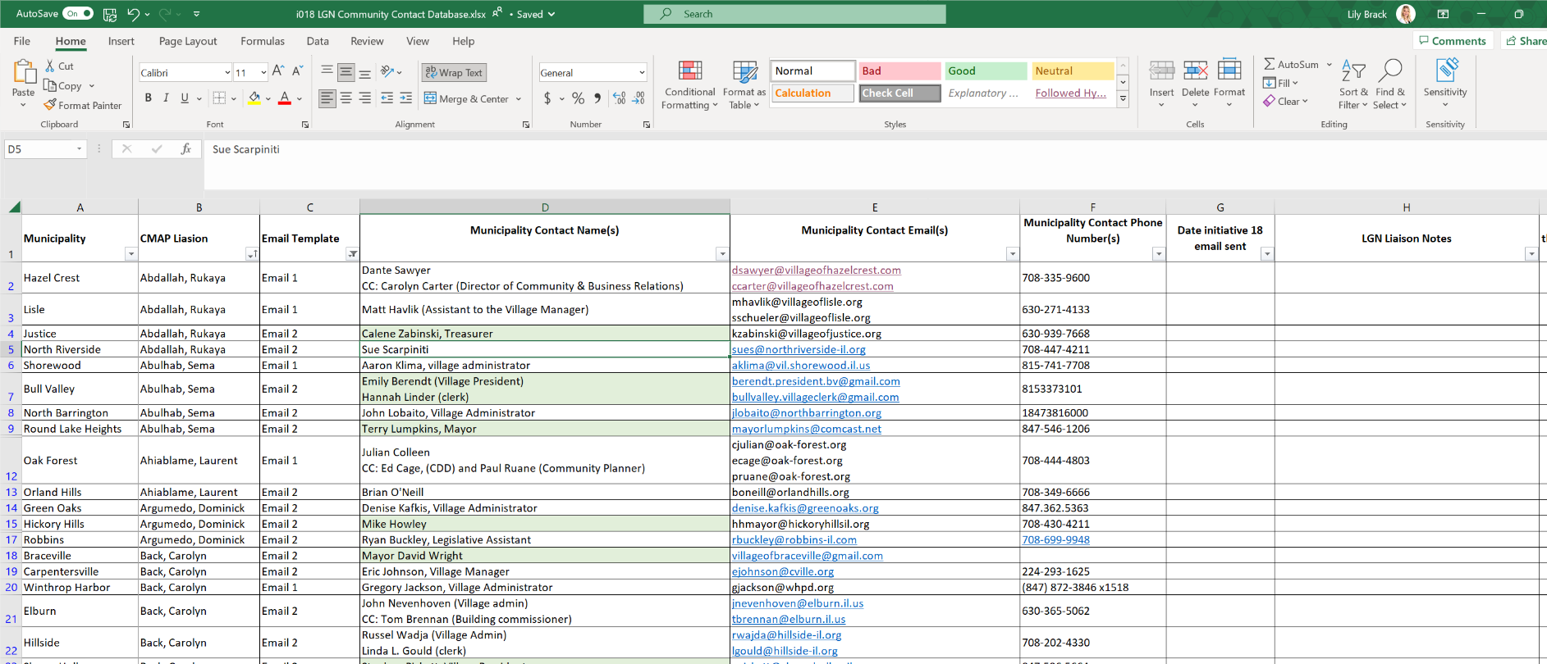
Community contact database
Notes:
Here’s an example of what the community contact database looks like. No CRM, fancy software, excel doc. scalability with stuff you have now
You’ll search for your name in column B to find your assigned communities and their contact information. You’ll see in column C we specify which email template should be sent, based on the characteristics of your community.
Please note that sometimes we have targeted initiatives focused on only on certain communities. For example, we might only contact communities in a certain county, or communities that are part of a certain cohort. If an initiative is targeted to a certain group of communities, we include that in the announcement email and make sure the contact database clearly specifies which communities are included.
Once you’ve sent the emails to your assigned communities, you should specify the date you sent the email in column G. This lets the LGN team know that you’ve completed the initiative.
You can use the last column to note any responses from your community, along with any changes to your community contact. Liaisons should feel free to modify their community contact information as they see fit, or as requested by the community. You do not have to ask the LGN team if you can change the contact information, but any changes should be noted in the notes column so we know to update the database for the next initiative.

Slide 40
Deploying an LGN initiative
1
Send optional office hours invitation and create initiative email template
2
Develop initiative
announcement and
community contact database
3
Announce initiative
and distribute
outreach template
Day of launch
4
Confirm date of outreach in the community contact
database

Slide 41
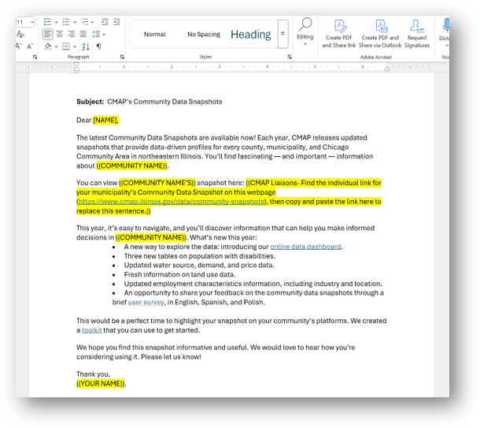
Outreach email template
Notes:
Here’s an example of what an email template will look like. These templates are totally customizable, and we encourage liaisons to modify the language to make it as personal as possible. For example, maybe you saw on the news that your community was recently awarded funding, or completed a big project, and you want to congratulate them. Or maybe you ate at a local restaurant over the weekend and want to tell the how much you enjoyed it. The personal touch is what sets the LGN apart from our other, more generic forms of communication.
Once you’ve customized the email templates, you’re good to send it off to your communities! Again, make sure to note the date you send your emails in the community contact database so we know you’ve completed the initiative.

Slide 42
Deploying an LGN initiative
1
Send optional office hours invitation and create initiative email template
2
Develop initiative
announcement and
community contact database
3
Announce initiative
and distribute
outreach template
4
Confirm date of outreach in the community contact
database
Week of launch

Slide 43
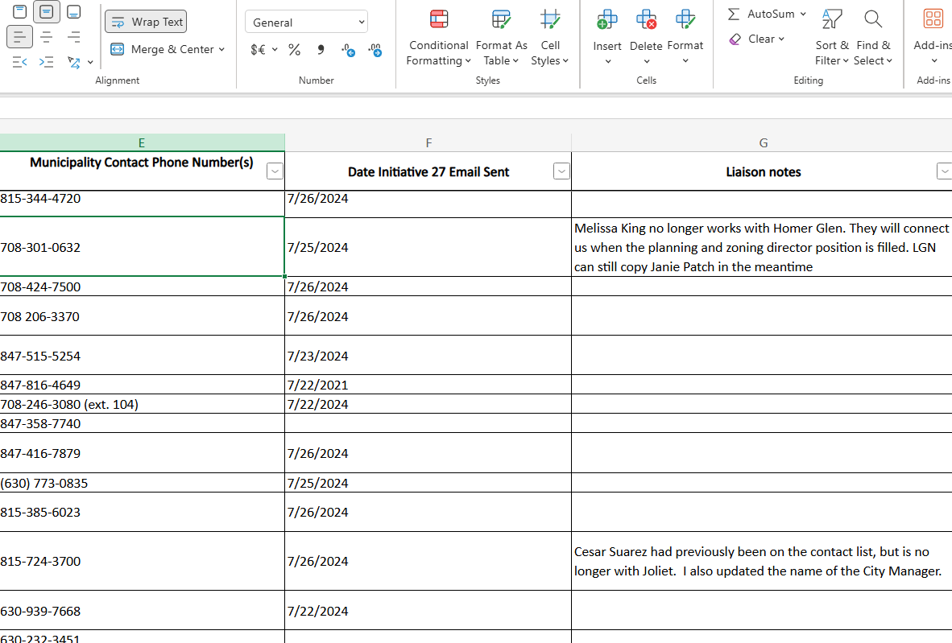
Documenting outreach dates and notes

Slide 44

The LGN benefits are numerous
Notes:
Mike
I’m going to round us out with some examples of how the LGN has provided great return on investment for CMAP; both in building trust, credibility, and rapport with our member communities, but also in increasing staff satisfaction and the amount we collect in member contributions. It’s also a tool that our team uses when crafting communication and engagement plans for our projects.

Slide 45
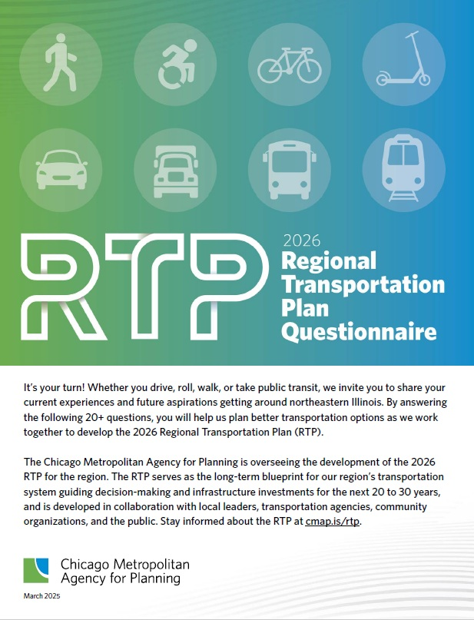




LGN success story: 2026 RTP survey
Goal: Increase number of completed RTP surveys
Launched LGN initiative March 2025
Communities helped spread the word to constituents
We reached our survey goal ahead of schedule!
Learn more
Notes:
Mike
The first example I’d like to share is for the regional transportation plan that we’re currently working on. At the beginning of this year, we decided to deploy a survey regionwide to take the temperature about how residents are experiencing and rate our current system, as well as their hopes for the future. We set a series of targets we wanted to hit in terms of the number of surveys completed, as well as the geographic spread of responses. We knew leveraging the LGN would be the way to make this happen. Working with Mai, Patrick, and the LGN team, we crafted the language we wanted to go out to all of our communities, as well as built a promotional toolkit with social media graphics, newsletter copy, and the sort that our community partners could share through their channels.
The outreach through LGN was a success. More than 15 communities shared the messaging. It was even picked up by our county partners, and a few of our COGs, and is still getting play months later.
And the big win was reaching our goal of 1,000 surveys completed, which we just reached last week. We’re keeping it up for the rest of the year, and are excited to see just how many more residents complete it.

Slide 46
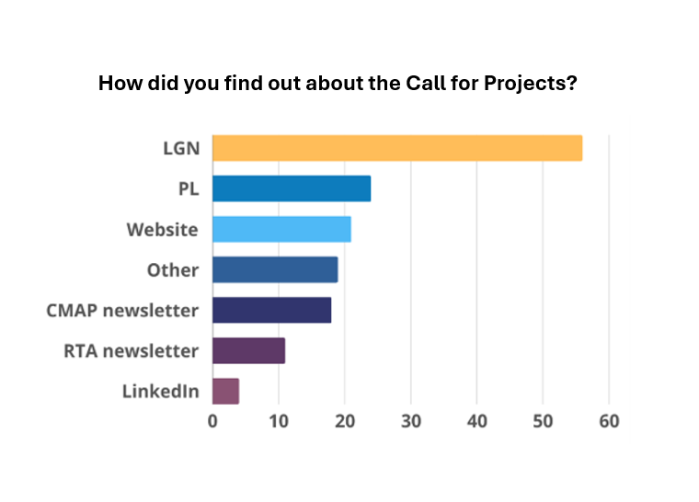




LGN success story: Technical assistance
Goal: Invite 284 communities to apply for technical assistance
Launched LGN initiative
Received 120 applications (2024) for assistance – historical record!
Strengthened relationships between community and CMAP staff liaison
Learn more
Notes:
Mike
Speaking of technical assistance, over the past couple of years we’ve leveraged the LGN network to get the word out about our technical assistance offerings when we open our call for projects. Just last year, thanks in great part to the LGN, we received a historic number of applications – 120! You can see here on the screen the 30 that were awarded funding.
And, when we survey communities who applied for technical assistance and ask them where they heard about the call to apply, they respond their LGN liaison.

Slide 47
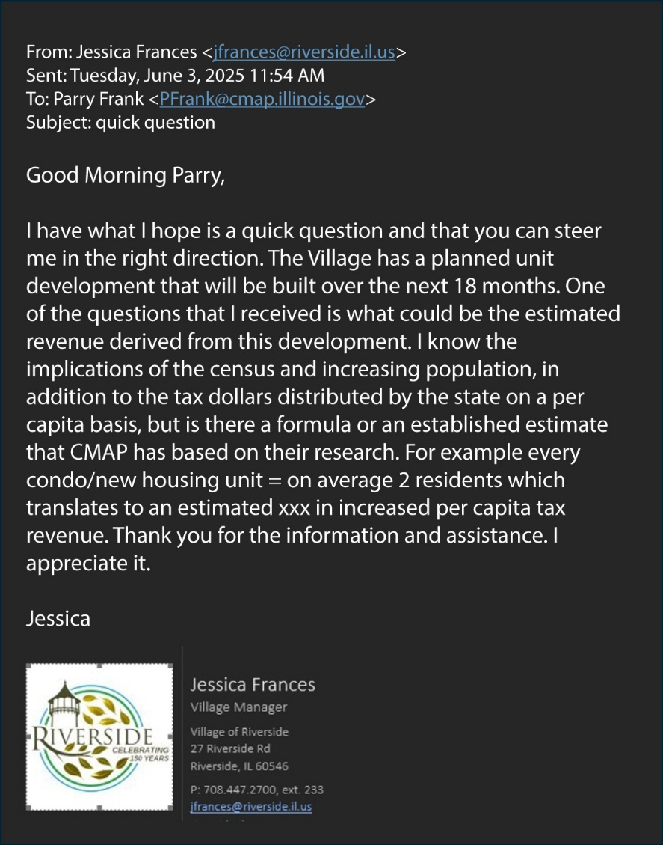



LGN success story: Two-way outreach
Goal: Become a trusted source for communities
Inquired about new development generated revenue estimates
Searching for data when considering closing a school
Interested in applying for technical assistance
Notes:
Mike
The LGN network isn’t one way! The CMAP staff who make it up are also contacted often as the first line when municipal staff have questions and don’t know who within CMAP to turn to. They turn to their LGN contact.
A few of the many examples includes Riverside . . . Evanston . . . Lake in the Hills . . .

Slide 48
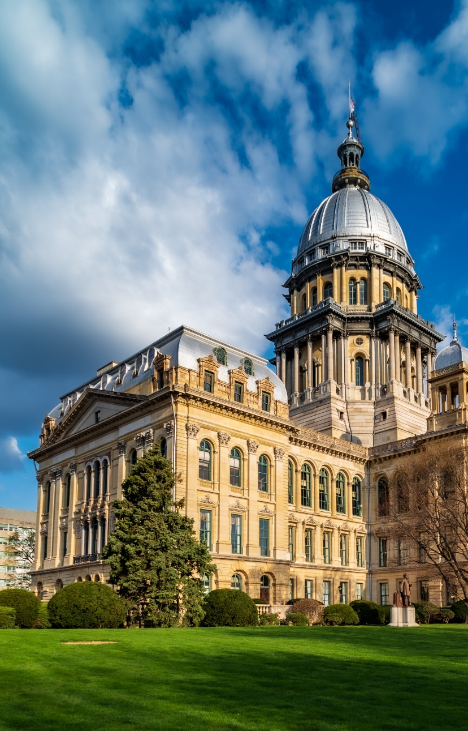
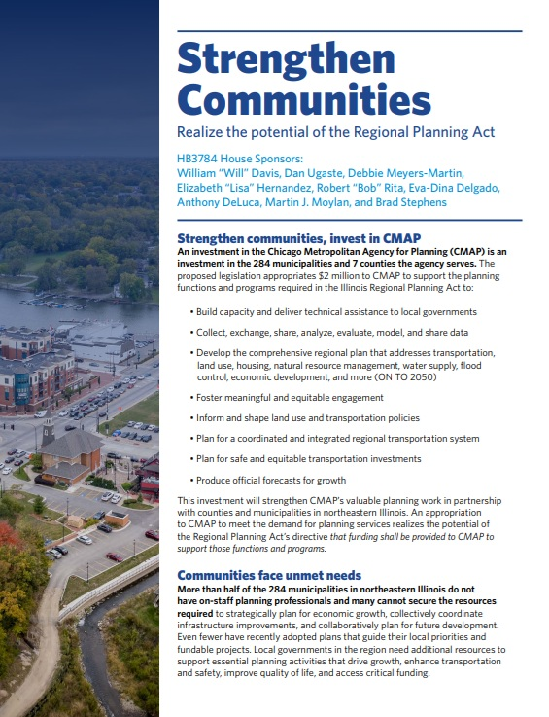



LGN success stories: $2M state funding
Goal: $2 million state appropriation to fulfill IL Regional Planning Act responsibilities
Launched LGN initiative in April 2027
Communities advocated on behalf of CMAP
IL General Assembly included
$2 million for CMAP in FY27 budget
Notes:
Mike
And the success of our LGN network has an impact on CMAP’s budget. A very real, recent example of this is the $2 million in funding allocated by the Illinois General Assembly this Spring session to support CMAP’s planning work.
Since CMAP’s inception 20 years ago, we’ve had an unfunded mandated to provide planning support across the region. The state of Illinois was supposed to provide that support annual to the tune of $2 million. Year after year our IGA has advocated in Springfield for the mandate to be funded, and year after year that failed to become a reality. Until this year. Turning a multifaceted approach, CMAP decided to leverage the LGN network to reach out to communities and ask them to speak with the state legislators to advocate for the $2 million to be funded. Many community members reached out to their legislators or filed witness slips in support.
On Saturday, May 30th session adjorned and CMAP got it’s $2 million, which we will use in some way to expand our technical assistance offerings. Again, LGN played a role in that.

Slide 49



LGN success story: Increased local contributions
Goal: Diversify CMAP’s revenue streams, per Federal direction
Increased collection rate of local match (20%) for federal funds (PL)
LGN initiatives increase trust, credibility, and value with member municipalities
Notes:
In 2016, the CMAP Board approved a local contribution structure to reduce the agency’s overreliance on the state to match federal funding. For FY2026, local contributions total $1.8 million, with approximately 85% of communities participating.
In recent years, we’ve seen a steady increase in contributions — a reflection of the stronger relationships our staff are building and the growing trust, credibility, and value that communities place in CMAP. The last fiscal year saw the highest number of communities pay their contributions.
We attribute that increase in part to the stronger relationships our staff are able to build through such initiatives, like the LGN.

Slide 50
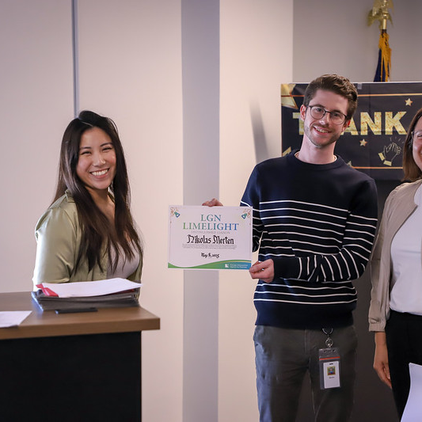



LGN success story: Finding a Godley contact
Goal: Locate missing contact for the village of Godley
Godley’s LGN liaison went on a hunt
Godley contact identified; LGN liaison is building a relationship
Godley applied for technical assistance
Godley’s CMAP liaison received LGN Limelight Award
Notes:
Mike
Another fun part of doing LGN at CMAP is staff involvement. Staff really are invested in the communities that they’re responsible for, and we have fun awards that we give out to acknowledge certain feats some reach when going above and beyond. They’re called the Limelight awards, they’re specific to LGN, and they’re given out at our quarterly all staff meetings.
One recent awardee, Nikolas – pictured on the screen with Mai and Erin – was for identifying a contact at the little village of Godley. Population 500, CMAP did not have a municipal contact for the village. For the longest time, we tried and tried and couldn’t get in touch. Eventually Nik discovered the number for the village treasurer, left a message, and got a returned call. They started talking. The mayor of the neighboring town encouraged their Godley counterparts to apply for technical assistance, which they did.
Not only were they awarded assistance last year for pavement management planning support, but this year – tomorrow to be exact – it will be announced that they’ll be receiving grant readiness support through the 2025 round of technical assistance. This is not public news yet – so dome of silence! All kidding aside, thanks to Nik’s efforts a small community in our region with need, who didn’t have any contact with CMAP, now is working on multiple projects with us.
LGN doesn’t just strengthen relationships, it builds them.
Since the LGN began, Godley was one of the lone communities where we couldn’t identify a contact. Many people tried, including former CMAPer Todd Schmittt
Through the hard work of Godley’s current liaison, not only was a contact identified, but Godley also applied for the 2025 Call for Projects for the first time ever!
CMAP’s budding relationship with Godley is a testament to the current liaison’s care and commitment to strengthening relationships with our communities – truly deserving of the LGN limelight

Slide 51
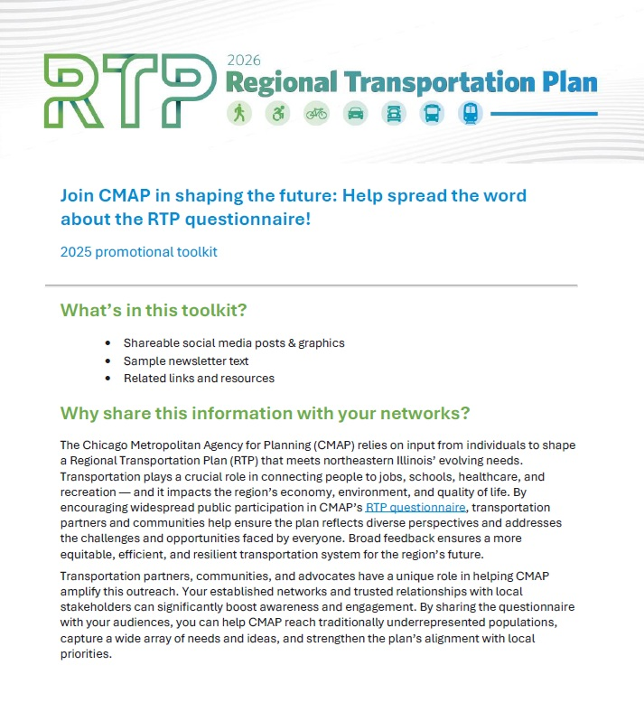
LGN as a communications + engagement tool
LGN is an important tool CMAP’s Communications + Engagement team
C+E plans consider LGN as a go-to for regional engagement
C+E regularly creates toolkits for LGN initiatives (e.g., shareable flyers, social media graphics, newsletter text)

Slide 52

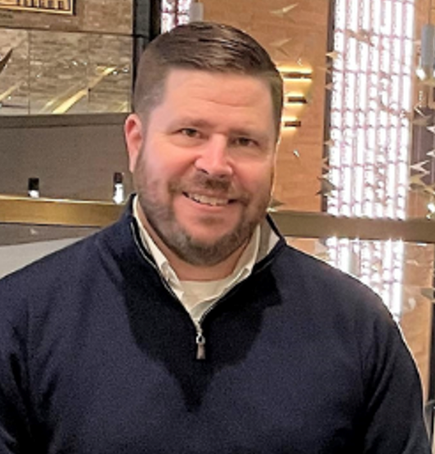


Let’s keep in touch
Mai Ellen Dang
Planner
mdang@cmap.illinois.gov
Patrick Day
Planning Principal
pday@cmap.illinois.gov
Mike Sobczak
Communications Senior
msobczak@cmap.Illinois.gov
Notes:
MC

Slide 53
Local units of government
Illinois: 6,390
Notes:
284 municipalities sounds like a lot, but Illinois is particularly governmental of partners to connect with, it’s a drop in the bucket compared to the many, many mosquito abatement districts, townships, cemetary districts, and others we've yet to loop in. We'll get to them soon tho, we're an ambitious group.

Slide 54

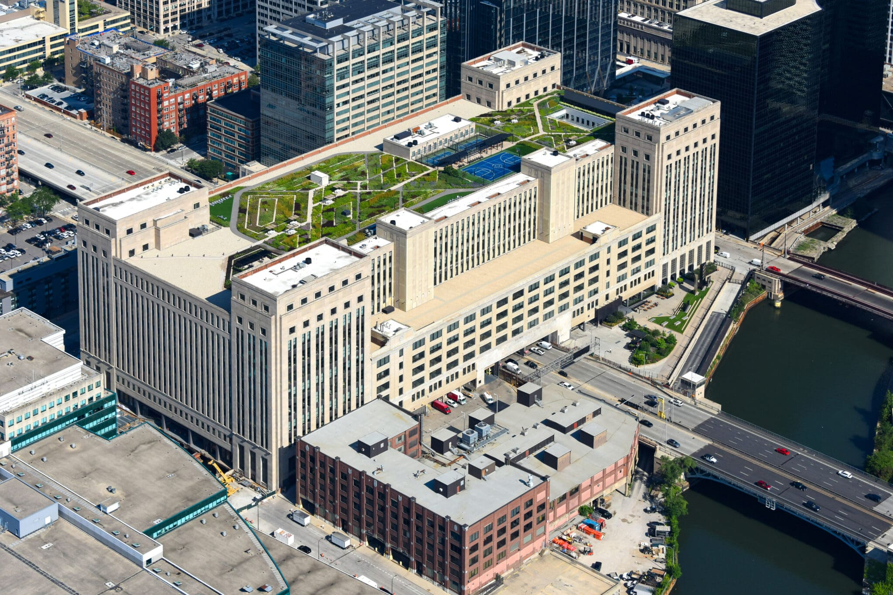

Housed in a historic building, the Old Post Office
Notes:
Long vacant; beautifully restored; please come visit some time!

Slide 55





Funding CMAP’s $43M FY26 budget
“Federal Mark”
Metropolitan
planning
(PL) funds
Illinois Department of Transportation
Allocated to
16 MPOs
CMAP
Northeastern Illinois Unified Work Plan
(pass-thru)
20%
Local match for federal funds
(80% of
funding)
Notes:
Here's a look at how funding flows to CMAP and the region.
Federal funds (known as metropolitan planning funds) come from the US Department of Transportation, through the Federal Highway Administration (FHWA) and the Federal Transit. Administration.
The “federal mark” passes through IDOT and then to CMAP as one of the 16 MPOs of Illinois. T
This funding supports the Unified Work Program (or UWP) which we will talk about in more detail in a moment as part of the FY26 budget.
Per federal law, receiving federal funding requires a 20% local match (which can only be achieved with non-federal funds). Therefore, CMAP meets this requirement through support from IDOT and local contributions counties, the Tollway, City of Chicago and the region's other cities and villages.

Slide 56

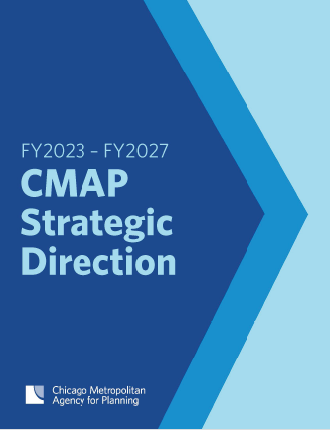
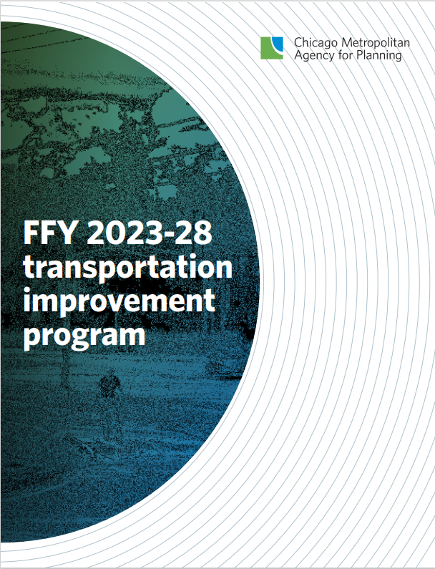
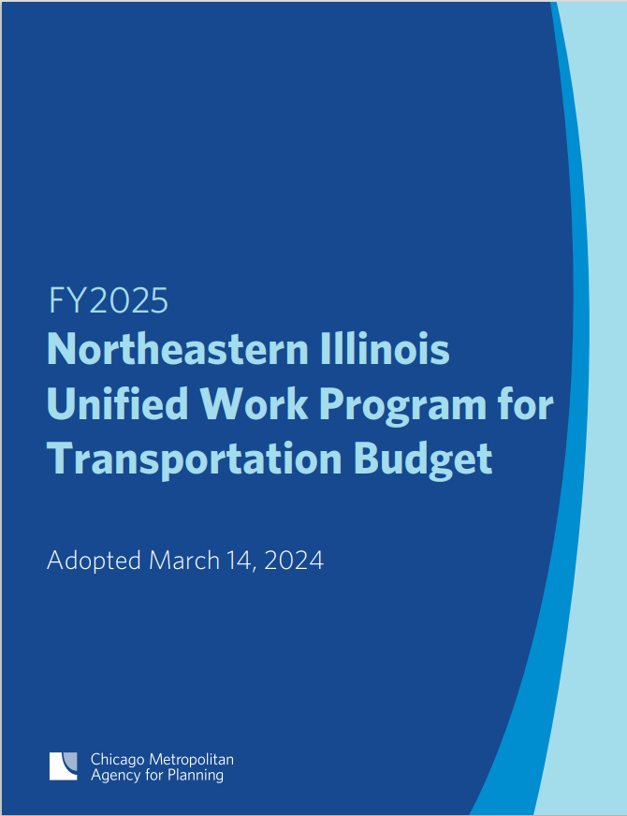
What guides our work?
Notes:
ERIN
CMAP’s work on behalf of the region is guided by our region’s long-range comprehensive plan – ON TO 2050 - and other plans that help provide direction and focus.
For many years, our region has relied on one, single, large-scale comprehensive plan. While this has served our region well, we are shifting to a multi-plan framework that provides a more dynamic and responsive approach to our region’s challenges and opportunities. Together, these plans will replace ON TO 2050 over time and collectively serve as the region’s comprehensive plan.
CMAP’s five-year Strategic Direction prioritizes our work into three areas including: transportation, climate, and regional economic competitiveness, as well as agency-wide services that support that work.
Since publishing the Strategic Direction in early calendar year 2023, the agency embarked on a comprehensive process to define multiyear program areas that advance the three focus areas:
transportation, regional economic competitiveness, and climate.
Program areas primarily include a portfolio of projects that are a high priority for the agency; each program is led by a program manager.
We also have program areas for agencywide services such as communications and engagement, finance, and human resources.
These guiding plans - along with these programs - inform our activities for the fiscal year which we outline in an annual budget and work plan.

Slide 57

How CMAP serves the region (our levers)
Plan regionally and locally
• Develop ON TO 2050 and coordinate implementation
• Strengthen communities through direct assistance, training, and resources
Prioritize and program
• Evaluate, manage, and distribute federal transportation funds
• Manage Transportation Improvement Program (or TIP)
Notes:
The Strategic Direction identifies CMAP’s “levers” – HOW we advance our goals.
We plan regionally and locally.
As the federally designated metropolitan planning organization (MPO), we work with our partners to develop and implement the region’s 30 year comprehensive plan (ON TO 2050).
This guides transportation investments and other regional priorities.
We prioritize and program funds.
CMAP receives federal dollars through IDOT as one of the state's 16 planning organizations and, through the Unified Work Program—which we shorten to UWP--grants funding annually to partner agencies to fund transportation planning studies and MPO activities. This also funds the work of the 11 planning liaisons through the Council of Mayors who help program federally funded transportation projects.
So what does all that mean? Well, CMAP manages the Transportation Improvement Program (or TIP, another acronym!), which is the region’s five-year program for putting the long-range plan into action. There are over a thousand active transportation projects in the five-year program, totalling just over a billion dollars – everything from transit station upgrades to bike lane improvements to redesigning roadways.
With our partners, we evaluate applications through a “Call for Projects” and prioritize and program these funds, using detailed criteria.

Slide 58
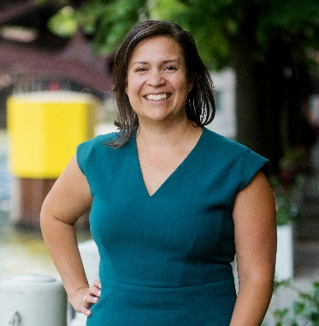
Executive
director
Deputy executive director
Finance and Administration
Transportation: Research, Analysis, and Programming
Communications and Engagement
Planning
Regional Policy and Implementation

Slide 59
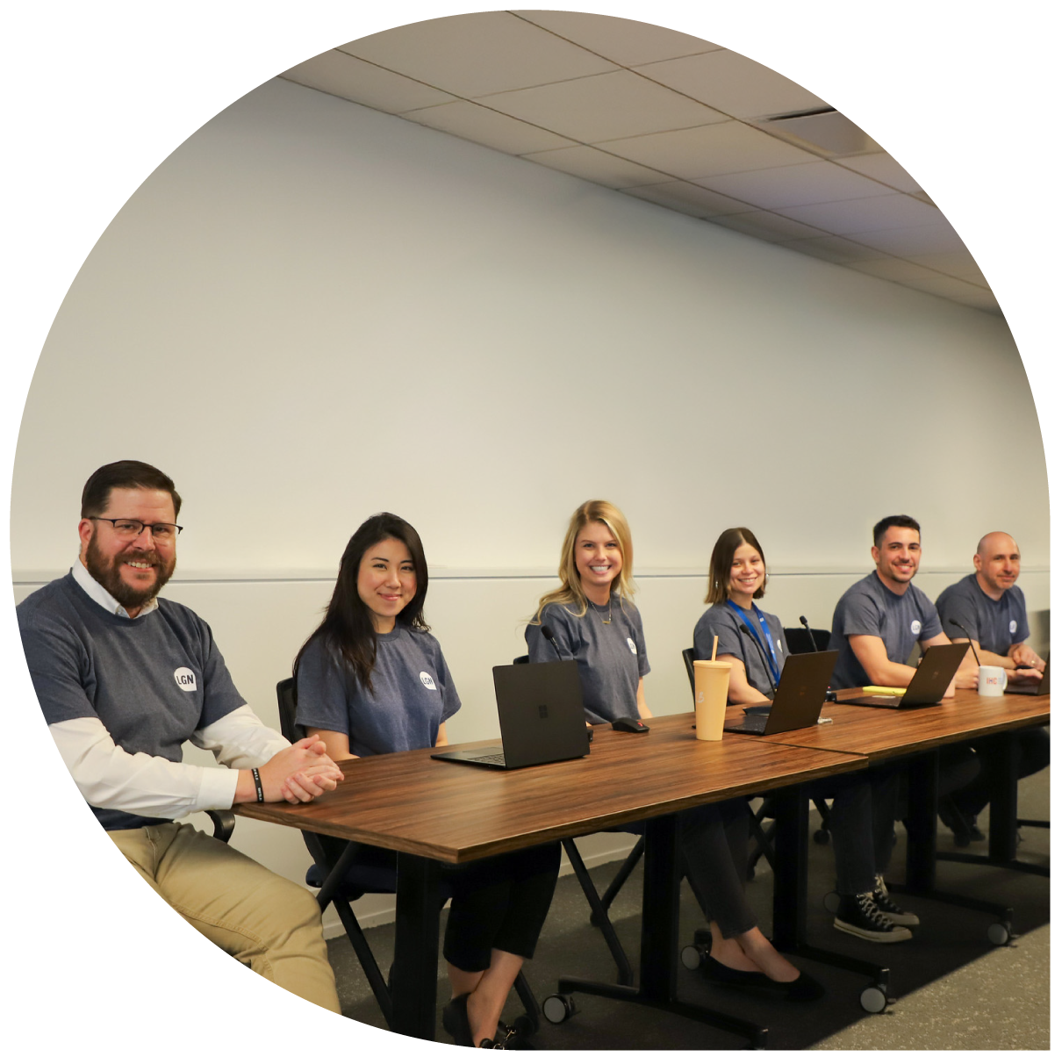
In 2020, CMAP launched LGN to better understand how we can assist communities
Establishes an active connection between CMAP staff and each of the region's 284 municipalities

Slide 60
How did it start?
  ED request in 2020, to meet emergent need
  Forced to reconsider how we connect with one another, and with an entire region
  Pulled together a framework, informed by a variety of lessons learned
  It worked really well, so we kept it

Slide 61
Description of efforts to ensure engaged contacts: CMAP and partner reliably overtime
Initial match
Ongoing new liaison orientation
New mayors introduction
Graphic with two people and arrows in between

Slide 62
What makes it effective?
1
Identify reliable contacts from CMAP and municipalities
Develop an LGN team
Build basic database and template documents
2
3
Notes:
Ensure reliable contacts among CMAP and municipality. New liaison orientation and on muni side: their preferred contact. Not always an elected official
Your LGN team may be a team of 1

Slide 63
How does CMAP forge stronger relationships with communities?

Slide 64

Evaluating LGN initiative success
Success looks different for every initiative
Clicks on a resource webpage
% of survey responses
Thank you email replies

