Slide 1


SolSmart – An Opportunity for Regional Planners
Andrew Light, World Resources Institute

Slide 2


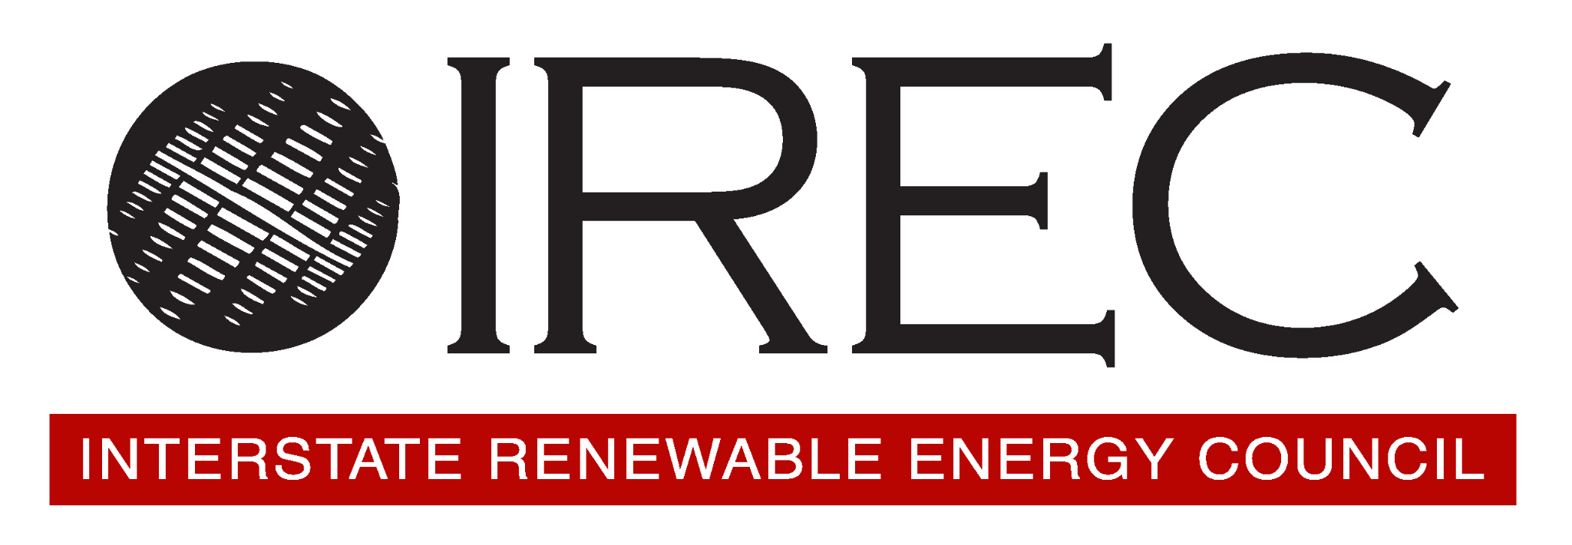




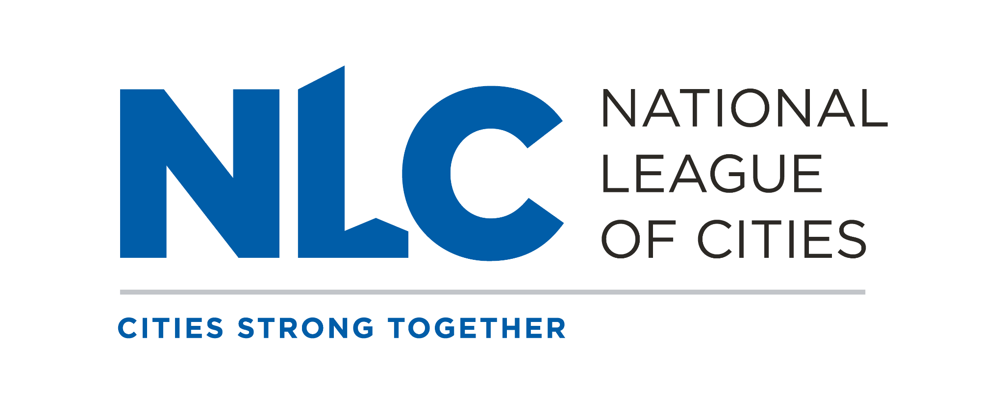






SolSmart
SolSmart is a national designation and FREE technical assistance program that helps local governments streamline their permitting and inspection processes to provide energy options for their residents and businesses
  Permitting & Inspection
  Planning & Zoning
  Government Operations
  Community Engagement
  Market Development
Notes:
Before I talk about the specific opportunity we have for regional planners I just want to briefly introduce SolSmart. SolSmart has been around since 2016. We are funded by the DOE to help local governments, which includes cities, towns, counties and regional organizations, to adopt best practices to create more solar-friendly communities- removing barriers, creating supportive policies and ultimately making it easier and more affordable to transition to solar energy.
When communities participate in SolSmart they receive free technical assistance and ultimately they earn national recognition for their accomplishments.
We are a big team with a great breadth of expertise in everything from solar permitting, planning, policy, financing, procurement, and more.
(Feel free to take a minute and intro WRI – Also mention NARC is an official partner of the program)

Slide 3

SolSmart: A Roadmap to
Advance Solar Locally
  Permitting & Inspection
About SolSmart
Best practices in solar
Technical assistance opportunities
How to get started!
Ask us anything
  Planning & Zoning
  Five
  “Solar-Ready” Categories
  Government Operations
  Community Engagement
  Market Development
Notes:
The SolSmart program focuses on 5 key areas when we work with communities- Permitting & inspection, planning & zoning, government operations, market development and community engagement. We are able to provide technical assistance in all these areas.

Slide 4

You’re Invited to Energy Tools Summer Camp!
Notes:
In partnership with NARC, the SolSmart Team and the National Renewable Energy Lab is excited to be able to offer a summer training opportunity for regional planners who are working on energy planning.

Slide 5
Join us for 3 interactive virtual sessions led by the National Renewable Energy Lab (NREL)
Energy Tools Summer Camp is for regional planners working on defining, developing or tracking energy goals.
Sessions will be geared toward planners comfortable using analytical tools.
Learn how to use free NREL Energy Planning Tools include PV Watts, SAM, SLOPE and access free data sets to inform your energy planning.
Earn 3 CM credits for AICP.
Notes:
This will be a virtual series geared to meet the needs of regional planners – particulary those who are working on defining, developing or tracking energy goals. We are able to offer AICP credit to those who participate in the full series. The training is geared toward those who are comfortable using analytical tool. By participating you will learn how to use a number of different free tools developed by the National Renewable Energy Lab

Slide 6
Session #1 Tools Overview- Learn about the range of free solar planning tools available from NREL.
Session #2 Tools Demos and In-Depth Training- NREL experts will provide detailed tool demos.
Session #3 – Office Hours – An opportunity for 1:1 support, meet with tool experts to get tailored advice and apply tools to the challenges of your region.

Slide 7
What You’ll Learn
After these sessions, you’ll be able to use free NREL tools to answer questions, such as:
How much electricity could a solar PV system generate on our public building?
Is solar PV going to be cost-effective at our site?
What procurement option would be best for our project?
Across our region, how can we find the most feasible and cost-effective solar projects?
How can we create basic project information that could support a grant application?
How does adding battery storage to a project impact the economics?

Slide 8
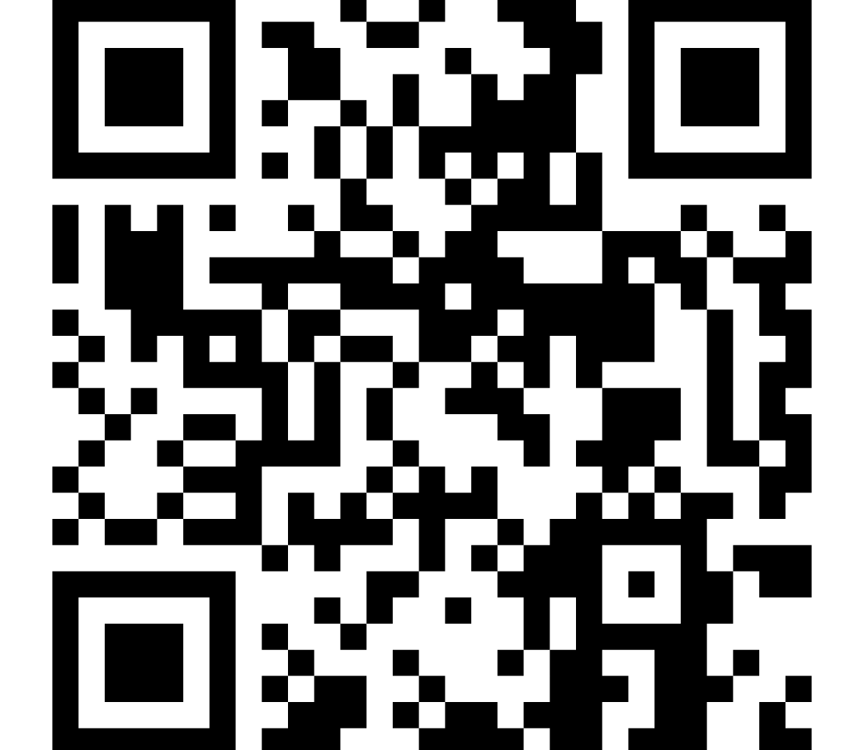
To learn more or sign up:
https://form.jotform.com/251535723093052

Slide 9


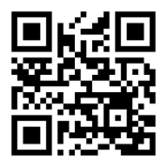
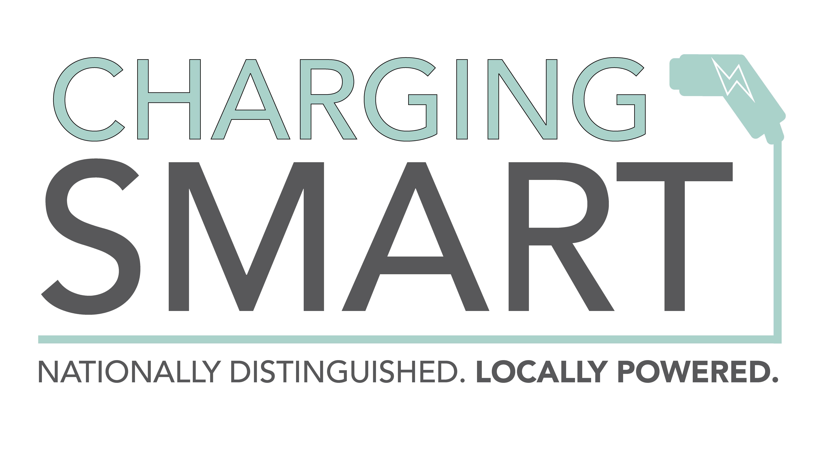
Energy-Ready.org
FREE Technical Assistance
Notes:
Before I close, I just want to encourage everyone to check out our Energy Ready website to learn more about the SolSmart Program and also the Charging Smart Program, for those of you working on EV infrastructure. Our team has a booth in the exhibit hall and hope you can find a minute to stop by and chat with us to learn more!

