Slide 1
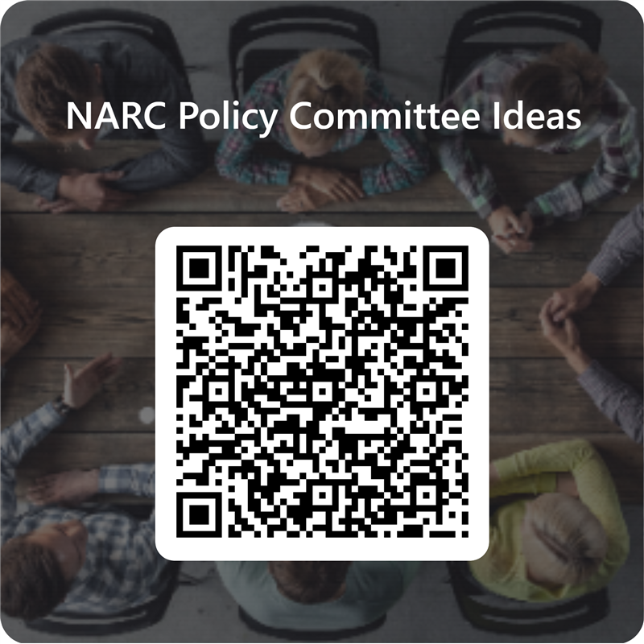

NARC Policy Committee Re-Orientation
Long-Term: Modernize NARC’s Policy Committees
Progress Since February
Short-Term and Medium-Term Goals
Next Steps: Your Input Needed
Questions and Feedback
Take the Survey
to Share Your Ideas

