Slide 1
Housing Strategies in the Puget Sound Region
National Association of Regional Councils
June 10, 2025

Slide 2
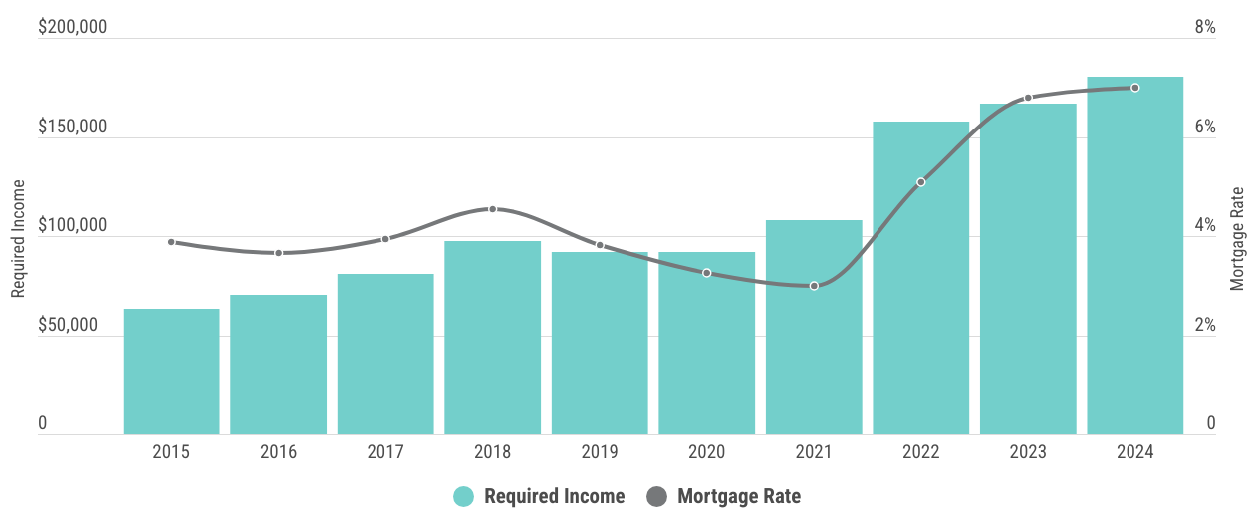
Homeownership Affordability
Income required to purchase the typically priced home hit an all-time high
Source: Zillow, Home Value Index; Freddie Mac, Primary Mortgage Market Survey; required income values calculated by PSRC
Note: Data are for the Seattle-Tacoma-Bellevue metropolitan statistical area which represents King, Pierce, and Snohomish counties. Assumes a 31% debt-to-income ratio, 30-year fixed rate mortgage, 20% down payment, 1% property tax, and 0.35% property insurance rate. Estimates are based on data collected in June of each year.

Slide 3
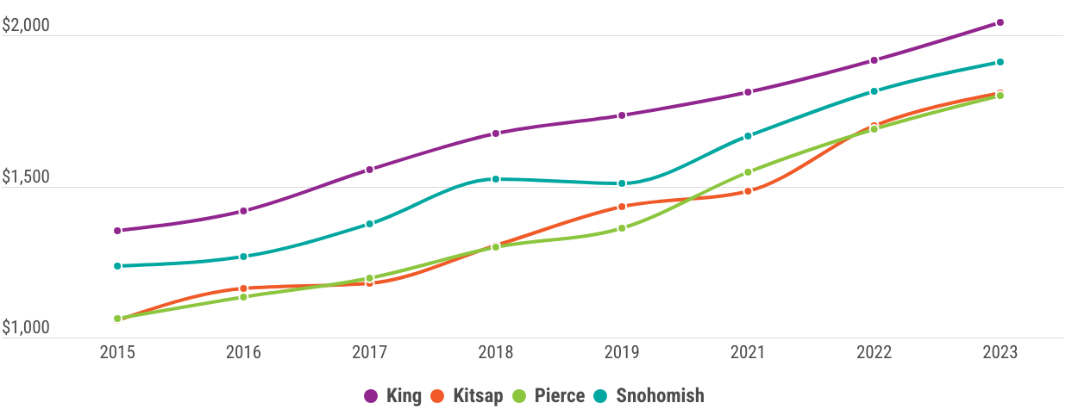
Rental Affordability
Rents have risen significantly across the region, with the largest percentage jump in Kitsap and Pierce counties
$2040 (+51%)
$1910 (+54%)
$1810 (+71%)
$1800 (+70%)
Source: U.S. Census Bureau, American Community Survey, 1 Year Estimates

Slide 4
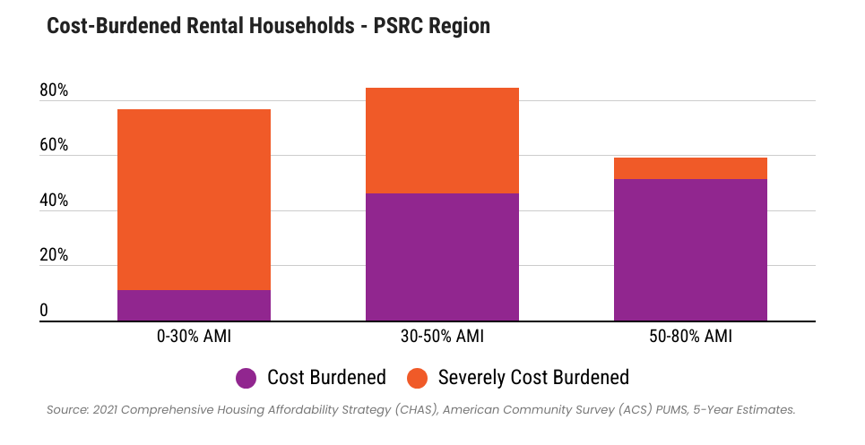

Slide 5
Affordability - Homelessness
20,000+ people living without
proper shelter in the region
King County
16,000+
Kitsap County
500+
Pierce County
2,600+
Snohomish County
1,100+
These data are assumed to be an undercount. Homelessness has many drivers, but a lack of housing affordable to most residents will only worsen the crisis.
Source: King County 2024 Point-in-Time Count, Kitsap County 2024 Point-in-Time Count, Pierce County Point-in-Time Count, Snohomish County Point-in-Time Count

Slide 6
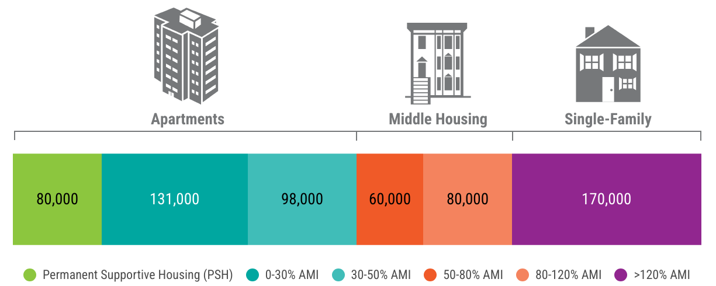
Local Progress – Housing Targets
Regionwide, jurisdictions are planning for 620,000+ new housing units and 77,000+ emergency housing beds by 2044
Source: Countywide Planning Policies: King, Kitsap, Pierce, and Snohomish Counties

