Slide 1


Metro Mayors Coalition
Regional Housing Task Force
NARC Conference
June 2025

Slide 2
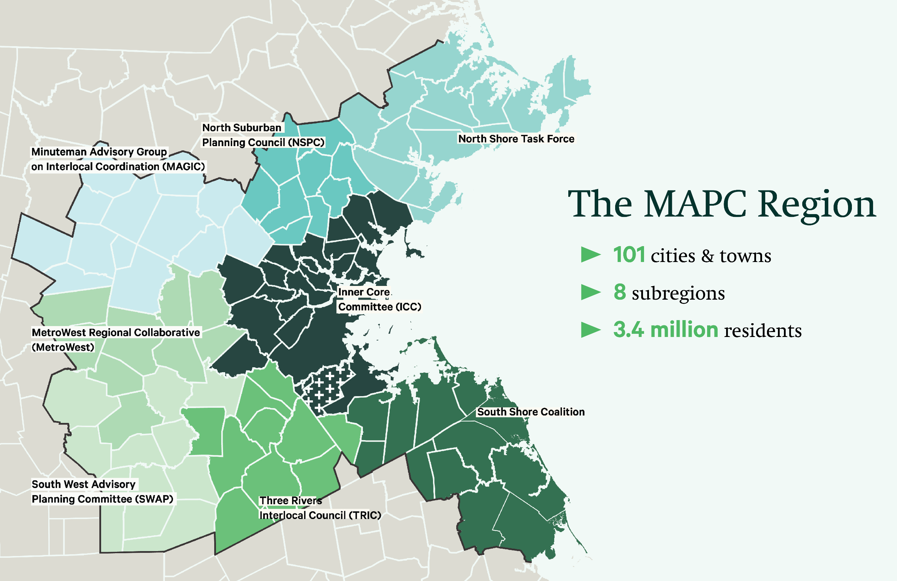
Legislative Priorities
AHA Implementation
QAP Advocacy

Slide 3
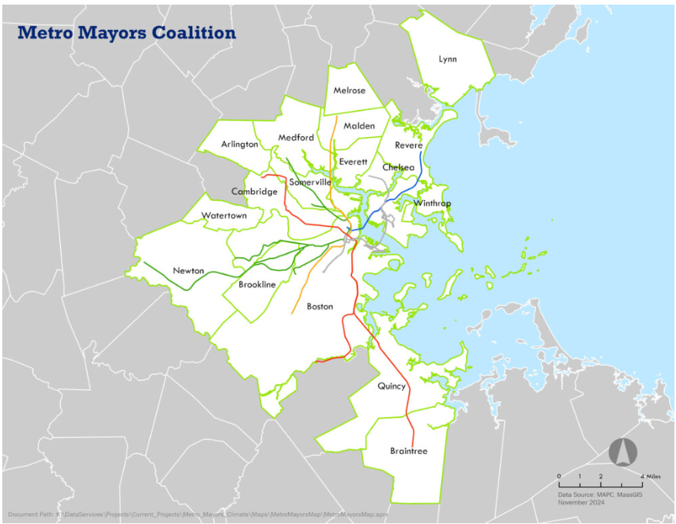


Housing Task Force
17 Communities,
established in 2017
Legislative Priorities
Goal to produce 185,000 new homes between 2015 and 2030
AHA Implementation
QAP Advocacy

Slide 4
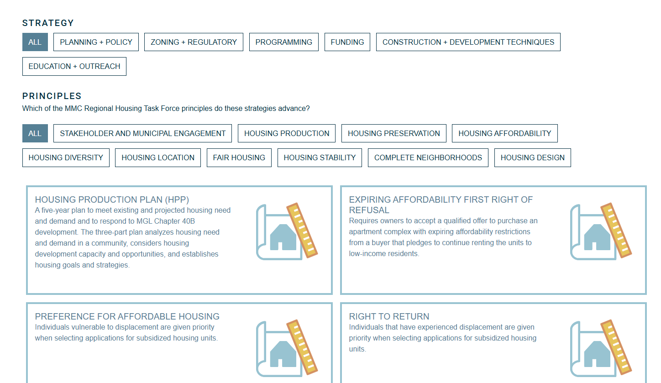
150+ Housing Strategies Identified

Slide 5





Task Force Work Plan
Convening/Admin
Advocacy
Production Tracking
Zoning Project
Disposition Project
Bimonthly meetings
Legislative Priorities
Data collection/analysis
Regional Nonconformity Analysis
Best practices for equitable development
Affordable Homes Act Implementation
Annual Report
Visual communications w/historic context
Mapping tool to identify and facilitate redevelopment of publicly owned land
Individual zoning recommendations

Slide 6
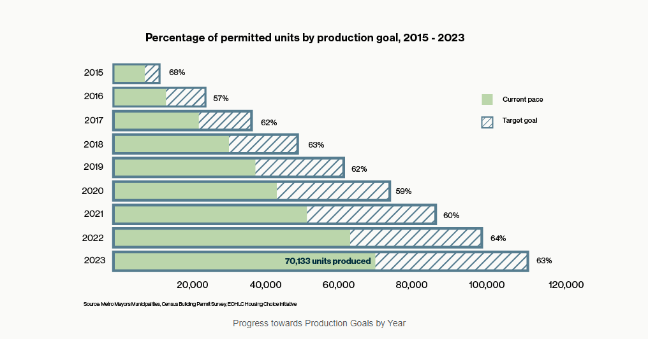

Slide 7
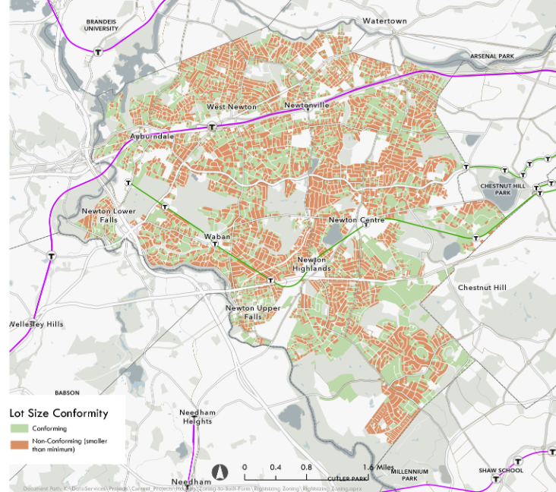
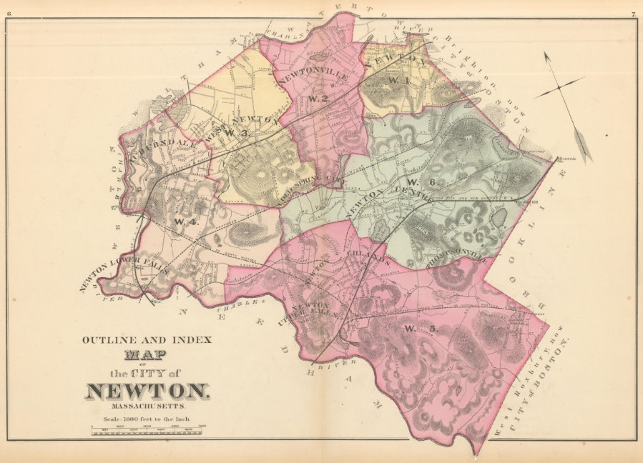
Local Implementation Projects
Rightsizing Zoning
A nonconformity analysis across all 17 projects
Zoning recs per community to modernize residential land use regulations
Goal: Legalize more compact, historic development patterns and housing types

Slide 8
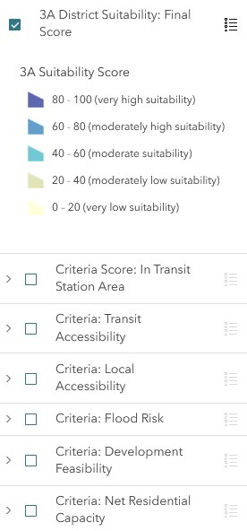
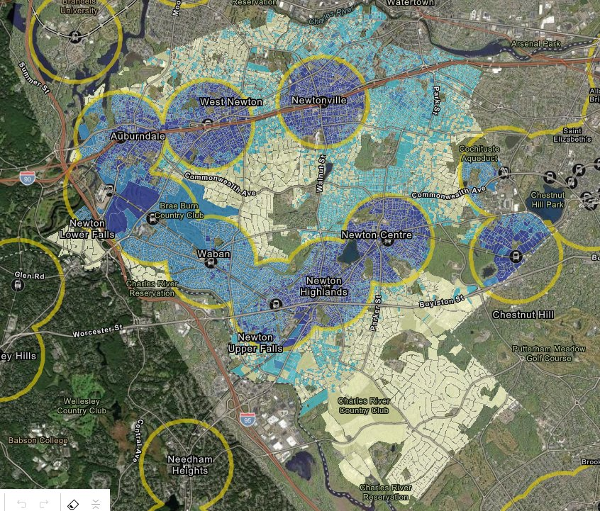
Local Implementation Projects
Disposition of Publicly Owned Land
Best practices for quicker disposition of land for Affordable Housing
GIS Mapping Tool to identify existing publicly owned parcels suitable for redevelopment + identify potential sites for public acquisition

Slide 9

For more information:
https://housingtaskforce.mapc.org/
eweyant@mapc.org

