Slide 1
HGAC Fee for Service Program
Diversifying Your Local Funds

Slide 2

FEE FOR SERVICE
Purpose Statement:
The H-GAC Fee for Service program provides member governments exclusive, high-quality solutions to certain administrative needs in an efficient, convenient manner at a cost lower than the market rate and generates an alternative revenue stream to the organization.

Slide 3




WHY?
Increase membership value
Maintain low membership dues ($0.04 per capita)
Increase local funds revenue

Slide 4


Research
What are the top three areas of service your local government needs support with?
Results:
New Staff Onboarding
Equipment Procurement
Videography
GIS Data Analysis
Cyber Security
Media Relations
And More…
Membership Survey
Notes:
We polled our board and XYZ..
The responses we received happened to also be in line with the areas with in the agency that have grown exponentially to provide more specialized services, including comms, hr, it, and data analytics and research.

Slide 5
PLANNING TOOLS AND RESOURCES

Slide 6


SERVICE “MENU”

Slide 7
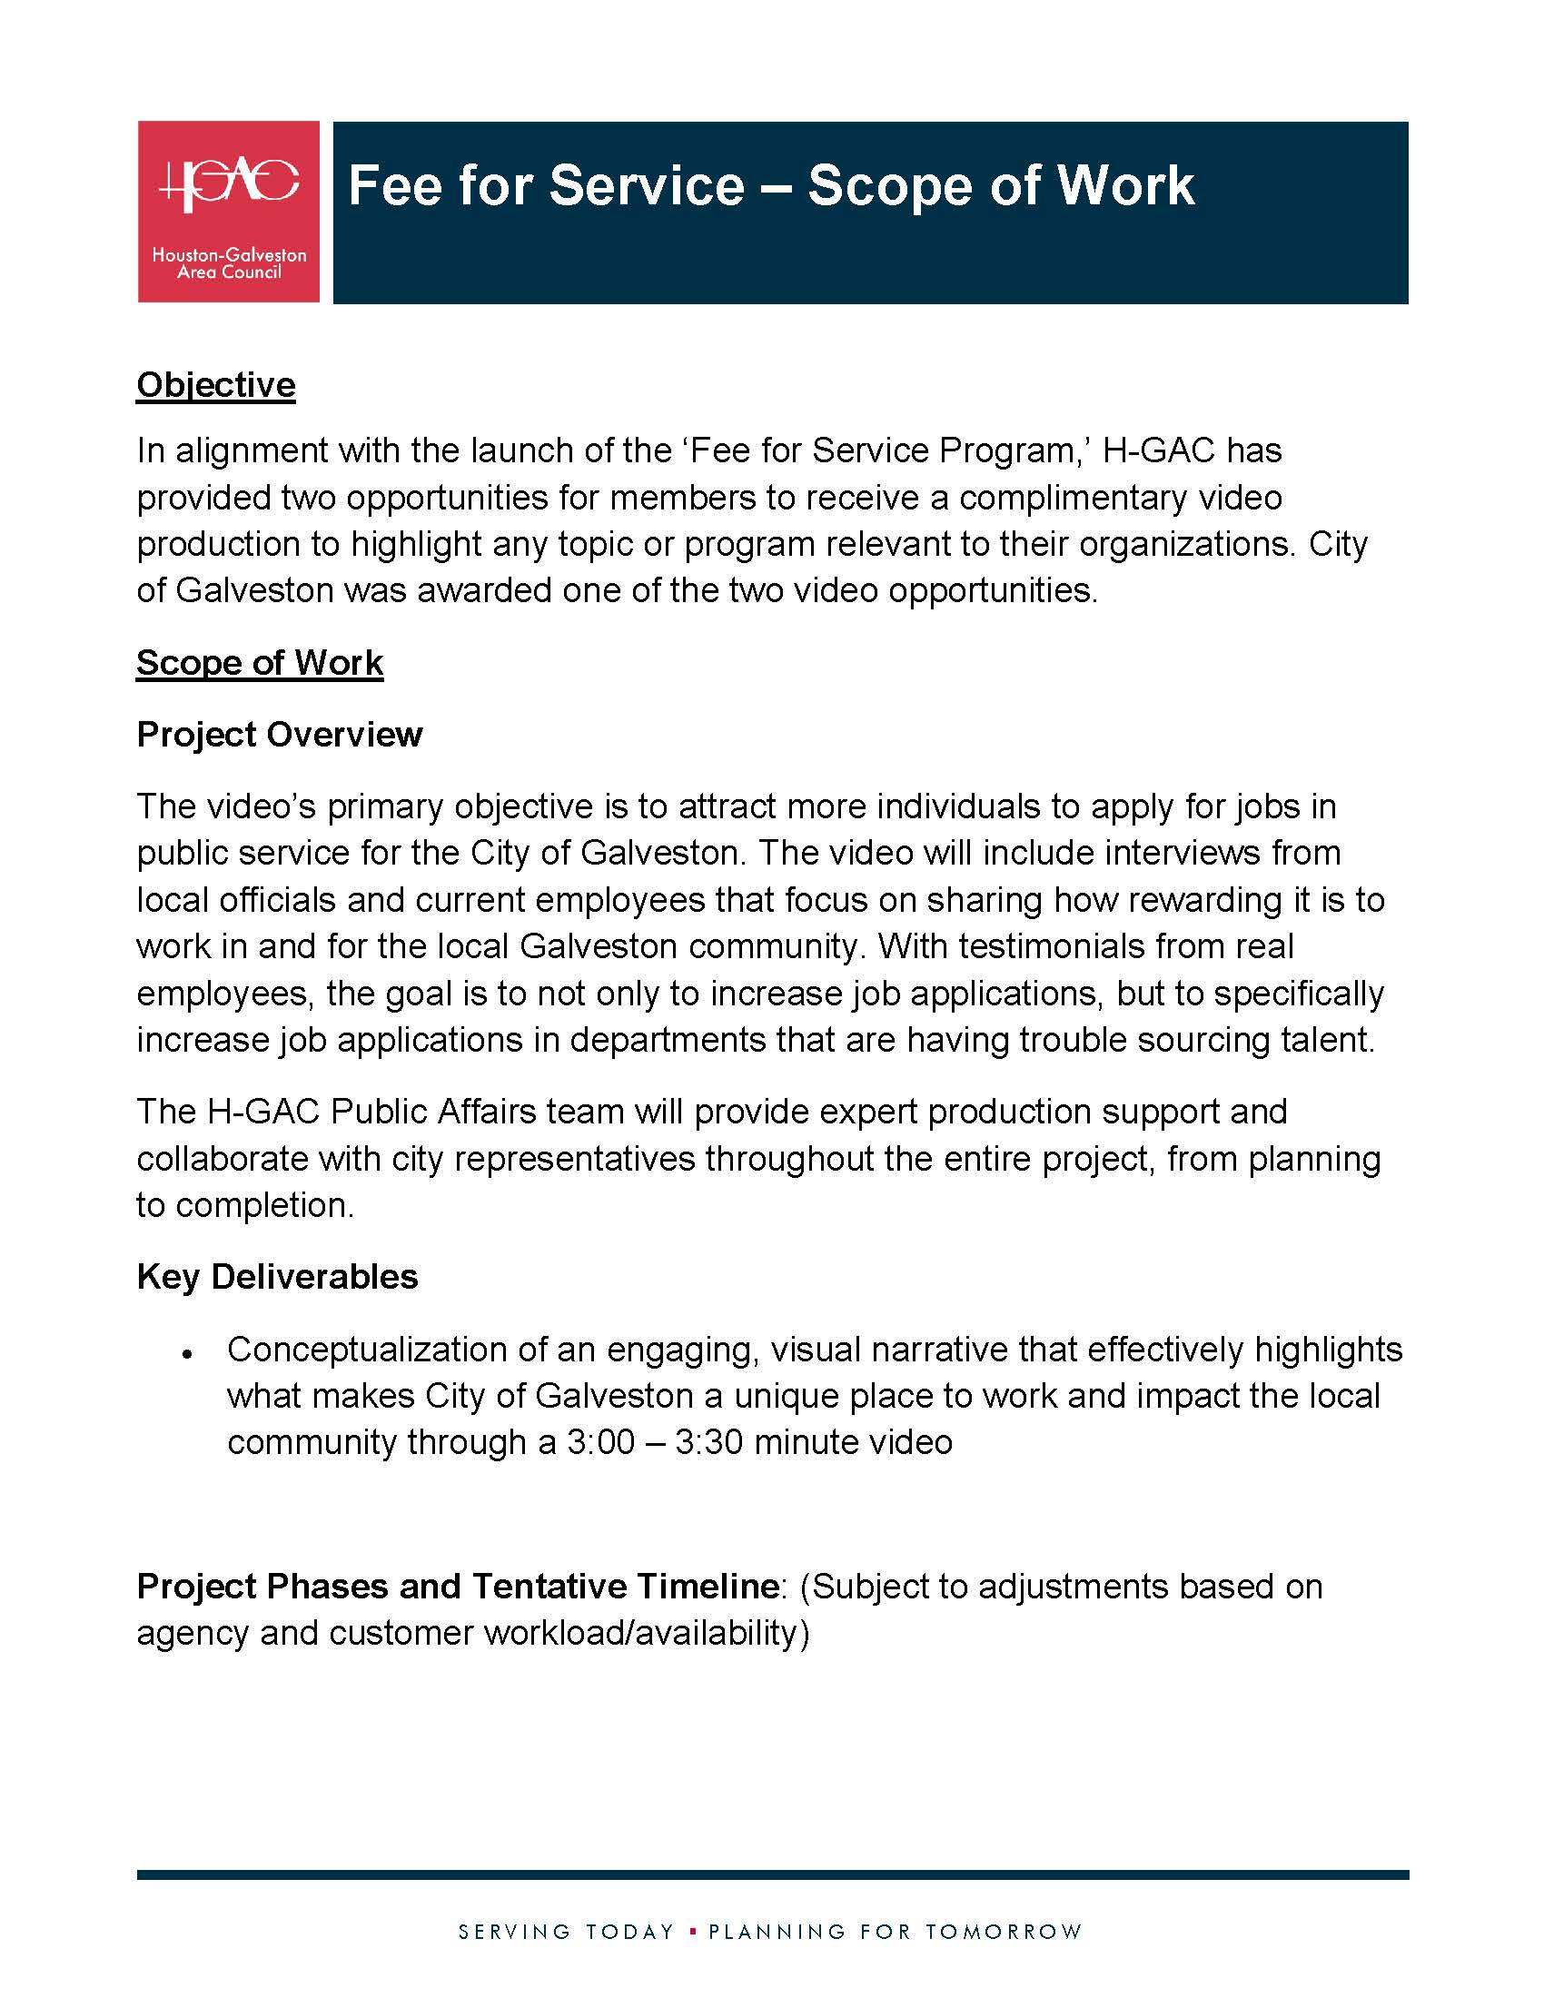
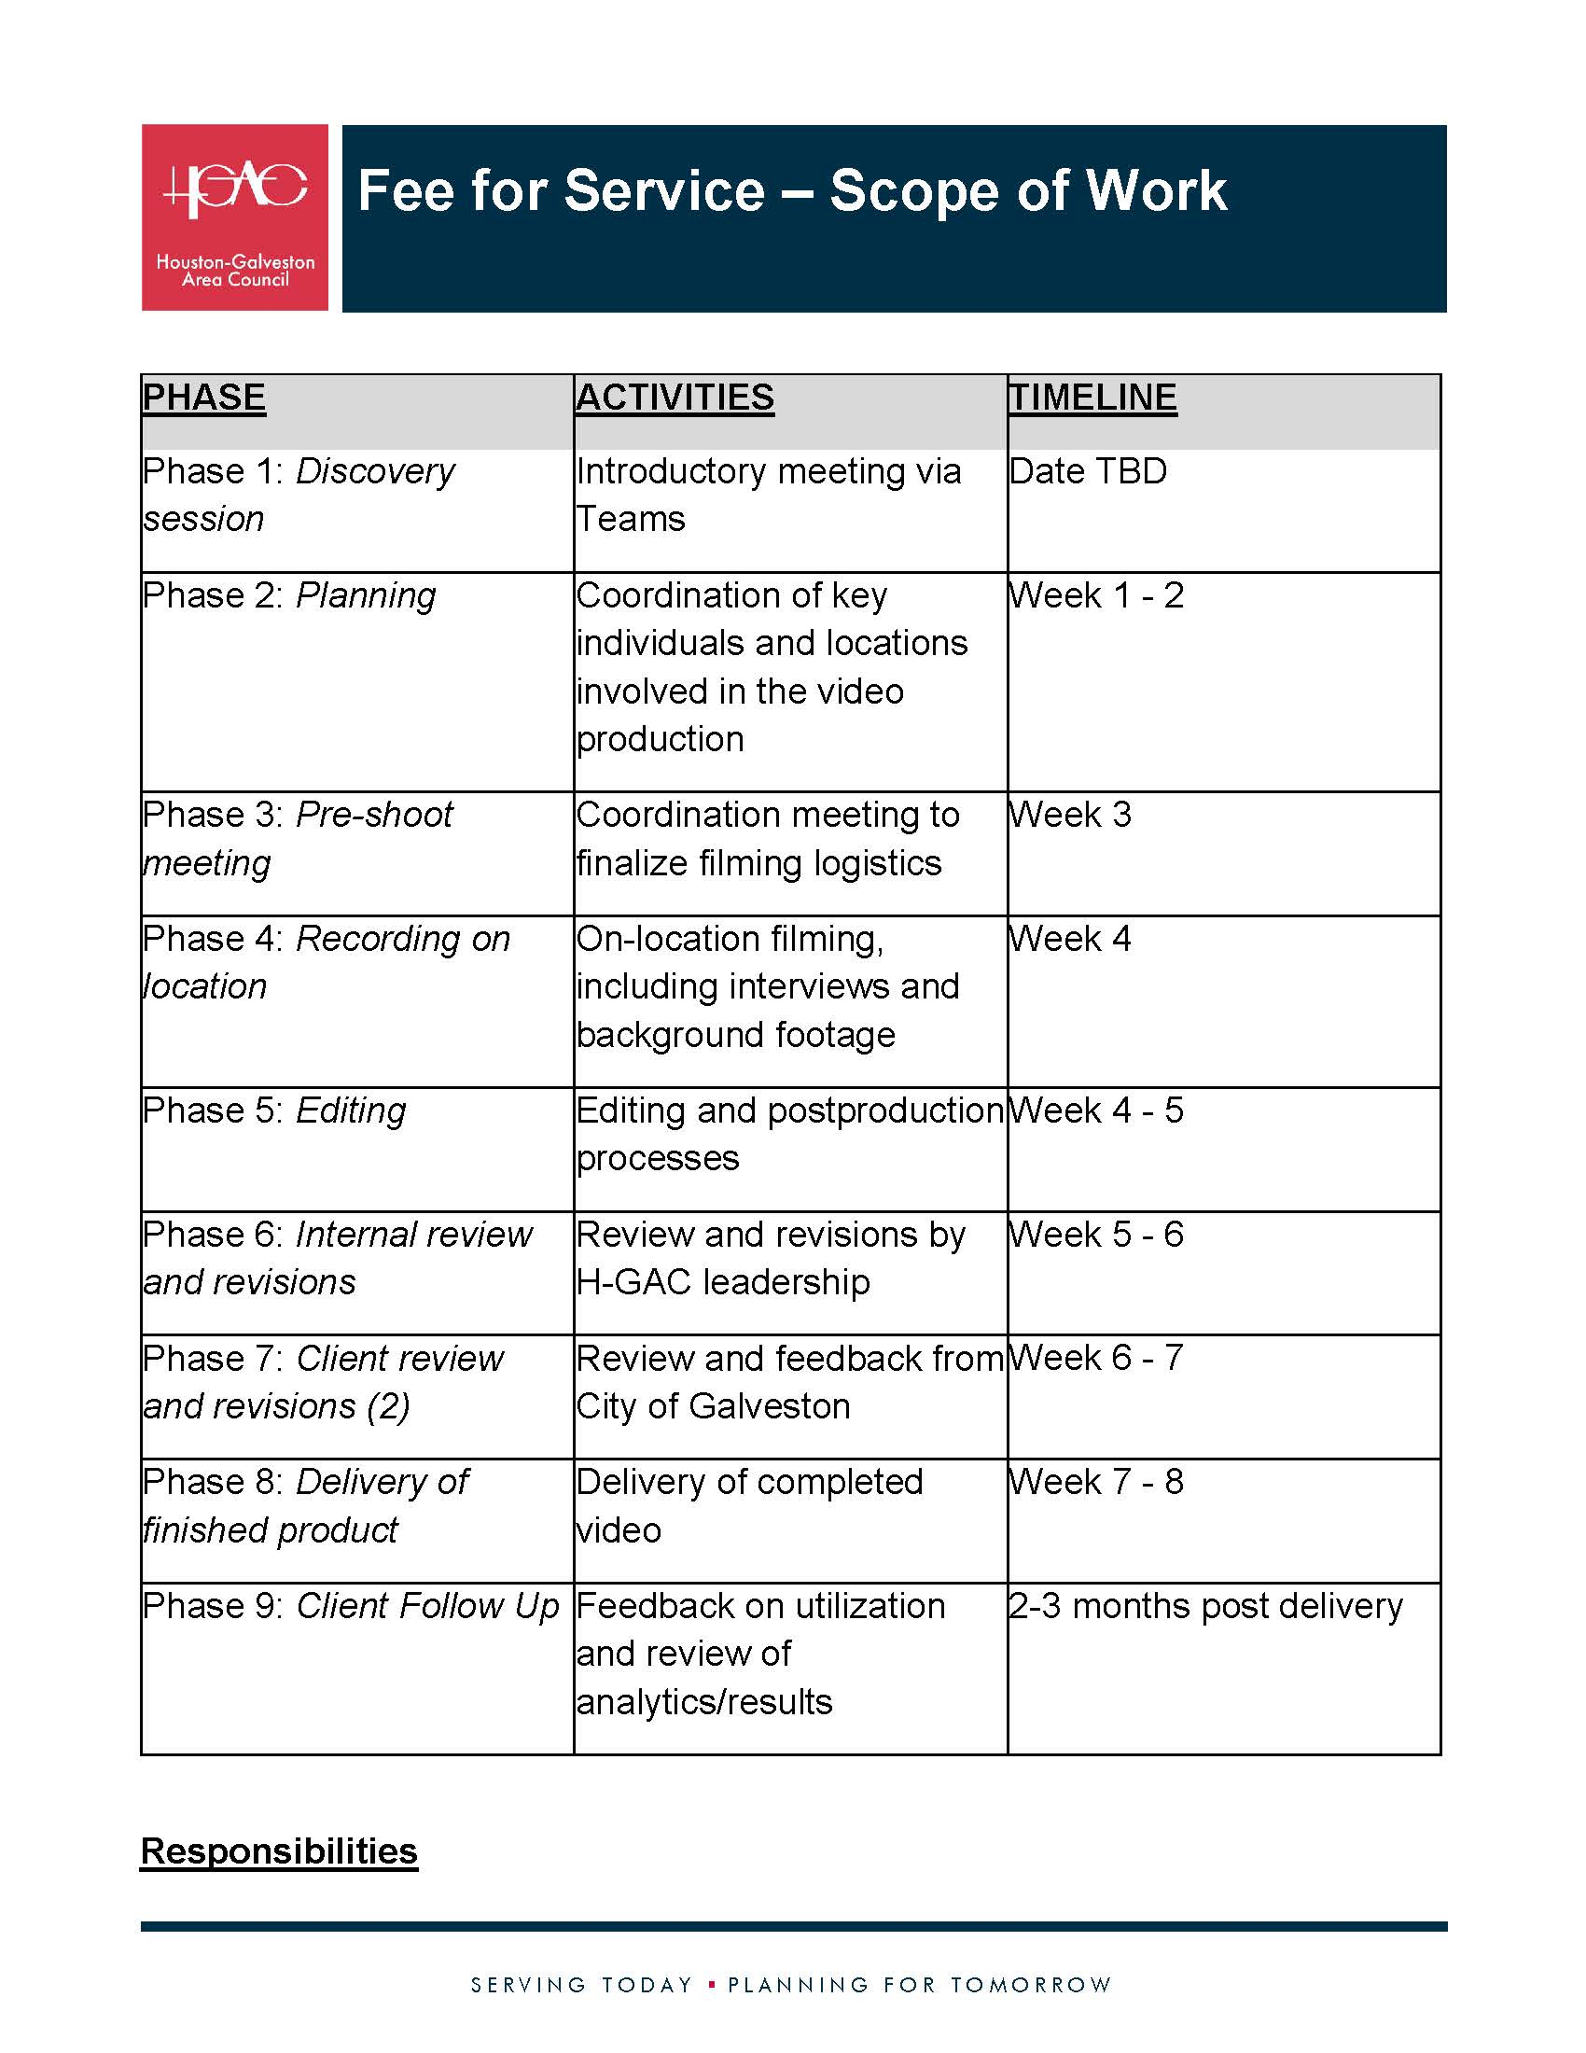
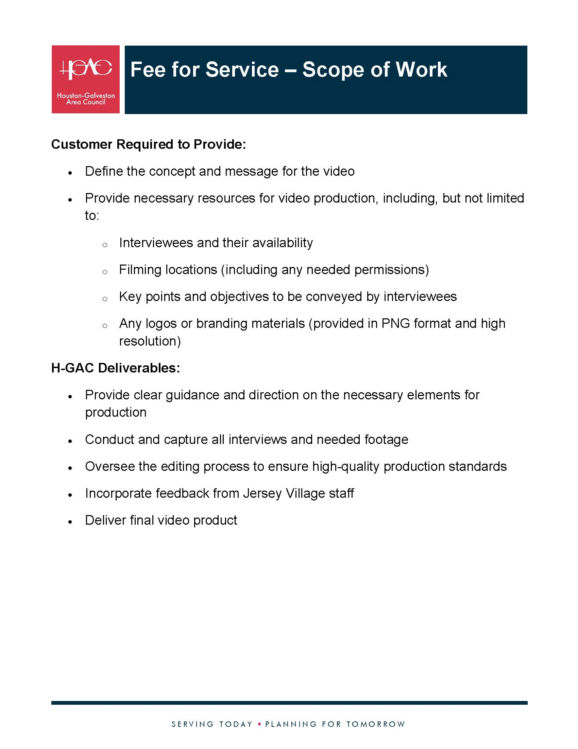
SCOPE OF WORK TEMPLATE

Slide 8
PRICE ESTIMATE TEMPLATE

Slide 9
2025 VIDEO PILOT PROJECT

Slide 10

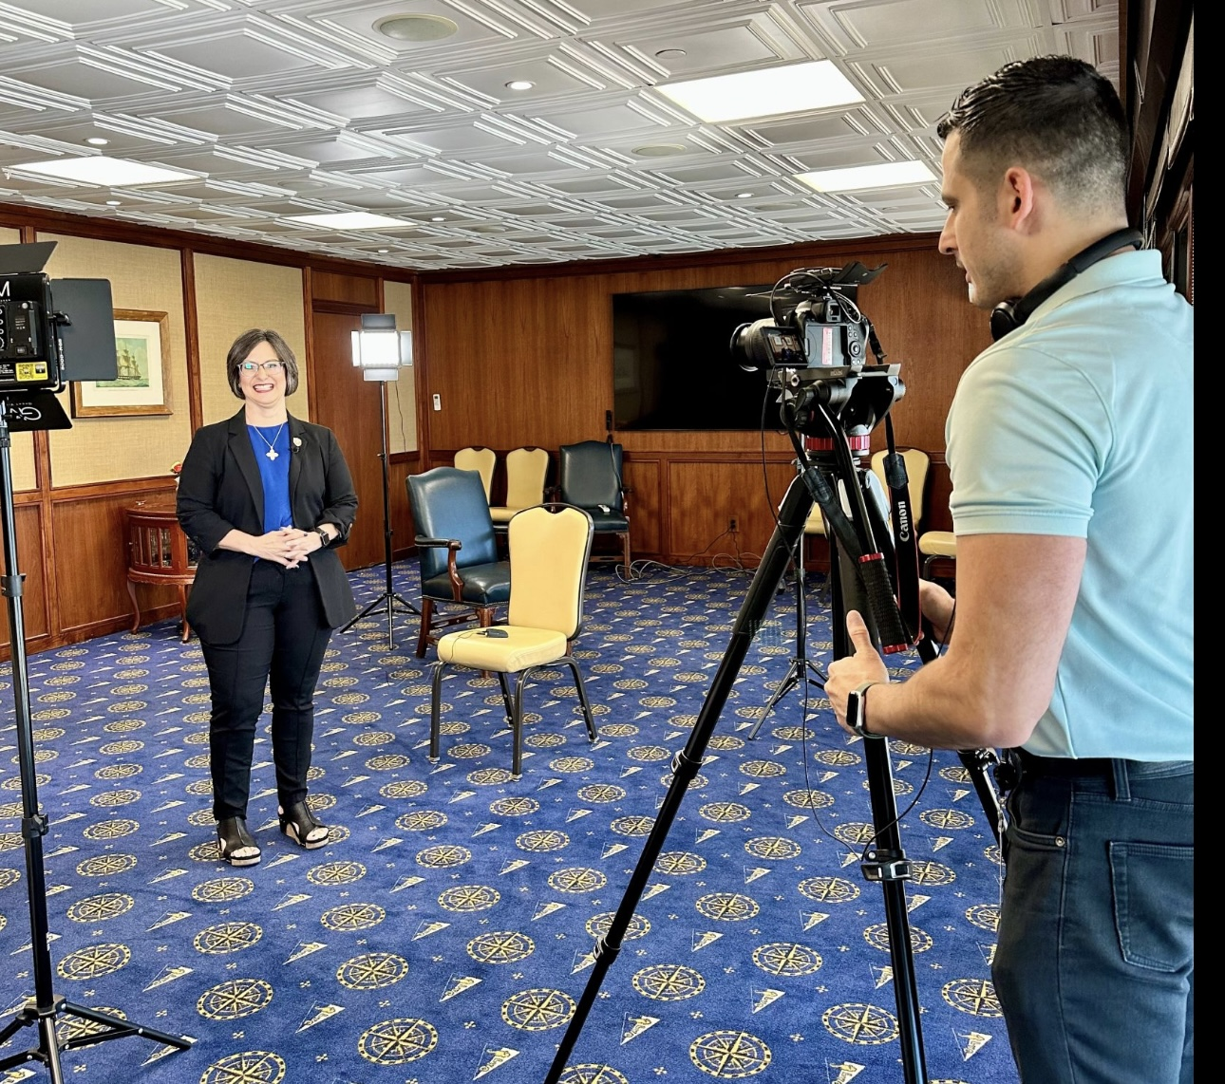
2025 VIDEO PILOT PROJECT
Estimated Completion: Early July 2025

Slide 11




Slide 12
KEY TAKEAWAYS (so far!)
Formal agreements can delay the timeline. Build this into the schedule or consider an alternative.
Providing a service to external parties can take up a lot of staff time. Work with your internal teams to see who has capacity ahead of time.
Be selective in what you choose to offer as a service. Pick what you can do well AND quickly.

Slide 13



Let’s Connect!
ashley.seals@h-gac.com
713.499.6658
linkedin.com/in/ashley-seals

