Slide 1

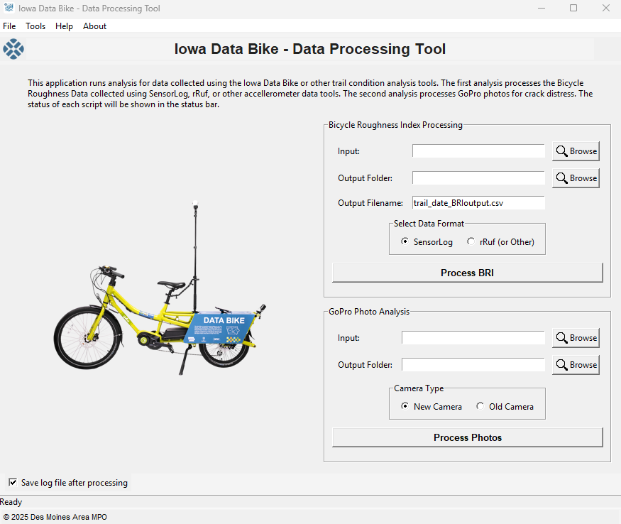
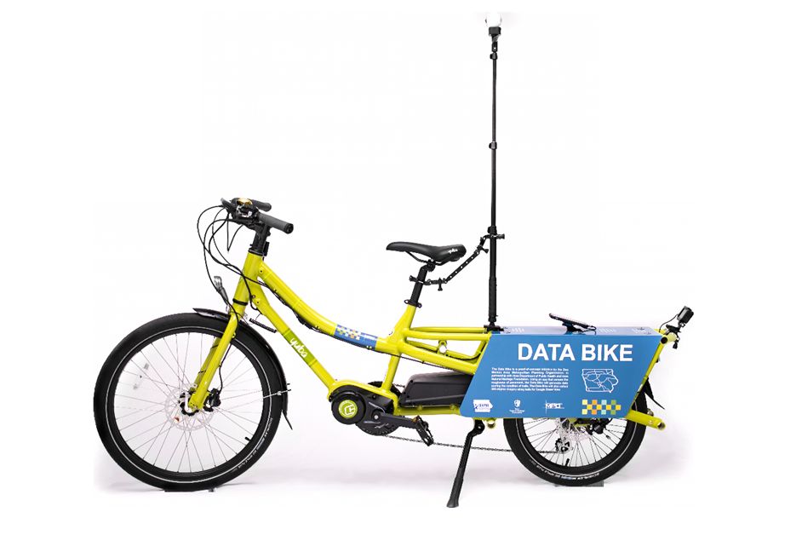

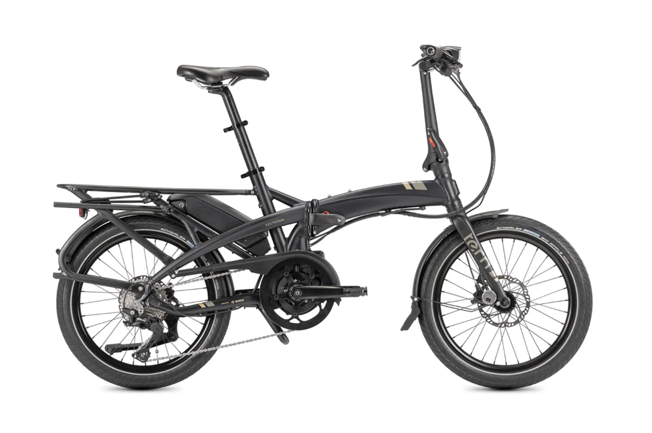
Iowa Data Bike
2025
MPO acquired a second Tern Vektron to support local trail collection and the bike loan program.
2024
Roughness data collection switched from rRuf to SensorLog
2017
Proof of Concept for Iowa Data Bike introduced to MPO Policy Board in November
2025
MPO developed the Data Bike Analyzer tool after working with InTrans on data analysis.
2024
The Original Iowa Data Bike – Yuba Spicey Curry – had issues and was decommissioned. MPO purchased a replacement bike – Tern Vektron.
2019
Started annual data collection rotation between regional and local trails

Slide 2
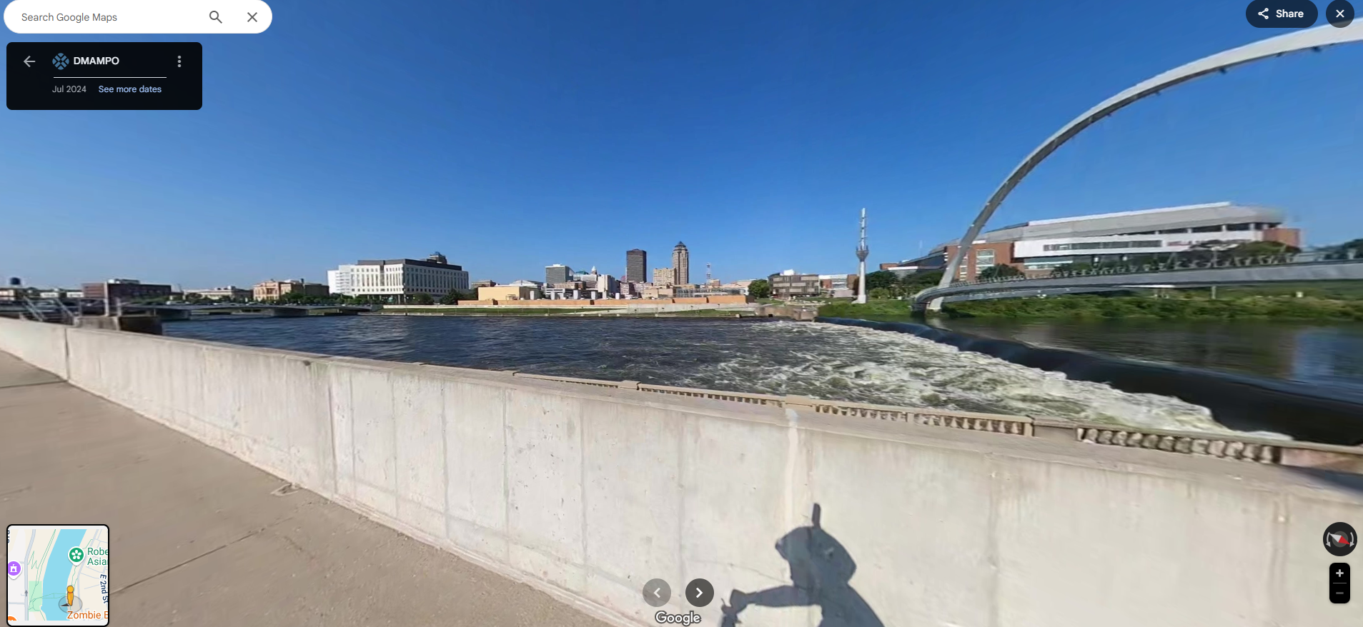
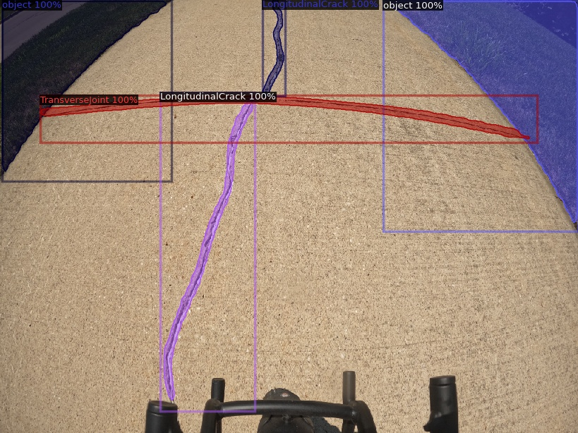
By the Numbers
Year | Miles
2017 | 388
2019 | 112
2020 | 78
2021 | 143
2022 | 114
2023 | 262
2024 | 244
Total | 1,340
Google Photo Spheres
  Photos: 15,231 Views: 5,323,748
Street View Segments
  Miles: 423.1 Views: 679,232
GoPro Photos
  345,867

