Slide 1
Measuring Mobility and Access to Opportunity
June 9, 2025
NARC Annual Conference

Slide 2

Southern California Association of Governments (SCAG)
6
COUNTIES
38,618
SQUARE MILES
VENTURA
$1.6T
REGIONAL GDP
16
TRIBAL GOVERNMENTS
LOS
ANGELES
SAN BERNARDINO
15th
LARGEST ECONOMY WORLDWIDE
191
CITIES
RIVERSIDE
ORANGE
IMPERIAL
18.7M
RESIDENTS
47.6%
OF STATE POPULATION
Notes:
Talking Points:
The SCAG region includes the six counties of Imperial, Los Angeles, Orange, Riverside, San Bernardino and Ventura.​
It also includes 16 federally recognized Tribal Governments.
In a region of 18.7 million people – 47.6% of the state – that is also among the most diverse in the world both demographically and geographically, there’s almost no way that any one person can really see what everyone here is doing. That’s where regional collaboration becomes so important.

Slide 3
Sustainable Communities Strategy
California Government Code 65080(b)(2)(B)
As part of developing the Regional Transportation Plan (RTP) SCAG must prepare a Sustainable Communities Strategy (SCS)
Land-Use & Housing Strategies
+ Multimodal Transportation Investments & Policies
= GHG emission reduction from passenger vehicles
Notes:
Senate Bill 375 became effective January 1, 2009.
It resulted directly from goals laid out in the Global Warming Solutions Act of 2006 (Assembly Bill 32).
Although the focus is on GHG emission reduction, in practice VMT is used as a proxy measure even as the vehicle fleet is transitioning to more hybrid and zero emission vehicles.

Slide 4
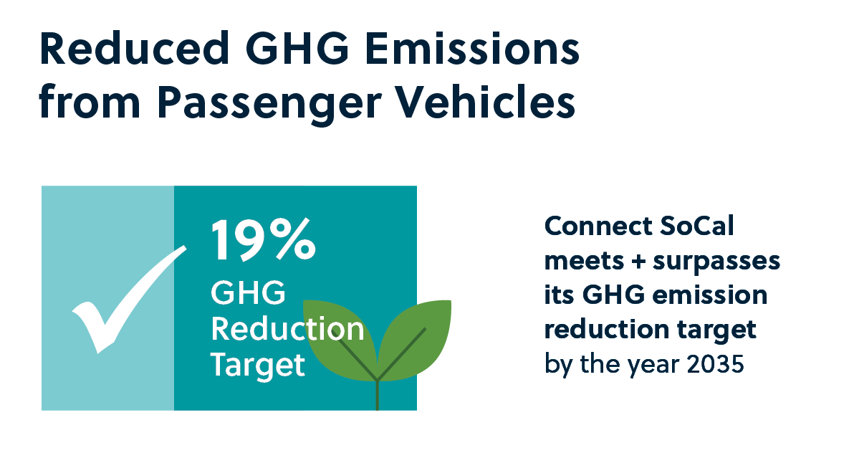
Plan Performance: New Metrics
Accessibility “Co-Benefits”
Local infrastructure and services costs to support new growth
Household costs: annual transportation and home energy/water use
Land consumption: new (greenfield) land consumed to accommodate new urban growth
Share of population residing within priority development areas
Building energy use and costs, water use and costs
  .
Regulatory Requirement
Notes:
Co-Benefits
Local infrastructure and services costs to support new growth
Household costs: annual transportation and home energy/water use
Land consumption: new (greenfield) land consumed to accommodate new urban growth
Share of population residing within priority development areas
Building energy use and costs, water use and costs

Slide 5
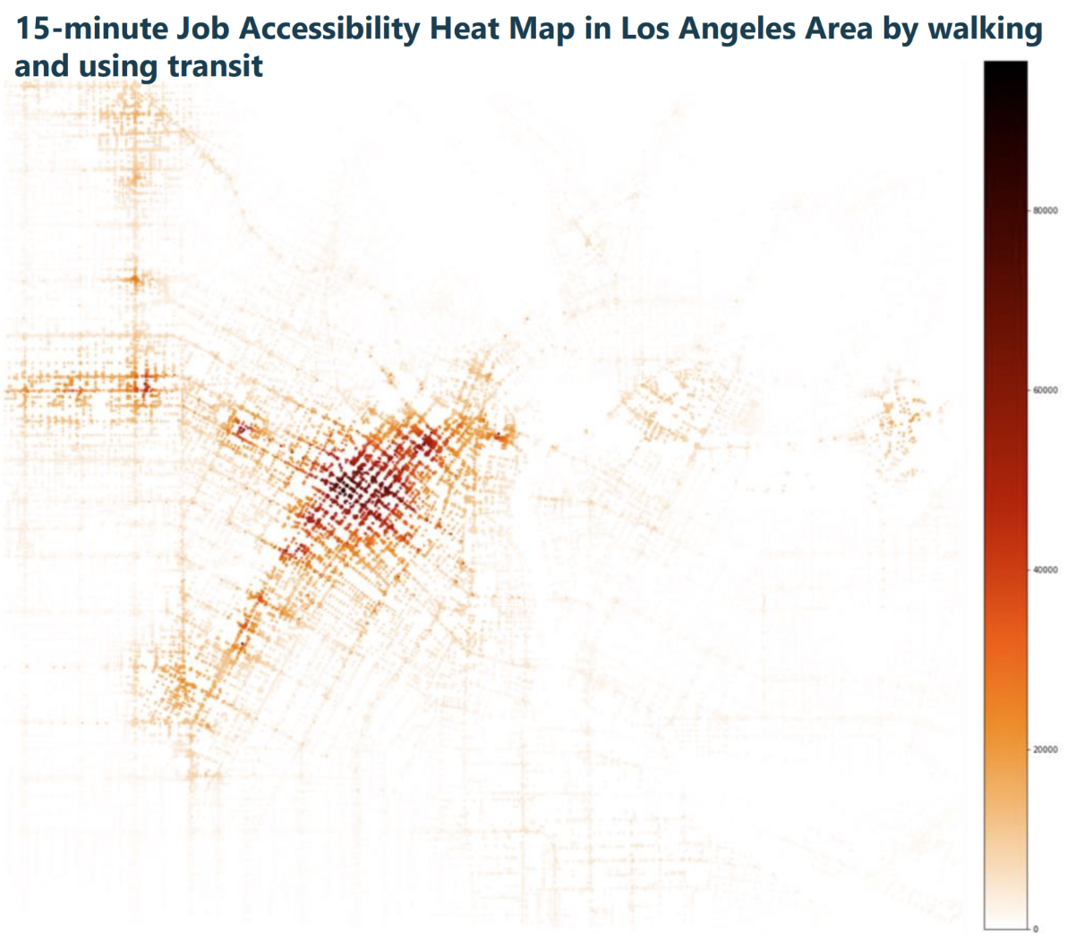
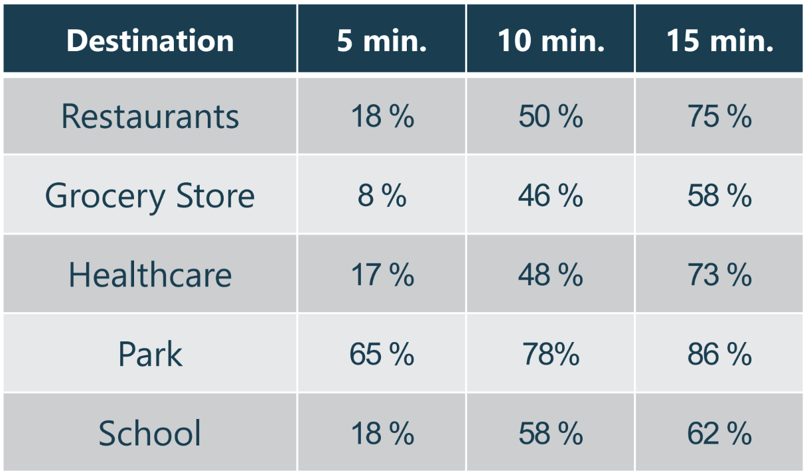
Plan Performance: New Tools
SCAG Scenario Planning Model
  Smaller zones to better capture detailed neighborhood land use impacts
  Estimate VMT reductions from strategies such as micromobility, mobility hubs
Share of City Population Within Walking Distance of Key Destinations
Notes:
In addition to a regional activity-based transportation model, SCAG utilizes a Scenario Planning Model (SPM)
Examples of SPM output shown

Slide 6
Fifteen Years of Sustainable Communities Strategies in Southern California?
Is SB 375 Achieving Its Goals?
Has Changing Metrics, Changed Outcomes?

Slide 7

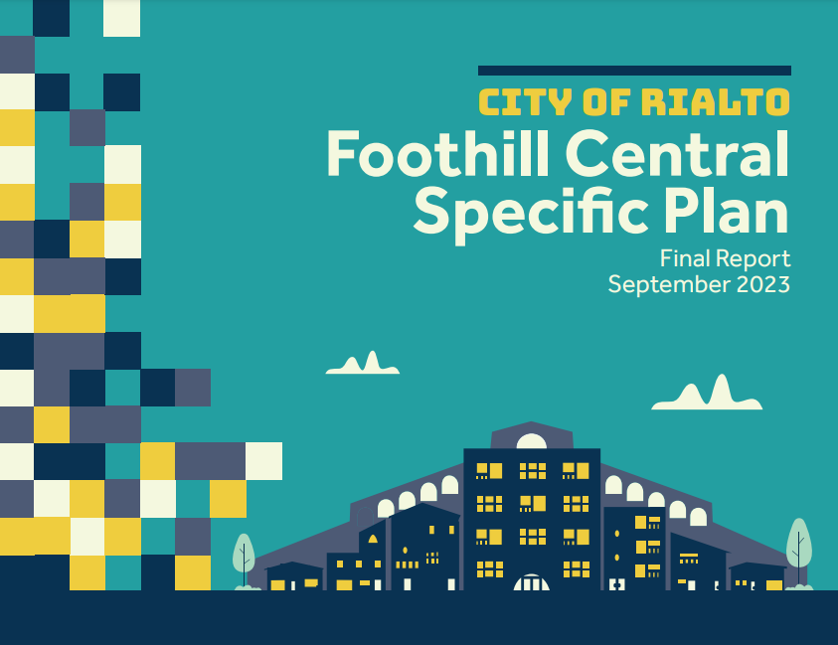
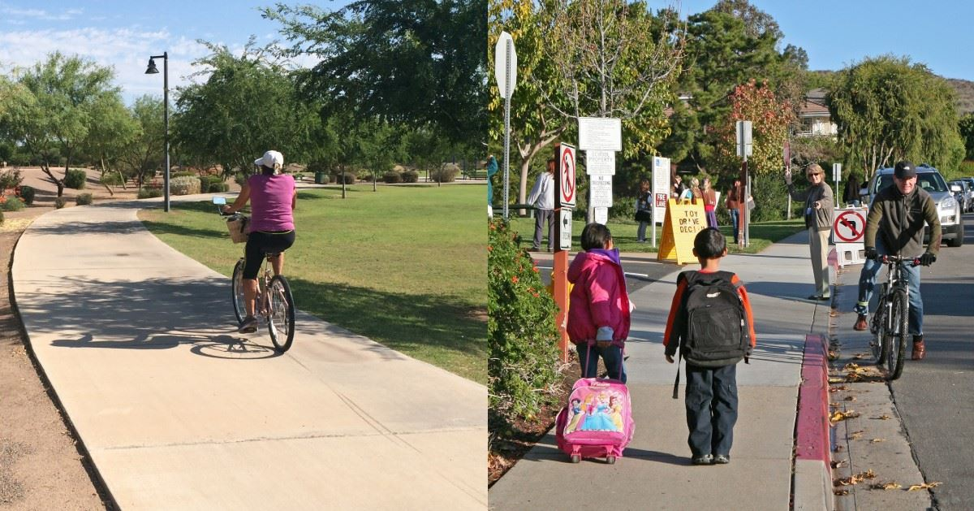

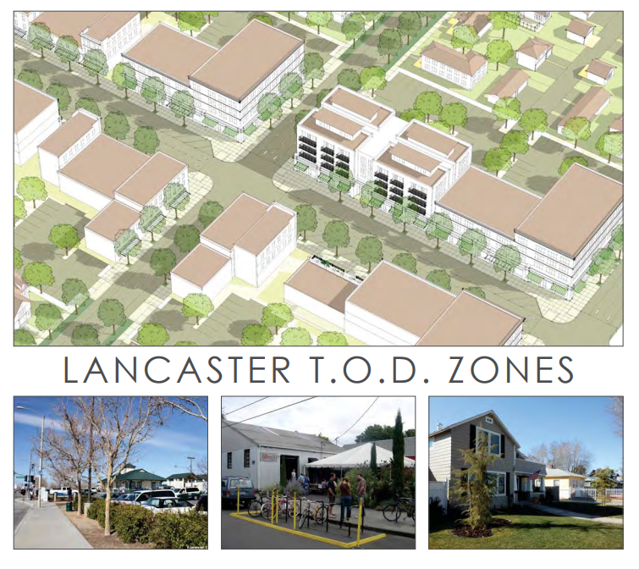
More Resources Have Been Dedicated to Local Planning: SCAG has Awarded Over $75M Since 2016
:
Active Lake Elsinore
Rialto Foothill Central Specific Plan
Active Transportation Plans
First/Last Mile Planning
Specific Plans
Enhanced Infrastructure Finance Districts
ADU Incentive and Implementation Programs
Electric Vehicle Charging
… and more
Lancaster Transit-Oriented Development Zones
Palm Springs Pedestrian Plan
Notes:
SCAG has directed significant resources to help local jurisdictions implement the regional Sustainable Communities Strategy

Slide 8



More Programs/Local Policy Change In the Works
RESOURCES & TOOLS
REAP 2: Housing Production and Supportive Infrastructure
REAP 1 & Housing Element Updates
Regional Pilot Initiative
Freight Program
Sustainable RH
Communities Program
Notes:
Grant Programs
SCAG grant programs help provide local cities and counties with the resources they need to build a sustainable future for their communities. Members can also get help in finding and securing grant funding from federal and state agencies for local projects.

Slide 9
The Region has Shifted Transportation Investments
SCAG has increased overall Operations & Maintenance, Active Transportation and Transit spending while decreasing Highway investments
Percent of RTP/SCS Expenditures
 | 2012 RTP/SCS | 2024 RTP/SCS | Change %
Operations & Maintenance (Total) | 41% | 60% | +19%
Transit (Capital and O&M) | 47% | 52% | +5%
Highway (Capital and O&M) | 18% | 13% | -5%
Active Transportation | 2%* | 5% | +3%
*2016 RTP/SCS percentage; 2012 RTP/SCS did not track AT as standalone
Note: Numbers do not reflect total plan expenditures and are illustrative of categories noted only
Notes:
Original data from Jaimee:
Overall O&M spending increases over time while Capital decreases over time. O&M spending increased from 41% of total Plan investment in 2012 to 60% of total Plan investment in 2024. Capital spending decreased from 50% in 2012 to 37% in 2024. The remainder is spending on debt service.
Active transportation investment increased from 2% of plan investment in 2016 to 5% of Plan investment in 2024. The 2012 RTP did not track active transportation as a standalone category.
Total transit investment (capital and O&M) increases from 47% to 52% while Highway investment (capital and O&M) decreases from 18% to 13% (excludes Goods Movement).
Highway capital has been decreasing as a % of capital investment, from 14% in 2012 to 8% in 2024.
Spending on operations and maintenance of regionally significant local streets and roads has increased over time, from 4% of Plan total in 2012 to 12% of Plan total in 2024.

Slide 10
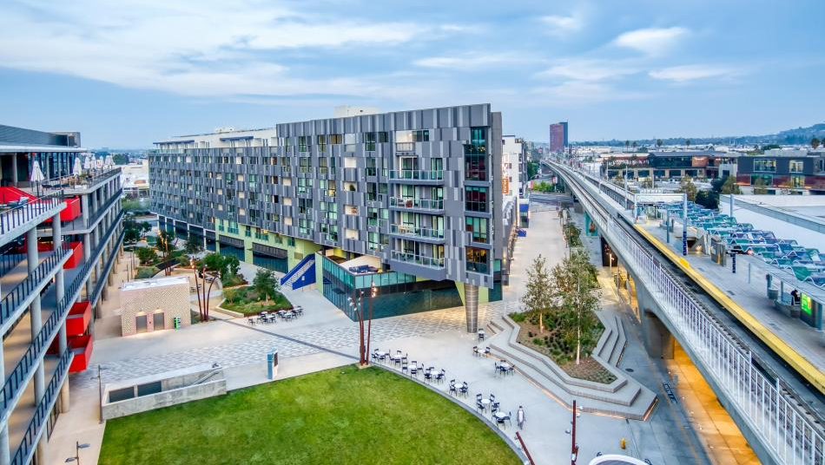
The Region has Increased Diversity of Housing Types…
Since 2012, the adoption year of SCAG’s first RTP/SCS:
  500,000 more households and one million more jobs near transit
Culver City Mixed-Use TOD (picture: ArchLenz Photography)

Slide 11
…Recent Housing is More “Location Efficient”, and
SCAG Region housing units that:
 | Exist in 1990 | Were added 1990-1999 | Were added 2000-2009 | Were added 2010-2019 | Exist in 2020
2019 Avg. VMT/capita | 20.82 | 23.05 | 22.8 | 21.07 | 21.15
# Housing Units (SCAG) | 5,271,651 | 455,081 | 642,736 | 362,632 | 6,463,002
Decennial Census; Average VMT/capita for housing units by period
Notes:
A strong focus of SB 375 has been to ensure that new growth takes place in more location-efficient areas of the region (SGC 2021). This can be planned for in many ways, e.g. proximity to transit or existing centers of activity. An oft-cited challenge is that this requires infill development with limited land availability, higher land costs, and more practical and institutional challenges such as existing uses, remediation needs, and neighbor opposition.
We used Census data for each decade to see how present-day (2019) per-capita VMT looks like based on when the homes in that area were built.
The 5.3 million housing units that existed in 1990… had an average per-capita VMT of 20.82
The homes built in the nineties and 2000s (a pretty large quantity of homes…) had a higher average VMT than that …
But on average the homes built in the 2010s were in slightly lower VMT areas… So much so that by 2020, the average Southern Californian drove a car a whole 158 feet less!

Slide 12
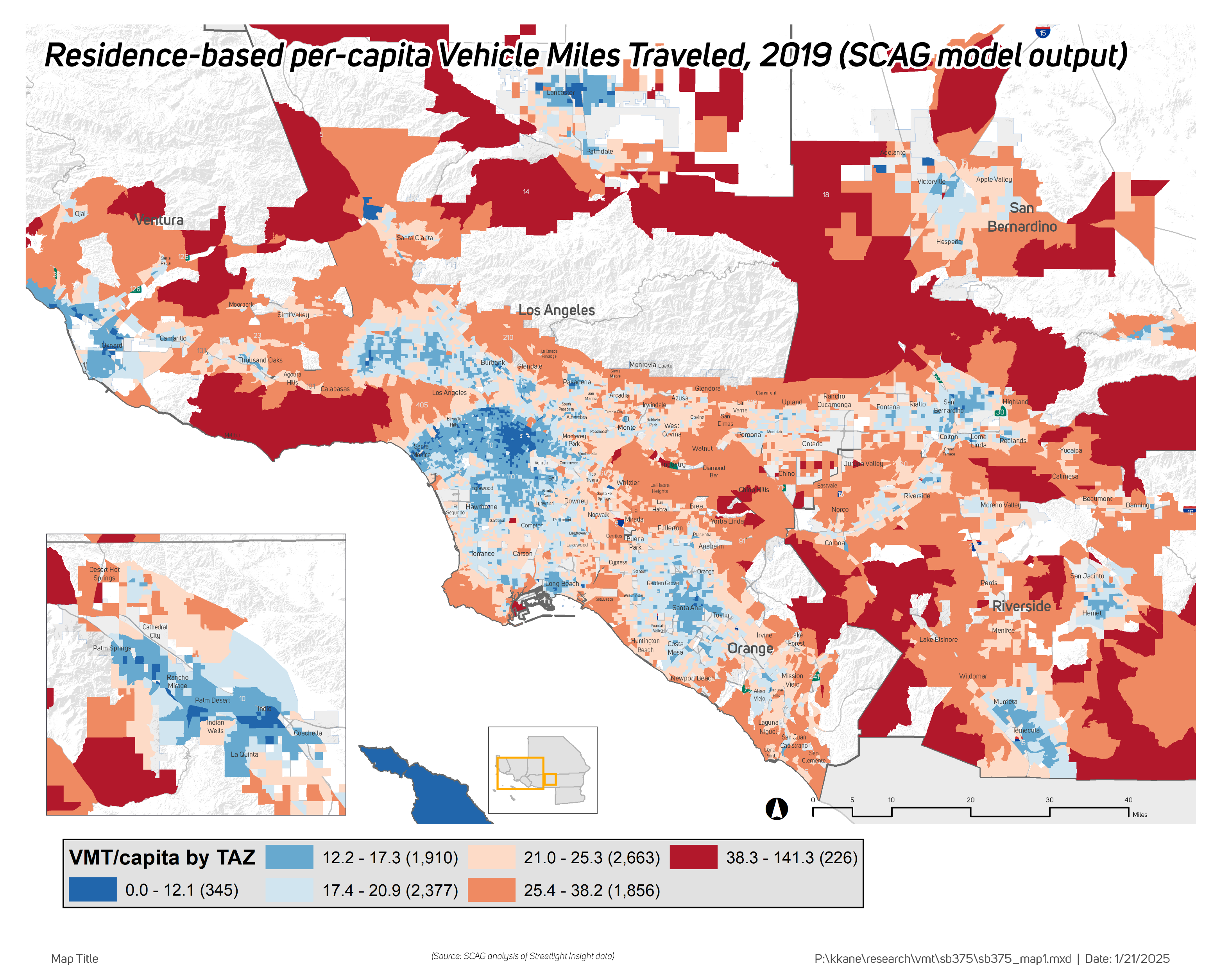
…Low VMT Per-capita Neighborhoods Exist Throughout the Region
Density and Destinations Contribute to Lower VMT Neighborhoods
Notes:
This is the first time we’ve been able to use our activity-based travel demand model results for this kind of analysis.
What I’m showing here is modeled VMT/capita across 11,267 TAZs.
It shows the TOTAL travel based on where you live…
But what stands out here is less the core-periphery gradient in travel demand… it’s far more nodal!

Slide 13
SCAG Region has Seen Steady Per-capita VMT Decline, Accelerated By COVID
2005-2023:
  VMT/capita down 9.1%; was down 5.8% by 2019
California is reducing more VMT per capita than the rest of the nation
Source: Caltrans HPMS, Average Daily total VMT and per-capita VMT
Notes:
It’s a similar story in Southern California.
Through 2019 per-capita VMT dropped 5.8 percent…
We know that WORK TRAVEL didn’t drop much during this time (I’ll get to that)—so, this portion likely reflects fewer nonwork, or discretionary miles. A good way to think of this is: either not traveling, or taking an alternative to driving, due to roadway congestion.
Through 2023, total trips were even lower, and per-capita VMT dropped ended 9.1% below 2005 levels.
California is reducing more VMT per capita than the rest of the nation
2005 – 2024
US: 3.2% drop
CA: 10.4% drop

Slide 14
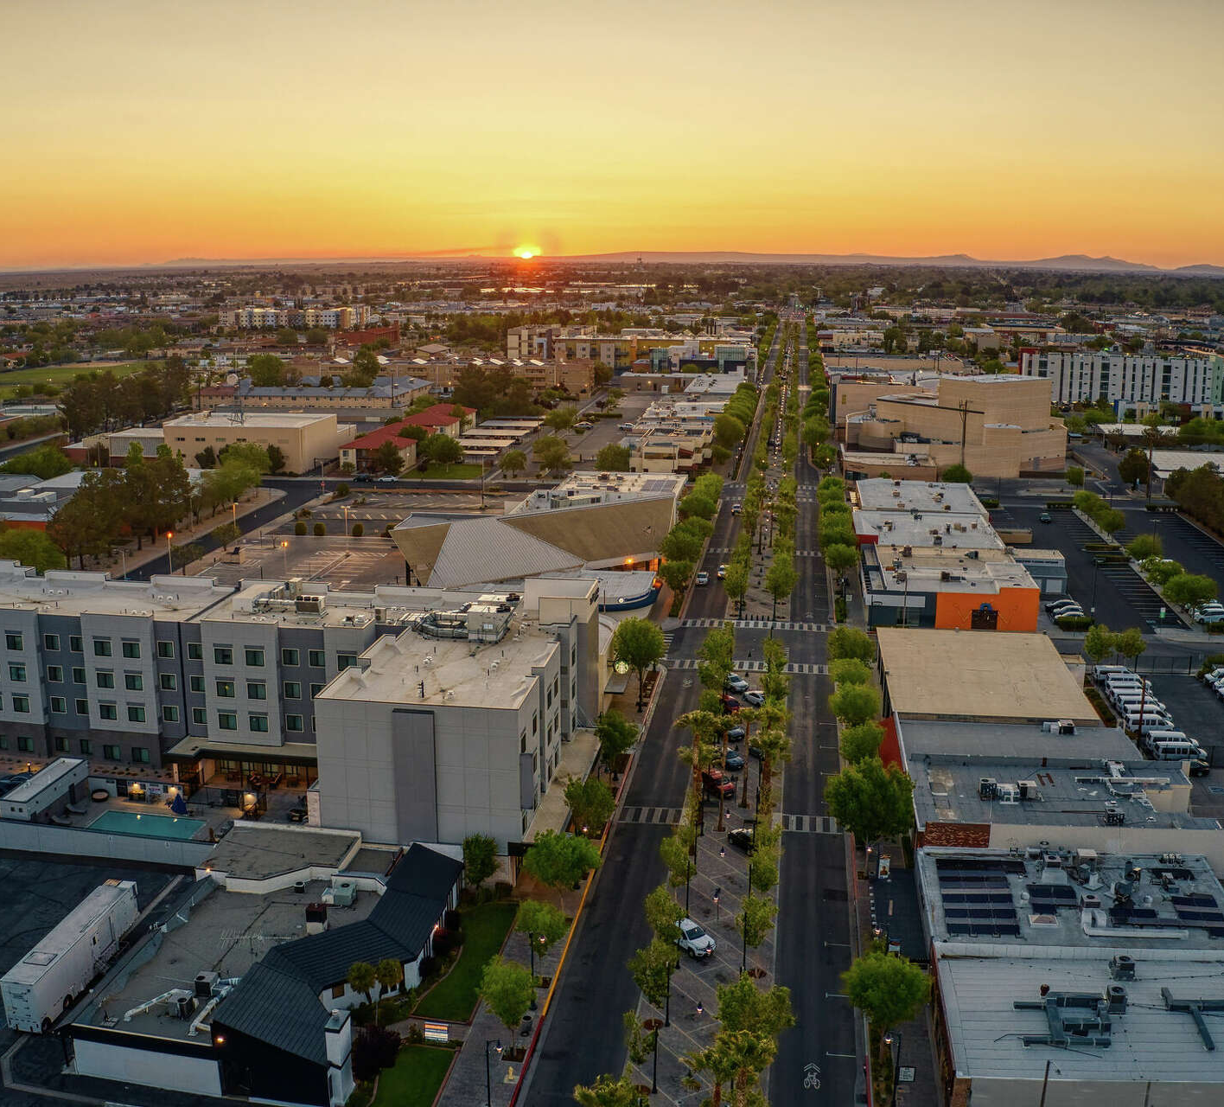
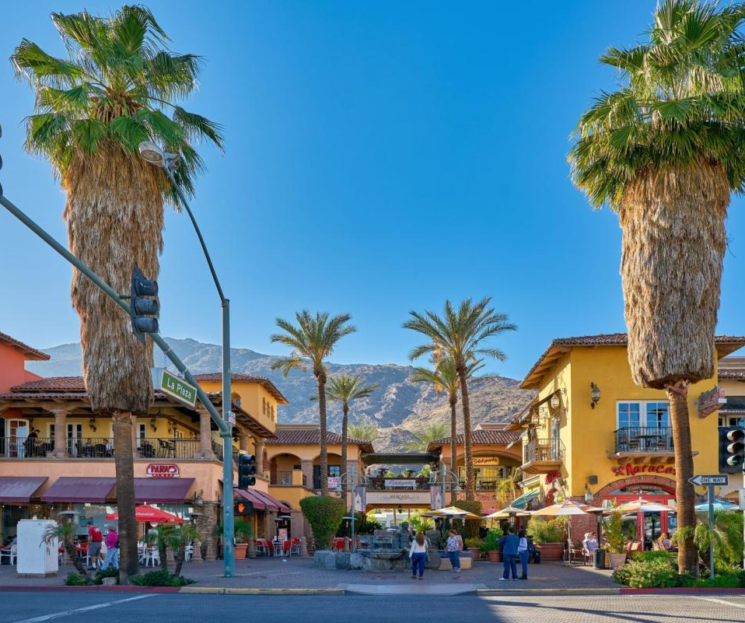
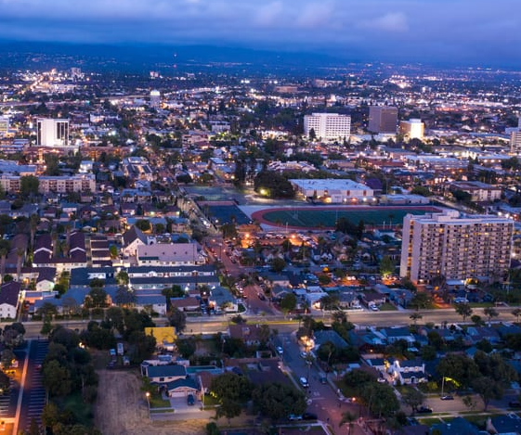
What Makes Communities Low VMT/More Accessible?
City of Lancaster
City of Palm Springs
City of Santa Ana
Source: sfgate.com
Source: visitpalmsprings.com
Source: justluxe.com
Notes:
Outskirts of Pasadena vs. outskirts of Temecula… vs. Palm Springs!!
Long Beach, Santa Ana, Riverside, San Bernardino, Pasadena, and Glendale stand out. Others are cities or groups of cities that are more self-contained, either by physical geography or a locus of mixed activity (homes, work, recreation) within a reasonably short distance. While these functional subregions represent a part of the broader labor market and housing market in the SCAG region—thus justifying inclusion as part of an MPO—their relationship with the rest of the region may be different. Some examples include the western Riverside county cities including Murietta/Temecula, the Coachella Valley (Palm Springs and vicinity), the Antelope Valley city of Lancaster, and Oxnard in Ventura county.

Slide 15
Technology & Economy Have Changed Travel Needs
2019-2023:
  699,000 fewer drive-alone commuters
  703,000 additional home-based workers
Notes:
Telecommuting just about tripled during the pandemic but has since given back some of those gains.
Drive-alone commute shares topped out around 76 percent, quickly drop to 65.9 percent of commutes in 2021, then tick up to 68.8 percent.
Now, the difference between 2019 and 2023 really tells the story:
Drive-alone commutes decreased by almost the exact same number as telecommuters.
We lost 112k transit users, gained 42k walk/bike…. And as population growth stalled and folks left the labor force there were 67k fewer commuters

Slide 16
Looking Forward
Revise Strategies?
Telework & Evolution of Work
Housing Need
“Complete” Communities
New Technologies
Sustainable Funding
Revise Metrics?
Analysis Paralysis → Implementation!
eVMT ≠ GHG
Pivot from “Less” (VMT) to “More” (Accessibility)
Notes:
Future strategies might seek to ensure that:
work-related travel declines are not simply replaced by non-work trips
benefits of work-from-home can accrue to lower-wage industries requiring on-site work, such as through reduced congestion or higher wages
SCS concept of a neighborhood mobility area prioritizes growth in areas close to neighborhood-facing destinations (restaurants, grocery stores, schools, medical facilities, apparel retailing)
A regional strategy to promote co-location (15-minute communities) may be especially effective given the decline in work trips.
High-resource, low-VMT areas can be uplifted as best practices, while low-resource, high-VMT areas are ideal locations for improved accessibility strategies.

Slide 17
https://scag.ca.gov/connect-socal

