Slide 1

2025 NARC Annual Conference
June 8-11, 2025

Slide 2











2

Slide 3
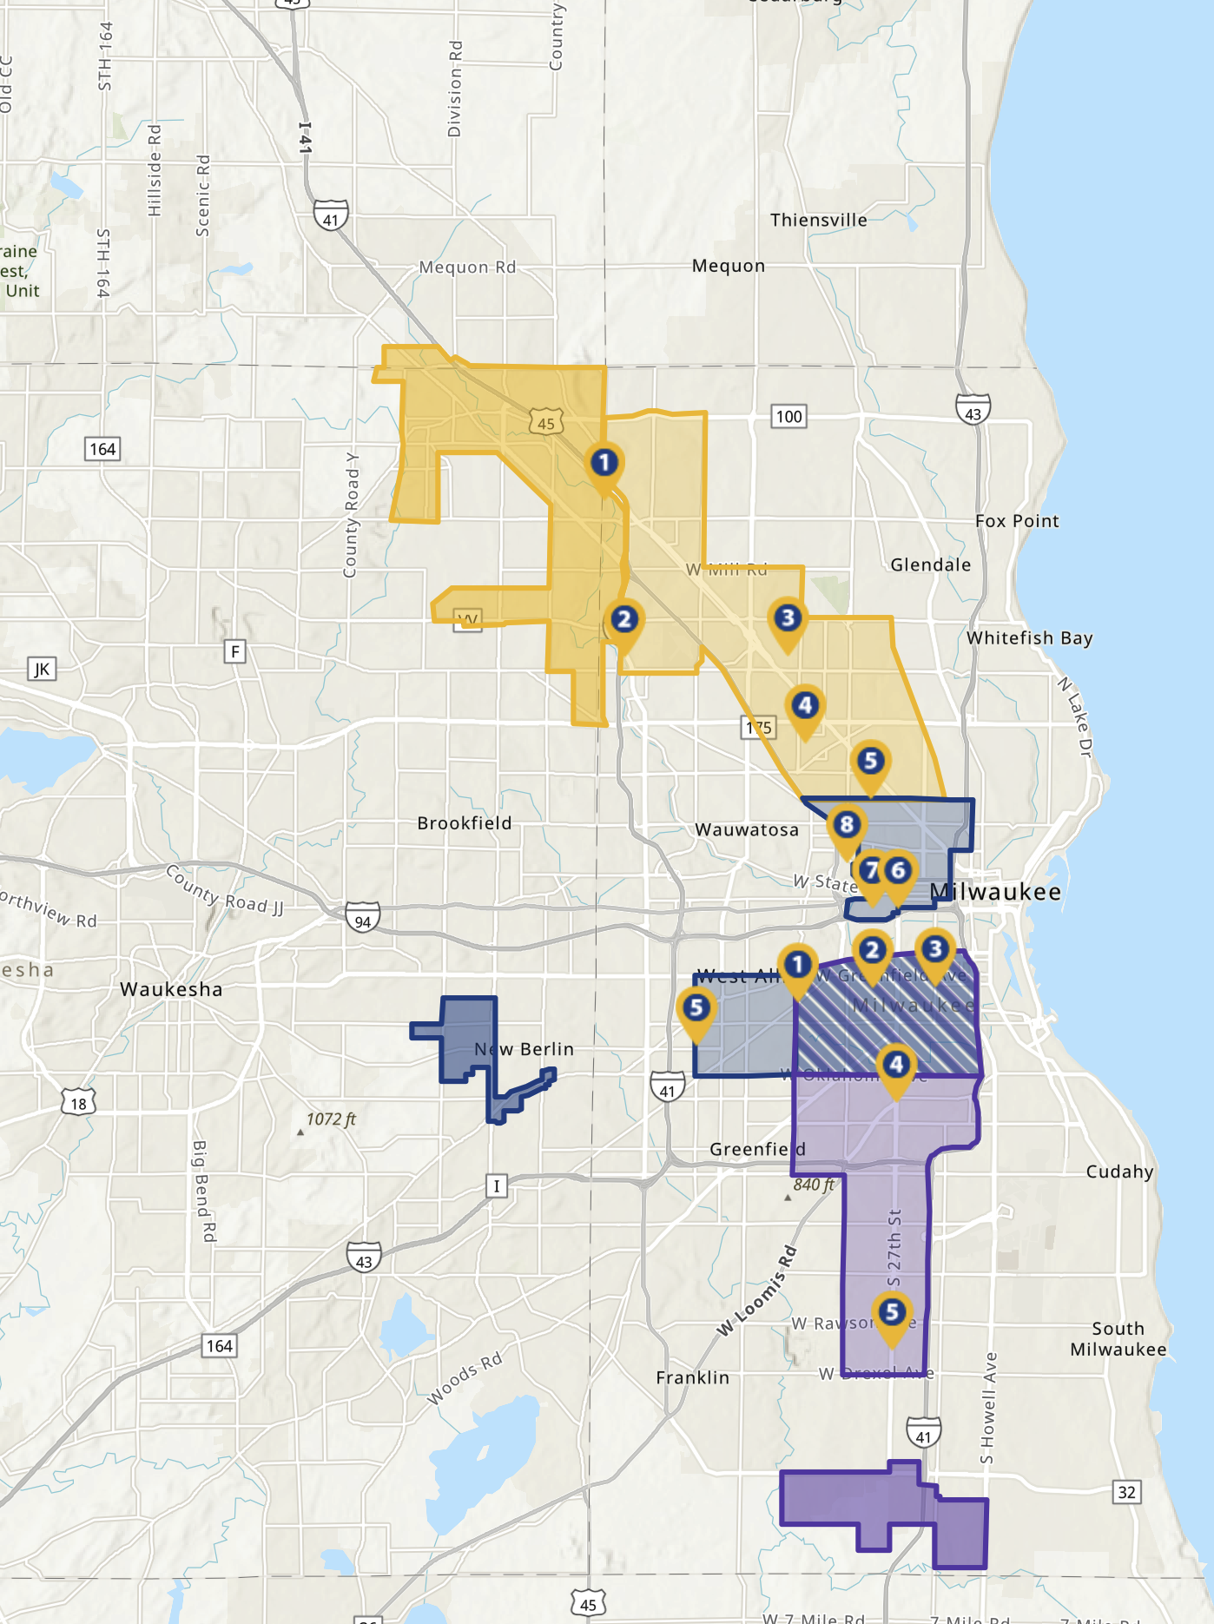
Connecting Milwaukee Workers to Suburban Job Centers
2022-2024
Over 100,000 rides
5,000 riders
185 Companies served
3

