Slide 1
Strategies for Dealing Financial Uncertainty & Becoming Financially Resilient
National Association of Regional Councils
June 9, 2025
Seattle, Washington

Slide 2


Your Speaker
Celina Cereceres, CPA, CFE
Whitley Penn, LLP
Partner
713-386-1175 (P)
713-377-3667 (M)
Celina.Cereceres@whitleypenn.com

Slide 3
What is the Current Landscape?
Increased Scrutiny from Federal Agencies
  Trend: Federal agencies like the U.S. Department of Transportation, HUD, and HHS are increasing oversight due to high-profile fraud cases and improper spending during pandemic-related funding (e.g., ARPA, IIJA).
  Risk: Greater chance of desk reviews, site visits, and audit findings.
  Mitigation: Robust internal controls, documentation, and readiness for audits/reviews

Slide 4
What is the Current Landscape?
COVID-19 Fraud Enforcement Task Force
Since 2021, 3,500 defendants charged with federal crimes
More than $1.4 billing seizures and forfeiture orders to recover stolen CARES Act Funds
More than 400 civil settlements and judgements
Five prosecutorial COVID-19 Fraud Enforcement Strike Forces – based in California, Colorado, Maryland, New Jersey and Florida
Pandemic Analytics Center of Excellence created to produce data products designed to detect, deter, and stop pandemic fraud across multiple agencies.

Slide 5
What is the Current Landscape?
COVID-19 Fraud Enforcement Task Force
Extending the statue of limitations for all COVID-19 fraud-related offenses
Extending the statutory authorization for the Pandemic Response Accountability Committee (PRAC), a body of 20 federal Inspectors General overseeing pandemic relief spending
Adequately resourcing COVID-19 anti-fraud efforts, including data sharing, lead development, criminal prosecutions and asset recoveries
Notes:
Michael C. Galdo Director, COVID-19 Fraud Enforcement

Slide 6
What is the Current Landscape?
Cybersecurity and Data Privacy Constraints
Risk: Many federal grants (especially from DOT, HHS, DOE) require protection of personally identifiable information (PII) or critical infrastructure data.
Mitigation: Implement NIST-aligned cybersecurity frameworks, regular IT audits, and cyber insurance coverage.
Workforce Turnover and Capacity Constraints
Risk: Loss of institutional knowledge and undertrained staff can lead to errors in grant management and reporting.
Mitigation:
  Cross-training and succession planning.
  Competitive compensation to retain talent.
  Leveraging technology to automate grant tracking and compliance tasks.
Notes:
Michael C. Galdo Director, COVID-19 Fraud Enforcement

Slide 7
What is the Current Landscape?
.
Match/Cost Sharing Compliance
Risk: Misstated or undocumented in-kind and cash matches are frequent issues in audits.
Mitigation:
  Clear policies and documentation.
  Regular reconciliation of match contributions.
Improper Allocation of Indirect Costs
Risk: Misapplication of indirect cost rates or lacking a proper cost allocation plan (CAP).
Mitigation:
  Obtain approved indirect cost rates.
  Update CAPs annually and align with actual activities.
Notes:
Michael C. Galdo Director, COVID-19 Fraud Enforcement

Slide 8
What is the Current Landscape?
.
Inadequate Subrecipient and Contractor Oversight
Risk: COGs often act as pass-through entities to local governments, non-profits, and contractors.
Mitigation:
  Risk-based subrecipient monitoring.
  Proper contractor vs. subrecipient classification.
  Site visits and performance reporting.
Notes:
Michael C. Galdo Director, COVID-19 Fraud Enforcement

Slide 9
What is the Current Landscape?
.
Single Audit Findings and Repeat Deficiencies
Risk: Repeat findings can trigger increased oversight or funding delays.
Mitigation:
  Proactive audit preparation.
  Immediate corrective action plans.
  Regular internal compliance reviews.
Evolving Compliance Requirements
Risk: Constant changes to Uniform Guidance, Buy America provisions, and Davis-Bacon enforcement can catch COGs off guard.
Mitigation:
  Subscription to compliance update services.
  Regular legal and grant compliance reviews.
Notes:
Michael C. Galdo Director, COVID-19 Fraud Enforcement

Slide 10
What is the Current Landscape?
.
Ineligible or Untimely Expenditures
Risk: Missed deadlines for obligation or liquidation can lead to questioned costs.
Mitigation:
  Grant dashboards tracking spend rates and key dates.
  Frequent communication with program staff and granting agencies.
Notes:
Michael C. Galdo Director, COVID-19 Fraud Enforcement

Slide 11
What is the Current Landscape?
.
GAQC Financial Statement Audit Environment
Funding cliffs, funding reductions, terminations/recissions, and stop work orders
Revenue recognition and the consideration of the collectability of receivables related to grant funds
Increase in need for going concern considerations in some cases
New accounting and auditing standards
Continued staffing resource challenges both at client an audit organizations
Notes:
Michael C. Galdo Director, COVID-19 Fraud Enforcement

Slide 12
Single Audit Developments
Hurricane and Wildfire Extensions
Financial Management Risk Reduction Act
Certain federal agencies and their grants have been abolished
Previous waivers of COVID-19 spending deadlines being scrutinized and, in some cases, retracted
Some federal agencies are stopping funding under programs that no longer align with agency goals
Many court cases challenging decisions reached have been filed
Increased risk
Follow-up on previous audit findings

Slide 13
CSLFRF Obligation Deadlines and Consequences
Notice to Recipients of Coronavirus State and Local Fiscal Recovery Funds U.S. Department of the Treasury Compliance Reviews and Related Recoupment Efforts March 25, 2025
Treasury intends to monitor recipients’ methods of obligating funds by 12/31/2024, deadline.
Treasury will recoup funds that recipients obligated or expended impermissibly, as well as to recapture those funds not spent by the 12/31/2024 deadline.

Slide 14
CSLFRF Obligation Deadlines and Consequences
Notice to Recipients of Coronavirus State and Local Fiscal Recovery Funds U.S. Department of the Treasury Compliance Reviews and Related Recoupment Efforts March 25, 2025
  Information document request or
  Financial Instructions to Return Unobligated Funds
    Amount owed by the recipient
    Date by which funds be repaid
    Direct the recipient to Pay.gov for repayment options
    Noncompliance with repayment will result in debt and the Treasury will follow standard debt collection policy and procedures (interest and penalties will accrue)

Slide 15
Single Audit – Example of Federal Agency Actions
On March 28, 2025, the U.S. Department of Education distributed a letter shortening the liquidation period for the Education Stabilization Fund (e.g. ESSER and HEERF)
Liquidation period was March 31, 2026 and was moved to March 31, 2025.

Slide 16
Reserve Balances
Explain to governing bodies the need to keep 90 days or more in reserves
Create revenue-generating activities for your government
  Training
  Purchasing cooperative
  Records management
  Outsourced accounting

Slide 17
Implications for CFOs
Compliance with Revised Deadlines: Organizations must ensure that all obligated federal funds are liquidated within the prescribed timeframes, as extensions are now limited and subject to stricter scrutiny.
Monitoring Policy Changes: Given the potential for abrupt policy shifts, continuous monitoring of federal directives and guidance is essential to maintain compliance and adapt financial strategies accordingly.
Risk Management: The recent funding freeze underscores the importance of having contingency plans to mitigate the impact of sudden funding disruptions on organizational operations.

Slide 18
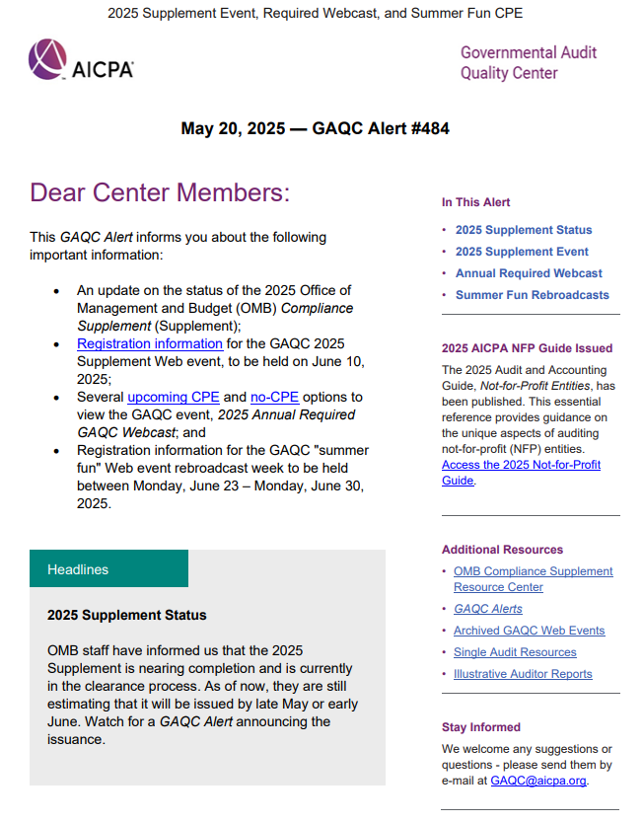
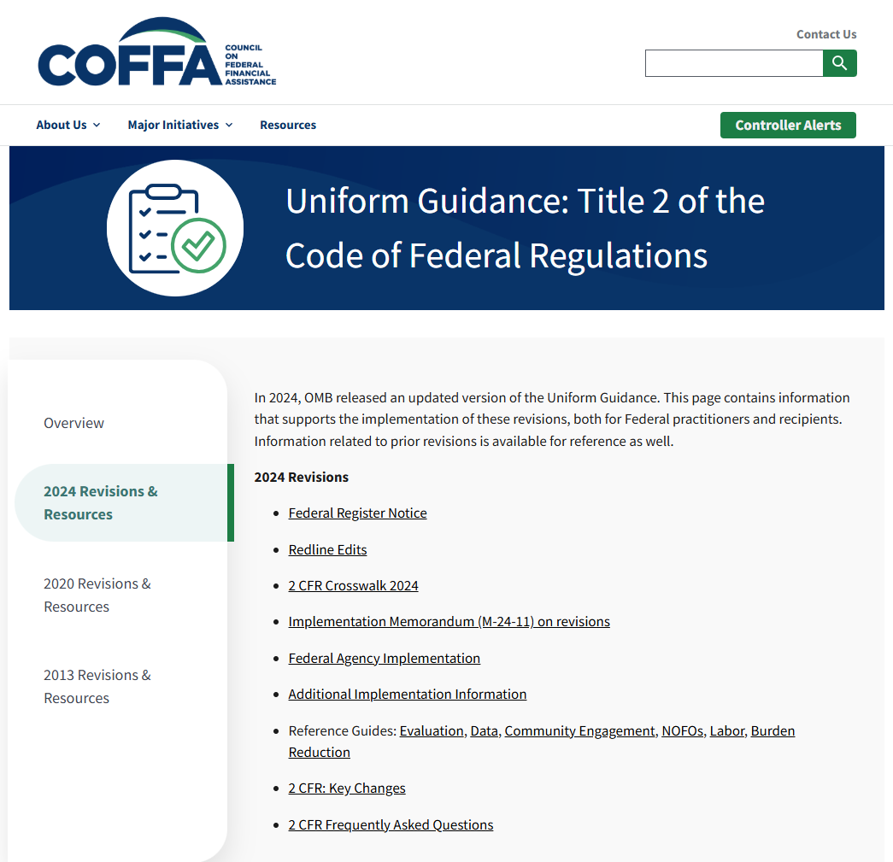
Stayed Tuned and Identify Resources
Council on Federal Financial Assistance
Government Audit Quality Center

Slide 19
Changes to Uniform Guidance
Acronyms and Definitions
Post Federal Award Requirements
Pre-Federal Award Requirements / Contents of Federal Awards
Notes:
As you might imagine, the changes made to the Uniform Guidance were extensive. For purposes of our discussion today, we’ll focus on the changes that are most relevant to the work you all do in procurement. These changes fall into three main categories: acronyms and definitions; pre-federal award requirements and contents of federal awards; and post federal award requirements.

Slide 20
Changes to Uniform Guidance: Effective Date
Effective Date | Election to Apply Early
October 1, 2024 | Federal agencies may elect to apply the final guidance to Federal awards issued prior to October 1, 2024, but they are not required to do so.
Notes:
Before we get into the changes, let’s quickly go over when they become effective. The effective date for the final guidance is October 1, 2024. Federal agencies may elect to apply the final guidance to Federal awards issued prior to that date, but they are not required to do so.

Slide 21
Acronyms and Definitions
Notes:
With that, let’s get started. First up, changes to the Acronyms and Definitions section of the Uniform Guidance. Here, we’ll focus on changes made to the use of the term “non-Federal entity.”

Slide 22
Changes to Uniform Guidance: Acronyms and Definitions
Non-Federal Entity
Recipient / Subrecipient
Notes:
In short, the revisions generally take out the term "non-Federal entity" and replace it with “recipient, “subrecipient,” or both.
In guidance put out by the OMB, the drafters explained that this change in terminology is not meant to change the scope or applicability of the guidance. Rather, it was made simply to put the regulations in “plain language” that is more easily understood, with the hope of ensuring more equitable access to Federal funding opportunities.
They explained that they found the term “non-Federal entity” made it challenging for readers to quickly understand which entity was being addressed.
So now, the revised version says whoever is meant to be referenced - “recipient and subrecipient,” or just “recipient,” etc. – basically, “say what you mean.”

Slide 23
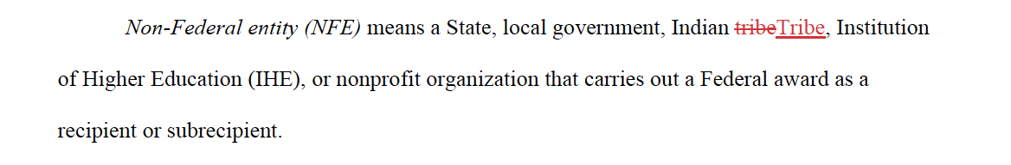
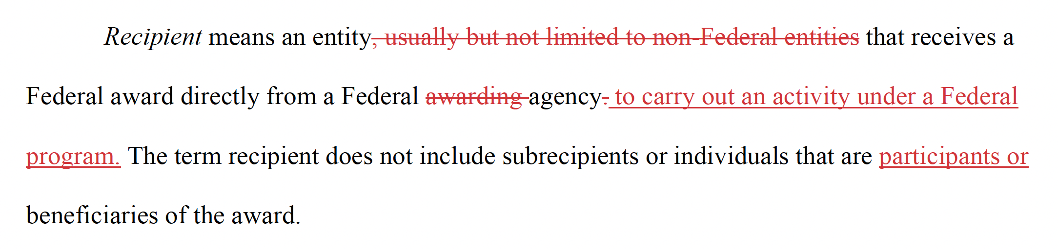
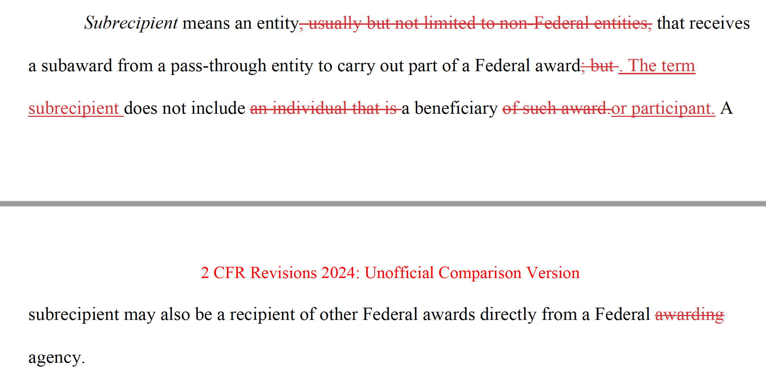
Acronyms and Definitions
Non-Federal entity
Recipient
Subrecipient
Notes:
The CFR continues to include a definition of the term ”non-Federal entity” with basically no changes, except to capitalize the word “Tribe.”
But as you’ll see, the regulations generally make the swap to the phrase “recipient or subrecipient” where the term “non-Federal entity” was previously used.
And as you can see, the definitions of recipient and subrecipient also mostly stayed the same, with the phrase “usually but not limited to non-Federal entities” deleted, since the terms are now used in most places where NFEs were previously referenced.

Slide 24
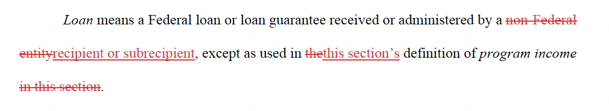
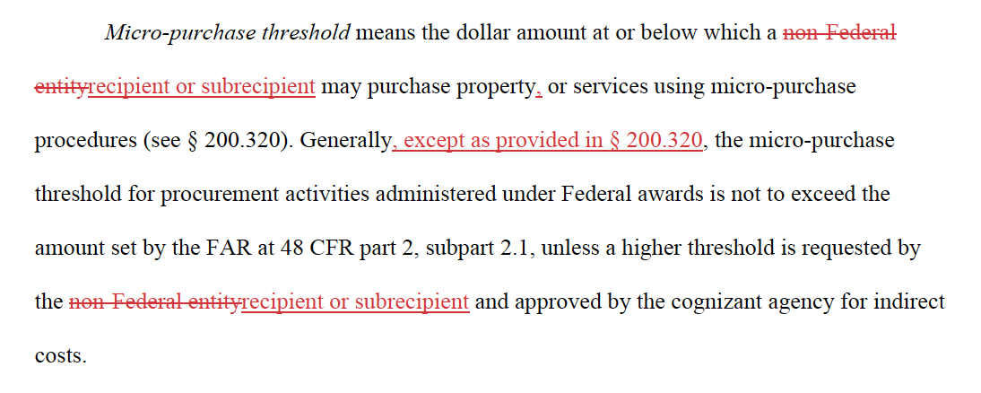
Notes:
Let’s look at a couple of examples of where these terms have been swapped. First, you can see here, in the revised definition of “loan,” the change from the term “non-Federal entity” to “recipient or subrecipient.”

Slide 25
Pre-Federal Award Requirements and Contents of Federal Awards
Notes:
And with that, we’ll move on to our second category of changes: Pre-Federal Award Requirements and Contents of Federal Awards.
In this section, we’ll go over a few revisions that will require you to make changes to federal certifications your district is likely already using, and one change that requires the addition of a new federal certification.

Slide 26


2 CFR § 200.215: Never Contract with the Enemy
Notes:
First up, let’s talk about the revisions made to the provision regarding “never contract with the enemy.”

Slide 27
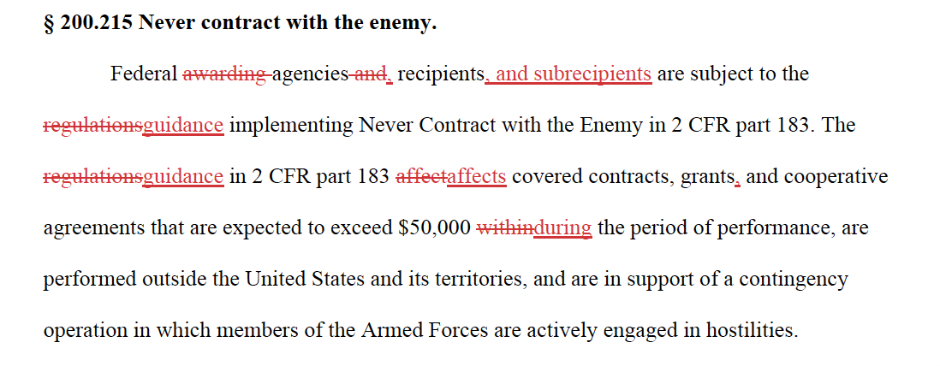
2 CFR § 200.215: Never contract with the enemy
Notes:
As you can see, there were several changes made to the regulation. The changes we're most interested in, for purposes of revising our federal certifications, are the addition of “and subrecipients” and the swap from “within” to “during” the period of performance.
The OMB’s guidance notes that the changes here are mostly to improve plain language and to explicitly state that this section applies to subrecipients, as well as recipients.
You’ll want to make corresponding changes in your “never contract with the enemy” certification.

Slide 28



2 CFR § 200.216: Prohibition on certain telecommunications and video surveillance equipment or services
Notes:
Next, let’s take a look at the revisions to the required certification regarding telecommunications and video surveillance equipment.
Here, as you’ll see, the revisions again seem aimed at streamlining and simplifying the regulations, not changing the substance or scope of the requirements.

Slide 29
2 CFR § 200.216: Prohibition on certain telecommunications and video surveillance equipment or services
Recipients and subrecipients are prohibited from obligating or expending loan or grant funds to:
(1) Procure or obtain covered telecommunications equipment or services;
(2) Extend or renew a contract to procure or obtain covered telecommunications equipment or services; or
(3) Enter into a contract (or extend or renew a contract) to procure or obtain covered telecommunications equipment or services.
Section 889 of Public Law 115-232 defines “covered telecommunications equipment or services” (2 CFR 200.216 (b)(1)-(4) and (c) 2 CFR 200: Frequently Asked Questions
Notes:
(b) As described in section 889 of Public Law 115-232, “covered telecommunications equipment or services” means any of the following:
(1) Telecommunications equipment produced by Huawei Technologies Company or ZTE Corporation (or any subsidiary or affiliate of such entities);
(2) For the purpose of public safety, security of government facilities, physical security surveillance of critical infrastructure, and other national security purposes, video surveillance and telecommunications equipment produced by Hytera Communications Corporation, Hangzhou Hikvision Digital Technology Company, or Dahua Technology Company (or any subsidiary or affiliate of such entities);
(3) Telecommunications or video surveillance services provided by such entities or using such equipment;
(4) Telecommunications or video surveillance equipment or services produced or provided by an entity that the Secretary of Defense, in consultation with the Director of the National Intelligence or the Director of the Federal Bureau of Investigation, reasonably believes to be an entity owned or controlled by, or otherwise connected to, the government of a covered foreign country;
(c) For the purposes of this section, “covered telecommunications equipment or services” also include systems that use covered telecommunications equipment or services as a substantial or essential component of any system, or as critical technology as part of any system.
12. What are “covered telecommunications equipment or services”? Section 889 of the NDAA of 2019 defines “covered telecommunications equipment or services” to mean telecommunications and video surveillance equipment or services produced by Huawei Technologies Company, ZTE Corporation, Hytera Communications Corporation, Hangzhou Hikvision Digital Technology Company, or Dahua Technology Company (or any subsidiary or affiliate of such entities). “Covered telecommunications equipment or services” also includes telecommunications or video surveillance equipment or services provided by an entity that the Secretary of Defense, in consultation with the Director of the National Intelligence or the Director of the Federal Bureau of Investigation, reasonably believes to be an entity that is owned or controlled by the government of a covered foreign country. Additional entities identified as covered entities will be identified as described in the question below. 13. How do you know if an entity has been added to the list of covered entities? Entities added to this list will be incorporated into the excluded parties list in the SAM (SAM.gov). When a user conducts a search of the excluded parties list, a record will appear describing the nature of the exclusion for any entity identified as covered by this prohibition. 14. What is the covered foreign country? The People’s Republic of China. 15. Can this prohibition be waived for grants and loans? Unlike Federal procurement, the prohibition cannot be waived for Federal assistance such as grants and loans. 16. Is it mandatory to include a specific provision in Federal awards and notices of funding opportunity issued on or after August 13, 2020? The awarding Federal agency must take positive steps to ensure that recipients are aware of the requirements associated with this provision as of August 13, 2020. While referencing 2 CFR Part 200 may likely suffice, including a specific provision may be a best practice in order to ensure clarity, especially because this is a new requirement. 17. Does the Section 889 prohibition apply to existing Federal awards as of August 13, 2020? Yes. The section 889 prohibition on covered telecommunications and video surveillance services or equipment is effective on all expenditures charged to Federal awards as of August 13, 2020, including awards made before that date

Slide 30
Post Federal Award Requirements
Notes:
And with that, we’ll turn to our third and final category of Uniform Guidance changes, those changes affecting post federal award requirements. We have quite a few to cover in this section, so let’s jump right in.

Slide 31


2 CFR § 200.318(h): Fair Labor Standards Act
Notes:
First up, a change to 200.318(h), which defines “responsible contractors.” The new addition requires the consideration of employees’ classification under the Fair Labor Standards Act.

Slide 32
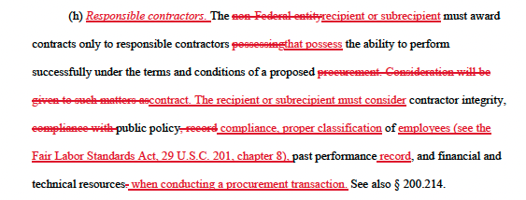
2 CFR § 200.318(h): Fair Labor Standards Act
Notes:
In the highlighted text here, you can see that revision, which adds a requirement that recipients or subrecipients consider the contractor’s proper classification of employees under the Fair Labor Standards Act.

Slide 33

2 CFR § 200.319: Geographic preferences
=
%
Notes:
Second, in section 200.319, titled ”Competition,” the new revisions have deleted the prior ban on using geographical preferences in evaluating bids or proposals.

Slide 34
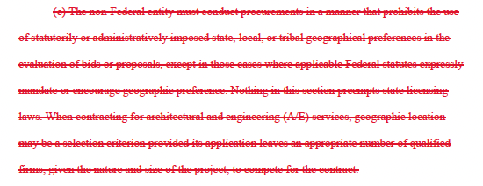
2 CFR § 200.319: Geographic preferences
Notes:
So, with the ban removed, geographic preferences may now be used, and you can now delete from your vendor documents any references to prohibitions on geographic preferences, if you have any.
However, before we move on, there is an important caveat that I want to add:

Slide 35
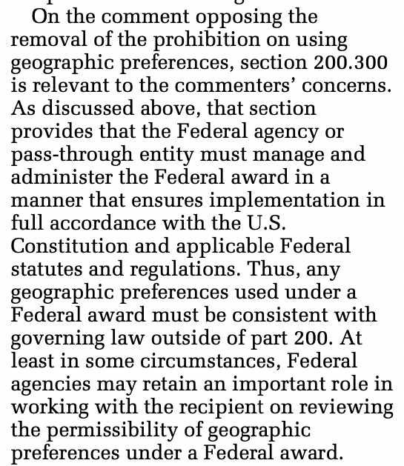
2 CFR § 200.319: Geographic preferences
Notes:
And it comes from the OMB’s guidance on this revision.
The OMB points out that the federal agency must ensure implementation in full accordance with the US Constitution and applicable federal statutes and regulations.
So, geographic preferences aren't banned anymore, but any that are used must still be consistent with all governing law.
The guidance also notes that federal agencies may have a role in working with recipients to review whether certain geographic preferences are permissible.

Slide 36
Capital Asset Threshold 2 CFR 200.313
Capital asset recognition threshold has increased from $5,000 to $10,000.
Make sure to properly budget for capital assets in the application and record them properly in the general ledger.
Equipment with FMV less than $10K → no further action;
FMV greater than $10,000 → must give Federal its proportionate share; $1,000 may be retained for administrative costs if asset is sold
Equipment retention – terms and conditions or PTE or federal agency may permit recipient/subrecipient to retain asset w/ no further obligation
Notes:
During the time that equipment is used on the project or program for which it was acquired, the recipient or subrecipient must also make the equipment available for use on other programs or projects supported by the Federal Government, provided that such use will not interfere with the purpose for which it was originally acquired. First preference for other use of the equipment must be given to other programs or projects supported by the Federal agency that financed the equipment. Second preference must be given to programs or projects under Federal awards from other Federal agencies. Use for non-federally-funded projects is also permissible, provided such use will not interfere with the purpose for which it was originally acquired. The recipient or subrecipient should consider charging user fees as appropriate.
Title to supplies acquired under the Federal award will vest upon acquisition in the recipient or subrecipient. When there is a residual inventory of unused supplies exceeding $10,000 in aggregate value at the end of the period of performance, and the supplies are not needed for any other Federal award, the recipient or subrecipient may retain or sell the unused supplies. Unused supplies means supplies that are in new condition, not having been used or opened before. The aggregate value of unused supplies consists of all supply types, not just like-item supplies. The Federal agency or pass-through entity is entitled to compensation in an amount calculated by multiplying the percentage of the Federal agency's or pass-through entity's contribution towards the cost of the original purchase(s) by the current market value or proceeds from the sale. If the supplies are sold, the Federal agency or pass-through entity may permit the recipient or subrecipient to retain, from the Federal share, $1,000 of the proceed.
200.313(f) added (f) - Equipment retention. When included in the terms and conditions of the Federal award, the Federal agency may permit the recipient to retain equipment, or authorize a pass-through entity to permit the subrecipient to retain equipment, with no further obligation to the Federal Government unless prohibited by Federal statute or regulation.

Slide 37
Supplies 2 CFR 200.314
Unused supplies at the end of the grant exceeding $10,000 – may be retained or sold. HOWEVER, federal government is due its fair share
Clarified that the requirements for unused supplies apply to the aggregate value of all supply types, and not just like-item supplies. Included a definition of “unused supplies."
Unused → new condition & unused
Increased threshold from $5,000 to $10,000
Notes:
During the time that equipment is used on the project or program for which it was acquired, the recipient or subrecipient must also make the equipment available for use on other programs or projects supported by the Federal Government, provided that such use will not interfere with the purpose for which it was originally acquired. First preference for other use of the equipment must be given to other programs or projects supported by the Federal agency that financed the equipment. Second preference must be given to programs or projects under Federal awards from other Federal agencies. Use for non-federally-funded projects is also permissible, provided such use will not interfere with the purpose for which it was originally acquired. The recipient or subrecipient should consider charging user fees as appropriate.
Title to supplies acquired under the Federal award will vest upon acquisition in the recipient or subrecipient. When there is a residual inventory of unused supplies exceeding $10,000 in aggregate value at the end of the period of performance, and the supplies are not needed for any other Federal award, the recipient or subrecipient may retain or sell the unused supplies. Unused supplies means supplies that are in new condition, not having been used or opened before. The aggregate value of unused supplies consists of all supply types, not just like-item supplies. The Federal agency or pass-through entity is entitled to compensation in an amount calculated by multiplying the percentage of the Federal agency's or pass-through entity's contribution towards the cost of the original purchase(s) by the current market value or proceeds from the sale. If the supplies are sold, the Federal agency or pass-through entity may permit the recipient or subrecipient to retain, from the Federal share, $1,000 of the proceed.
200.313(f) added (f) - Equipment retention. When included in the terms and conditions of the Federal award, the Federal agency may permit the recipient to retain equipment, or authorize a pass-through entity to permit the subrecipient to retain equipment, with no further obligation to the Federal Government unless prohibited by Federal statute or regulation.

Slide 38

Procurement 2 CFR 200.320
Informal Procurement Methods for Small Purchases
  Micro-purchases $10,000 and up to $49,999
  Small purchases have become “simplified acquisitions”
    Not to be confused with the Simplified Acquisition Threshold of $250,000
Notes:
So to summarize, this chart shows the structure of how the terms are now used. Informal procurement methods for “small purchases” now include (1) micro-purchases and (2) “simplified acquisitions” (which were formerly known as small purchases).

Slide 39
Word of Caution on Procurement
Vet all cooperatives and ensure they complied with Uniform Guidance
  Appendix II required provisions (i.e., certifications)
  Suspension and debarment
  Independent Cost/price analysis
    Purchasing entity should perform its own independent estimate and price analysis if spending $250,000 or more
  Any contract utilizing unit pricing or time and materials pricing must state a “not-to-exceed” amount.
Notes:
So to summarize, this chart shows the structure of how the terms are now used. Informal procurement methods for “small purchases” now include (1) micro-purchases and (2) “simplified acquisitions” (which were formerly known as small purchases).

Slide 40
Other Changes
2 CFR 200.321 Veteran-owned Businesses
2 CFR 200.323 Products and Services that can be Reused, Refurbished, or Recycled.
2 CFR 200.324 Contract Cost and price
2 CFR 200.337 Access to records
Notes:
200.321 The list of business types already included small businesses, minority businesses, women’s business enterprises, and labor surplus area firms. As I mentioned, the new addition is the inclusion of veteran-owned businesses here, and you’ll want to make the corresponding addition to your district’s certification on this topic.
What’s new here is the addition of a sub-part (b) requiring that recipients and subrecipients purchase, acquire, or use products and services that can be reused, refurbished, or recycled; contain recycled content, are biobased, or are energy and water efficient; and are sustainable.
The revised regulation also notes that this may include the purchase of compostable items and others that reduce the use of single-use plastic products.
As we’ve discussed with some of the other revisions, you’ll want to add this new language to your existing certification on 200.323.
Contract/Price This revision makes the notable deletion of the prior sub-paragraph requiring profit to be negotiated as a separate element of the price.
As you may recall, this requirement previously applied when there was no price competition and in all cases where cost analysis was performed. A fair and reasonable profit was previously determined based on a consideration of the complexity of the work, the contractor’s risk and investment, the amount of subcontracting, the quality of the past performance, and industry profit rates in the area for similar work. All of that has been deleted now.
The OMB’s guidance doesn’t give a rationale for why this sub-section was deleted. But it does note that even though this practice is no longer required, recipients are not prohibited from taking such action if deemed necessary in instances where there is no price competition. So, in other words, you can if necessary, but you don’t have to.
These revisions broaden the right of access to records in a few different ways.
First, you’ll notice the change from the phrase “documents, papers, or other records” to just “records,” which doesn’t specify or suggest any particular format.
Second, the purposes for which records may be accessed now include the execution of site visits, and importantly, for “any other official use.” So, whereas there used to be a circumscribed list of purposes for access, now there are two examples and a catchall of “any other official use.”
Finally, the access to personnel for interview and discussion can be related to documents, or, the new addition “the federal award in general.”
You’ll want to make the corresponding changes to your vendor certification regarding access to their records.

Slide 41
Indirect Cost Rate Changes & Calculation Risks
Previous Rate: 10% of Modified Total Direct Costs (MTDC).
Updated Rate: Increased to 15% of MTDC.
Applicability: This new rate is available to all non-federal entities that do not have a negotiated indirect cost rate agreement (NICRA). Entities can elect to use the 15% rate for any award executed on or after October 1, 2024.
MTDC – Remove all distorting items including capital outlay, bad debt, debt service and subawards over $50,000
Notes:
📌 1. De Minimis Indirect Cost Rate Increase
Previous Rate: 10% of Modified Total Direct Costs (MTDC).
Updated Rate: Increased to 15% of MTDC.
Applicability: This new rate is available to all non-federal entities that do not have a negotiated indirect cost rate agreement (NICRA). Entities can elect to use the 15% rate for any award executed on or after October 1, 2024.
Implementation Note: The increased rate applies to new awards or when the current approved or provisional negotiated indirect cost rate expires.
---
📌 2. Subaward Threshold for Indirect Cost Recovery
Previous Threshold: Indirect costs could be applied to the first $25,000 of each subaward.
Updated Threshold: Raised to $50,000 per subaward.
Implementation Note: This change applies to new awards issued on or after October 1, 2024. For institutions with existing NICRAs, the updated threshold becomes effective when their current rate agreement is renegotiated to reflect this change.
---
✅ Action Items for CFOs and Procurement Officers
Policy Updates: Revise internal policies to reflect the increased de minimis rate and subaward threshold.
Staff Training: Ensure that relevant personnel are informed about these changes and understand their implications.
Budgeting: Adjust budgeting practices to account for the higher indirect cost recovery and subaward thresholds.
NICRA Consideration: For entities with existing NICRAs, plan for renegotiation to incorporate the updated subaward threshold.

Slide 42
Indirect Cost Rate Changes & Calculation Risks
Subaward Threshold for Indirect Cost Recovery
Previous Threshold: Indirect costs could be applied to the first $25,000 of each subaward.
Updated Threshold: Raised to $50,000 per subaward.
Implementation Note: This change applies to new awards issued on or after October 1, 2024. For institutions with existing NICRAs, the updated threshold becomes effective when their current rate agreement is renegotiated to reflect this change.
Notes:
---
✅ Action Items for CFOs and Procurement Officers
Policy Updates: Revise internal policies to reflect the increased de minimis rate and subaward threshold.
Staff Training: Ensure that relevant personnel are informed about these changes and understand their implications.
Budgeting: Adjust budgeting practices to account for the higher indirect cost recovery and subaward thresholds.
NICRA Consideration: For entities with existing NICRAs, plan for renegotiation to incorporate the updated subaward threshold.

Slide 43
Single Audit
2 CFR 200.501 Audit Requirements
  Scheduled of Expenditures of Federal Awards equal or exceed $1,000,000 will be subject to a Single Audit
  Will be applicable for audit periods beginning after October 1, 2024 (fiscal years ending September 30, 2025 and later)
  Type A threshold will start at $1,000,000 (previously $750,000)
  Type B threshold: will start at $250,000 (previously $187,500)

Slide 44
Recommendations
Policy Updates: Revise internal procurement policies to align with new thresholds and methods.
Training: Educate staff on updated conflict of interest rules and domestic preference requirements. Review grant agreements and look for effective dates or automatic applicability clauses.
Monitoring: Enhance subrecipient monitoring procedures to comply with clarified responsibilities.
Audit Preparedness: Review Single Audit processes in light of potential submission extensions.

Slide 45
GASB No. 102 Certain Risk Disclosures
Provide users of government financial statements with essential information about risks related to a government’s vulnerabilities due to certain concentrations or constraints.
Concentration - lack of diversity related to an aspect of a significant inflow of resources.
Constraint - limitation imposed on a government by an external party or by formal action of the government’s highest level of decision-making authority. Concentrations and constraints may limit a government’s ability to acquire resources or control spending.

Slide 46
GASB No. 102 Certain Risk Disclosures
Assess whether a concentration OR constraint makes the primary government reporting unit or other reporting units report a liability for revenue debt vulnerable to the risk of a substantial impact
Has the event or events related to the concentration or constraint occurred, have begun to occur, or are more likely than not to begin to occur within 12 months of the date the financial statements are issued.
If statement applies, the disclosure must discuss the actions taken by the government prior to the issuance of the financial statements to mitigate the risk.
Notes:
Near-term: Within 12 months of the date of the financial statements.
Severe impact: A significant negative effect that is more than temporary.
Disclosures are required only when:
1. The condition exists at the financial statement date,
2. It makes the government vulnerable to a near-term severe impact, and
3. The impact is at least reasonably possible.

Slide 47
GASB No. 102 Certain Risk Disclosures
Concentration in Revenue Source
Constraint by Grant Restrictions
Legal or Regulatory Constraint
Notes:
🧾 Examples of Disclosures
🟦 Example 1: Concentration in Revenue Source
A city relies on a single major employer (e.g., a tech plant) for 45% of its property tax revenue. The plant is closing in the next year.
Disclosure Might Say:
> “The City is economically dependent on XYZ Corp., which accounts for 45% of the City’s property tax revenue. XYZ Corp. has announced it will cease operations by March 2025, which could severely impact general fund revenues. The City is evaluating cost-reduction measures and exploring diversification of its tax base.”
---
🟦 Example 2: Constraint by Grant Restrictions
A school district receives 60% of its funding from a federal grant requiring strict use for only STEM education. New federal regulations propose cutting this program next fiscal year.
Disclosure Might Say:
> “The District’s STEM program is primarily funded by the Federal Innovative Learning Grant, which comprises 60% of instructional revenues. Proposed federal budget cuts for FY 2026 may eliminate this grant. The District is developing alternative funding plans and reviewing program scaling options.”
---
🟦 Example 3: Legal or Regulatory Constraint
A government is subject to a state law capping property tax increases, and inflation is rapidly outpacing allowed growth.
Disclosure Might Say:
> “State statute limits property tax increases to 2% annually. With inflation at 5.8% and population growth at 3%, this constraint could result in underfunding of essential services. The government is lobbying for relief legislation and considering service prioritization measures.”

Slide 48

Questions?

