Slide 1

James Kinnick, P.E. - Executive Director
Notes:
Lighter Background Blue snagged off the letterhead for new hires ☺.

Slide 2
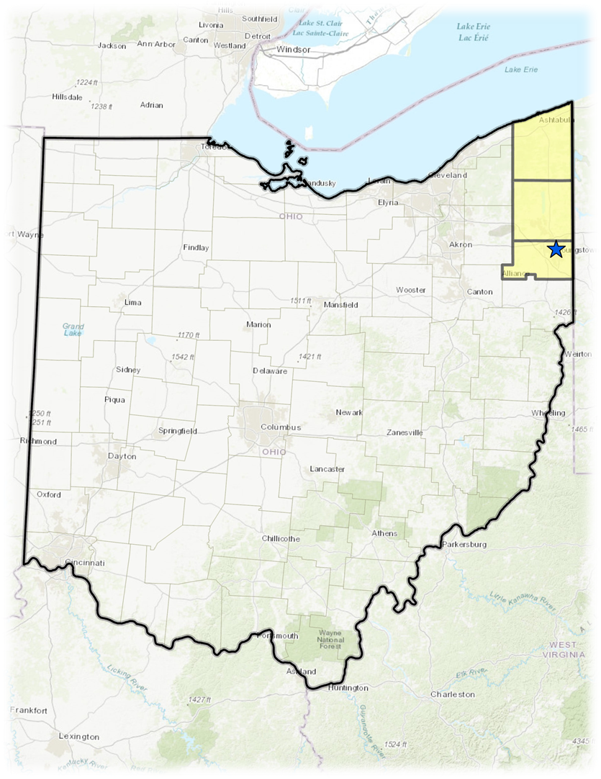
About Eastgate
Three Counties: 550,000 people
Council of Governments
Metropolitan Planning Organization
Committees
  General Policy Board (GPB)
  Finance Executive Committee (FEC)
  Technical Advisory Committee (TAC)
  Citizens Advisory Board (CAB)
OHIO
Notes:
Lighter Background Blue snagged off the letterhead for new hires ☺.

Slide 3


Economic Transformation
50 Years Ago
2nd Largest Steel Producer in the Country
City of Youngstown Population 160,000
Current 59,000
Today
Ultium Battery Plant
Foxconn
Kimberly Clark Manufacturing Facility
Ohio’s 1st Innovation Hub for Aerospace and Defense
Notes:
Lighter Background Blue snagged off the letterhead for new hires ☺.

Slide 4
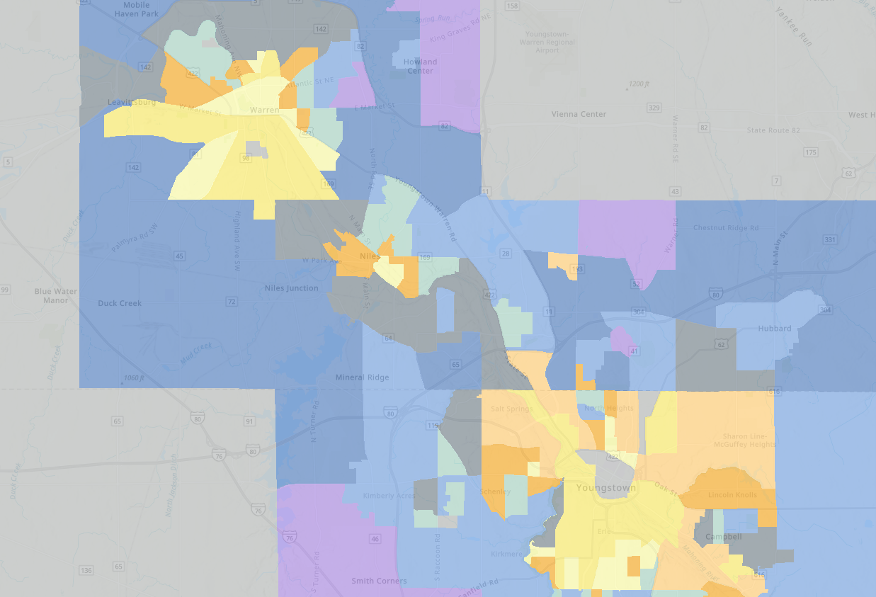
The “NEED” to Grow
10,000 workers
5,000 houses by 2030
Housing Assessment and Strategy
Notes:
Lighter Background Blue snagged off the letterhead for new hires ☺.

Slide 5
Strategy and Partners
Mahoning Valley Housing Strategy
Protect & Enhance Existing Housing
Housing Council
Steering Committee
Coordinated Zoning
& Permitting
Emerging
Developer Training
Proactively Assemble Land
Support Existing
Residents & Protect Vulnerable Populations
Notes:
Lighter Background Blue snagged off the letterhead for new hires ☺.

Slide 6
Questions?
James Kinnick, P.E. - Executive Director
Website: Eastgatecog.org
Email: Jkinnick@eastgatecog.org
Notes:
Lighter Background Blue snagged off the letterhead for new hires ☺.

