Slide 1

June 2025
Understanding Impact: An Investigation of the U.S. Economic Development Administration
This Photo by Unknown Author is licensed under CC BY-SA

Slide 2
Urban’s Research on EDA
Research Brief: EDA Programs and Project Types
Research Brief: History and Programmatic Overview of EDA
Research Brief: The Location of EDA Grants
Website: EDA at Work
Feature: Revitalizing a Tribal Economy through Cultural Connection
Research Brief: EDA’s role in Disaster Recovery and Resilience
Research Brief: Local Impacts of EDA Construction Investments
Research Report: EDA Revolving Loan Fund Program
Research Brief: Impact of EDA Projects on Private Investment

Slide 3
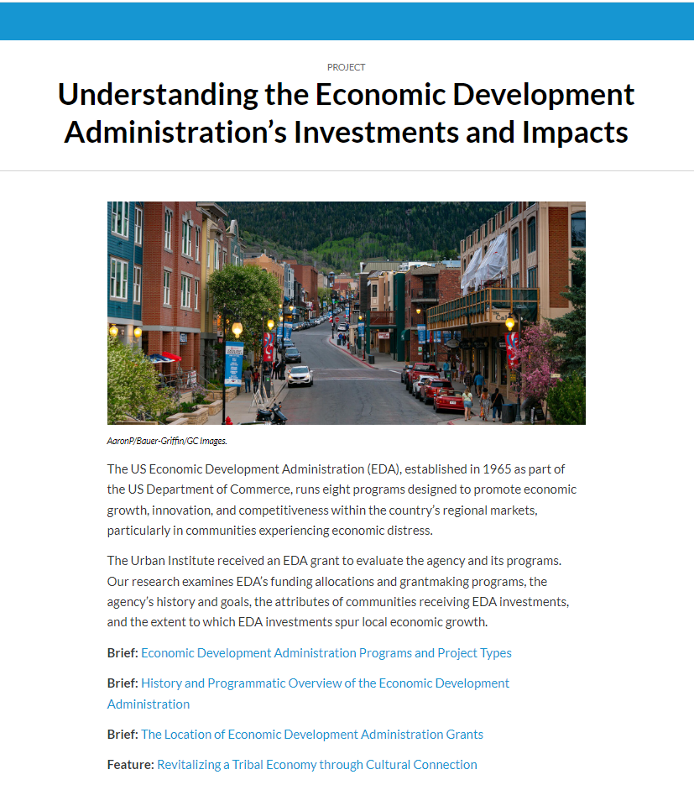
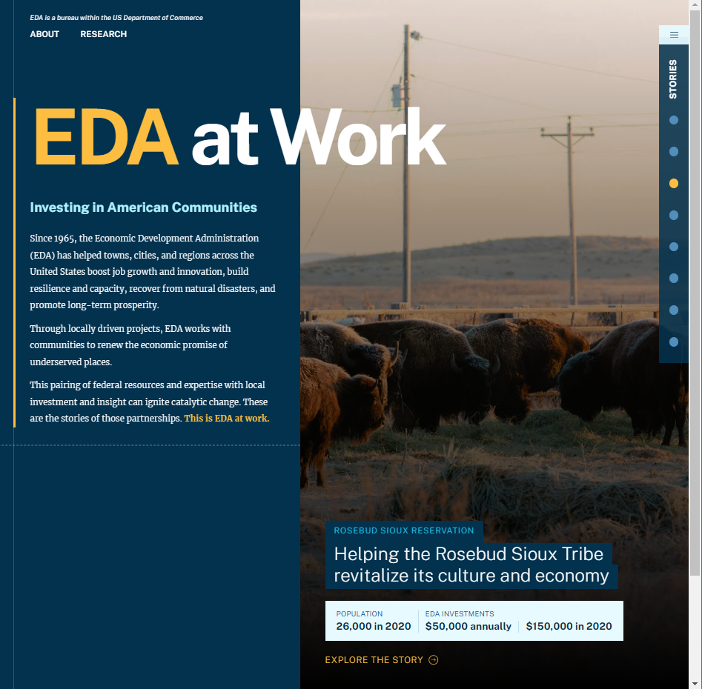
https://www.urban.org/eda
https://www.eda.gov/eda-at-work/home.html
Notes:
Published work can be found on our project page at urban.org and everything is linked at the EDA at work microsite at eda.gov.

Slide 4
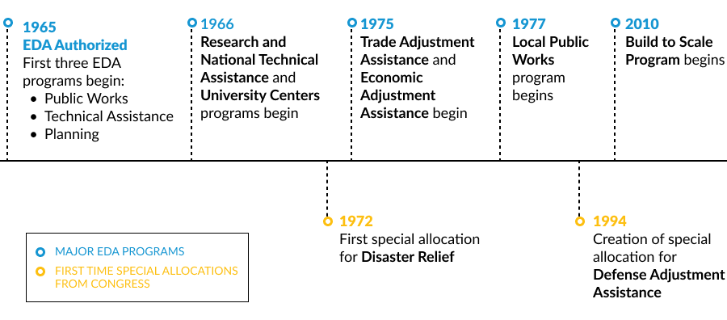
Notes:
EDA’s programs grew in response to regional economic development needs. When the agency launched in 1965, it had three major programs: Public Works, Planning, and Local Technical Assistance. The Research and National Technical Assistance program and University Centers program followed shortly after, in 1966. By the 1970s, structural changes to the economy led EDA to establish two new programs, Trade Adjustment Assistance for Firms and Economic Adjustment Assistance (EAA), that aimed to address the long-term consequences of deindustrialization and the immediate challenges of firm closures in communities. The Local Public Works program emerged in the late 1970s as a one-year initiative to address the lingering issues of unemployment after the 1973 to 1975 recession. Finally, Build to Scale, formerly Regional Innovation Strategies, is the newest EDA program, developed in 2010 to support economic development focused on innovation and entrepreneurship. Among these, the eight major programs (excluding Local Public Works) continue to evolve to meet the changing needs of communities and regional economies. In this our history brief, we discuss the programs and their evolutions in detail.

Slide 5
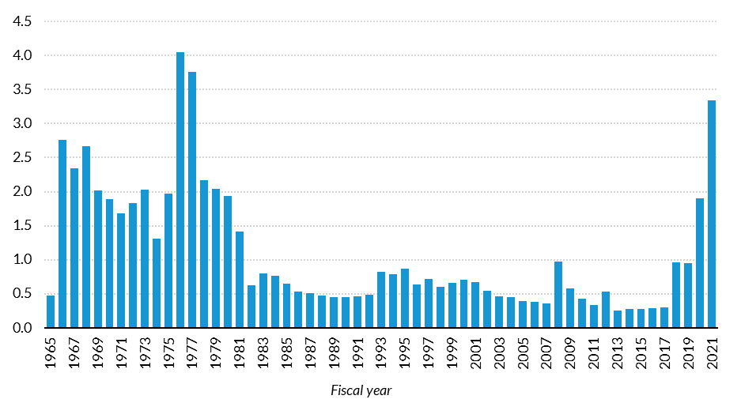
Federal Appropriations to EDA, 1965–2021
Billions of inflation adjusted 2021 dollars
Notes:
Congress did not reauthorize EDA from 1982 to 1998; instead, the agency was funded by annual appropriations. As one former staff member summarized,
“For 16 of EDA’s first 33 years, the agency survived by appropriations since we were not authorized. Many years, the president’s budget had EDA zeroed out. Amazingly, EDA not only survived, but as evaluations showed, we performed well…Congress was very strong to fund us through appropriations because the results in their districts were always very effective.”
In 1998, after a long period of diminishing funding and limited authority, EDA was reauthorized and received renewed support from both Congress and the executive branch of the federal government. However, EDA was last authorized in 2004, and its authorization expired in 2008.
Since 2008, funding has spiked when Congress has added disaster recovery funding and more recently with CARES and ARPA. (more on disaster later)

Slide 6
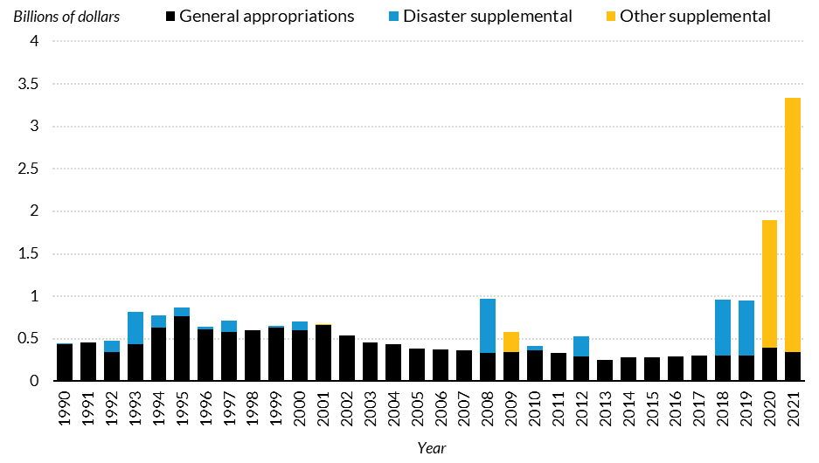
Federal Appropriations to EDA, by Type, 1990–2021
Billions of Inflation Adjusted 2021 Dollars
Notes:
A large portion of the funding to support EDA’s disaster recovery and resilience work is authorized through supplemental appropriations, which have grown over time and have been increasingly used by Congress to fund recovery efforts for federally declared events (Lake and Leichenko 2004). Figure 1 displays EDA appropriations between 1990 and 2021. During this 32-year period, there have been 16 supplemental appropriations for disaster recovery and resilience accounting for 15 percent of all EDA funding during that time. Supplemental funding for economic crises during the Great Recession and the COVID-19 pandemic accounts for an additional 22 percent of EDA’s funding over the 32-year period but 42 percent of the agency’s funding from 2008 to 2021.

Slide 7
EDA Programs
Economic Adjustment Assistance
Public Works
Planning
Local Technical Assistance
University Centers
Build to Scale
Research and National Technical Assistance
Trade Adjustment Assistance for Firms
Notes:
EDA administers programs in eight areas.
Economic Adjustment Assistance helps state and local interests design and implement strategies to adjust or bring about changes to an economy. The program focuses on areas that have experienced or are under threat of serious structural damage to the underlying economic base. As part of Economic Adjustment Assistance (EAA), EDA administers its Revolving Loan Fund Program, which supplies small businesses and entrepreneurs with the capital needed to start or expand their businesses. EAA also provides strategy grants to support the development, updating, or refinement of a Comprehensive Economic Development Strategy (CEDS) and implementation grants to help execute activities identified in a CEDS. Implementation grants could include infrastructure improvements, such as site acquisition, site preparation, construction, rehabilitation, and facility equipment. For example, in 2017, EAA provided funding to support the establishment of the Advanced Manufacturing Performance Center at the State University of New York Polytechnic Institute’s Albany and Utica campuses.
Public Works helps distressed communities revitalize, expand, and upgrade their physical infrastructure to attract new industry, encourage business expansion, diversify local economies, and generate or retain long-term, private sector jobs and investment. Public Works program investments include infrastructure development such as fiber-optic cable for businesses and industrial parks, water and sewer systems improvements, business incubator facilities, port and harbor facility expansions, and brownfields redevelopment. For example, in 2018, a Public Works grant provided funding to a telephone cooperative in Eureka, Montana, to install fiber-optic cable to provide high-speed internet services to businesses in the region.
Planning supports local organizations (Economic Development Districts, Indian Tribes, and other eligible areas) with short- and long-term planning efforts. The CEDS Content Guidelines provide suggestions, tools, and resources for developing a CEDS. For example, the New Hampshire Department of Business and Economic Affairs received a planning grant in 2018 to create a statewide economic development strategic plan informed by industry cluster analysis, economic and workforce development structures, foreign direct investment opportunities, economic resiliency, communications strategies, and public input.
Build to Scale, previously named Regional Innovation Strategies, is a program that supports innovation and entrepreneurship capacity-building activities by creating and expanding cluster-focused proof-of-concept and commercialization programs and early-stage seed capital funds. Build to Scale oversees three competitive grant programs: the Venture Challenge (formerly i6 Challenge), the Capital Challenge (formerly Seed Fund Support Grants), and the Industry Challenge. The Venture Challenge provides competitive grants to intermediary organizations, such as accelerators, universities, and nonprofits, that support the development of new business ventures. The Capital Challenge focuses on entities like angel networks or investor training programs in communities with limited access to risk capital. The Industry Challenge is a pilot partnership between the EDA and Department of Energy to support entrepreneurship and accelerate company growth within a particular part of the energy economy.
Trade Adjustment Assistance for Firms (TAAF) is a national network of 11 centers that help strengthen the competitiveness of US companies which lost domestic sales and employment because of an increase in imports of similar goods and services. Through TAAF, eligible firms can receive direct technical assistance to create and implement targeted business recovery plans.
University Centers are a partnership between the federal government and academia that makes the resources of universities available to the economic development community. University Centers devote the majority of their funding to responding to technical assistance requests from local governments and private-sector businesses in the economically distressed parts of their EDA-designated service regions. For example, an EDA grant supported a University Center in Indiana where two universities worked to create a tool for researchers to document local poverty levels for use with new initiatives such as Opportunity Zones.
Local Technical Assistance helps fill the knowledge and information gaps that may prevent leaders in the public and nonprofit sectors in distressed areas from making optimal decisions on local economic development issues. This could include feasibility studies to determine whether a region’s market will support, for example, a high-technology business incubator.
Research and National Technical Assistance (RNTA) supports research and evaluation projects and technical assistance projects with a national scope. Many research projects focus on identifying best practices in economic development or providing data and tools to support economic development goals. National Technical Assistance projects support specific groups or stakeholders or focus on a nationwide set of issues. For example, RNTA provided grant support so the Indiana Business Research Center could develop many of the tools on StatsAmerica.org. EDA funds were used to develop the research behind the tools and support the maintenance and public availability of this source of information for economic development stakeholders across the nation.
For our analysis, we combined two program areas—University Centers and Local Technical Assistance—into a program we call Technical Assistance.
In addition to EDA’s grant programs, Economic Development Integration is an effort whereby the Office of Management and Budget designated EDA to lead the federal government’s efforts to maximize the integration of economic development resources from all sources—including federal, state, local, and philanthropic—to achieve more effective and sustainable outcomes for communities across the US.

Slide 8
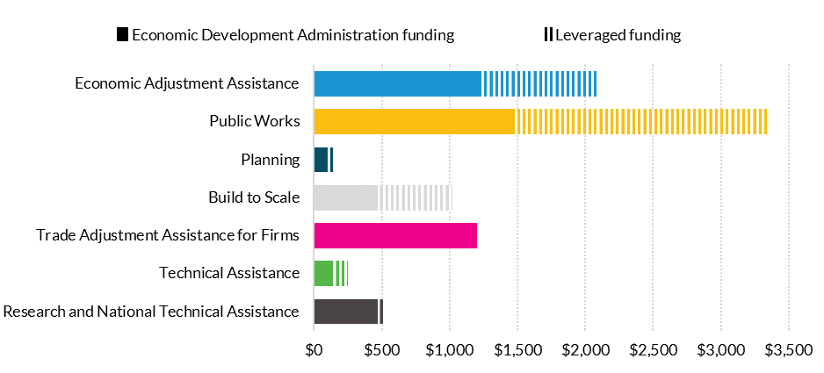
Average EDA grant and project size, by program, 2010-19
Thousands of 2019 dollars
Notes:
EDA grants cover a sizable portion of project costs, but the projects also regularly leverage local funds. (Many of EDA’s grant programs require a local match to access the agency’s funding.)
The Public Works and Economic Development Act of 1965 requires that the maximum EDA investment in a project cannot exceed 50 percent of the total project cost unless certain conditions are met. EDA can cover up to 80 percent of total project costs in more economically distressed regions. Regions eligible for an EDA investment of up to 80 percent include those with a 24-month unemployment rate that is at least 225 percent of the national average and those whose per capita income is no more than 50 percent of the national average F
From 2010 to 2019, EDA funds covered 53 percent of full project costs, but the share varied by program and project type. The average EDA project was $975,000 in size, including the local match, and received $517,000 in funding from the agency.
Looking by program, the largest projects between 2010 and 2019, on average, were in Public Works (figure 7). The average Public Works project cost $3.35 million to complete, with EDA providing 44 percent of the funding ($1.47 million). The rest ($1.88 million) came from local matches.
EAA projects were the next largest, averaging $2.10 million in total funding. The average EAA project received $1.22 million from EDA and $882,000 from local matches. EDA funds made up 58 percent of the total funding for EAA projects. TAAF grants were the next largest. The average grant to Trade Adjustment Assistance Centers was $1.20 million.
Unlike the majority of EDA programs, TAAF is governed by the Trade Act of 1974, which does not require a cost share for TAAF grantees.
Build to Scale is highly leveraged, with EDA funds representing 46 percent of total project financing. Build to Scale requires a 50 percent match from private firms and local governments, under the Stevenson-Wydler Technology Innovation Act of 1980.9 EDA’s average funding per project for this program was $467,000, the average match was $554,000, and the average total size was $1.02 million.
In contrast to Build to Scale, RNTA leverages relatively few local dollars, with 88 percent of funding coming from EDA. RNTA’s average total project size was $527,000, the average EDA grant was $467,000, and the average local match was $61,000.
Technical Assistance projects were the second-smallest among the seven EDA programs. On average, they received $249,000, with funding split evenly between EDA ($125,000) and local matches ($125,000). (These figures are for single grants, but technical assistance providers can receive successive grants to support their work.)
The program with the smallest projects, on average, was Planning. Its projects averaged $162,000 in total costs. The average EDA grant to these projects was $96,000. The average local match was $66,000. EDA contributed 59 percent of total costs for Planning projects.

Slide 9
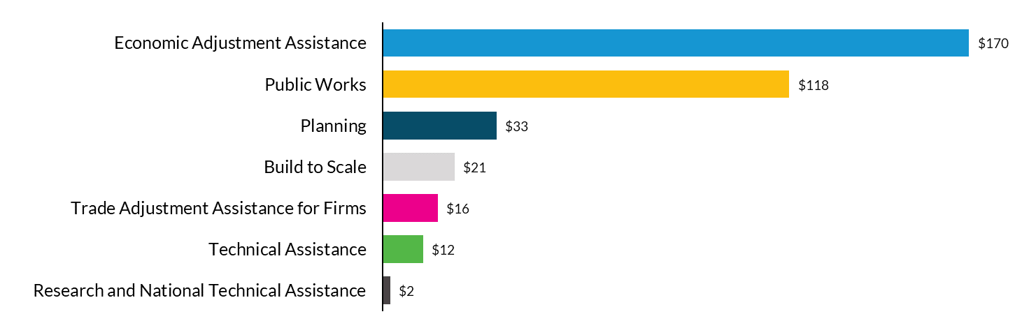
Most EDA Funding Flows Through the EAA and PW Programs
EDA funding awarded, annual average by program, 2010-19
Millions of 2019 dollars
Notes:
The EDA provided $3.6 billion in grants from 2010 to 2019, or an average of $361 million a year. More than three-quarters of EDA’s grant funds were distributed through two programs: EAA and Public Works. EAA alone represented nearly half of all EDA grant funding, averaging $170 million a year (figure 1). Public Works granted an average of $118 million a year. EAA and PW include construction projects. EAA includes the widest range of project types.
Planning was the next-most-used program, with $33 million in annual grants. It was followed by Build to Scale ($21 million annual average) and TAAF ($16 million). Another $12 million was devoted to Technical Assistance annually and $2 million to RNTA. (All dollar amounts in this brief are inflation-adjusted to 2019.)

Slide 10
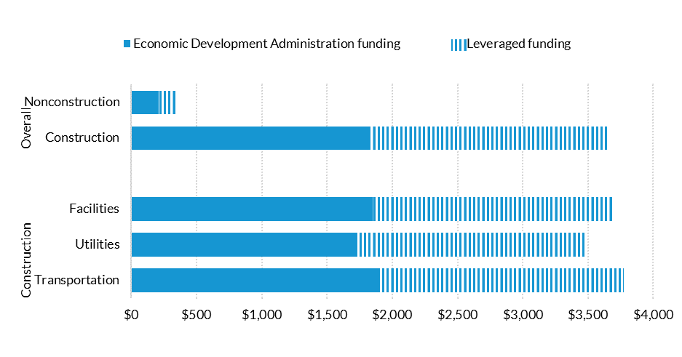
Average EDA project size, by project type, 2010-19
Thousands of 2019 dollars
Notes:
The differences in leverage amounts can largely be explained by the types of projects funded by the various EDA programs. Nonconstruction projects were smaller and leveraged fewer local dollars. The average nonconstruction project cost $344,000, and EDA grants covered 60 percent of the costs (figure 8). The typical EDA nonconstruction grant amount was $208,000, and the typical local leverage was $136,000. In contrast, the typical construction project cost $3.64 million, with 50 percent coverage from the EDA. Both the average EDA construction grant and the average local contribution were $1.82 million.

Slide 11
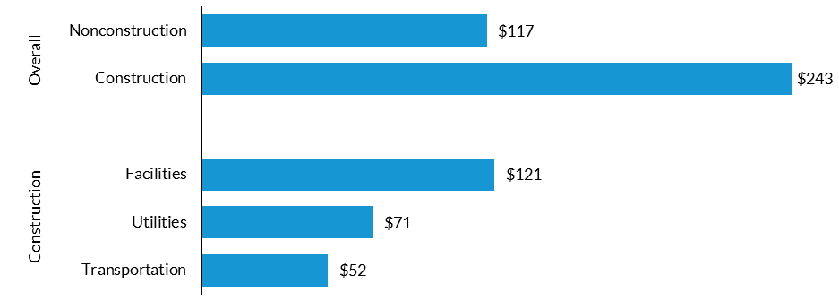
Construction Projects Get Majority of Funding
EDA funding, annual average by project type, 2010-19
Millions of 2019 dollars
Notes:
EDA projects are generally either construction projects, such as developing new utility lines in a county, or nonconstruction projects, such as providing funding to support a municipality’s disaster and resiliency planning efforts. Planning, Build to Scale, TAAF, Technical Assistance, and RNTA support nonconstruction projects, while Public Works supports construction projects. EAA is flexible, supporting both construction and nonconstruction projects.
In creating a typology of projects, we define construction projects as facilities, utilities, or transportation infrastructure. We establish these categories by building from EDA’s internal project classifications. In the small share of cases where project classifications were still in doubt, we used a combination of automated text analysis and individual sorting to determine what category to place grants in. In the most challenging cases, EDA staff assisted with individual sorting to ensure grants were correctly classified.
From 2010 to 2019, construction projects received roughly two-thirds of EDA’s funding, with the remainder going to nonconstruction projects. On average, construction projects received $243 million a year, and nonconstruction projects received $117 million a year (figure 5).
Within construction projects, facility projects received the highest level of funding—half of all construction funding and more than all nonconstruction funding. Facility projects received $121 million a year on average. Utility projects were roughly a third of EDA’s annual construction spending and almost a fifth of EDA’s overall spending; they received $71 million a year on average. Transportation projects received roughly $52 million on average each year.

Slide 12
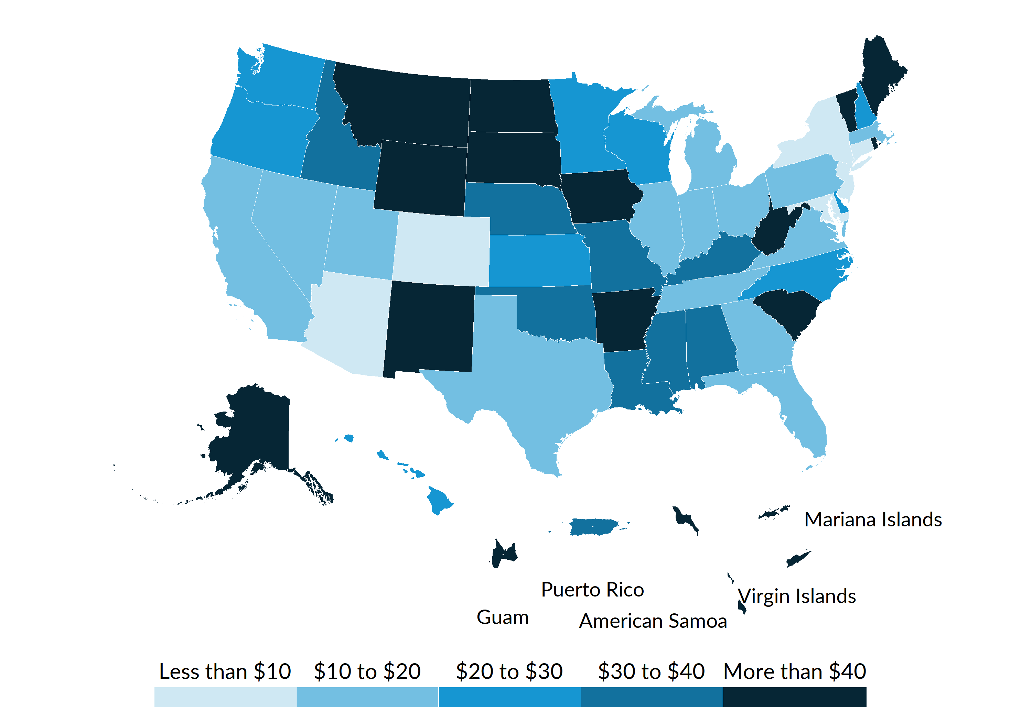
Where Is EDA Investing?
Total EDA project investment per capita, 2010-2021
Inflation adjusted
2021 dollars
Notes:
Relative to state population, EDA invested more in less populous states, such as Alaska, Maine, Iowa, Montana, South Dakota, West Virginia, and Wyoming, between 2010 and 2021 (figure 1). The US Virgin Islands and the Northern Mariana Islands territories also received considerable total project investment per capita. Differences between states can be significant; Alaska, for example, received $170 of total project investment per capita, while Maryland received $10 per capita. The number of grants per capita also differs across states: Montana received 30 grants per 100,000 people, while New Jersey received less than 1 grant per 100,000 people (table A.1).
EDA construction and nonconstruction investment are strongly aligned.

Slide 13
EDA’s Rural Focus
 | Grants | Total project investment (in millions)
Projects in OMB-defined MSAs | 5,196 (60%) | $6,864 (67%)
Projects outside OMB-defined MSAs | 3,413 (40%) | $3,418 (33%)
Construction projects in OMB-defined MSAs | 984 (56%) | $4,312 (63%)
Construction projects outside OMB-defined MSAs | 781 (44%) | $2,551 (37%)
Construction projects in Census-defined urban areas | 729 (54%) | $3,251 (61%)
Construction projects outside Census-defined urban areas | 631 (46%) | $2,058 (39%)
Only 15% of US population lives outside of an MSA
Only 18% lives outside of an urbanized area
But..
33% of funding goes outside of MSAs
Almost 40% of construction investment is “rural”
Notes:
Nonmetropolitan areas receive $74 in total project investment per capita compared with $26 per capita for metropolitan areas. The same general trends exist for the number of grants. Nonmetropolitan areas receive 7.3 grants per 100,000 people compared with 2.0 grants per 100,000 people for metropolitan areas. This means that nonmetropolitan areas had more than three times more grants per 100,000 people than metropolitan areas and nearly three times the level of total project investment. In the United States, nearly six in seven people live in metropolitan areas (85 percent). Even though metropolitan areas have the smallest number and dollar amounts of EDA grants per capita, they still represent the largest share of activity overall because metropolitan areas represent such a high share of the US population. When looking at project locations and not at the intended impact areas, 60 percent of grants and 67 percent of investments go to metropolitan areas. (Unfortunately, we do not observe in program data the extent to which intended impact areas are metropolitan or nonmetropolitan, so we cannot describe their locations—only those of project locations.) Conversely, nonmetropolitan areas—

Slide 14
Benefits of EDDs
 | Grants | Total project investment (in millions)
Projects in EDDs | 6,752 (77%) | $7,563 (71%)
Projects outside EDDs | 2,053 (23%) | $3,017 (29%)
Construction projects in EDDs | 1,421 (79%) | $5,229 (74%)
Construction projects outside EDDs | 378 (21%) | $1,859 (26%)
52% of US population lives in a county that has or is part of an EDD
And..
71% of EDA funding flows to projects in EDDs
EDDs get more than 2.5 times as much construction funding per capita
Notes:
There are higher levels of investment inside EDD areas per capita than for areas outside of EDDs. More than 77 percent of EDA grants and 71 percent of total project investment went to areas covered by an EDD, while only 52 percent of the US population lives in areas with an EDD (table 3). Per capita, the total project cost invested in EDD areas is more than three times the amount of investment outside of EDD areas, while the number of grants in EDD areas is more than two times the number of grants outside of EDD areas.

Slide 15
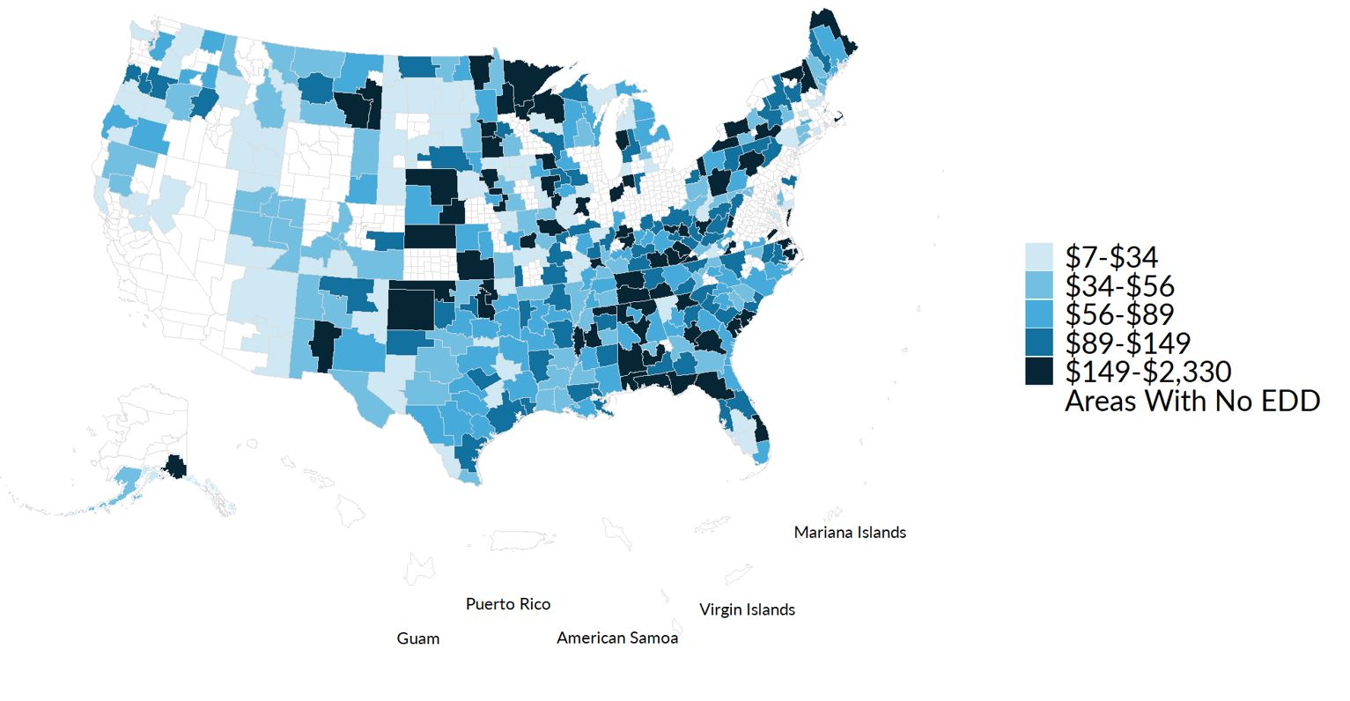
Some EDDs are superusers
Total EDA project investment per capita, 2010-2021
Inflation adjusted
2021 dollars
Notes:
Relative to state population, EDA invested more in less populous states, such as Alaska, Maine, Iowa, Montana, South Dakota, West Virginia, and Wyoming, between 2010 and 2021 (figure 1). The US Virgin Islands and the Northern Mariana Islands territories also received considerable total project investment per capita. Differences between states can be significant; Alaska, for example, received $170 of total project investment per capita, while Maryland received $10 per capita. The number of grants per capita also differs across states: Montana received 30 grants per 100,000 people, while New Jersey received less than 1 grant per 100,000 people (table A.1).
EDA construction and nonconstruction investment are strongly aligned.

Slide 16
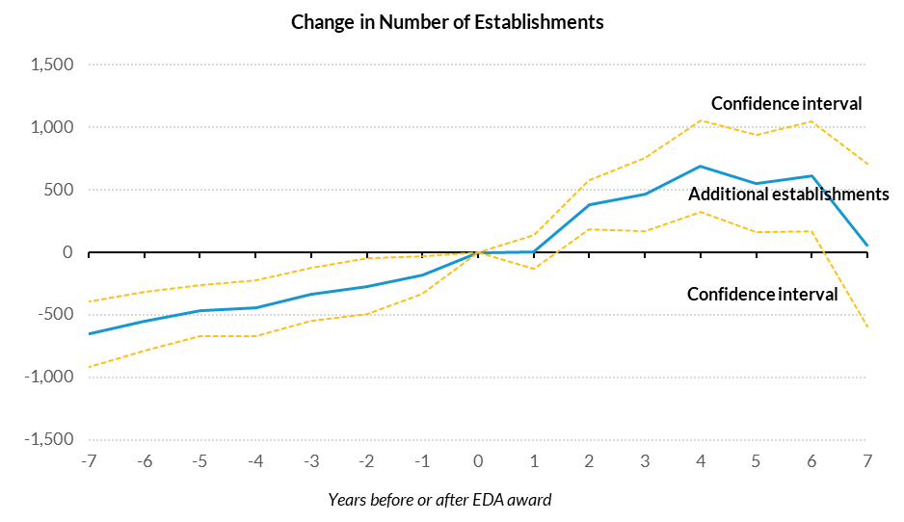
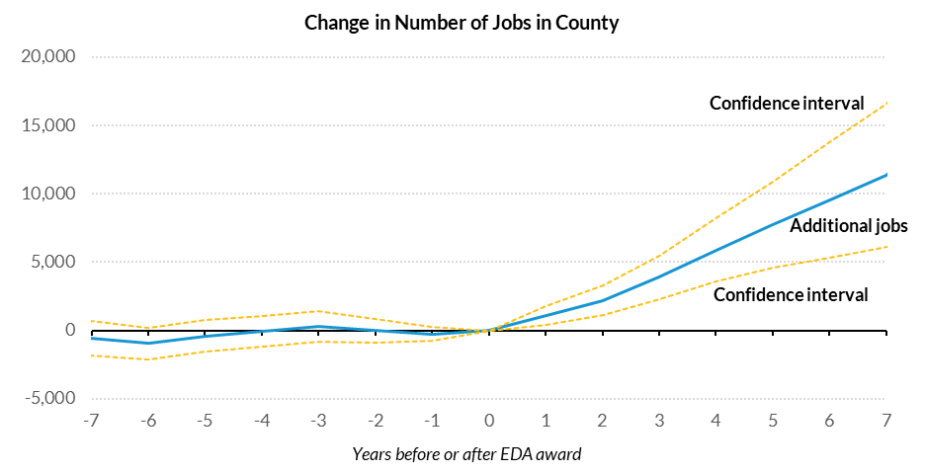
Changes in Establishments and Jobs in Counties
Before and After EDA Projects
Notes:
As with census tracts, we first plot whether there are patterns in counties before EDA construction grants were awarded (figure 3). We see similar patterns present in pre-grant county trends as in the tract level. Counties with EDA projects typically saw moderate growth in the number of establishments before receiving an EDA award. Establishment growth then spiked in the three years following the award before leveling off. And like the tract-level event studies, jobs in the county were relatively flat before an EDA award but increased after.

Slide 17
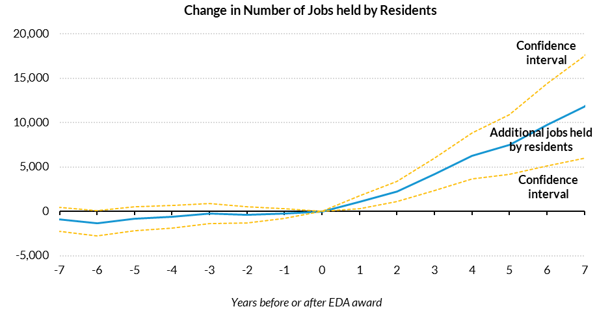
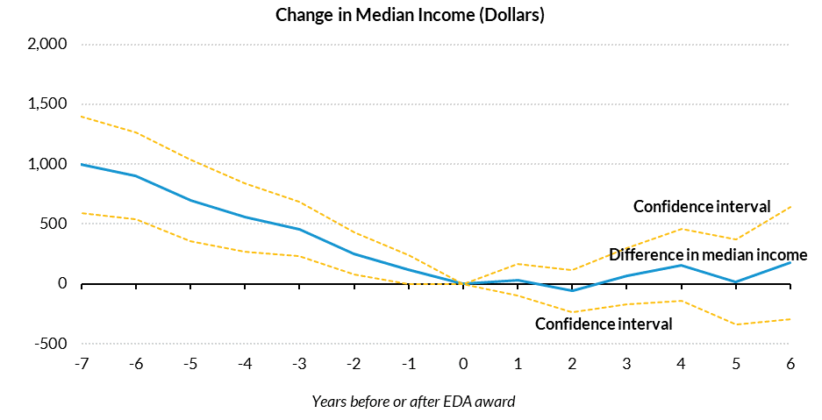
Changes in Employment and Income in Counties
Before and After EDA Projects
Notes:
Similar to our findings at the tract level, we do not see evidence of a preexisting trend in the number of jobs held by residents of the county; however we do see increasing employment after the grant. (The difference between the tract- and county-level findings may be because many more people live and work in the same county than live and work in the same tract.) As at the tract level, incomes at the county level appear to have been falling before the EDA grant was awarded. The decline stops shortly after the EDA award, and incomes are essentially flat at the county level. Our estimates of EDA’s impact on the number of establishments in a tract and the median income in the tract include controls for pre-award trends, but our estimates of EDA’s impact on jobs in the county and jobs held by residents of the county do not, as pre-award trends are not visible.

Slide 18
Estimated Impact of EDA on the Economies of Counties
 | Establishments | Jobs in the county | Jobs held by residents | Median Income
Effect per $1 million | -28.5 | 877* | 895* | $45*
(95% confidence interval) | (-96 to 39) | (175 to 1,578) | (178 to 1,612) | (6 to 85)
Effect per EDA award | -72.0 | 7,027*** | 6,970*** | $382***
(95% confidence interval) | (-328 to 184) | (3,548 to 10,506) | (3,678 to 10,262) | (165 to 596)
Average in year of EDA grant Decision | 13,927 | 140,202 | 129,696 | $49,898
Decision dates of projects | 2010-2014 | 2010-2015 | 2010-2015 | 2010-2013
Years in analysis | 2003-2017 | 2004-2018 | 2004-2018 | 2007-2016
Place trends | Yes | No | No | Yes
Number of awards | 621 | 702 | 694 | 534
Number of place-by-year observations | 43,710 | 43,725 | 43,185 | 29,400
Sources: Urban Institute Analysis of EDA program, Data Axle, LEHD, and ACS data.
Notes: 95 percent confidence intervals (listed in parentheses) are heteroskedastic robust and clustered at the tract level. Regressions include year and tract fixed effects, controls ….., and a five-year development window (two years before the project start date through two years after). * p < 0.10, ** p < 0.05, *** p < 0.01.
Notes:
With regression analysis, we are unable to determine whether $1 million invested into EDA construction projects leads to an increase in the number of establishments within the county; our 95 percent confidence interval ranges from 96 fewer jobs to 39 more jobs (table 2). Given that we estimated an increase of between 0 and 5 jobs at the tract level, we may just not have the precision to pick up the effects.
We find that $1 million in EDA construction project investment is associated with an average increase of between 175 and 1,578 jobs in a county (table 2). This amounts to a cost per job of less than $6,000 at the county level. For each EDA grant, we estimate an increase of between 2,548 and 10,262 jobs per county.
Unlike at the census tract level, we find that $1 million in EDA construction project investment is associated with increased jobs for residents—between 178 and 1,612 more jobs held by residents in the county. And we find approximately 3,679 to 10,262 more jobs held by residents in the county for each EDA construction grant.
Finally, and in contrast with the tract-level estimate, we also find a modest increase in median income of between $6 and $85 per $1 million invested. We also estimate that county median income increases by $382 on average ($165 to 596) per construction grant.
This statement seems to complement my previous comment on page 4. It seems there clearly are county level impacts, but we state otherwise on page 3.
While this paper is a bit technical, the way its written with respect to county and tract level impacts makes it hard for the reader to understand/follow. If we ca improve that in areas, it could help with messaging our impacts.
I appreciate this comment. We have explored presenting analysis by outcomes (establishments, jobs, jobs held by residents, incomes) rather than by geography and think this is the clearer of the two options.

Slide 19
Summary of Estimated Impacts
 | Tract | County
Establishments | + | not detected
Jobs | + | +
Jobs held by residents | not detected | +
Median Income | - | +

Slide 20
Q&A

