Slide 1

Good Morning!

Slide 2
The National Association of Regional Councils (NARC) serves as the national voice for regions by advocating for regional cooperation as the most effective way to address a variety of community planning and development opportunities and issues.

Slide 3
Leading In Times of Great Change with Confidence and Clarity
Today’s government leaders are navigating unprecedented complexity, balancing evolving community needs, shifting policy landscapes, and growing demands for innovation and accountability. Don’t miss this workshop focused on real-world strategies and leadership skills needed to guide your teams and communities through change effectively. Led by Dr. Tim Rahschulte, Chief Architect of the National Association of Regional Councils High Performance Leadership Academy, this session will explore the driving forces behind the growing need for change in government, from economic pressures to workforce shifts and more. Dr. Rahschulte will also share proven frameworks and leadership practices to help you build adaptability, foster resilience, and lead with a positive mindset—even in the face of resistance or uncertainty. Participants will walk away with practical concepts for planning, implementing, and sustaining change—plus insights from peers facing similar challenges. By the end of this workshop, participants will be better prepared to lead through complexity with clarity, confidence, and consistency.

Slide 4
Leading In Times of Great Change with Confidence and Clarity
Workshop Agenda (4 Hours)
8:30–8:45 — Welcome, Context Setting & Workshop Objectives
8:45–9:30 — The Forces Driving Change Today
9:30–10:15 — How To Lead Change When Everything Is Changing
10:15–10:30 — Break
10:30–11:15 — The Two Questions To Ask When Leading Change
11:15–11:45 — Your Next 90-Days To
11:45–12:15 — Regarding Change, Some Things Never Change
12:15–12:30 — Closing Reflections & Commitments
Notes:
Leading In Times of Great Change with Confidence and Clarity
Description: Today’s government leaders are navigating unprecedented complexity, balancing evolving community needs, shifting policy landscapes, and growing demands for innovation and accountability. Don’t miss this keynote presentation focused on real-world strategies and leadership skills needed to guide your teams and communities through change effectively. Led by Dr. Tim Rahschulte, Chief Architect of the National Association of Regional Councils High Performance Leadership Academy, this session will explore the driving forces behind the growing need for change in government, from economic pressures to workforce shifts and more. Dr. Rahschulte will also share proven frameworks and leadership practices to help you build adaptability, foster resilience, and lead with a positive mindset—even in the face of resistance or uncertainty. Participants will walk away with practical concepts for planning, implementing, and sustaining change—plus insights from peers facing similar challenges. By the end of this presentation, participants will be better prepared to lead through complexity with clarity, confidence, and consistency.
Speaker: Tim Rahschulte, PhD, Chief Executive Officer, Professional Development Academy
Date/Time: Sunday, February 1, 2026; 8:30 am – 12:30 pm ET
Interested in participating in the NARC High Performance Leadership Academy for FREE? Attend this workshop for your chance to win tuition in an upcoming cohort. Three FULL SCHOLARSHIPS will be provided to participants.
Workshop Agenda (4 Hours)
Leading in Times of Great Change with Confidence and Clarity
Facilitator: Dr. Tim Rahschulte
8:30–8:45 — Welcome, Context Setting & Workshop Objectives
Introductions and participant expectations
Overview of today’s challenges for government leaders
Workshop goals: clarity, confidence, and consistency in leading change
8:45–9:30 — The Forces Driving Change Today
What keeps you up at night
What gets you up in the morning
What fuels your passion, pursuit, and purpose
Three topics to consider
How to lead change when everything is changing
The two questions all great leaders ask when leading change
When it comes to change, some things never change
Interactive small-group exchange: “What’s driving change in your agency or region?”
Outcome: Participants understand the root causes behind organizational and community complexity.
9:30–10:15 — How To Lead Change When Everything Is Changing
The phases of change and framework to make change effective
The perception of change
The formula for change
Interactive small-group exchange: “How are you planning for effective, positive, and sustaining change?”
Outcome: Participants learn mindset frameworks for navigating uncertainty with steadiness.
10:15–10:30 — Break
10:30–11:15 — The Two Questions All Great Leaders Ask When Leading Change
The Two Questions
Simplifying complexity and translating thought into action
Aligning people, process, and purpose
Interactive small-group exchange: “Detailing ‘best advice’ for change; we’ve all got it.”
Outcome: Leaders gain concrete tools for designing and executing successful change initiatives.
11:15–11:45 — Your Next 90-Days To
Strategies for building resilience at team and organizational levels
Communication frameworks to reduce resistance (remember, feedback is a gift)
Coaching and supporting staff through ambiguity (what’s now and what’s next
Interactive small-group exchange: “What resistance do you face, and what has worked?” and “What is your next 90-days?”
Outcome: Participants develop stronger interpersonal leadership approaches.
11:45–12:15 — When It Comes To Change, Some Things Never Change
Setting meaningful metrics and intentional feedback loops
Modeling behaviors that reinforce new norms and soliciting feedback
Maintaining momentum after early wins and setting the next 90-days
Planning for continuous improvement and adaptability (there is always the next 90-days)
Outcome: Leaders leave with a method for long-term change sustainability.
12:15–12:30 — Closing Reflections & Commitments
Key takeaways
One leadership commitment to apply in the next 30 days
Final Q&A

Slide 5
What keeps you up at night?

Slide 6
Transparent and open government
Increasing citizen engagement
Legislative/regulatory changes
Managing citizen expectations
Community planning issues
Diversity, Equity, Inclusion
Recruitment and retention
Operational inefficiencies
Digital Transformation
Water Infrastructure
Mental Wellbeing
Transportation
Cybersecurity
Housing
Budget
. . .
What keeps you up at night?

Slide 7
V | U | C | A
Volatile | Uncertain | Complex | Ambiguous
The environment demands you react quickly to ongoing changes that are unpredicted | The environment requires you to take action without full information and certainty of decisions | The environment is dynamic with many interdependencies and multiple factors affecting one another | The environment is new or unfamiliar and outside the competencies and expertise of your team and partners

Slide 8
V | U | C | A
Volatile | Uncertain | Complex | Ambiguous
The environment demands you react quickly to ongoing changes that are unpredicted | The environment requires you to take action without full information and certainty of decisions | The environment is dynamic with many interdependencies and multiple factors affecting one another | The environment is new or unfamiliar and outside the competencies and expertise of your team and partners

Slide 9
V | U | C | A
Volatile | Uncertain | Complex | Ambiguous
The environment demands you react quickly to ongoing changes that are unpredicted | The environment requires you to take action without full information and certainty of decisions | The environment is dynamic with many interdependencies and multiple factors affecting one another | The environment is new or unfamiliar and outside the competencies and expertise of your team and partners

Slide 10
“The role of a leader is to affect change.”

Slide 11
“The role of a leader is to affect change.”
“Affecting change is the greatest test of leadership.”

Slide 12
HELP WANTED
A self-starter, focused on delivering excellence in an environment of constant change and the occasional crisis (which, to be honest is becoming more regular than occasional). Speaking of the environment, you will answer to several stakeholders, all of whom have critical projects for you to complete and all of whom have critical commentary about your predecessor and about your probability for success. As you may imagine, the environment has competing priorities, along with constrained resources, and limited funding. There are mandates. Oh, yes, there are mandates setting expectations of what should be done, when, and how. Most people will not want this job because of the need to navigate the complexity of our business, the challenges of our business, and the high demand for results. Speaking of results, regardless of how successful you are, you will not often be thanked. So, only apply for this position if you are tough enough – tough with thick skin, resilience, and grit.

Slide 13
HELP WANTED
A self-starter, focused on delivering excellence in an environment of constant change and the occasional crisis (which, to be honest is becoming more regular than occasional). Speaking of the environment, you will answer to several stakeholders, all of whom have critical projects for you to complete and all of whom have critical commentary about your predecessor and about your probability for success. As you may imagine, the environment has competing priorities, along with constrained resources, and limited funding. There are mandates. Oh, yes, there are mandates setting expectations of what should be done, when, and how. Most people will not want this job because of the need to navigate the complexity of our business, the challenges of our business, and the high demand for results. Speaking of results, regardless of how successful you are, you will not often be thanked. So, only apply for this position if you are tough enough – tough with thick skin, resilience, and grit.

Slide 14
HELP WANTED
CONGRATUATIONS, YOU’RE HIRED!
A self-starter, focused on delivering excellence in an environment of constant change and the occasional crisis (which, to be honest is becoming more regular than occasional). Speaking of the environment, you will answer to several stakeholders, all of whom have critical projects for you to complete and all of whom have critical commentary about your predecessor and about your probability for success. As you may imagine, the environment has competing priorities, along with constrained resources, and limited funding. There are mandates. Oh, yes, there are mandates setting expectations of what should be done, when, and how. Most people will not want this job because of the need to navigate the complexity of our business, the challenges of our business, and the high demand for results. Speaking of results, regardless of how successful you are, you will not often be thanked. So, only apply for this position if you are tough enough – tough with thick skin, resilience, and grit.

Slide 15
Transparent and open government
Increasing citizen engagement
Legislative/regulatory changes
Managing citizen expectations
Community planning issues
Diversity, Equity, Inclusion
Recruitment and retention
Operational inefficiencies
Broadband Development
Digital Transformation
Water Infrastructure
Mental Wellbeing
Transportation
Cybersecurity
Housing
Budget
. . .
What keeps you up at night?

Slide 16
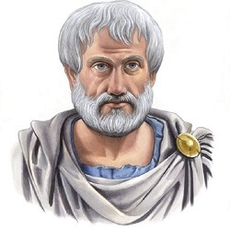
“Change in all things is sweet.”
-Aristotle

Slide 17
Thank You!

Slide 18
Transparent and open government
Increasing citizen engagement
Legislative/regulatory changes
Managing citizen expectations
Community planning issues
Diversity, Equity, Inclusion
Recruitment and retention
Operational inefficiencies
Broadband Development
Digital Transformation
Water Infrastructure
Mental Wellbeing
Transportation
Cybersecurity
Housing
Budget
. . .
What keeps you up at night?

Slide 19
What will you do with the world as you find it?
What shows up when you do?
Transparent and open government
Increasing citizen engagement
Legislative/regulatory changes
Managing citizen expectations
Community planning issues
Diversity, Equity, Inclusion
Recruitment and retention
Operational inefficiencies
Broadband Development
Digital Transformation
Water Infrastructure
Mental Wellbeing
Transportation
Cybersecurity
Housing
Budget
. . .

Slide 20
What will you do with the world as you find it?
What shows up when you do?
Transparent and open government
Increasing citizen engagement
Legislative/regulatory changes
Managing citizen expectations
Community planning issues
Diversity, Equity, Inclusion
Recruitment and retention
Operational inefficiencies
Broadband Development
Digital Transformation
Water Infrastructure
Mental Wellbeing
Transportation
Cybersecurity
Housing
Budget
. . .

Slide 21
Welcome.
You are in the right place.
You are here at the right time.
And, you are in good company.

Slide 22
Leading In Times of Great Change with Confidence and Clarity
Today’s government leaders are navigating unprecedented complexity, balancing evolving community needs, shifting policy landscapes, and growing demands for innovation and accountability. Don’t miss this workshop focused on real-world strategies and leadership skills needed to guide your teams and communities through change effectively. Led by Dr. Tim Rahschulte, Chief Architect of the National Association of Regional Councils High Performance Leadership Academy, this session will explore the driving forces behind the growing need for change in government, from economic pressures to workforce shifts and more. Dr. Rahschulte will also share proven frameworks and leadership practices to help you build adaptability, foster resilience, and lead with a positive mindset—even in the face of resistance or uncertainty. Participants will walk away with practical concepts for planning, implementing, and sustaining change—plus insights from peers facing similar challenges. By the end of this workshop, participants will be better prepared to lead through complexity with clarity, confidence, and consistency.
SUNDAY FEBRUARY 1 | 8:30 to 12:30
Tim Rahschulte | timr@pdaleadership.com

Slide 23

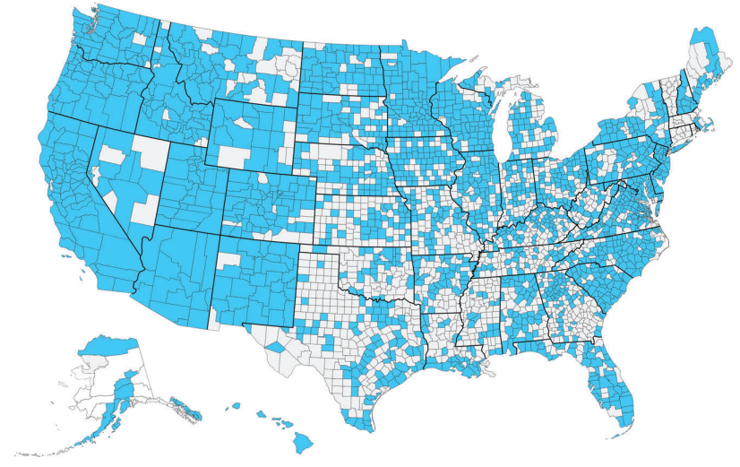
The High-Performance Leadership Academy develops critical skills required to successfully navigate change, such as adaptability, resilience, and a positive mindset. Participants will learn how to plan, execute, and sustain effective change and overcome the challenges of resistance, fear, and uncertainty. Sharing proven change leadership frameworks and models participants will have real-world perspectives for their unique challenges for change. By the end of the session, participants will have a clear understanding of how to navigate the complexity of change and be better equipped to lead positive outcomes with clarity, confidence, consistency.

Slide 24
The High-Performance Leadership Academy develops critical skills required to successfully navigate change, such as adaptability, resilience, and a positive mindset. Participants will learn how to plan, execute, and sustain effective change and overcome the challenges of resistance, fear, and uncertainty. Sharing proven change leadership frameworks and models participants will have real-world perspectives for their unique challenges for change. By the end of the session, participants will have a clear understanding of how to navigate the complexity of change and be better equipped to lead positive outcomes with clarity, confidence, consistency.
naco.org/skills
timr@pdaleadership.com

Slide 25
1
2
3
How to lead change when everything is changing
Two questions remind great leaders to always be great
When it comes to change, some things never (ever) change

Slide 26
ENGINEER

Slide 27
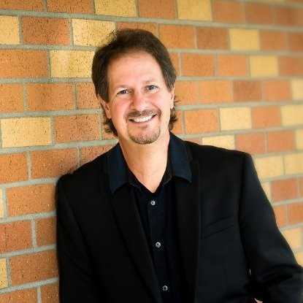
ENGINEER
Russ Martinelli

Slide 28

ENGINEER
Russ Martinelli

Slide 29

ENGINEER
Russ Martinelli

Slide 30
ENGINEER
Who’s going to take care of the PEOPLE?
Russ Martinelli

Slide 31
HELP WANTED
A change agent who cares deeply for the human condition. A person who understands that such care and concern starts inside the organization and radiates outward to every person in the community. Metrics of efficiency and effectiveness are important, but we seek a leader who knows the measure of what matters most. We need someone who faces the reality of our challenges with hope, optimism, and a spirit of possibility. Our leader is a bridge-builder, a dream-catcher. Our leader knows that the flip side of the effective leadership coin is effective followership, that a standard-issue uniform does not make a team, and that excellence is a mindset, not a policy. Our leader does not demand better outcomes, rather our leader works to improve the culture of work in ways that enable the highest possible value for those we serve. Our leader believes that leadership is a contact sport and shows the importance of that every day. Our leader believes the philosophy of our work is people serving people, period. Our leader is you!

Slide 32
HELP WANTED
A change agent who cares deeply for the human condition. A person who understands that such care and concern starts inside the organization and radiates outward to every person in the community. Metrics of efficiency and effectiveness are important, but we seek a leader who knows the measure of what matters most. We need someone who faces the reality of our challenges with hope, optimism, and a spirit of possibility. Our leader is a bridge-builder, a dream-catcher. Our leader knows that the flip side of the effective leadership coin is effective followership, that a standard-issue uniform does not make a team, and that excellence is a mindset, not a policy. Our leader does not demand better outcomes, rather our leader works to improve the culture of work in ways that enable the highest possible value for those we serve. Our leader believes that leadership is a contact sport and shows the importance of that every day. Our leader believes the philosophy of our work is people serving people, period. Our leader is you!

Slide 33
We live in a highly specialized world where it’s easy to overlook the FUNDAMENTALS.

Slide 34

YOUR LOGO

Slide 35

What do you see? What do you sense? What do you expect?

Slide 36
Our Mission
Is to provide regional leadership and fiscally responsible, necessary public services so that residents can enjoy living in a healthy and safe community.
Our Vision
Citizens serving citizens by working collaboratively, innovatively, efficiently, and effectively. We will be responsive to our customers while being fiscally prudent.
Our Values
Accountable
All People Realize Their Full Potential
Communicate and Collaborate
Measure Results
Open and Honest
Public Interest First
Relentless Improvement

Slide 37
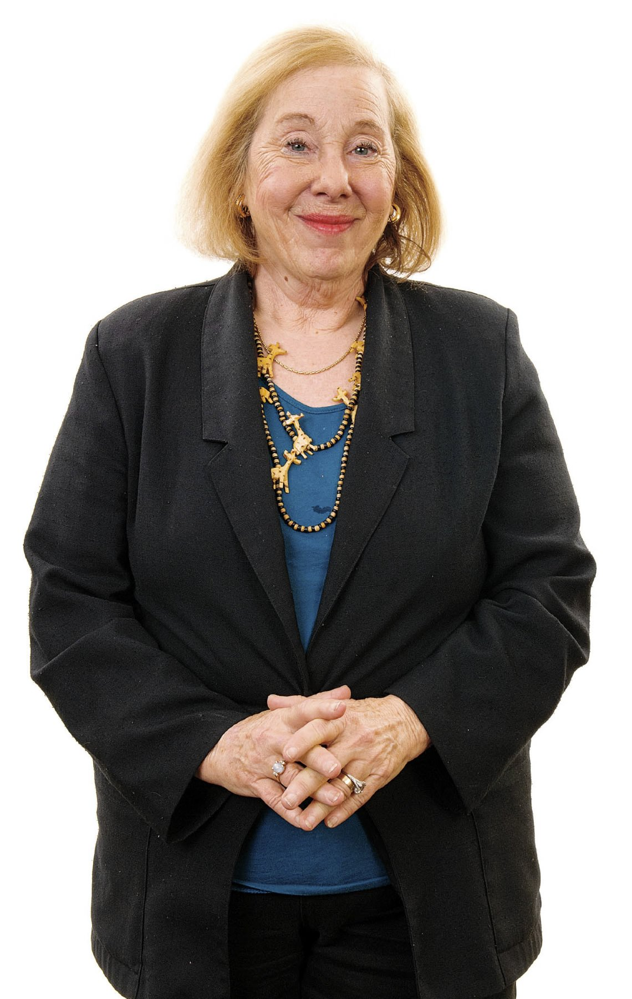
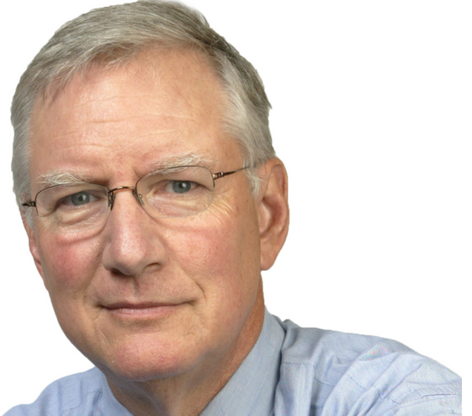
The Fundamentals
The theory of work is simple: PEOPLE SERVING PEOPLE.
Tom Peters Rosabeth Moss Kanter

Slide 38
V | U | C | A
Volatile | Uncertain | Complex | Ambiguous
The environment demands you react quickly to ongoing changes that are unpredicted | The environment requires you to take action without full information and certainty of decisions | The environment is dynamic with many interdependencies and multiple factors affecting one another | The environment is new or unfamiliar and outside the competencies and expertise of your team and partners
VISION | UNDERSTANDING | CLARITY | AGILITY

Slide 39
V | U | C | A
Volatile | Uncertain | Complex | Ambiguous
The environment demands you react quickly to ongoing changes that are unpredicted | The environment requires you to take action without full information and certainty of decisions | The environment is dynamic with many interdependencies and multiple factors affecting one another | The environment is new or unfamiliar and outside the competencies and expertise of your team and partners
VISION | UNDERSTANDING | CLARITY | AGILITY

Slide 40
Leading in Times of Great Change

Slide 41
Leading in Times of Great Change
SUCCESS
Plan
TIME

Slide 42
Leading in Times of Great Change
SUCCESS
Plan
TIME

Slide 43
Leading in Times of Great Change
SUCCESS
Plan
TIME

Slide 44
Leading in Times of Great Change
SUCCESS
Plan
TIME

Slide 45
Leading in Times of Great Change
SUCCESS
Expect the world push back against your plans.
Plan
TIME

Slide 46
Leading in Times of Great Change
SUCCESS
SUCCESS
Expect the world push back against your plans.
Plan
TIME
Reality
TIME

Slide 47
Leading in Times of Great Change
SUCCESS
SUCCESS
Expect the world push back against your plans.
Plan
TIME
Reality
TIME

Slide 48
Leading in Times of Great Change
SUCCESS
SUCCESS
Expect the world push back against your plans.
Plan
TIME
Reality
TIME

Slide 49
What will you do with the world as you find it?
What shows up when you do?

Slide 50

What will you do with the world as you find it?
You bring your weather.
What shows up when you do?

Slide 51
People hate two things,
change and the way things are.

Slide 52
People hate two things,
change and the way things are.

Slide 53
Why is change so hard?

Slide 54
D x V x F > R

Slide 55
D x V x F > R
Dissatisfaction Vision First Steps Resistance

Slide 57
Key Take Away
Have a point of view, but be willing to change that view

Slide 58
25
45
8

Slide 59
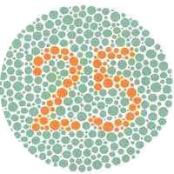
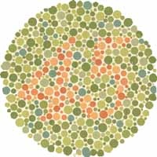

25
45
8

Slide 60
Key Take Away
Focus on getting it right, not on being right

Slide 61
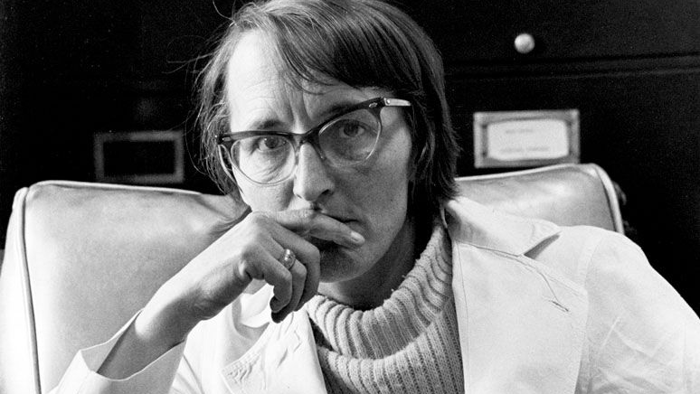
Elizabeth Kubler-Ross

Slide 62


Slide 63
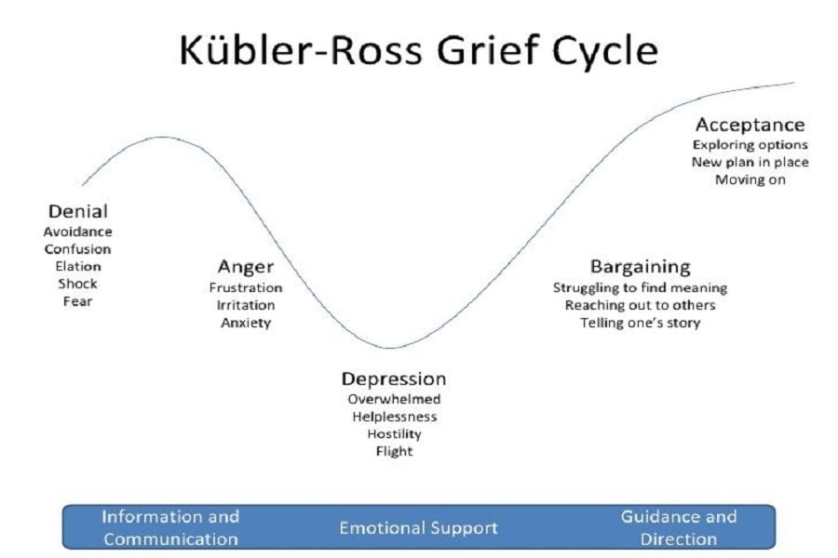

Slide 64
How to lead change when everything is changing
What do great leaders do?

Slide 65
How to lead change when everything is changing

Slide 66
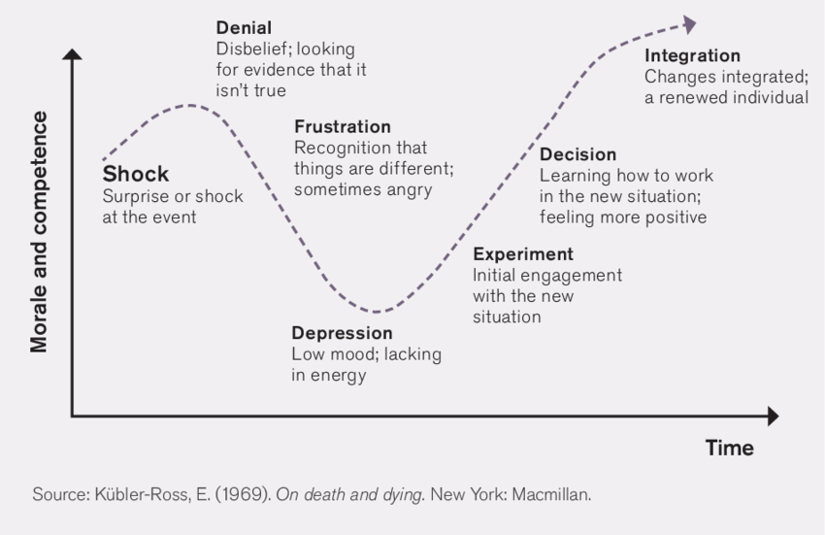
Applied over the years to organizational change

Slide 67
Meet people where they are, not where you think they should be or may want them to be.
Amber Case

Slide 68
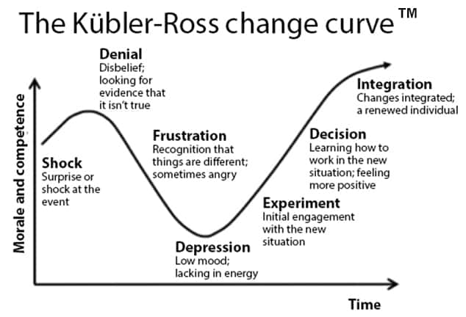
Lead by example.
Encourage praise.
Celebrate wins.
Respond to objections.
Plan for the dip.
Watch and address behavior.
Encourage exploration.
Provide time to test.
Lots of training.
Reinforcement.
Give time to adjust.
Listen to concerns.
Provide empathy.
Create rationale.
Provide care/support.

Slide 69
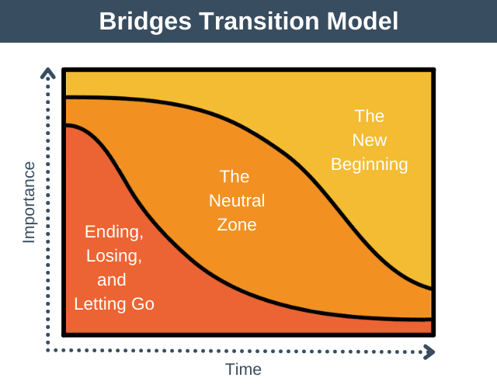

Slide 70
What will you do with the world as you find it?
What shows up when you do?

Slide 71
Be the heliotropic effect.

Slide 72
Be the heliotropic effect.

Slide 73
Be the heliotropic effect.

Slide 74
Be the heliotropic effect.
Three things characterize the people who are energizers.
A relentless focus on the bright side.
Redefining negatives as positives.
Fast response time. Energizers don’t dawdle.

Slide 75
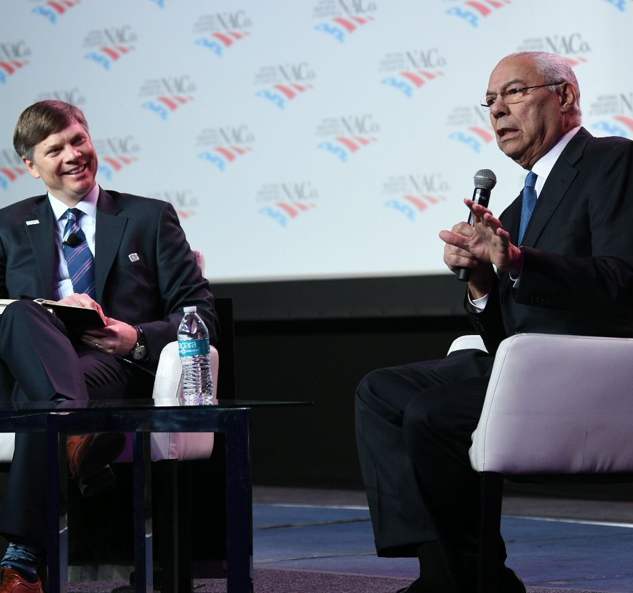
“Leadership is the art of accomplishing more with a group of people than the science of management says is possible.”
- General Colin Powell

Slide 76
Leadership is art - your art. As the artist, you sign your name to your work every day.
Colton Janes

Slide 77
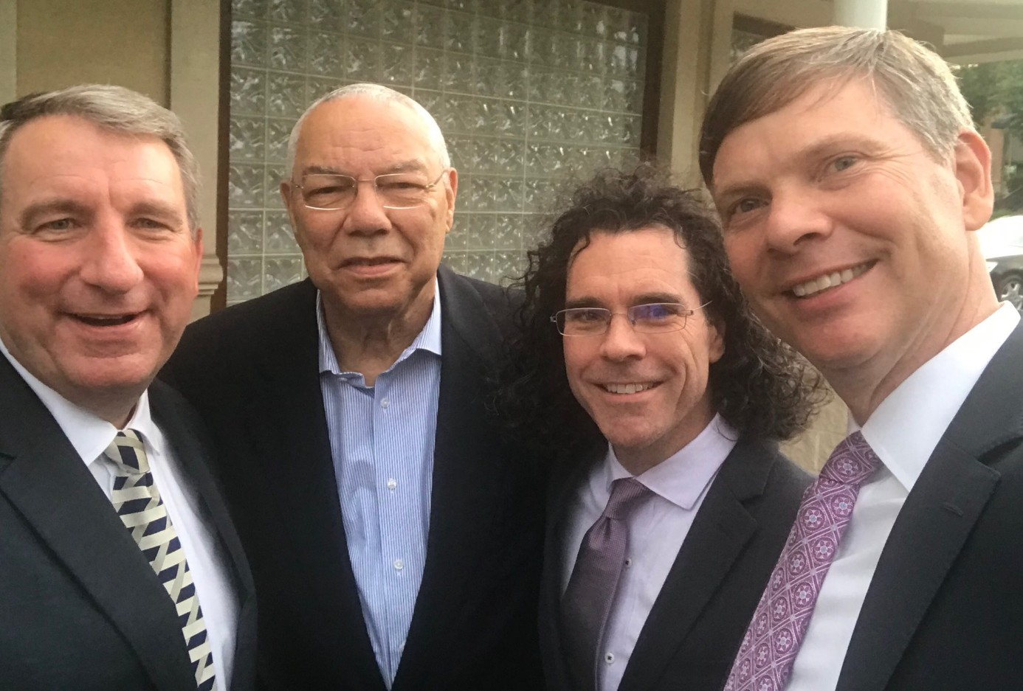
The foundation of success is a positive mindset.
“Perpetual optimism is a force multiplier.”
You bring your weather.
Notes:
Your ability to accomplish anything starts with what you believe is possible. If you don’t believe you can accomplish your goals, you put yourself and those you lead at a mental and philosophical deficit that’s hard to overcome. If, however, you believe in your opportunity to succeed, you immediately increase the likelihood that you will. It’s a mindset. It’s an attitude. It’s an outlook you hold about yourself and others that becomes the lens through which you can picture what’s possible.

Slide 78
“I’ve come to the frightening conclusion that
I am the decisive element.
It is my personal approach that creates the climate. It is my daily mood that makes the weather. I possess tremendous power to make life miserable or joyous. I can be a tool of torture or an instrument of inspiration, I can humiliate or humor, hurt or heal. In all situations, it is my response that decides whether a crisis is escalated or de-escalated, and a person is humanized or de-humanized. If we treat people as they are, we make them worse. If we treat people as they ought to be, we help them become what they are capable of becoming.”
Johann Wolfgang von Goethe

Slide 79
Who is the most influential leader in your life?

Slide 80
EXAMPLE
Notes:
Accidently at state of Oregon for 14 years.
In state government work because of Dan Brennen.

Slide 81
48

Slide 82

Sometimes, the best way to communicate really well is to listen really, really well.
Jan Dean

Slide 83
Who is the most influential leader in your life?
What are three lessons you learned from that leader?

Slide 84
48

Slide 85
Know at the beginning, you may not be there to see the end.
Jan Dean

Slide 86
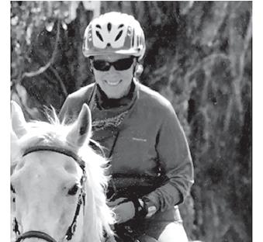
You may not get the chance to do a better job tomorrow.
Jan Dean
1952 – 2017

Slide 87
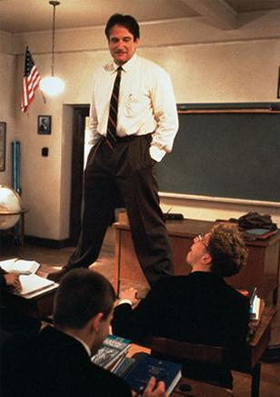
You can’t wait to be great.
Carpe diem. Seize the day. Make your lives extraordinary.
Robin Williams
Dead Poets Society

Slide 88
Who is the most influential leader in your life?
What are three lessons you learned from that leader?
How do you apply these lessons in times of change?

Slide 89
“Leadership has always been difficult, and in the face of a rapidly changing (vuca) environment it will only get harder. But it won’t be impossible, and it will be essential.”
-General Stan McChrystal (US Army, Retired)

Slide 90
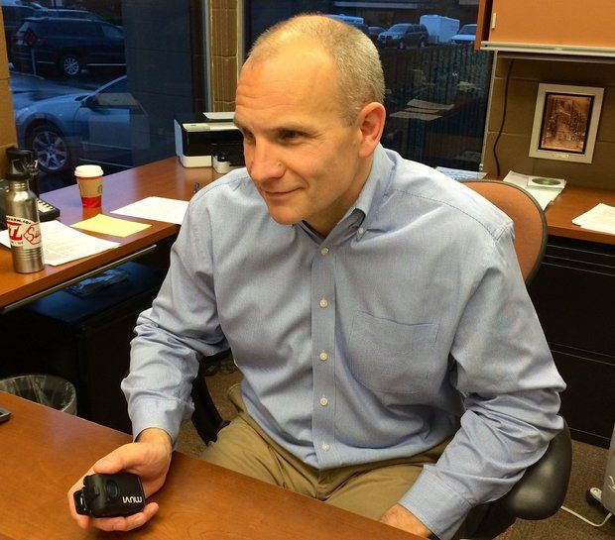
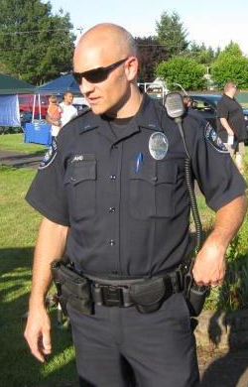
Be good at what you do.
Deliver great service.
Take care of each other.
Jim Band

Slide 91
HOW TO WIN FRIENDS AND INFLUENCE PEOPLE

Slide 92
HOW TO WIN FRIENDS AND INFLUENCE PEOPLE
BECOME A FRIENDLIER PERSON
Don't criticize, condemn or complain.
Give honest, sincere appreciation.
Arouse in the other person an eager want.
Become genuinely interested in other people.
Smile.
Remember that a person's name is to that person the most important sound in any language.
Be a good listener. Encourage others to talk about themselves.
Talk in terms of the other person's interest.
Make the other person feel important - and do so sincerely.
The only way to get the best of an argument is to avoid it.

Slide 93
HOW TO WIN FRIENDS AND INFLUENCE PEOPLE
BECOME A FRIENDLIER PERSON
Don't criticize, condemn or complain.
Give honest, sincere appreciation.
Arouse in the other person an eager want.
Become genuinely interested in other people.
Smile.
Remember that a person's name is to that person the most important sound in any language.
Be a good listener. Encourage others to talk about themselves.
Talk in terms of the other person's interest.
Make the other person feel important - and do so sincerely.
The only way to get the best of an argument is to avoid it.
WIN PEOPLE TO YOUR WAY OF THINKING
Show respect for the other person's opinions. Never say, "You're wrong."
If you are wrong, admit it quickly and emphatically.
Begin in a friendly way.
Get the other person saying, "Yes, yes" immediately.
Let the other person do a great deal of the talking.
Let the other person feel that the idea is his or hers.
Try honestly to see things from the other person's point of view.
Be sympathetic with the other person's ideas and desires.
Appeal to the nobler motives.
Dramatize your ideas.

Slide 94
HOW TO WIN FRIENDS AND INFLUENCE PEOPLE
BECOME A FRIENDLIER PERSON
Don't criticize, condemn or complain.
Give honest, sincere appreciation.
Arouse in the other person an eager want.
Become genuinely interested in other people.
Smile.
Remember that a person's name is to that person the most important sound in any language.
Be a good listener. Encourage others to talk about themselves.
Talk in terms of the other person's interest.
Make the other person feel important - and do so sincerely.
The only way to get the best of an argument is to avoid it.
WIN PEOPLE TO YOUR WAY OF THINKING
Show respect for the other person's opinions. Never say, "You're wrong."
If you are wrong, admit it quickly and emphatically.
Begin in a friendly way.
Get the other person saying, "Yes, yes" immediately.
Let the other person do a great deal of the talking.
Let the other person feel that the idea is his or hers.
Try honestly to see things from the other person's point of view.
Be sympathetic with the other person's ideas and desires.
Appeal to the nobler motives.
Dramatize your ideas.
CHANGE PEOPLE WITHOUT RESENTMENT
Throw down a challenge.
Begin with praise and honest appreciation.
Call attention to people's mistakes indirectly.
Talk about your own mistakes before criticizing the other person.
Ask questions instead of giving direct orders.
Let the other person save face.
Praise the slightest and every improvement. Be "lavish in your praise."
Give the other person a fine reputation to live up to.
Use encouragement. Make the fault seem easy to correct.
Make the other person happy about doing the thing you suggest.

Slide 95
Some things will never, ever change
It’s all about people. Period.
People are the lifeblood of any team, organization, community.
Effectiveness is grounded in our connections with one another – the touchpoints we have with one another – in our work throughout our workplace, and for the customers we serve.

Slide 96
Leaders, Change, Teams, Outcomes
Leaders are responsible for change.
Change is hard (but not impossible).
Change occurs when teams overcome resistance.
Leaders are always looking to help teams achieve more.

Slide 97
Any group of people aligned on achieving a purpose has the potential to be great. Any group has the possibility of becoming a high-performing team and realizing greatness. The potential and probability of that actually happening, however, is contingent upon several things.
List three reasons why great teams are great.

Slide 98
Defining the High Performing Team

Slide 99
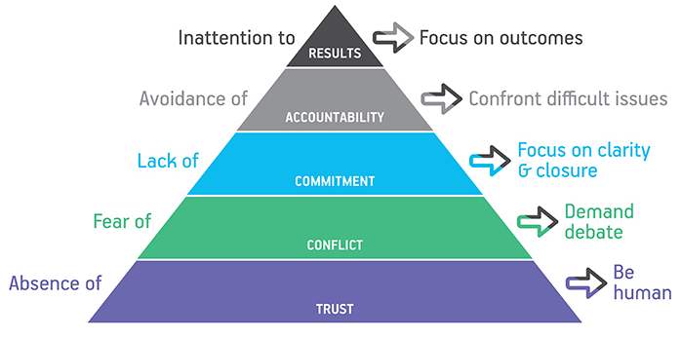
Defining the High Performing Team
Patrick Lencioni says it starts with trust and having open and constructive conflict, strong commitment, ownership and accountability, and laser focus on results.
Additionally, is leadership. Moving an average team to good or a good team to a great one – and realizing greatness – is the product of leadership influence.
There is also the need for great followership.
And much more. . . .

Slide 100
Defining the High Performing Team
A high performance organization is an organization that achieves financial results that are better than those of its peer group over a longer period of time, by being able to adapt well to changes and react to these quickly, by managing for the long term, by setting up an integrated and aligned management structure, by continuously improving its core capability, and by truly treating employees as its main asset.
Andre A. de Waal

Slide 101

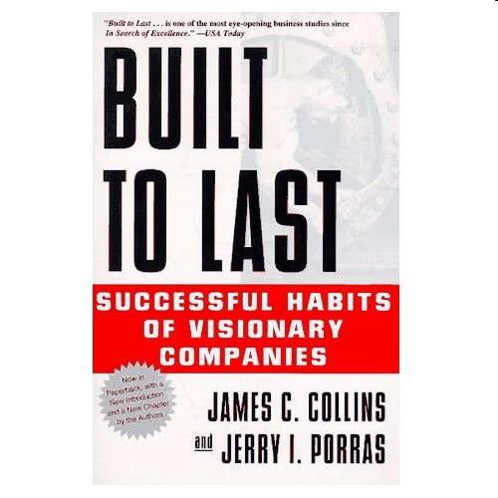

Defining the High Performing Team

Slide 102

Defining the High Performing Team
-37%
Absenteeism
The difference in results between the top quartile (highest performing organizations) and the bottom quartile (lowest performing organizations) include:
-49%
Turnover
-49%
Safety Incidents
-60%
Defects
Customer Rating
+12%
Productivity
+18%
Profitability
+16%

Slide 103
If you need to create high performing teams, then you need to create a new culture.
Team and Organization Performance
CULTURE

Slide 104
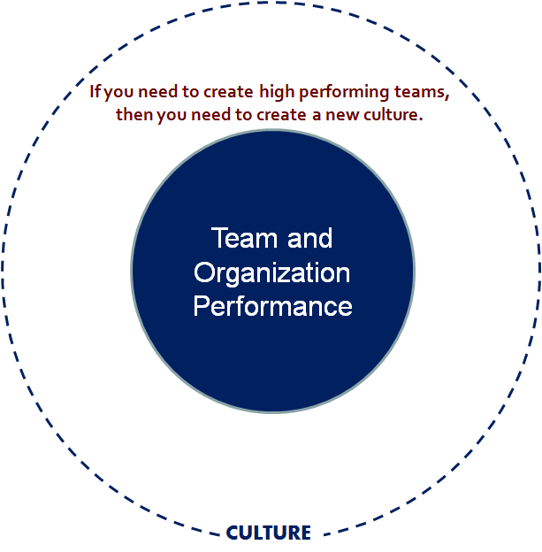





ACADEMICS
Notes:
Many organizations have spent time researching and summarizing the levers of culture and performance.
The Malcolm Baldrige Performance Excellence Program is comprised of 7 elements including: leadership, strategic planning, customer focus, workforce focus, knowledge management, operations focus, and results.
Fortune Magazine regularly reports on the Most Admired Companies and the Best Places to Work.
Gallop has the great workplace award.
Accenture conducts regular research to develop their High Performance Workforce Study and findings.
There have been a number of academic researchers report findings on high performing teams. Andre de Waal, among others, has contributed significantly in this regard.
Additionally, there are varying accrediting associations, quality boards, and performance scorecards that provide lists and criteria for measuring and improving high performance.
The challenge (and importance) is identifying what’s most important to your organization and being consistent with its use. Jim and I have found in our research and practice that nine particular elements are most important. Jim is now going to talk about each and in so doing provide questions that can be used for you to diagnose your own organization’s culture relative to performance.
Jim . . .

Slide 105
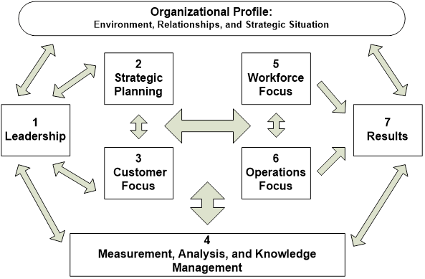

Slide 106
Leadership—Examines how senior executives guide and sustain the organization and how the organization addresses governance, ethical, legal and community responsibilities.
Strategic planning—Examines how the organization sets strategic directions and how it determines and deploys key action plans.
Customer focus—Examines how the organization determines requirements and expectations of customers and markets; builds relationships with customers; and acquires, satisfies, and retains customers.
Measurement, analysis, and knowledge management—Examines the management, use, analysis, and improvement of data and information to support key organization processes as well as how the organization reviews its performance.
Workforce focus—Examines how the organization engages, manages, and develops all those actively involved in accomplishing the work of the organization to develop full potential and how the workforce is aligned with the organization’s objectives.
Process management—Examines aspects of how key production/delivery and support processes are designed, managed, and improved.
Results—Examines the organization’s performance and improvement in its key business areas: customer satisfaction, financial and marketplace performance, workforce, product/service, and operational effectiveness, and leadership. The category also examines how the organization performs relative to competitors.

Slide 107
The 12 Elements Of Great Management
I know what is expected of me at work.
I have the materials and equipment I need to do my work right.
At work, I have the opportunity to do what I do best every day.
In the last seven days, I have received recognition or praise for doing good work.
My supervisor, or someone at work, seems to care about me as a person.
There is someone at work who encourages my development.
At work, my opinions seem to count.
The mission or purpose of my organization makes me feel my job is important.
My associates or fellow employees are committed to doing quality work.
I have a best friend at work.
In the last six months, someone at work has talked to me about my progress.
This last year, I have had opportunities at work to learn and grow.
Notes:
Gallup has perhaps the easiest, fastest to complete, and most direct. Here are there 12 statements that determine engagement. If your answers are “yes” you are engaged. Similar to the questions Jim outlined, working on each of these statements can lead to greater engagement and higher performance.

Slide 108
1. Be Aware of How You Work
Be your own boss. Be flexible. Know who you are as a leader.
2. Get to Know the Rest of the Team
Think of your team as puzzle pieces that can be placed together in a variety of ways.
3. Clearly Define Roles & Responsibilities
A team should operate as a mosaic whose unique strengths and differences convert into a powerful united force.
4. Be Proactive with Feedback
Take the time to remind someone of how and what they can be doing better. Learn from them. Don’t complicate the process of constructive feedback. Feedback is two-way communication.
5. Acknowledge and Reward
When people are acknowledged, their work brings them greater satisfaction and becomes more purposeful.
6. Always Celebrate Success
Celebration is a short-lived activity. Don’t ignore it. Take the time to live in the moment and remember what allowed you to cross the finish line.
Building A High Performing Team: A Leader’s Role
Glenn Llopis

Slide 109
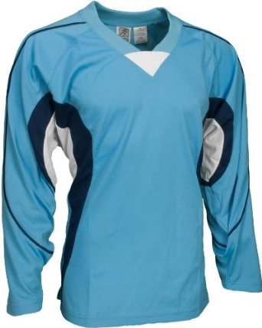
“Wearing the same shirt doesn’t make a team.”
Steve Buchholz & Thomas Roth
9
Notes:
Steve Buchholz and Thomas Roth once said, “Wearing the same shirt doesn’t make a team.” I think we would all agree that this statement is true.
The difference between a group of loosely affiliated people and a high performing team goes (way) beyond apparel as I think we have seen from our own experience and today’s discussion.
As noted in Art Kleiner’s and Rutger von Post’s interview with Edgar Schein, the best teams are those that are more effective at giving and receiving assistance and act as if everyone has a stake in the outcome.
This concludes my portion of today’s webinar. Let’s return the webinar back to Tim and Debra.
Thanks for your time today!

Slide 110
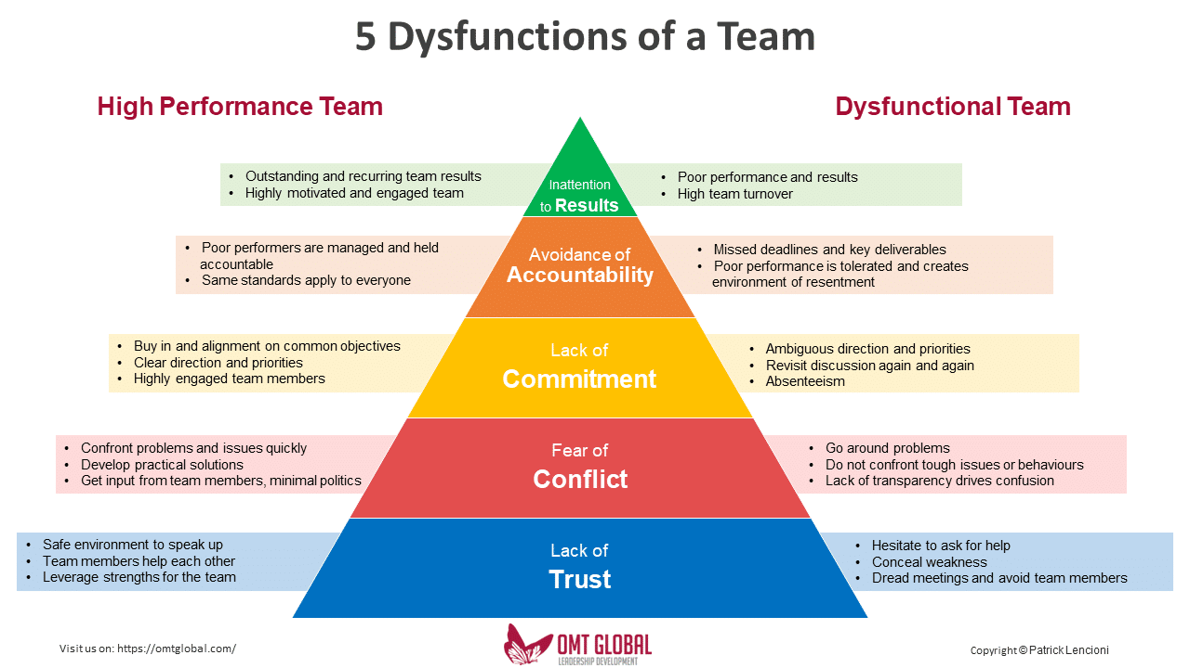
Patrick Lencioni

Slide 111
How effective is your team?
Score each item by placing the number 1, 2, or 3.
The number you use for each statement represents the following: 1/rarely, 2/sometimes, 3/usually.
Team members are passionate and unguarded in their discussion of issues.
Team members call out one another’s deficiencies or unproductive behaviors.
Team members know what their peers are working on and how they contribute to the collective good of the team.
Team members quickly and genuinely apologize to one another when they say or do something inappropriate or possibly damaging to the team.
Team members willingly make sacrifices (such as budget, turf, head count) in their departments or areas of expertise for the good of the team.
Team members openly admit their weaknesses and mistakes.
Team meetings are compelling, and not boring.
Team members leave meetings confident that their peers are completely committed to the decisions that were agreed on, even if there was initial disagreement.
Morale is significantly affected by the failure to achieve team goals.
During team meetings, the most important—and difficult—issues are put on the table to be resolved.
Team members are deeply concerned about the prospect of letting down their peers.
Team members know about one another’s personal lives and are comfortable discussing them.
Team members end discussions with clear and specific resolutions and calls to action.
Team members challenge one another about their plans and approaches.
Team members are slow to seek credit for their own contributions, but quick to point out those of others.
SOURCE: Lencioni

Slide 112
How effective is your team?
Scoring: Combine your scores for the preceding statements as indicated below:
Dysfunction I: Absence of Trust | Dysfunction 2: Fear of Conflict | Dysfunction 3: Lack of Commitment | Dysfunction 4: Avoidance of Accountability | Dysfunction 5: Inattention to Results
Statement 4: __ Statement 6: ___ Statement 12: ___ Total: _______ | Statement 1: __ Statement 7: ___ Statement 10: ___ Total: _______ | Statement 3: __ Statement 8: ___ Statement 13: ___ Total: _______ | Statement 2: __ Statement 11: ___ Statement 14: ___ Total: _______ | Statement 5: __ Statement 9: ___ Statement 15: ___ Total: _______
A score of 8 or 9 is a probable indication that the dysfunction is not a problem for your team. A score of 6 or 7 indicates that the dysfunction could be a problem. A score of 3 to 5 is probably an indication that the dysfunction needs to be addressed.
Regardless of your scores, it is important to keep in mind that every team needs constant work, because without it, even the best ones deviate towards dysfunction.

Slide 113
First things first – the model of high performance
High Performance Organizations
Talent Management
high potential talent
teams
alignment
succession
roles
growth
selection
recruitment
Individuals
incentives
Teams
practices
policies
structure
strategy
vision
Organizational Enablers
Notes:
This model aims to illustrate the need to align talent while leveraging organizational enablers. And, only from doing both can high performance teams and organizations be created and sustained.
Organizations that are high performing recognize the need for to embrace human capital as a core strategy. They align strategy with organizational workforce planning relative to business objectives. They create commitment, shared vision and values, actively communicate, build trusting relationships, etc. Realizing high potential is ultimately about alignment (vision, market, strategy, support structures, decisions, behaviors, etc…). Doing the effectively inevitably builds higher levels of employee engagement.
Think about engagement for a moment. How engaged are your staff?

Slide 114
Top-10 Enablers That Create High Performing Teams
Enabler #1 – Commitment to excellence ; learn, improve
Enabler #2 – Clarity in strategy, purpose, and expectations
Enabler #3 – Ability to plan for and effectively realize change
Enabler #4 – Active communication – brutally honest
Enabler #5 – Highly engaged employees
Enabler #6 – Winning attitude, winning culture
Enabler #7 – Reward and recognize teams
Enabler #8 – Measure what matters – do a few things well
Enabler #9 – Invest in relationships
Enabler #10 – Collaborate across the organization
Notes:
If we summarize the best and most practical levers or enablers for creating a high performance team or organization, this would be our Top 10 list.
Enabler #1 – Commitment to excellence ; learn, improve
Enabler #2 – Clarity in strategy, purpose, and expectations
Enabler #3 – Ability to plan for and effectively realize change
Enabler #4 – Active communication – brutally honest
Enabler #5 – Highly engaged employees
Enabler #6 – Winning attitude, winning culture
Enabler #7 – Reward and recognize teams
Enabler #8 – Measure what matters – do a few things well
Enabler #9 – Invest in relationships
Enabler #10 – Collaborate across the organization
With that, we will open up the webinar for questions. Thank you.

Slide 115
The National Association of Regional Councils (NARC) serves as the national voice for regions by advocating for regional cooperation as the most effective way to address a variety of community planning and development opportunities and issues.

