Slide 1



Local Officials in Transportation Coalition
National Conference of Regions
Tuesday, February 3, 2026
Royal Sonesta Capitol Hill
National Conference of Regions 2026

Slide 2
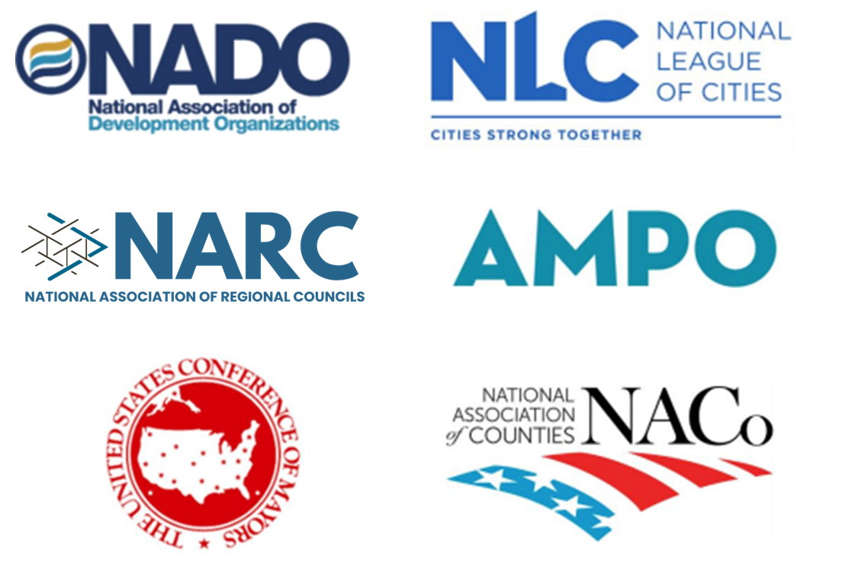
Who We Are
The Local Officials in Transportation (LOT) Coalition amplifies the voices of thousands of organizations and individuals across the nation with a vested interest in the long-term success of our transportation system. Together, our members own, maintain, plan for, and support millions of road miles and hundreds of thousands of bridges nationwide.
National Conference of Regions 2026

Slide 3
Setting the Stage: Reauthorization Background
National Conference of Regions 2026

Slide 4
Impacts on Regions
National Conference of Regions 2026

Slide 5
Responding to Congress:
LOT Proposal
National Conference of Regions 2026

Slide 6
LOT Priorities & Proposal
Fixes bridges based on condition and ownership
Delivers local and regional priority projects faster
Targets safety dollars to high-risk roads
Strengthens accountability and local project selection
Builds planning capacity to deliver better projects faster
Provides support for rural transportation planning organizations
Protects local and regional dollars from being transferred away
National Conference of Regions 2026

Slide 7
How You Can Help
Educate
and
Contact your Members of Congress!
National Conference of Regions 2026

Slide 8
Messages to Share
Local governments and their specialized agencies own and operate:
  over 75% of the nation’s road miles,
  more than half of its bridges, and
  the majority of public transit systems.
Yet, local governments receive only 16% of federal transportation dollars via STBG suballocations.
National Conference of Regions 2026
Notes:
Brittney

Slide 9
Messages to Share
The current structure costs us time, money, safety, and progress.
Empowering local governments will:
  ensure smarter investments,
  efficiently complete projects, and
  provide communities of all sizes—urban and rural—the tools and resources they need to thrive.
National Conference of Regions 2026
Notes:
Ben

Slide 10
Messages to Share
Rebalance Funding & Decision-Making Authority
Outcome → Greater transparency & accountability in how dollars are spent
Outcome → Federal funds directed where they deliver the highest impact
Strengthen Planning & Project Delivery
Outcome → Faster delivery & smart, locally responsive investments
Support Rural Regions
Outcome → Drive connectivity, safety, and economic opportunity in rural America
Streamline Delivery
Outcome → Quicker, low-cost improvements that maximize taxpayer value
National Conference of Regions 2026
Notes:
Leeann

Slide 11
Q&A
Contact Us
NARC: Leeann Sinpatanasakul leeann@narc.org
AMPO: Katie Economou keconomou@ampo.org
NADO: Mirielle Burgoyne mburgoyne@nado.org
NLC: Brittney Kohler kohler@nlc.org
NACo: Ben Gilsdorf bgilsdorf@naco.org
USCM: Kevin McCarthy kmccarty@usmayors.org
National Conference of Regions 2026

